Slide 1


Evaluating Lay Evidence
Compensation Service Training Staff
Start here
June 2014

Slide 2

Lesson Overview
This lesson is a self-study course intended to teach VSRs and RVSRs to evaluate Lay Evidence prior to requesting an exam.
Use your mouse to navigate through the course by selecting the next arrow on each slide
Practical Exercise slides will require additional selections before the next arrow appears

Slide 3


Target Audience
This lesson is intended for Entry Level VSRs and RVSRs

Slide 4
Objective
Lay Evidence Credibility
Identify critical points to determine the credibility of lay evidence

Slide 5


38 CFR §3.159 Department of Veterans Affairs assistance in developing claims

Slide 6

When Evaluating Lay Evidence
Accept it at face value unless there is reason to question it
When conflicting evidence exists, weigh all as appropriate

Slide 7

Credibility Determinations
Is the Lay Evidence Credible
The determination of credibility is a finding of fact.
Competent/Qualified
Consistency
Plausibility
Circumstances of Service

Slide 8
Credibility Determinations
Credibility
Competent
The VSR, RVSR or DRO must make a credibility determination for Lay Evidence
Select each tab on the left for more information
Plausible
Consistent
Circumstances of Service

Slide 9
Credibility Determinations
Competent
Competent
  Competent lay evidence means any evidence not requiring that the proponent have specialized education, training, or experience. Lay evidence is competent if it is provided by a person who has knowledge of facts or circumstances and conveys matters that can be observed and described by a lay person.
Plausible
Consistent
Circumstances of Service

Slide 10
Credibility Determinations
Plausible
Competent
Are the veteran’s statements regarding in-service manifestations of injury, disease, or of an event reasonable or otherwise capable of being true?
Plausible
Consistent
Circumstances of Service

Slide 11
Credibility Determinations
Consistent
Competent
Is the Veteran consistent with their statement? Are there conflicting statements of record?
Plausible
Consistent
Circumstances of Service

Slide 12
Credibility Determinations
Circumstances of Service
Competent
Is the Veteran’s statement consistent with their service? The VSR, RVSR or DRO must conclude if the statement is consistent with the circumstances of service.
Plausible
Consistent
Circumstances of Service

Slide 13
Competent Lay Evidence Regulation
38 CFR §3.159 Department of Veterans Affairs assistance in developing claims.
(a) Definitions. For purposes of this section, the following definitions apply:
  (2) Competent lay evidence means any evidence not requiring that the proponent have specialized education, training, or experience. Lay evidence is competent if it is provided by a person who has knowledge of facts or circumstances and conveys matters that can be observed and described by a lay person.

Slide 14
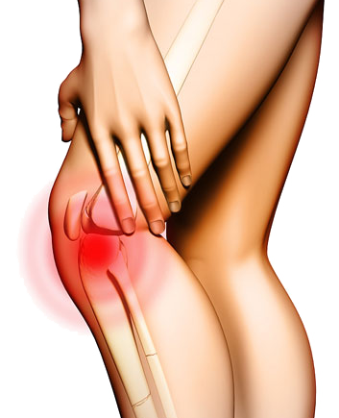
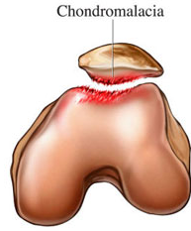
Competent Lay Statements
A claimant is competent (qualified) to describe symptoms of a disability that he or she is experiencing, such as knee pain.
However, he or she may not be competent to diagnose their own medical condition or offer a medical opinion.

Slide 15
Competent or Qualified Lay Statements are sufficient when:
A layperson is competent to identify the medical condition
A layperson is reporting contemporaneous medical diagnosis
Or, lay testimony describing symptoms at the time supports a later diagnosis by a medical professional.
The next slide provides a few examples

Slide 16
The lists are just a few examples
Not qualified to provide a diagnosis without medical evidence
Cancers
Cause of Death
Bronchial Asthma
Meniere’s Disease
Rheumatic Fever
Chondromalacia
Disk Herniation
Diagnosis of any other medical condition with requires special training to diagnose
Is qualified to describe symptoms
Asthma Symptoms
Tinnitus
Headaches, dizziness, etc.
Pain in feet; Flat Feet
Joint Symptoms, dislocations and broken bones
Varicose Veins
Psychiatric Symptoms (Paranoid Schizophrenia or Depression)
Fall Injury/Trauma
Some skin disorder (rashes)
Frostbite residuals

Slide 17
Select the Not Competent statements
Click on 5 Correct Answers to move here
Cancers
Disk Herniation
Incorrect Try Again
Headaches
Meniere’s Disease
Cause of Death
Incorrect Try Again
Incorrect Try Again
Asthma Symptoms
Bronchial Asthma
Psychiatric Symptoms
NEXT

Slide 18
Select the Competent statements
Click on 5 Correct Answers to move here
Tinnitus
Psychiatric Symptoms
Incorrect Try Again
Cause of Death
Injury or Trauma
Joint Symptoms
Incorrect Try Again
Incorrect Try Again
Cancers
Headaches
Bronchial Asthma
NEXT

Slide 19

Plausibility
  Appearing worthy of belief <the argument was both powerful and plausible>
The circumstances are reasonable and/or possible.

Slide 20
Plausibility
Plausibility: The claimed condition must be possible considering all other evidence.
Is there medical evidence to make it possible?
Is there evidence of circumstances of service to make it possible?

Slide 21
Inherently Incredible Claims Regulation
38 CFR §3.159(d), VA will not provide assistance in obtaining evidence if a claim is inherently incredible or clearly lacks merit, even when the application itself is substantially complete.
A VSR or RVSR has the authority to determine whether a claim is incredible or without merit.

Slide 22
Examples of Inherently Incredible
A Veteran alleges service-connected (SC) tinnitus caused hammertoes, but no medical evidence to support this allegation is furnished.
A Veteran claims PTSD as a result of combat service in Vietnam, but military records clearly show no foreign or combat service.

Slide 23
Tree falls
in forest
NOT
Possible
Veteran is 100 miles away
Claims the tree caused a chain reaction which
Caused his knee disability

Slide 24

The Lay Testimony is Consistent
The claimants statements “are” or “are not” consistent.
  Definition:
  always acting or behaving in the same way
  of the same quality; especially : good each time
  continuing to happen or develop in the same way

Slide 25
Circumstances of Service Regulation
Due consideration must be given to the places, types, and circumstances of service.
  38 CFR §3.159 Department of Veterans Affairs assistance in developing claims.
  (a)(4) For purposes of paragraph (c)(4)(i) of this section, event means one or more incidents associated with places, types, and circumstances of service giving rise to disability.

Slide 26
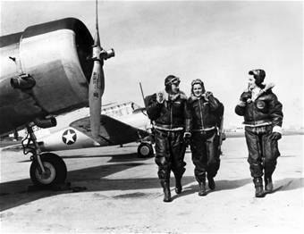
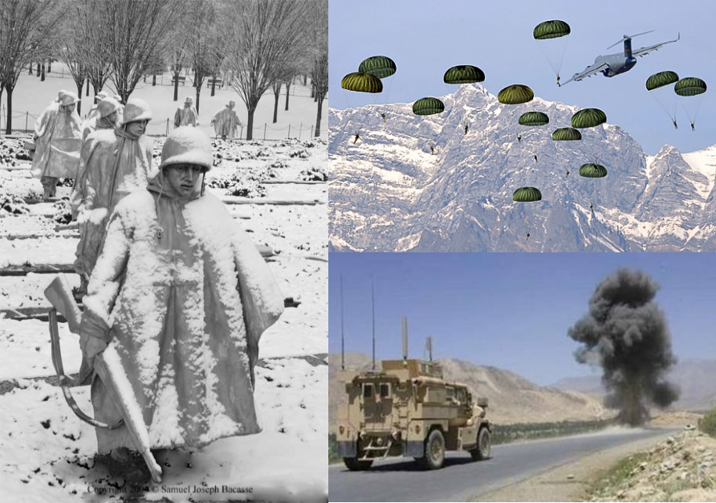
Service Lay Statements
A claimant is competent (qualified) to describe events, places and circumstances of their service.
However, in most cases the circumstances of service must be corroborated.

Slide 27
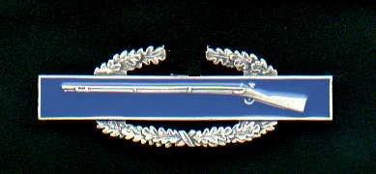





Military Occupational Specialty
The service records, to include a Military Occupation Specialty (MOS), of a Veteran can establish the “event” in service if the service treatment records themselves do not show an event occurred.

Slide 28
Combat Veterans Regulation
38 CFR §3.304(d) Combat. Satisfactory lay or other evidence that an injury or disease was incurred or aggravated in combat will be accepted as sufficient proof of service connection if the evidence is consistent with the circumstances, conditions or hardships of such service even though there is no official record of such incurrence or aggravation. (Authority: 38 U.S.C. 1154(b))
Combat Status is an adjudicative determination, which may involve weighing evidence. M21-1MR IV.ii.1.D.13.c, III.iii.2.E.32.c, III.iv.5.9.a, III.iv.4.H.32.c; VAOPGCPREC 12-99

Slide 29
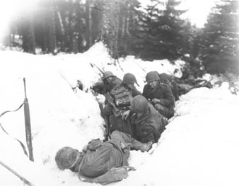
Combat Lay Statement
Veteran submits a claim for service connection for frostbite of his feet sustained during WWII; states that he still has cold feet and pain.
STRs are negative for any frostbite or foot injury, or disease. Separation document shows a WWII European-Middle Eastern medal, and participation in the campaigns in Ardennes and Rhineland. (The Battle of the Bulge, fought from December 16, 1944, through January 28, 1945, was fought in the Ardennes.)
Notes:
Evidence

Slide 30
Combat Lay Statement Credibility Finding
Lay Statement: Claims frostbite, exposed to cold during WWII and has continued cold feet and pain.
Evidence of Record: WWII Battle of the Bulge Veteran
Veteran is competent in statement
Plausible – exposure to extreme cold causes frostbite
Veteran’s statement is consistent in all claims
Statement is consistent with the circumstances of service. Extreme cold conditions existed in service.

Slide 31
Combat Veteran Practical Exercise
A Veteran submits a claim for service connection for low back pain sustained during operation Iraqi Freedom. The Veteran asserts that he was in Iraq and injured his back diving for cover while under attack. STRs are negative for any thoracolumbar spine injury, or disease.
Separation document shows award of Combat Infantry Badge and service in Iraq.
Select all correct components below then select next to continue
Competent
Plausible
Consistent
Service
Notes:
Evidence

Slide 32

Combat Veteran Practical Exercise Answer
The Veteran is competent to describe low back pain.
The claim is plausible. The Veteran asserts that he was in Iraq and injured his back diving for cover while under attack.
The Veterans statement is consistent throughout.
The claim is consistent with service. Separation document shows award of CIB and service in Iraq.
Competent
Plausible
Consistent
Service
Notes:
Evidence

Slide 33
In-Service Decisions
When there is not a clear nexus, the relationship between the in-service activities and the claimed current condition must be determined or other evidence showing a nexus between service and current disability.
Establishing events or conditions of service to have occurred is generally an adjudicative decision.
The nexus linking the in-service event to a current disability is a medical decision or opinion.
VSR, RVSR and DRO
Examiner

Slide 34
In-Service Decisions
The VSR, RVSR or DRO informs the examiner about the in-service event.
The examiner establishes if the in-service event is linked to the current diagnosis.*
*There is one exception to the rule in cases involving PTSD due to Military Sexual Trauma. The examiner may establish the in-service event with identified markers.

Slide 35
Course Summary
For many cases decided by VA, we are not dealing with certainty, but rather what is more likely than not of what happened.
The Department must consider lay evidence, but may give it whatever weight it concludes the evidence is entitled to.

Slide 36
Practical Exercise 1
A Veteran submits a claim for service connection for hearing loss caused by acoustic trauma in service. STRs are negative for any threshold shift or diagnosis of hearing loss by VA standards. However, the separation document shows he was a jet mechanic in service.
Select all correct components below then select next to continue
Competent
Plausible
Consistent
Service

Slide 37
Practical Exercise 1 Answer
The Veteran is competent to state hearing loss.
It is plausible for noise exposure to cause hearing loss.
The Veteran’s statement is consistent throughout.
The statement is consistent with service for noise exposure as a jet mechanic.
Competent
Plausible
Consistent
Service

Slide 38
Practical Exercise 2
A Veteran submits a claim for service connection for his right knee noting that it is still painful after many parachute jumps during service. STRs are negative for any right knee injury, disease, or event. However, the separation document shows he earned a Master Parachutist Badge in service.
Select all correct components below then select next to continue
Competent
Plausible
Consistent
Service

Slide 39

Practical Exercise 2 Answer
The Veteran’s statement is competent. Right knee pain after many parachute jumps during service.
Plausible. Knee conditions are common with parachute jumps.
Consistent. The Veteran’s statements do not change.
Consistent with Service. Master Parachutist Badge in service.
Competent
Plausible
Consistent
Service

Slide 40
Not Credible Practical Exercise
Veteran files a claim for Diabetes due to exposure to Agent Orange.
Records indicate the Veteran served from 1980 to 1989.
Select the reasons the statement is NOT credible
Competent
Plausible
Consistent
Service

Slide 41

Not Credible Practical Exercise Answer
The Veteran is not competent to provide a diagnosis for Diabetes without medical evidence.
The claim is not plausible. The Veteran was not exposed to Agent Orange during service.
The claim is not consistent with service due to the agent orange exposure periods.
= did not meet credibility standards
Competent
Plausible
Consistent
Service

Slide 42

You have now completed the
Evaluating Lay Evidence Lesson
Log into TMS, and complete the evaluations for TMS 3879907 to receive credit for this course. Print the course after completing the evaluations.
Exit

