Slide 1
Vocational Rehabilitation and Employment
The Veteran Employment Center (Job Seekers)
2014

Slide 2
Outline
The Veterans Employment Center on eBenefits
Job Seeker Features
Job Search Features
Job Search Results
Military Skills Translator
Résumé Builder
Make Résumé Profile Public
Edit and Delete Résumé
Department of Defense DS-Logon Instructions
Additional Resources
Notes:
This briefing is intended for Veterans, Servicemembers, and their family members, herein we will refer to this population as the, job seekers or job seeker. Recipients of this training will receive information about the new Veterans Employment Center (VEC). We will discuss and review the (read outline) ...

Slide 3

The Veteran Employment Center on eBenefits
www.ebenefits.va.gov/ebenefits/
Notes:
Today we will learn about the new Veterans Employment Center (VEC) on eBenefits, which has replaced the VetSuccess.gov website. The VEC is located on the eBenefits website at www.eBenefits.va.gov, and clicking on the last tab of the main ribbon bar https://www.ebenefits.va.gov/ebenefits/jobs.
The VEC is the federal government’s single authoritative internet source for connecting transitioning Servicemembers, Veterans and their families to meaningful career opportunities. The VEC is the first government-wide product that brings together a reputable cadre of public and private employers with real job opportunities, and provides transitioning Servicemembers, Veterans and their families with the tools to translate their military skills into plain language and build a profile that can be shared – in real time – with employers who have made a public commitment to hire Veterans.
Benefits to:
Veterans, Servicemembers and Family members include:
Access to over 1.2 million open positions searchable with advanced search capabilities
A military skills translator
A profile (résumé) builder to assist job seekers with their employment search
Employers include:
Access to a bank of verified and searchable Veteran profiles
The ability to post their open positions through the National Labor Exchange (NLX)
Tool to make public commitments to hire Veterans
After clicking on the Employment Center tab users will be directed to the VEC’s homepage. (Next Slide)

Slide 4
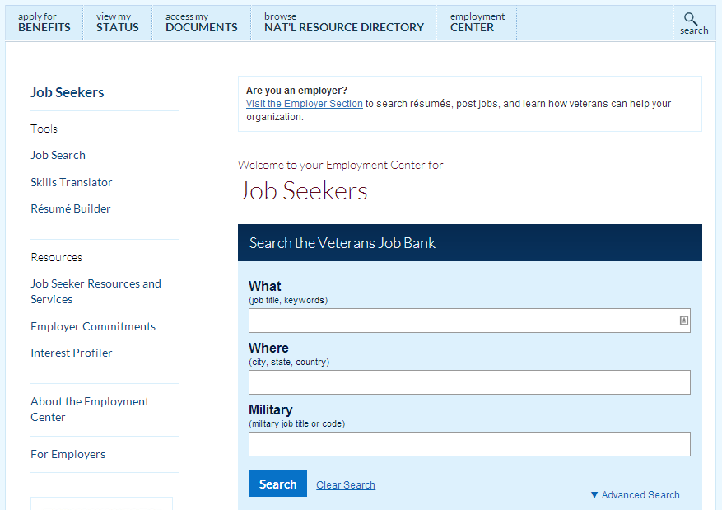
Job Seeker: Features & Main Page
Notes:
The homepage defaults to job seeker resources and services.
Notice the side bar to the left of the screen, the VEC provides job seekers with 3 main features:
Job Search
Skills Translator
Résumé Builder
The tool bar will remain available for the duration of the session.
The VEC also provides job seekers with additional resources that will be shown later in the presentation.
We will start by demonstrating the job search feature, which is located on the main page and is available from the logged out view.
The job search feature searches the Veterans Job Bank (VJB), which has approximately 1.5 million open positions. Open positions are aggregated from an employers website and is updated approximately every 24hrs.
With so many open positions on VJB, it is important for job seekers to drill down as closely as possible to the jobs in their local area, emphasizing on their specialized skills. Advance search features are provided for job seekers to find the types of employment opportunities relevant to them in their preferred geography.
Within the basic search, job seekers are provided 3 fields for entering information to start the search query. The “advanced search” link on the right corner of the job search box gives job seekers even more fields for refining their job searches. (Next Slide)

Slide 5
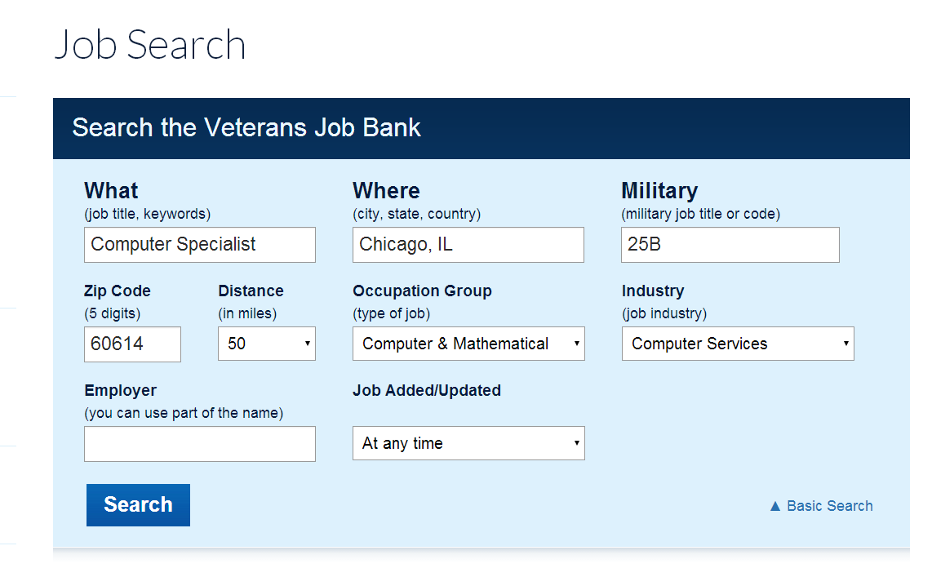
Job Seeker: Job Search
Notes:
This slide shows the advanced job search features within the VEC. Notice that the basic search features are still available and have been completed with key words. Those fields are completed with “Computer Specialist” and “Chicago, IL” and a military occupation code “25B”.
Job seekers can further refine their results by entering a “Zip Code” desired “Distance” in miles from the zip-code, as well as an “Occupational Group,” or “Industry”. Job seekers can also search for a specific employers jobs, and by the newness of the position by selecting a date the job was added.
After clicking search job results will populate at the bottom of the page.

Slide 6
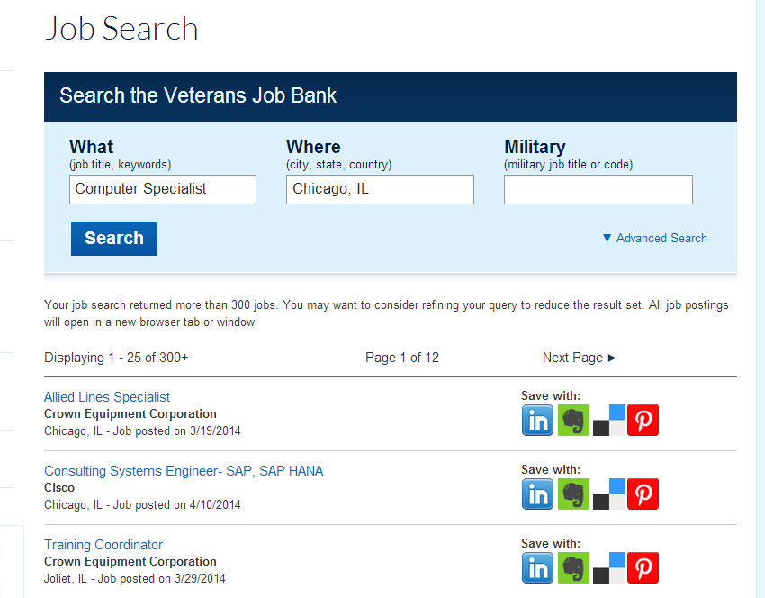
Job Seeker: Job Search
Save Positions With:
LinkedIn
Evernote
Delicious Pinterest
Notes:
Search results are displayed below. This search yielded more than 300+ results using the basic job search for Compute Specialist in Chicago, IL. Job seekers should refine search results using advanced search features when results are large as is the case in this example.
The blue hyperlinks displayed, will direct a job seeker to the employers site for further instructions about that companies application process.
Jobs can be saved with the VEC using LinkedIn, Evernote, Delicious, or Pinterest; job seekers must have an associated account with one of these sites before they can start using this feature

Slide 7
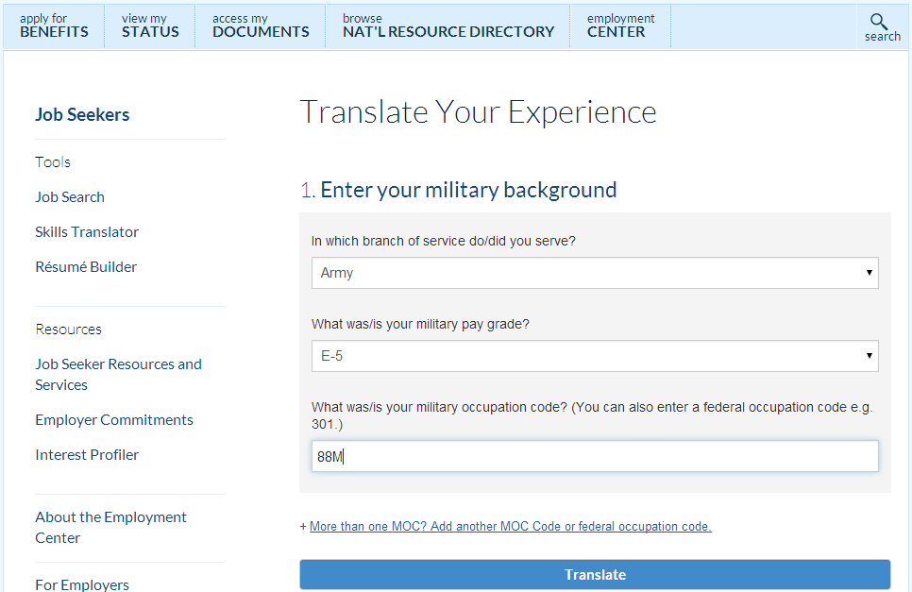
Military Skills Translator
Notes:
Now we will explore the Skills Translator.
Military Skills Translator
Helps job seekers automatically populate skills into their VEC’s Résumé Builder.
There are 3 fields that need to be completed that allows job seekers to translate military occupation codes AND federal occupation codes into the skills associated with those occupations.
Military Service Branch
Military Pay Grade
Military Occupation Code
If Federal Employee select federal occupation in the first drop down and enter the occupation code (e.g., 0343).
If you have more than one Military Occupation Specialty (MOS,) or were or are a federal employee; you can add additional occupation codes by clicking the blue hyperlink above translate.
Click the translate button when finished.

Slide 8
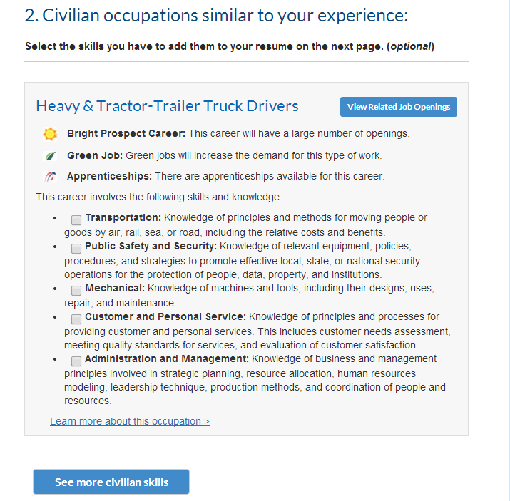

Military Skills Translator
Notes:
The skills translator takes the MOS (Use sample MOS and discuss results) used and translated it into a Standard Occupational Code (SOC). The translation provides job seekers with a snapshot of the occupation specific skills and information about the:
Number of job openings
Projected demand within the occupation
Availability of apprenticeships
Translation results are retrieved from O*Net and when the “Learn more about this occupation” link is clicked the job seekers is directed to the O*Net page with the related occupational information.
Job seekers can perform a job search for this occupation by clicking “View Related Job Openings”.
Job seekers should click “See More Civilian Skills” before the “Next Step: Generate a Résumé” button, or else the Résumé will not appear or generated.

Slide 9
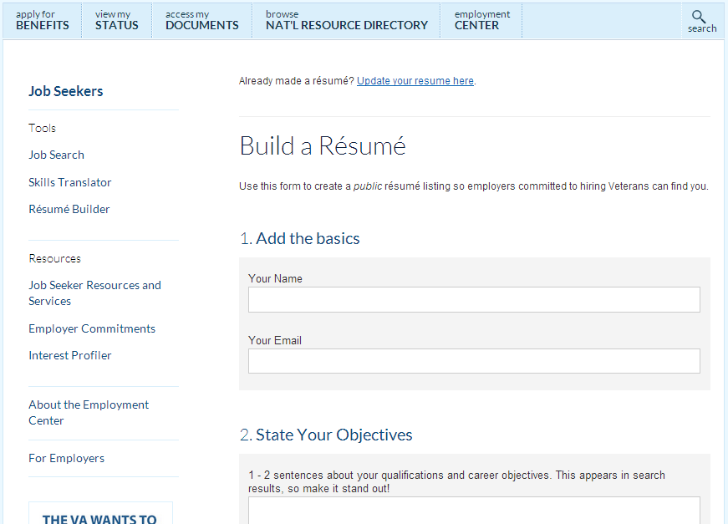
Build a Résumé
Notes:
Finally, job seekers have a “Résumé Builder” made available to them on the VEC. If the job seeker used the skills translator and selected occupation specific skills, those checked skills will have been ported over into the Résumé Builder. Job seekers who do not wish to use the skills translator can start with the Résumé Builder.
Résumé Builder
To begin using the “Résumé Builder” job seekers must first enter their name and email address these are minimal requirements before job seekers are able to move to the next phase of posting their profile for employers view. Prior to posting the résumé for employers, the résumé builder will not save the job seekers résumé profile information.
Job Seekers should complete all items on the Résumé Builder. Remember, this information is searchable by employers so job seekers should be exhaustive in their efforts to outline their work experience with a well developed employment goal that identifies the occupations of interest.

Slide 10
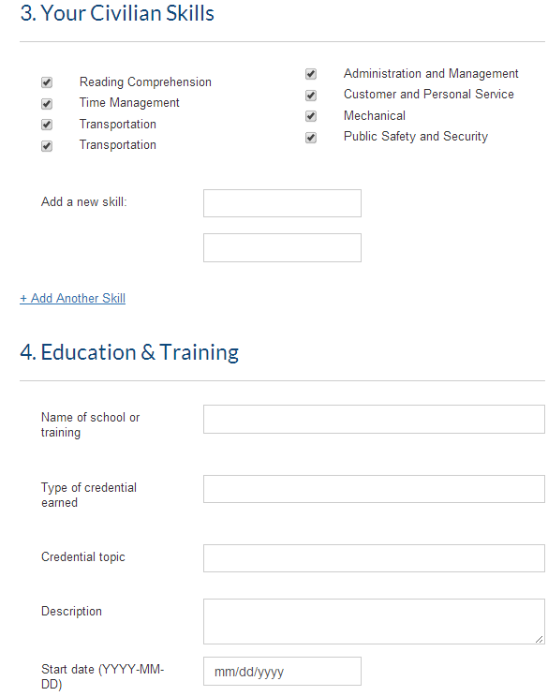
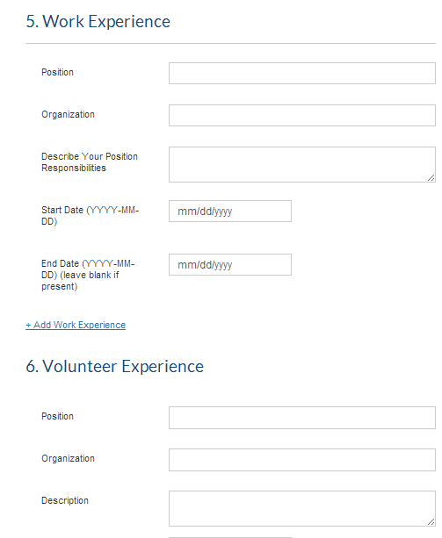
Build a Résumé
Notes:
Here is an example additional fields in the Résumé Builder. Notice, the skills from the (Sample MOS) skills translation have been pre populated and job seekers are offered the opportunity to add additional skills.
Job seekers may add as many education, work, and volunteer experiences as they please; to add additional experience click the “Add” hyperlink to generate additional fields

Slide 11
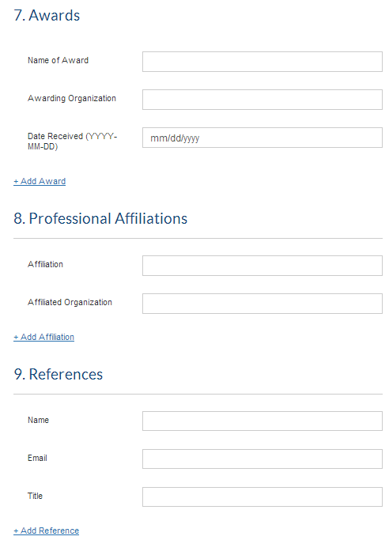
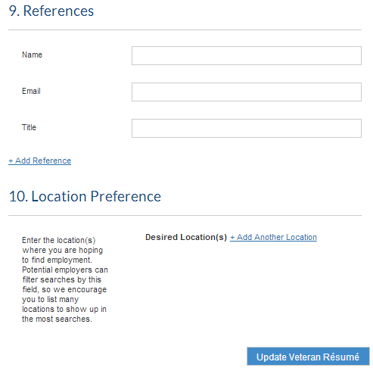
Build a Résumé
Notes:
Especially important for job seekers who are moving and transitioning Servicemembers is the “Location Preferences” item #10, the location preference chosen by a job seekers allow employers to view résumé in the locations chosen.
Since employers are able to sort résumé profiles by the date they were last updated it is important to update your résumé every 30 days while job seeking. Otherwise a job seeker risks the employer excluding all job seeker profiles not updated $≤$30 days.

Slide 12
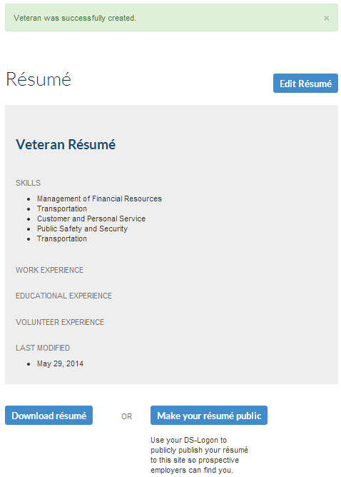
Make a Résumé Public
Make your résumé public
  Requires DS-Logon
Download résumé
Continue editing after using your DS-Logon
Notes:
Once the “Update Résumé” button is clicked job seekers will see a page similar to this, but with the information they input.
Job Seekers have the option to download a copy of their résumé by clicking “Download Résumé,” a Word .doc résumé will automatically download.
To make a résumé public click “Make your Résumé Public;” a DS-Logon page requiring a username and password will open within the current window. If the job seeker does not have a DS-Logon the job seeker can close, or open a new window to register for a DS-Logon. This is done by clicking “Register” at the top right-hand corner in the eBenefits website.
Job seekers with a DS-Logon information must login before the résumé can be viewed by verified employers on the VEC.
Note* Job seekers must click “Update Veteran Résumé,” from the previous page, and then they must click “Make Your Resume Profile Public,” to save the profile for future editing. Making the profile public in effect saves the résumé/profile to the database and job seekers can return to the VEC at anytime to update their profile. However, job seekers must use their DS-Logon to make their profile public before they close the application. Otherwise their information will not be saved.

Slide 13

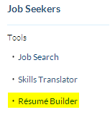
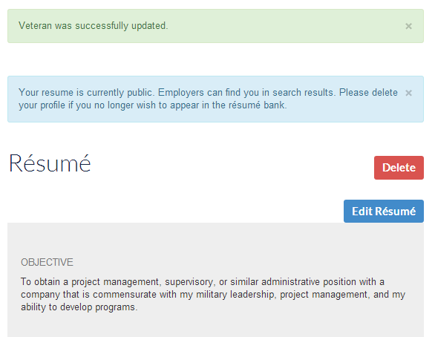
Edit and Delete a Résumé
Confirm the Résumé is public
For future visits to the VEC, remember Click “Résumé Builder” to delete or edit a résumé
Notes:
Job seekers who have posted their résumé using their DS-Logon can return to the VEC to edit their resume by clicking on “Résumé Builder”.
Job seekers will be prompted at the top of the screen with a question. “Already made a résumé? Update your résumé here”. Job seekers should click this hyperlink to edit a resume that was already publicly posted.
Job seeker can also:
Confirm the Résumé is Public
Delete Résumé
Edit Résumé

Slide 14
DS-Logon Instruction
Before job seekers can post a public résumé they must have a DS-Logon
To obtain a DS-Logon job seekers must be listed in the Defense Enrollment and Eligibility Reporting System (DEERS)
Job seekers visit the www.eBenefits.va.gov web portal and register by clicking “Register” on the main page in the top right-hand corner
Problems with you DEERS information?
  Contact the Defense Manpower Data Center Support Office (DSO)
    1-800-5380-9552
  Contact your local uniformed services personnel office
    http://www.dmdc.osd.mil/rsl/
Once the DS Logon is obtained job seekers can make a résumé public post a public resume (profile)
Notes:
Here are the instructions for obtaining a DS-Logon.

Slide 15
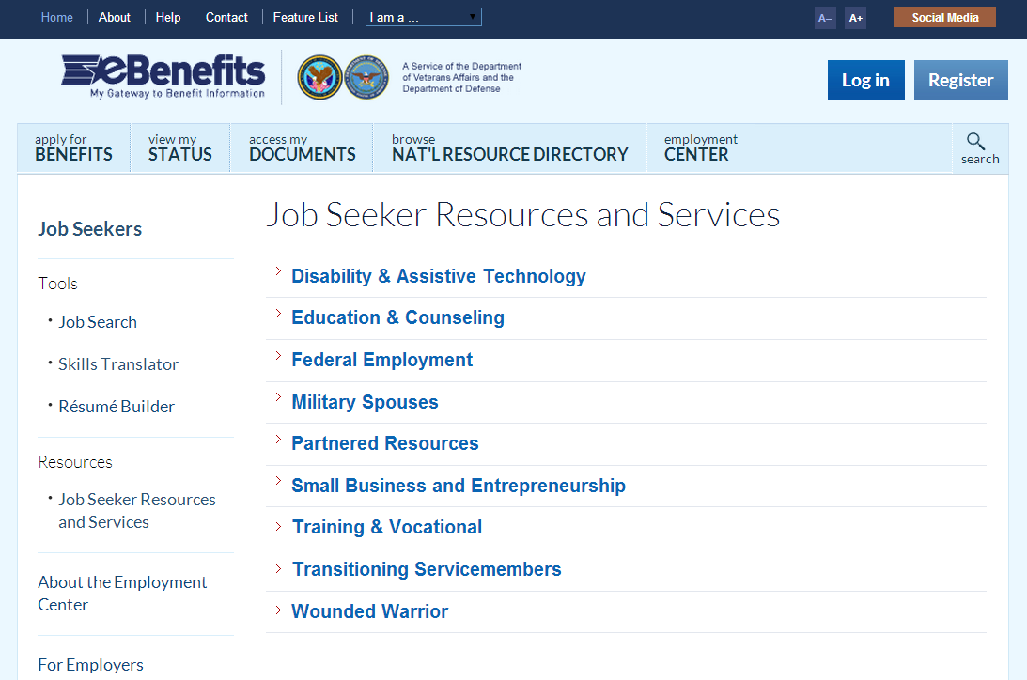
Additional Resources
Notes:
Job seekers are provided additional resources these are available without being logged-in.

Slide 16


Questions
Questions about the Employment Center? Email the Office of Economic Opportunity Technical Assistance Mailbox at-
OEOECSUPPORT.VBAVACO@VA.GOV
Click to watch a tutorial or go to: https://www.youtube.com/watch?v=VWfhI-eSoWk
Notes:
Thank you for taking the time to learn more about new Employment Center on eBenefits, remember the VEC can be fully leveraged by anyone who is enrolled in (DEERS), that is Servicemembers, transitioning Servicemembers, Veterans, and their families. Watch a short tutorial on how to best use the new Employment Center on YouTube, visit https://www.youtube.com/watch?v=VWfhI-eSoWk. If you have additional questions or experience technical issues with the Employment Center, please contact the VA at OEOECSUPPORT.VBAVACO@VA.GOV.

