Slide 1
Aid to Process for Ch31 Electronic Request for Medical Services using CAPRI and CPRS
Security Keys:
VR&E – DVBA CAPRI VRE_COUNSELOR (on the CLAIMS system) plus MAILMAN mail group DVBA VR VOCREHAB PERSONNEL (on the VistA system)
VHA – DVBA CAPRI VRE_ COUNSELOR plus DVBA CAPRI VHA_COORDINATOR plus MAILMAN mail group DVBA VR VOCREHAB PERSONNEL

Slide 2
Vocational Rehabilitation and Employment – Chapter 31 Program
VBA program of services for Service-members and Veterans who have VA-rated service-connected disabilities
Training and employment services
Independent living services
FY 2013 program participants – 138,815
Male – 110,329 (81.2%) – Female – 25,486 (18.8%)
Serious employment handicap – 97,045 (71.5%)
Employment handicap – 38,770 (28.5%)

Slide 3
VHA Directive 2010-022
Vocational Rehabilitation: Ch31 Benefits Timely Access to Health Care Services
Sets out the policy for provision of timely access to any VHA health care services for participants in the Department of Veterans Affairs Vocational Rehabilitation Program
Ref. Title 38, United States Code, Chapter 17

Slide 4
VR&E Counselor
VBA employs VR&E Counselors
Evaluate need for Ch31 services; determine entitlement and type/extent of services; suitable employment objective; approve Ch31 services
Request medical services to assist in determining capacity for and suitable employment objective (as example)
Provide case management during Rehabilitation plans for training/employment or independent living
Request medical services to support continued participation and ability to achieve rehabilitation goals and objectives

Slide 5
Log into CAPRI through either the VistA or CAPRI log-in screen

Slide 6
Select Patient

Slide 7
Highlight and select the Veteran’s record

Slide 8
Select “VocRehab” tab

Slide 9
CAPRI “Add Medical Services Request” screen

Slide 10
Point of Contact detail

Slide 11
Medical Service Request updates “VocRehab” tab

Slide 12
Medical Service Request also updates “VR&E” Reports

Slide 13
The VHA Coordinator works in CPRS to create and sign a Consult Order

Slide 14
In CPRS select Orders function and clinic appointment

Slide 15
In CPRS order a consult

Slide 16
In CPRS – reason for Medical Service Request is added to consult order

Slide 17
Consult order added in CPRS

Slide 18
In CPRS electronic signature code

Slide 19
In CPRS – completed consult order

Slide 20
Consult order appears in CAPRI Medical Services Request

Slide 21
In CAPRI – Medical Services Request is updated when VHA Coordinator connects the consult to the request

Slide 22
CAPRI generates e-mail notifications and sends to VHA Coordinator and VR&E Counselor e-mail account

Slide 23
CAPRI allows you to change your e-mail preference (MAILMAN or Outlook) and displays in “POC”

Slide 24
Example of CAPRI e-mail alert of New Ch31 Referral for Medical Services

Slide 25
Ch31 Request Status
New – Message reads, “Chapter 31 Referral for Medical Services New” – sent to VHA Coordinator
Pending – Message reads, “Chapter 31 Referral for Medical Services pending” – sent to VHA Coordinator and VR&E Counselor (“aging” follow-on messages)
Completed – Message reads, “Chapter 31 Referral for Medical Services completed” – sent to VHA Coordinator and VR&E Counselor
Cancelled – Message reads, “Chapter 31 Referral for Medical Services Cancelled” – sent to VHA Coordinator and VR&E Counselor
Use the ~5-digit DFN in the Patient ID field on Patient Sector screen to access the record referenced in e-mail alert message

Slide 26
Medical Services Request Cancellation

Slide 27
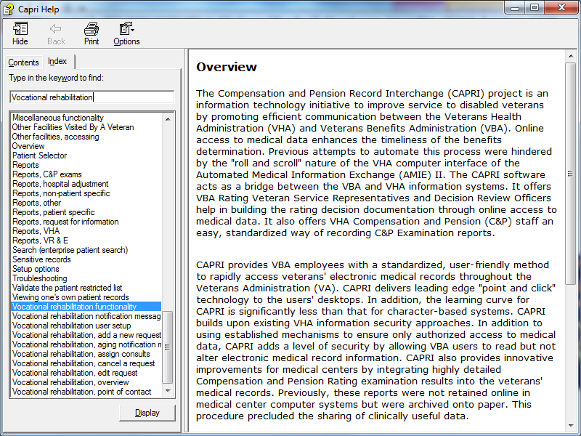
CAPRI On-Line Help
CAPRI On-Line Help includes all of the steps illustrated

Slide 28
CAPRI Reports – VR&E Reports

Slide 29
Select VR&E Status and complete Report Setup screen

Slide 30
Plain Text option – on-screen

Slide 31
Delimited Export Data Option – open in an Excel Spreadsheet

Slide 32
Save Delimited Text Format to your computer in .txt file

Slide 33
Open Excel spreadsheet – select “File” and “Open”

Slide 34
Locate the CAPRI delimited text file that you saved on your computer

Slide 35
3-step Text Import Wizard – step 1

Slide 36
3-step Text Import Wizard – step 2

Slide 37
3-step Text Import Wizard – step 3

Slide 38
CAPRI Medical Service Request Data in Excel spreadsheet

Slide 39
Conclusion to CAPRI process aid review
VHA and VR&E want you to be successful in your use of CAPRI and CPRS
Reach out to us with questions
Use training and reference resources available on-line
VR&E Training in use of CAPRI functionality – TMS 3812161
VHA Training in use of CPRS – TMS 8512
CAPRI on-line Help

Slide 40
Thank you!

