Slide 1
Personalized, Integrated and Engaging Employment Services
October TSES Training Call
Notes:
PATTY
Introduction

Slide 2
Notes:
HEIDI
St. Cloud Vocational Rehabilitation Services overview

Slide 3
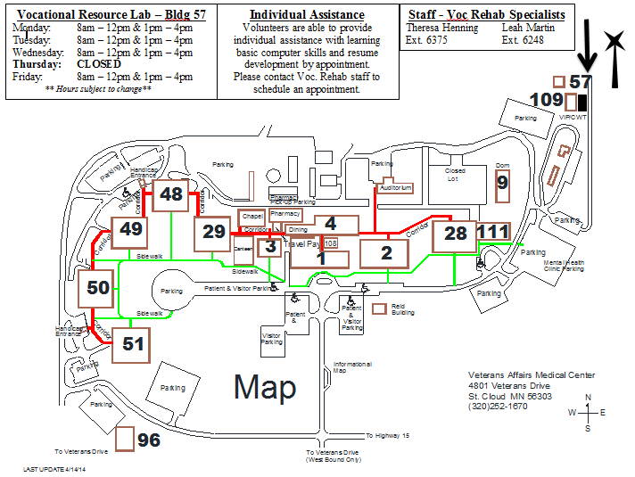
Notes:
HEIDI
Vocational Resource Lab overview

Slide 4
The following principles should guide each step of the assessment process:
Self-determination, based on informed choices, should be an overriding goal of assessment.
Assessment is a dynamic intervention process.
Assessment facilitates self-discovery of talents, goals, strengths, and needs.
The purposes and goals of assessment should be clear.
Assessment should be integrated into a larger plan of individualized services.
Assessment should consider environmental factors affecting the Veteran.
Assessment reports should be written in language that is easily understood.
Assessment activities should be positive and lead to self-empowerment.
Notes:
JULIE
“Nothing about them without them.”
Not a one time meeting. Changes overtime.
Their path not ours.
Repeated frequently to ensure “on the same page.”
KAREN
It’s a team endeavor
Ask questions. “What is their World”
“In their own words.”
Focus on the positives.

Slide 5
Vocational Assessment Profile
Current living situation
Employment/Volunteer History/Hobbies
Past CWT
Military
Legal
Income/Financial Benefits
Education/Training
Other barriers to employment
Family/Religion/Ethnicity
Assessment of Health and Safety (impact)
Goal(s)
-Strengths
-Needs
-Abilities
-Preferences
Notes:
JULIE
Is important to coordinate (HUD VASH, Homeless, etc.) Impacted by income? (Section 8), Needed for year end and NEPEC. Supports/abuse/substance use/danger
KAREN
What they have done in their past can impact their future. Doesn’t have to be employment. What moves them?
JULIE
What worked? What didn’t? What is going to be different? Are we the best program?
KAREN
Transferrable skills. Service Connected/Non-Service Connected. Educational Benefits (GI Bill and Chapter 31)
JULIE
VJO. Impact on type of work environment. Parole/Probation requirements. How to discuss with employers. (DO NOT DO Background Check)
KAREN
Benefits counseling. (SSDI, HRA, County Benefits, VA benefits…US Code 1718). They can make an informed choice.
JULIE
SE (on the job). Other; GI Bill? Chapter 31? FAFSA, MN GI BILL, OJT (Post 9/11), local programs
KAREN
Transportation. Family Obligations. Debt (i.e. Child support). Learning disabilities. Physical Disabilities. Lack of computer skills. Motivation
JULIE
Support/Barrier? Impact on work environment and schedule? Who they relate to? How do they see themselves? What are their un/conscious biases?
KAREN
Physical (bending/stooping, adaptive equipment), Education (reading, writing, thinking/learning, memory), Communication (interpersonal skills, assertiveness), Skills ( phone, computer, job seeking), Safety (medication, seizures, flashbacks), Cultural, Mental Health Symptomology.
JULIE
Strength-based patient centered approach (empowerment)
What do they feel they need to get from this intervention?
KAREN
Identification of inherent strengths. “Elevator Speech”
What do they want?

Slide 6
Individualized Plan of Care – (POC)
The initial Plan of Care is developed in approximately the first three meetings.
POC is individualized for each Veteran.
The Veteran, along with their VRC/VRS, discuss the Veteran’s vocational goals based on information from the Vocational Assessment Profile.
The Veteran, with assistance from the VRC/VRS, identifies the Problems, Goals, Objectives, and Interventions.
This information is entered in MH Treatment Suite.
SMART Goals are used.
Specific, Measurable, Adaptable, Realistic and Time-Bound.
Notes:
BRAD
Introduction to creating Plans of Care

Slide 7
Problem Vocational/occupational circumstances OR vocational challenges described by the Veteran. i.e. “What do you struggle with regarding employment?” “What has gotten in the way in the past?”
SE
TW
“I need assistance in finding and maintaining employment.”
“I need assistance with obtaining good references and working on my people skills. I need help in finding a good job.”
Notes:
ERIN, BRAD AND THERESA
Problem/Need:
Vocational challenges described by the Veteran, “ Quotes are best.
Vocational/Occupational Circumstances
[Obtain Employment]: I am unemployed and want to return to work.
[Maintain Employment]: I have difficulty maintaining employment.
[Work Conflict]: I have been having repeated incidents of conflict in the work setting.
[Legal]: I have the following legal problem affecting employment:
[Income]: I do not have adequate financial resources in the following areas:
[Acceptance of Feedback]: I have difficulty accepting feedback due to:
[Education]: I need training in order to:
[Volunteer]: I need to volunteer in order to:

Slide 8
Goal Use the Veteran’s words as much as possible. Ask questions, i.e. “Where do you want to get to?” “What do you want to accomplish regarding your employment goals?”
SE
TW
Veteran stated, “I want to continue working at Wal-Mart, part-time, around 20-30 hours a week. My main goal is to continue working there until I can get a job in housekeeping at the VA. I am also interested in looking for employment in the granite industry.”
Veteran stated, “I want to be able to list some good references on my applications and be able to work with others without losing my temper. I want to find permanent, full-time employment.”
Notes:
BRAD, ERIN AND THERESA
For SE: The goal needs to include content that describes the type of work the Veteran would like to do and indicate days/hours desired.

Slide 9
Objective How will the Veteran accomplish the goal? Ask questions and make suggestions. “What will you do to obtain or maintain employment?” Good opportunity to brainstorm with the Veteran and identify challenges and obstacles to their goal.
SE
TW
Veteran stated, “I will meet with my VRS once a week. I will keep my USA jobs account updated and check available jobs weekly and discuss with my VRS. I will report any issues with my job at Wal-Mart to my VRS.”
Veteran stated, “I will participate in Transitional Work and practice good communication skills. I will attend the job prep class on interpersonal communication skills and I will work with my VRC/VRS to job search.
Notes:
ERIN, BRAD AND THERESA
The objective is “what the Veteran will do.”
Objective:
I will acquire skills to help me enter the workforce within TIME FRAME. Progress will be measured through______. (IT, TW, Observation of job seeking skills, self report, Vocational Staff observation, etc.)
I will attend and participate in education/vocational programs. Progress will be measured through_____. (IT, TW, Observation of job seeking skills, etc)
I will learn to communicate with supervisors and peers in the workplace in a positive manner, without conflict. Progress will be measured by______. (IT, TW, Supervisor feedback, Observation of on-the-job skills, etc)
I will improve my ability to interact with supervisors and peers without verbal or behavioral conflict. Progress will be measured by_____. (IT, TW, Supervisor feedback, Observation of on-the-job skills, etc)

Slide 10
Intervention The supports the Veteran needs to help meet the objective. Duties of the Vocational Staff. VRS will……
SE
TW
VRS will assist with USA jobs, share job leads for the granite industry and the VA, and assist Veteran with any issues that may arise at his job at Wal-Mart.
VRS will monitor the Veteran’s performance in TW on a monthly basis and assist in the Vocational Resource Lab for job searching. VRS will also assist in providing resources on communication skills and anger management.
Notes:
ERIN, BRAD AND THERESA
Intervention:
Vocational Staff will_____.
Vocational Staff will work with me using_____. (IT, TW, Job Preparation Skills Class, Job Seeking Skills Training, Job Support Training,etc)
Teach Job Seeking Skills.
Teach Job Keeping Skills.
Explore vocational options.
Explore educational options.
Explore volunteer opportunities.
Meet in the community and/or provide transportation and support during the process of job seeking.
Meet in the community/job site/office to provide job support.

Slide 11
Plan of Care Review
Plan of Care should be formally reviewed in MH Suite every six months if Veteran is not working.
If Veteran is working, POC should be formally updated in MH Suite within a month of his/her start date and every six months thereafter.
If Veteran’s vocational goals change at anytime it is appropriate to update the POC.
Notes:
BRAD and ERIN
POCs are “informally” reviewed at every appointment.
ERIN: Transitional Work participation is 6 months. The POC is “formally” reviewed and documented in MH Suite at the end of the 6 months. It is “informally” reviewed at monthly appointments and documented in progress notes.

Slide 12
Job Search Tools
Take on many forms:
Job carving
Word of mouth
Family and friends (ROI needed)
Networking with community organizations
Walk-in exploration
Newspaper
Internet
Attending job fairs
Cold calling employers
Notes:
KARI

Slide 13
VRS Assistance
VRS provides assistance with:
Picking up applications
Filling out applications
Returning applications/follow-up
Creating/updating résumé
Introducing the Veteran and/or the program to employers
Interview preparation
Job seeking skills trainings
Getting proper identification (to verify employment eligibility)
Transportation assistance
Notes:
KARI and ERIN
ERIN: Transitional Work provides one:one assistance with these services during the monthly appointments.

Slide 14
Follow Along Support
Time-Unlimited and Individualized Support: Follow-along supports are individualized and continued for as long as the Veteran wants and needs support.
Supports are individualized and vary from Veteran to Veteran based on needs and desires.
Support includes face-to-face contacts, fading or transitioning.
Other supports may include phone calls, meetings with employers to obtain extra feedback, consultation with treatment team when needed, development of self-monitoring strategies and plans, and limited on-the-job coaching to learn new duties, when job duties change.
Notes:
KARI

Slide 15
Integration with VA Staff (TW)
Monthly meetings with site supervisors to assess participant progress and address any issues or questions.
Monthly work therapy email articles to site supervisors and other key staff
Topics include: work therapy expectations, disability awareness, boundaries, roles of site supervisor and Vocational staff, etc.
Yearly site supervisor training
Frequent communication between Vocational staff and site supervisors
Notes:
THERESA

Slide 16
Integration with VA Staff (SE)
Attend weekly team meetings with providers and Mental Health Treatment Coordinators (MHTC).
Additional sign providers and MHTC on vocational assessment profile, plan of care, and critical notes.
Call or meet in person with providers as needed to address urgent issues.
Notes:
BRAD

Slide 17
Engagement with Veterans
Face-to-face contact, at minimum of once weekly, is ideal.
Assist Veterans in finding jobs that match their preferences, strengths, experiences, and unique challenges rather than jobs that are available. This type of match or congruence between Veterans and jobs critically affects satisfaction, tenure, and success. Individual preference is paramount.
Develop a consistent plan in close collaboration with Veterans as part of integrated services.
Notes:
KARI

Slide 18
Thank you for your attention! ☺
Questions
&
Answers

