Slide 1
WARRIOR CARE AND TRANSITION PROGRAM
Warrior Transition Command (WTC)
Mr. Lonnie Moore, Program Analyst
Career and Education Readiness Branch (CERB)
WTC G-1
7 October 2014
“The views, opinions and findings contained in this report are those of the authors(s) and should not be construed as an official Department of the Army position, policy or decision, unless so designated by other official documentation.”

Slide 2
OUR MISSION
As the Army’s proponent for Warrior Care and Transition; provide centralized oversight, guidance, and advocacy empowering wounded, ill or injured Soldiers, Veterans, and Families through a comprehensive transition plan for successful reintegration back into the force or into the community with dignity, respect and self-determination.
Mr. Lonnie Moore/619.532.8035/lonnie.c.moore.civ@mail.mil

Slide 3
The Army’s Proponent for Warrior care and Transition
IAW NDAA 2008, Sec 1611, Army’s Warrior Care and Transition Program (WCTP) is required to provide a comprehensive policy on care, management, medical and disability evaluation, RTD and/or transition of Recovering Army Service Members
WTC serves as the proponent for the WCTP to include WTU and Warrior in Transition [Soldier] related cadre selection, doctrine, education, force management, plans policy, training, and transfers
WTC provides centralized oversight, guidance, and advocacy for wounded, ill or injured Soldiers, Veterans, and Families
WTC works in coordination with MEDCOM, OTSG, the Army staff, other Army agencies and commands, the Joint Staff, other Services, federal agencies (e.g. VA, DOL) and Congress to coordinate, synchronize, and direct execution of the WCTP
Executes the Army Wounded Warrior (AW2) Program: advocates for 18,295 Soldiers/Veterans
Develops and executes an Organization Inspection Program (OIP)
WA
ME
Heidelberg
VT
ND
NH
MT
CT
OR
ID
SD
MN
WI
MI
NY
WY
NE
IA
MD
NV
UT
MO
KY
WV
CO
KS
NC
AZ
NM
OK
AR
TN
SC
TX
AL
GA
LA
MS
PR
Mr. Lonnie Moore/619.532.8035/lonnie.c.moore.civ@mail.mil

Slide 4
Warrior Care is an Enduring Requirement
This requirement to care for our wounded, ill, and injured Soldiers and their Families will endure beyond the present hostilities
IAW NDAA 2008, Sec 1611, Military Services are required to provide a comprehensive policy on care, management, medical and disability evaluation, RTD and/or transition of Recovering Service Members
Congressional and Senior DoD Leadership View: Caring for the Wounded Warrior and the Veteran is a “sacred obligation”
WTC Estimate: Between 4500 and 5500 Compo 1, 2 and 3 Soldiers will require case managed care through 2015
Mr. Lonnie Moore/619.532.8035/lonnie.c.moore.civ@mail.mil

Slide 5
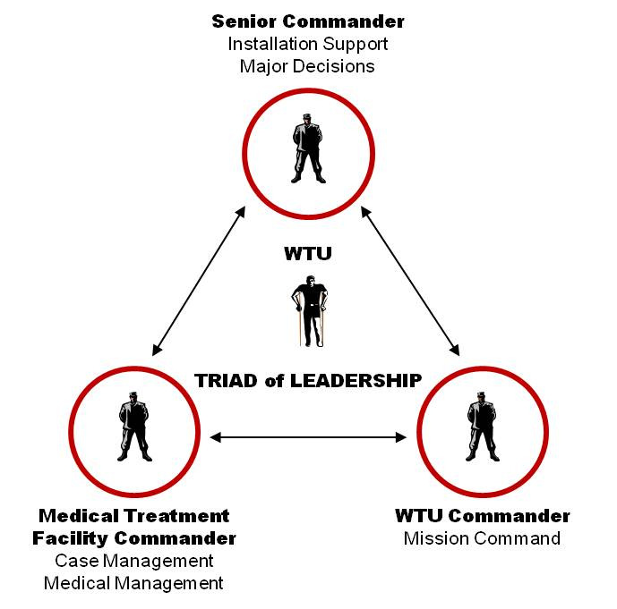
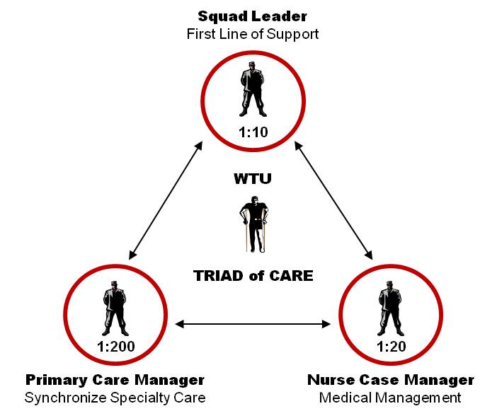
warrior care and transition program oversight
Program Management
Force Management
Policy Guidance
Codifying/Enforcing Standards
Coordinating with Agencies
Training
OIP
AW2
MEDICAL
COMMAND
ASG Warrior Care & Transition / CDR
Warrior Transition
Command
PROPONENCY
PROPONENCY
Regional Medical Commands
Medical Treatment Facilities
Warrior Transition Units
Mr. Lonnie Moore/619.532.8035/lonnie.c.moore.civ@mail.mil

Slide 6
DEMOGRAPHICS WTU/CBWTU POPULATION
5069 Soldiers in our WTU/CBWTUs
Active – 48% (2413); Guard – 28% (1441); Reserve – 24% (1215)
66% - are in IDES (this is 19% of the Total Army IDES Population)
More than 59,000 Soldiers have Returned to Duty or their communities after successfully completing the Warrior Care and Transition Program
Return To Duty (RTD) or Return to their communities:
60% with the first year
88% within the first two years
47% of all WTU Soldiers are RTD
WTU/CBWTU:
83% are in WTUs
17% are in CCUs
Primary Conditions (WOUNDED, ILL & INJURED):
9% physically wounded (includes TBI)
12 % psychologically wounded (primary PTSD)
39% ill or injured (deployment related)
40% ill or injured (non deployment related)
Medical Conditions:
45% - Behavioral Health Related
Deployments:
85% - have deployed at least once during their Army Career
Mr. Lonnie Moore/619.532.8035/lonnie.c.moore.civ@mail.mil

Slide 7
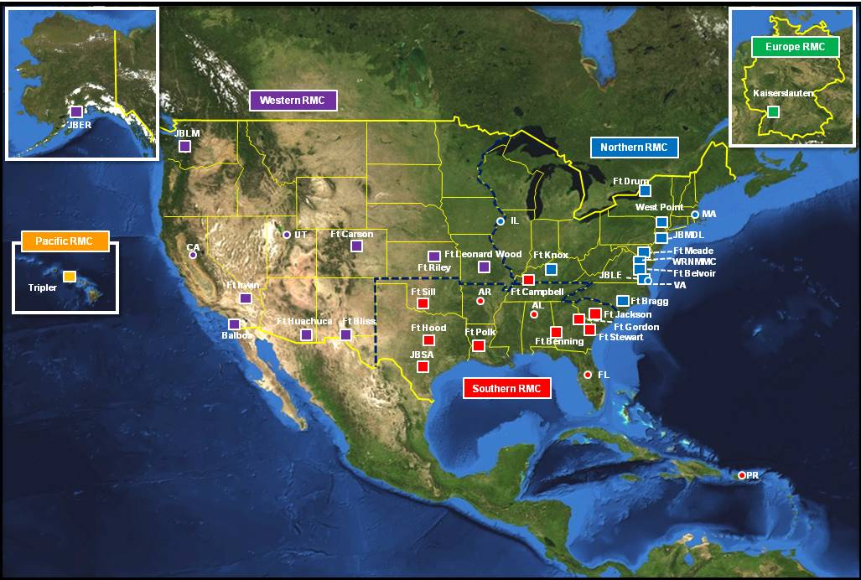
WARRIOR TRANSITION UNITS & POPULATION
24 Warrior Transition Units
14 CCUs
5,069 Soldiers
Mr. Lonnie Moore/619.532.8035/lonnie.c.moore.civ@mail.mil

Slide 8
Community care – what and why
What
Establish 14 Community Care units on Army installations
under MC of Senior CDR, MTF CDR and WTU CDR (TOL).
Concurrently, nine existing CBWTUs are disestablished.
- Soldiers do not move
- Care plans are not changed
- Cadre may have the opportunity to continue on active
duty to support the Soldier Care and Transition mission
Why
Improves the care and transition of our Soldiers through standardization and reduces echelons:
- Streamlines MC/M2 – cadre will have close proximity to the MTF, SFAC and other essential resources
- Eliminates redundancies (e.g. in-processing)
- Avoids delays in initiating treatment plan in each Soldier’s community
Provides the opportunity for more Soldiers to heal closer to home:
- Establishes 13 units co-located at existing WTUs, more capable of supporting Community Care
- Community Care units can support up to 300 Soldiers each
Provides more direct MC relationship for Soldiers in Community Care
Converts mobilization TDAs to a multi-component TDA
- Provides enduring RC cadre requirements
Natural evolution of a downsizing Army
Community Care construct
WA
ME
VT
ND
NH
WTU-JBLM
MT
CT
OR
MN
WI
NY
ID
WY
SD
MI
WTU-BELVOIR (x2)
WTU-CARSON
NE
IA
MD
NV
WTU-RILEY
WTU-KNOX (x2)
WV
Zip Code 931XX & Above
UT
CO
KS
MO
KY
NC
WTU-BRAGG
AZ
NM
TN
WTU-GORDON
Zip Code 930XX & Below
OK
AR
SC
TX
AL
GA
WTU-BLISS
LA
MS
WTU-STEWART
WTU-HOOD
WTU-BENNING
PR
Mr. Lonnie Moore/619.532.8035/lonnie.c.moore.civ@mail.mil

Slide 9
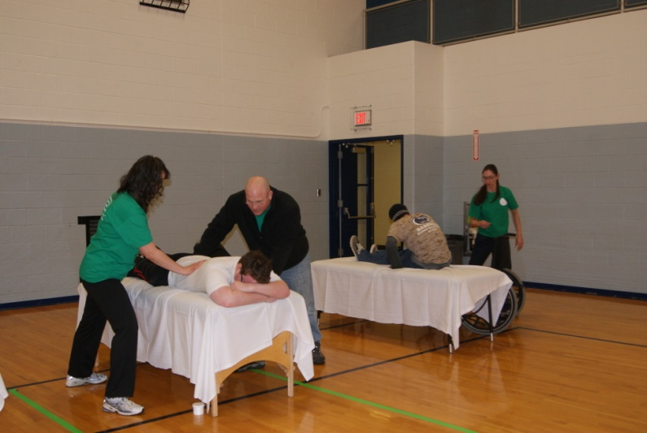
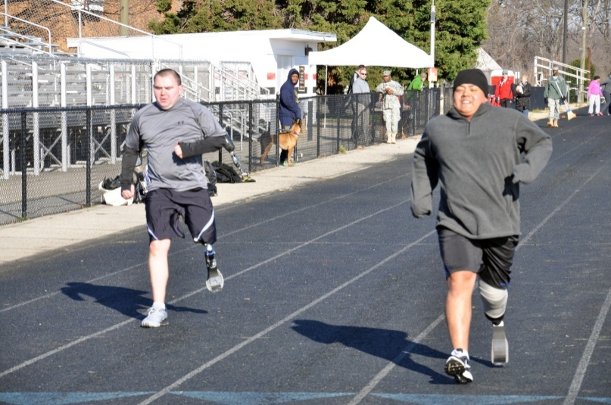
Comprehensive transition plAN (CTP)
Senior Commander
SIX CTP DOMAINS
CAREER
PHYSICAL
EMOTIONAL
SOCIAL
FAMILY
SPIRITUAL
State Agencies
Non-
Profits
Primary Care
Manager
Dept. of Labor
Dept. of Veterans’ Affairs
Return to the Force
Veteran
Status
Soldier & Family
Squad
Leader
Triad of Care
Nurse Case Manager
WTU Commander
Triad of Leadership
MTF Commander
CTP Processes: Facilitated by the Interdisciplinary Team
In-Process
Goal Setting
Transition Review
Rehabilitation
Reintegration
Post-Transition
REHABILITATION
TRANSITION READINESS
ADAPTIVE RECONDITIONING
Mr. Lonnie Moore/619.532.8035/lonnie.c.moore.civ@mail.mil

Slide 10
Career and Education Readiness (CER)
Career strongly influences success in other domains
Begins with realistic goal-setting using the SMART model
CER Activities include
Remain-in-the-Army Work Assignments (RIAWA)
Federal Internships
Education and Training
VA Vocational Rehabilitation & Employment (VR&E) Services
Soldier for Life-Transition Assistance Program (SFL-TAP)
Key is to start early, as medical appointments allow, in the rehabilitation or reintegration process of the CTP
Career readiness is the product of sustained effort, not a single event
CER is a Team Effort led by each Soldier’s Transition Coordinator, Squad Leader and Occupational Therapist with input from the Soldier
Mr. Lonnie Moore/619.532.8035/lonnie.c.moore.civ@mail.mil
Notes:
CER Eligible – Eligibility for a Career and Education Readiness (CER) activity is based on two distinct evaluations made by the Medical Management (M2) and the WTU Commander.
The M2 evaluation must conclude that the Soldier is medically, emotionally and physically ready to participate in a CER activity while continuing medical treatment. The NCM – in collaboration with the IDT – is responsible for coordinating the medical management evaluation of CER eligibility with all members of the M2. The NCM is also responsible for documentation.
The Commander evaluation must conclude that the Soldier demonstrates the initiative and self-discipline required to participate in a CER activity. The Company Commander is responsible for the CER eligibility evaluation and the Squad Leader is responsible for documentation.
Remain in the Army Work Assignments (RIAWA). A place of duty (in addition to the Soldier's medical routine) that is MOS-appropriate and provides a productive work therapy environment aligned with the Soldier's career track and long-term goals. The position must ordinarily be filled by a Soldier and not a civilian employee. If the position is normally filled by a civilian employee, it may be suitable for an internship.
Education/training. Enhances a Soldier‘s knowledge in a specific area. Courses may be self-paid, paid by scholarship, reimbursed by tuition assistance, VA VR&E, or GI Bill or may be offered without fee.
Internships. OWF or CHTW internships are permitted at federal agencies, including Army, and may or may not be on the installation. These positions would normally be filled by civilian employees. OWF/CHTW is typically aligned with Transition from the Army track.

Slide 11
REGULATORY GUIDANCE- DoD/VA IDES MOU
Memorandum of Understanding Between the Department of Defense and the Department of Veterans Affairs- Signed 1 February 2012
“Outlines the parameters in which eligible active duty Service Members can received vocational rehabilitation counseling services and assistance.”
Should be informed and referred to a VRC for counseling on VR&E services and assistance if they are:
Evaluated by a DoD or VA physician and determined to have a severe injury or illness which could cause their referral into IDES
Assigned to a Service’s Wounded Warrior program and are participating in the E2I program to the extent authorized by law
Being processed through the IDES and are being referred to a PEB
Develop a Career Plan with the Service Member and ensure the career plan is given to the Recover Care Coordinator (RCC) or Chain of Command for review
Provide VR&E services and assistance to Service Members with severe injuries and illnesses participating in the E2I program or processing through IDES
Mr. Lonnie Moore/619.532.8035/lonnie.c.moore.civ@mail.mil

Slide 12
REGULATORY GUIDANCE- VBA Circular 28-12-01
VBA Circular 28-12-01- Procedures for Implementing the Provisions of PL 110-181, NDAA 2008, as extended by PL 112-56, Vow to Hire Heroes Act
DVA OGC determined, as a result of law:
Service Members who incur a serious illness or injury that may render them unable to perform their military duties are entitled to VR services under title 38, USC, chapter 31
Eligibility and entitlement are established without regard to a VA service-connected disability rating or a determination of employment handicap
Entitlement is based upon the receipt of VA Form 28-1900, Disabled Veterans Application for Vocational Rehabilitation, and qualifying information related to military service
Referral to PEB
Military Status Service Referral (MSSR) for Service Members who are participating in E2I and have not been referred to a PEB and are not enrolled in IDES
Mr. Lonnie Moore/619.532.8035/lonnie.c.moore.civ@mail.mil

Slide 13
WHAT’S NEXT
Ongoing Staff Assistance Visits (SAV) between WTC and VA VR&E Office
SAVs have already occurred at Fort Riley and Fort Carson
Joint published SOP between WTC and VA VR&E office
Targeted for completion by 30 October
Collaboration on metrics gathering
Congress directs each service to gather Recover Care Program (RCP) metrics and report to OSD monthly:
Percent of Recovering Service Members (RSMs) referred for VR&E services though the Department of Veterans Affairs
Percent of RSMs enrolled in VR&E services
WTC collects monthly:
How many Soldiers completed a VA VR&E career assessment?
How many Soldiers enrolled in VR&E and completed a VR&E career assessment were enrolled in one the five VR&E tracks to employment?
How many Soldiers were matched/referred to an employment or educational opportunity by the VR&E counselor?
Mr. Lonnie Moore/619.532.8035/lonnie.c.moore.civ@mail.mil

Slide 14
SOP
Designed for WTUs and VA VR&E counselors to establish common work flow processes and expectations
Ideally demonstrates a best practice for early intervention (prior to IDES referral)
Identifies key stakeholders in each organization
VA VR&E Counselor (VRC)
WTU Transition Coordinator (TC)
WTU Occupational Therapist (OT)
WTU Nurse Case Manager (NCM)
WTU Commander (CDR)
WTU Squad Leader (SL)
….and most importantly the SOLDIER and his/her FAMILY
SOP is guidance for a process; in order to be successful each VRC and WTU must work together to execute written procedures at the local level
Mr. Lonnie Moore/619.532.8035/lonnie.c.moore.civ@mail.mil

Slide 15
COMMENTS/QUESTIONS
Mr. Lonnie Moore/619.532.8035/lonnie.c.moore.civ@mail.mil

