Slide 1
CWINRS Subsistence Allowance Module (SAM): Supplemental Issues Training

Slide 2
Training Topics
Override Function
Stop Pay: Date Last Paid
Removal of a Dependent
Amended Awards: Change in Credit Hours
Questions?

Slide 3
CWINRS SAM: Supplemental Issues Training
Override Function

Slide 4
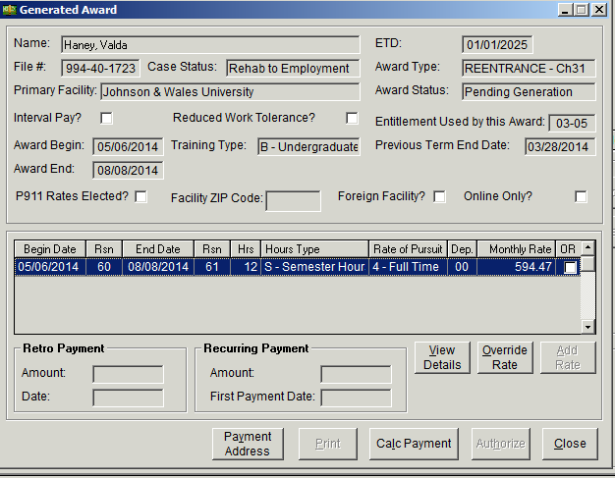
Override Function – 1
Once you generate an award, the Generated Award screen will now have an additional selection available: Override Rate.
Select the award line you want to change and click the Override Rate button.
Note: The Override Rate button will be greyed out (not active) until you select the award line you want to change.

Slide 5
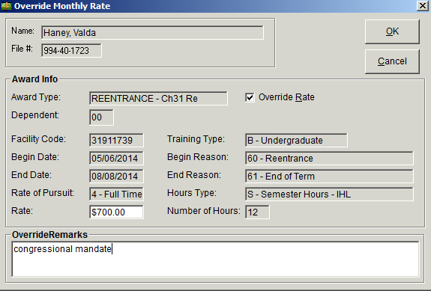
Override Function – 2
Select the ‘Override Rate’ field at the top of the screen to activate the other fields in the screen.
Enter the new rate in the ‘Rate’ field.
Input a specific remark stating why the rate was changed in the ‘Override Remarks’ section.
Click OK for the system to accept the changes.
4
1
2
3

Slide 6
Override Function – 3
Determine that the system has pulled through the correct rate (Note: The system has been programmed to prevent the payment of the SA rate above the legal limits provided by law.) Enter the new rate in the ‘Rate’ field.
Select the ‘Calc Payment’ button to complete.
5
6

Slide 7
CWINRS SAM: Supplemental Issues Training
Stop Pay: Date Last Paid

Slide 8
Stop Pay: Date Last Paid – 1
Highlight your award and click on the Amend Button.
On the “Select Amendment Type” screen, choose Enrollment Change –Complete Withdrawal/Stop.

Slide 9
Stop Pay: Date Last Paid – 2
On the “Add Info for Complete Withdrawal” screen, choose the reason for withdrawal
Click the appropriate response for “Mitigating Circumstances”
Complete the narrative if appropriate
Click OK to continue!

Slide 10
Stop Pay: Date Last Paid – 3
On the “Add Info for Complete Withdrawal” screen, answer the popup screen that asks “Do you want to pay for one day?”
In most cases, the answer is NO! If you elect to say yes, SAM will pay for the last day of training.
Click OK to continue!

Slide 11
Stop Pay: Date Last Paid – 4
Clicking OK on the “Add Info for Complete Withdrawal” screen will return you to the “Add Amended Subsistence Allowance Award (Enrollment Change) screen”
Click OK to continue!

Slide 12
Stop Pay: Date Last Paid – 5
Clicking OK will return to the Awards screen.
Click on the Generate command button to Generate your award. The award for the stop pay will be Set To Authorization.
Authorize your award.
Note: Stopping a running award will always create an overpayment.

Slide 13
CWINRS SAM: Supplemental Issues Training
Removal of a Dependent

Slide 14
Removal of a Dependent – 1
Access your SAM case and go to the Dependents Tab.
Click on the Dependent that you want to remove from SAM and Click on the Remove command button.

Slide 15
Removal of a Dependent – 2
On the Remove Dependent screen, use the drop down and select a reason for the removal of the dependent.

Slide 16
Removal of a Dependent – 3
After you select a reason for removal, Click OK to continue!

Slide 17
Removal of a Dependent – 4
After you have clicked OK to confirm your reason for the removal of the dependent, SAM will return you to the Dependent Tab with your completed action.

Slide 18
Removal of a Dependent – 5
Select the Awards Tab to return to the Awards Screen.
SAM will now show that your last award(s) may require an amendment. This is signified by the Asterisk {*} on the first column.

Slide 19
Removal of a Dependent - 6
Once a dependent has been successfully removed, the next step is to perform an amended award.
Click on the Amended award and Select the Amended Type (this case, it will be a dependent change).

Slide 20
Removal of Dependent - 7
On the “Add Amended Subsistence Allowance Award (Dependent Change)”, a new screen showing the award change will appear. Click OK to continue!

Slide 21
Removal of a Dependent - 8
The Pending Generation Screen will appear and a new award can be generated.

Slide 22
Removal of a Dependent - 9
SAM will return you to the Generated Award screen and you will be able to see that the amendment took effect. In this case, the dependency was reduced to 00.
You have now successfully removed a dependent and amended the award!

Slide 23
CWINRS SAM: Supplemental Issues Training
Amended Awards: Change in Credit Hours

Slide 24
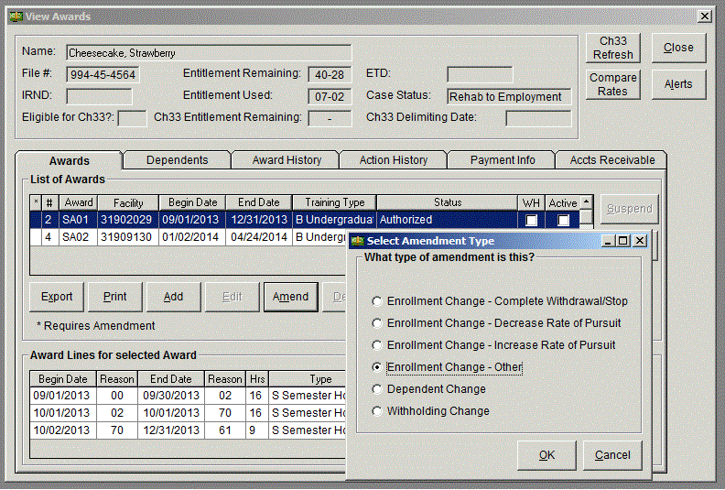
Amended Awards: Change in Credit Hours – 1
Go to your selected award.
Highlight the Award and click on the command button entitled Amend.
By clicking Amend, the “Select Amendment Type” screen will pop-up.
Select “Enrollment-Change - Other”.
Click OK to continue!

Slide 25
Amended Awards: Change in Credit Hours – 2
On the next screen, “Add Amended Subsistence Allowance screen (Enrollment change)”, click on the Edit command button

Slide 26
Amended Awards: Change in Credit Hours – 3
On the “Edit Enrollment Certification Information” screen, change the number of credit hours and adjust the rate of pursuit to each enrollment period (if necessary).

Slide 27
Amended Awards: Change in Credit Hours – 4
When SAM returns you to the “Add Amended Subsistence Allowance Award Screen (Enrollment Change)” screen, check your work to ensure it is correct.
Click on OK to continue!
Note: In the example, the award was changed to 8 credits hours (1/2 time).

Slide 28
Amended Awards: Change in Credit Hours – 5
Select Generate to Generate your award for your changes to take effect!

Slide 29
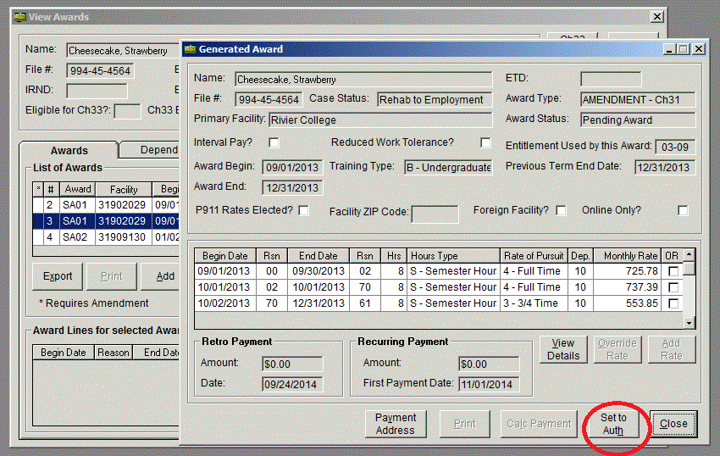
Amended Awards: Change in Credit Hours – 6
Last Step! Click on Set to Authorization.
Your award must now be authorized by yourself or an approved authorizer for SAM.

Slide 30
This page is intentionally left blank for future training topics

Slide 31
Questions?
Please feel free to contact any of the individuals below should you have any questions regarding this training.
Point of Contact | Contact Information
Ruth Comeau | Ruth.Comeau@va.gov (603) 222-5776
Richard Franco | Richard.Franco@va.gov (973) 297-3001
Kat Sylvester | Kathy.Sylvester@va.gov (202) 461-9671

