Slide 1
Subsistence Allowance Module
Finance Training Guide
Notes:
Introduce yourself and inform participants of the lesson topic.
Inform participants of the purpose of the class.
The purpose of this lesson is to familiarize the trainee with available Fact Sheets and frequently used forms.
Share with participants that the information provided will help them assist Veterans with general questions or with questions about a VA form.

Slide 2
Learning Objectives
At the end of this training guide you should be able to;
Know how to identify and view CH31 SAM Awards, Payments and Receivables in FAS.
Know how to Process Chapter 31 Fiscal Transactions in FAS
Identify FAS differences between CH31 and C&P
Know how to identify and view CH31 SAM Awards, Payments, and Receivables SHARE
Identify how Pilot cases will be selected and approved
Identify finance steps for processing awards in SAM

Slide 3
Background
The Subsistence Allowance Module (SAM) is a new function of CWINRS that will replace the Chapter 31 BDN functions
Subsistence Allowance awards processed in SAM are paid using the VETSNET Finance and Accounting System (FAS)
VR&E is currently piloting the SAM functionality at several Regional Offices.
Manchester, NH/White River Junction, VT were the first sites and have been up and running since May 2011
Newark, NJ; Philadelphia, PA; and Jacksonville/St. Petersburg, FL followed later in 2011
Houston, TX and Milwaukee, WI began processing awards in SAM in June, 2013
Current Pilot cases consist mostly of new Chapter 31 beneficiaries
June 2013, VR&E began selecting cases that have prior BDN award history to pilot in SAM

Slide 4
Background (continued)
Finance staff at the selected stations will be required to review the BDN master record for all selected cases prior to processing awards in SAM
Cases with financial balances will be approved for the SAM Pilot (financial balances include Proceeds, Unassociated Funds, Receivables, and Deductions)
If any financial balances exist in BDN, Finance will clear these balances prior to AWARD input in SAM
Finance must respond to VR&E with approval or disapproval within 5 business days
Finance must track and monitor all pilot cases for payment accuracy
A monthly report on all Pilot cases must be sent to ORM Finance Services
ORM will periodically review pilot cases for accuracy

Slide 5
All demographic information is fictitious
DISCLAIMER

Slide 6
How to Identify SAM Awards in FAS
In FAS, enter the file number in the search box and select “Search”
Once the record is displayed on the main FAS Screen, select “View Transaction History to view all authorized awards
The “Select Awards” box will display all authorized Chapter 31 awards
Select one or multiple awards and then select one of the transaction view options to view All Transactions, Accountable Balances, Deductions, Payments, or Receivables
1
2
3
4

Slide 7
FAS All Transactions Screen
Select “View Details” to drill down to a single transaction

Slide 8
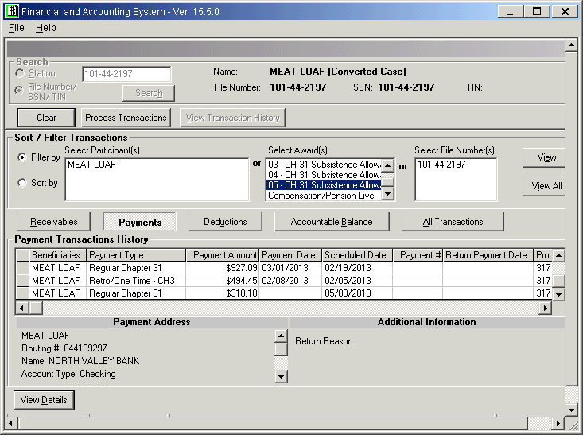
View Payments in FAS

Slide 9
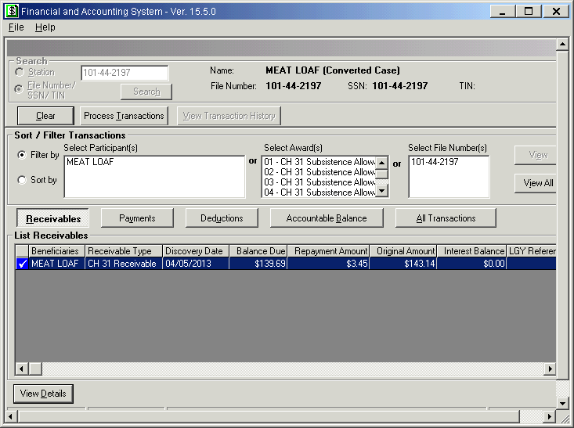
View Receivables in FAS
View Payments in FAS

Slide 10
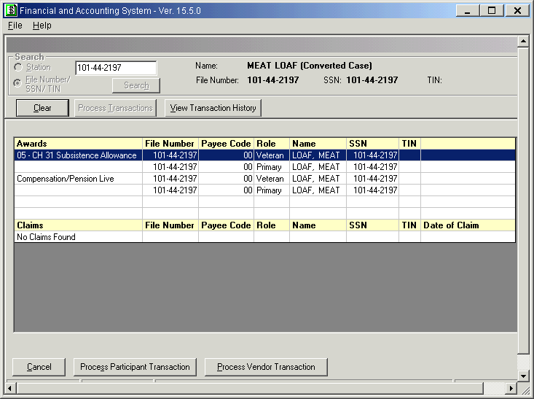
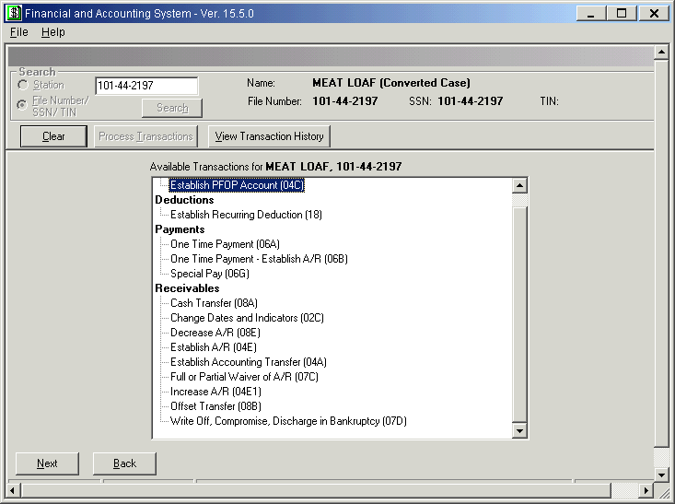
Process Fiscal Transactions
To process Chapter 31 Fiscal Transactions, select “Process Transactions” tab and select award
From “Available Transactions” Screen, select your transaction

Slide 11
Process Fiscal Transaction (continued)
Once transaction is selected, enter necessary data to complete the transaction
Additional cost codes and program type information have been added to the standard drop down menus to accommodate Chapter 31
All fiscal transactions will require a fiscal authorization by a user at the same station

Slide 12
What is Different in FAS for CH31?
New Fiscal Transaction – 06L-Work Study
Chapter 31 Work-Study benefits will be processed in FAS using the 06L fiscal transaction
The 06L transaction is restricted to the four Regional Processing Offices (Atlanta, Buffalo, Muskogee, or St. Louis)
Stations should work with their RPO contacts to handle requests for Work-Study benefits
Chapter 31 Receivables
SAM/FAS receivables will not automatically be sent to C&P for collection after 30 days
Stations will be required to establish a deduction (18 transaction) to collect the CH31 debts from the C&P award
ORM Finance Services will provide periodic lists of terminated CH31 awards with receivables for the stations to work

Slide 13
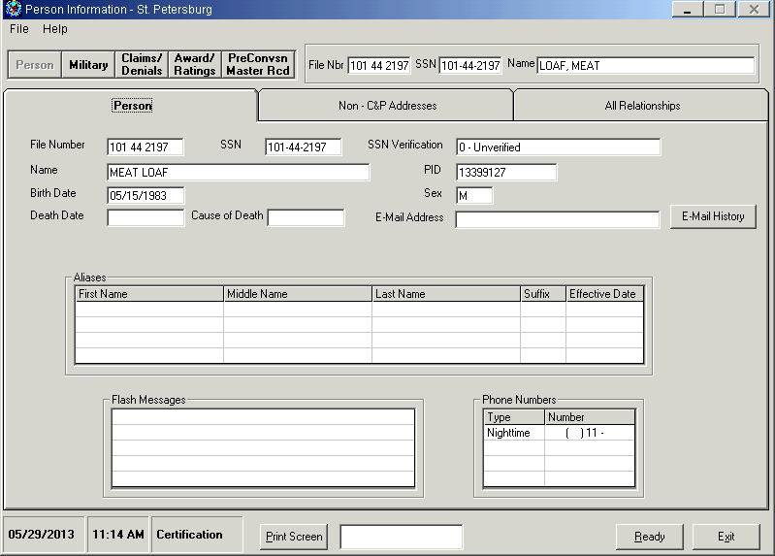
View Chapter 31 Award Information in Share
To view Chapter 31 award information in Share, use the “Corporate Inquiries” command
On the “Person Information” screen, select “Awards/Ratings” tab

Slide 14
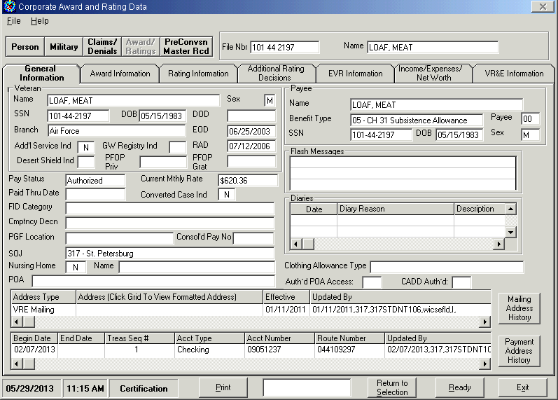
View Chapter 31 Information in Share
On the “Award/Ratings” screen, select the Chapter 31 award to view
The “General Information” tab will display general Chapter 31 information, including entitlement information

Slide 15
View Chapter 31 Award Information in Share
The “Award Information” tab will display Chapter 31 award information, including Date Last Paid
This screen will also display any accountable balance information for the claimant (receivables, deductions, or proceeds.

Slide 16
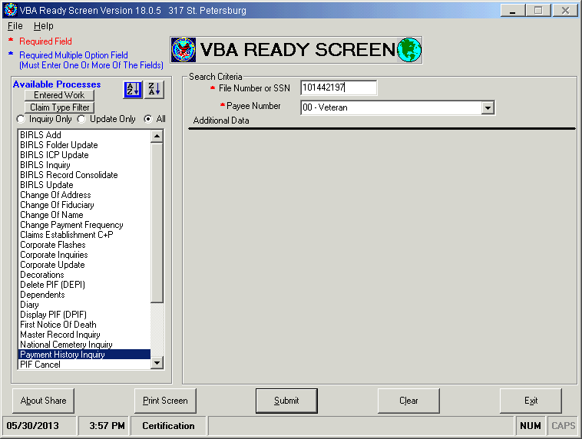
View Chapter 31 Payment History in Share
Share will continue to display all Chapter 31 Payment History. To access Payment History, use the “Payment History Inquiry” command

Slide 17
Steps for Selecting Pilot Cases
Cases eligible for the Pilot must meet one of the following conditions:
Original awards for new beneficiaries for Subsistence Allowance, Employment Assistance Allowance, or Alternative Employment Assistance Allowance (except cases with Post 9/11 grandfathered rates) or;
Cases with prior BDN award history and a terminated BDN master record
Cases with financial balances (proceeds, unassociated, receivables, & deductions) will be approved for migration to SAM, as long as the financial balances are cleared in BDN prior to SAM.
A VETSNET C&P record must be established for the beneficiary
SAM Awards will only start at the beginning of a term/semester
The beneficiary must not have an active award in BDN
NOTE: Ch31 payments out of VETSNET will use C&P payment address. Cases can be paid by EFT or Check.

Slide 18
Steps for Processing New SAM Awards
VR&E identifies potential Pilot cases and forwards spreadsheet to Finance for concurrence
VR&E will complete their portion of the spreadsheet prior to forwarding to Finance
Finance reviews BDN Master Record for history and financial balances
Finance will forward a courtesy copy of the Spreadsheet to ORM Finance Services prior to beginning review
Once review is completed, Finance will return spreadsheet to VR&E with concurrence or non-concurrence
Finance will send a courtesy copy of the completed spreadsheet to ORM Finance Services
If finance concurs, VR&E will process and authorize the award in SAM. If Finance does not concur, VR&E will process the award in BDN
Pilot cases will continue to be tracked monitored by both Finance and VR&E for payment accuracy
ORM Finance Services will periodically review approved cases for payment accuracy
Finance will review the BDN record again, prior to any supplemental SAM award

Slide 19
Pilot Case Reporting Requirements
Each Pilot station will receive a spreadsheet to be used for tracking and monitoring of Pilot Cases
Finance will be responsible for documenting whether a financial balance exists in BDN and whether they approve the case for the Pilot
Finance will be required to respond to a VR&E request for review within 5 business days.
Reviews pending greater than 5 business days will be reported to ORM Finance Services
VR&E will be responsible for documenting BDN award information and new SAM award information
Spreadsheets should be submitted to ORM Finance Services each time a case (or group of cases) is approved for SAM and again at the end of each month

Slide 20
Questions?
ORM Finance Services Points of Contact
1. Brandon Robinson:
ORM Finance Services
Financial Operations & Reengineering Division
Brandon.Robinson@va.gov
202-461-9924
2. Amy Beach:
ORM Finance Services
Fiscal Systems Division
Amy.Beach@va.gov
727-299-8656
ORM Operations Mailbox: VAVBAWAS/CO/OPERATIONS

Slide 21
Thank You
The End!

