Slide 1
DEPARTMENT OF VETERANS AFFAIRS SERVICES FOR MILITARY SEXUAL TRAUMA (MST)
PRESENTATION FOR THE VETSUCCESS ON CAMPUS MONTHLY TRAINING CALL
Kerry Makin-Byrd, PhD
National MST Support Team, VA Mental Health Services
August 21, 2014

Slide 2
VA Administrative Structure
Department of Veterans Affairs (VA)
Veterans Benefits Administration (VBA)
Veterans Health Administration
(VHA)
National
Cemetery Administration
Disability compensation
Educational benefits
Vocational rehabilitation benefits
Home loans and life insurance
Medical treatment
Mental health treatment
Burial and memorial benefits

Slide 3
What Is Military Sexual Trauma?
3

Slide 4
What is Military Sexual Trauma (MST)?
Military sexual trauma (MST) is sexual assault or repeated, threatening sexual harassment that occurred during a Veteran’s military service
Official definition is given by Title 38 U.S. Code 1720D:
“Physical assault of a sexual nature, battery of a sexual nature, or sexual harassment [“repeated, unsolicited verbal or physical contact of a sexual nature which is threatening in character”] which occurred while the veteran was serving on active duty or active duty for training”
In this definition, sexual harassment and assault are conceptualized as experiences along a single continuum
MST can occur on or off base, while a Veteran was on or off duty
Perpetrator identity does not matter
Both men and women experience MST

Slide 5
What is MST?
Any sort of sexual activity in which someone is involved against his or her will
Someone may be:
Physically forced into participation
Unable to consent to sexual activities (e.g., intoxicated)
Pressured into sexual activities (e.g., with threats of consequences or promises of rewards)
Can involve things such as:
Threatening, offensive remarks about a person’s body or sexual activities
Threatening and unwelcome sexual advances
Unwanted touching or grabbing
Oral sex, anal sex, sexual penetration with an object and/or sexual intercourse
Compliance does not mean consent

Slide 6
How Common is MST?
This can be difficult to know, as sexual trauma is frequently underreported
When screened as part of the Veterans Health Administration’s (VHA) universal screening program, about 1 in 4 women and 1 in 100 men tell their VHA health care provider that they experienced sexual trauma in the military
These data speak only to the rate among Veterans who have chosen to seek VA health care
Because MST is an experience, not a diagnosis, these data cannot address what percent of those who screened positive need or want treatment
Although women experience MST in higher proportions than do men, because of the large number of men in the military there are significant numbers of men and women seen in VA who have experienced MST
In 2013, 43% of the Veterans seen in VHA who had experienced MST were men

Slide 7
Impact
People are remarkably resilient after experiencing trauma
There is no one way that Veterans respond to MST
Many cope quite well and recover without professional help
Some continue to have difficulties at times or strong reactions to certain situations
Some experience more profound or longer-term problems
May be particularly likely for multiply traumatized Veterans
Veterans of Iraq and Afghanistan may have relatively recent MST experiences, making their distress perhaps more acute

Slide 8
Common Mental Health Diagnoses
Among users of VA health care, the mental health diagnoses most commonly associated with MST are:
PTSD
Depressive Disorders
Anxiety Disorders
Bipolar Disorders
Drug and Alcohol Use Disorders
Schizophrenia and Psychoses
Other mental health diagnoses common among sexual trauma survivors more generally include:
Eating Disorders
Dissociative Disorders
Somatization Disorder

Slide 9
Common Physical Health Problems
Among users of VA health care, the physical health diagnoses most commonly associated with MST are:
Liver disease
Chronic pulmonary disease
Chronic pain (e.g., lower back pain, headaches)
Gastrointestinal problems (e.g., Irritable Bowel Syndrome)
Gynecological problems (e.g., menstrual disorders, pelvic pain)
Women: Obesity, weight loss, hypothyroidism
Men: AIDS

Slide 10
VA Policies & Initiatives Related To MST
10

Slide 11
Veterans Health Administration Response to MST
All Veterans are screened for experiences of MST
Free treatment for mental and physical health conditions related to MST
MST Coordinator at every VA Medical Center, to serve as a point person for Veterans and staff
Education and training of staff
Outreach to Veterans
National MST Support Team, to perform national monitoring, to coordinate MST-related education and training, and to promote best practices in the field

Slide 12
MST Screening
Recognizing that many survivors of sexual trauma do not disclose their experiences unless asked directly, it is VA policy that all Veterans seen for health care are screened for MST
Screening is conducted in a private setting, by qualified providers
Providers receive training in how to screen sensitively and respond to disclosures
Veterans who report having experienced MST are offered a referral to mental health for further assessment and/or treatment

Slide 13
Free MST-Related Health Care
VA provides all MST-related care free of charge
Treatment for mental and physical health conditions related to MST
Outpatient, inpatient, and residential care
Medications

Slide 14
Eligibility for MST-Related Health Care
Veterans do not need to have reported their experiences of MST at the time or have other documentation that they occurred in order to receive free MST-related health care
Service connection (VA disability compensation) is also not required
This benefit extends to Reservists and members of the National Guard
At many facilities, Active Duty personnel can also receive these services
Veterans may be able to receive free MST-related care even if they are not eligible for other VA care
There are no length of service or income requirements to receive MST-related care
Veterans with Other Than Honorable discharges may be able to receive MST-related care with Veterans Benefits Administration (VBA) Regional Office approval
Pre-military trauma and pre-existing conditions do not impact eligibility for MST-related care

Slide 15
Mental Health Care Services Available
VHA offers a full continuum of mental health services for Veterans who have experienced MST
Every VA medical center provides MST-related mental health outpatient services
Outpatient services are organized different at different facilities – some have identified “MST clinics”, others provide services in a more distributed fashion
Services available include formal psychological assessment and evaluation, psychiatry, and individual and group psychotherapy
Specialty services are available to target problems such as Posttraumatic Stress Disorder (PTSD), Substance Use Disorders, Depression, and homelessness
Evidence-based psychotherapies are available at all VA Medical Centers
Community-based Vet Centers also have outpatient services available
For Veterans who need more intense treatment and support, VHA has mental health residential rehabilitation and treatment programs (MH RRTPs) and inpatient programs available
Some of these programs focus specifically on MST or have specialized MST tracks

Slide 16
Single Gender Versus Mixed-Gender Programs
VA recognizes that some Veterans will benefit from treatment in an environment where all of the Veterans are of one gender
May help address a Veteran’s concerns about safety
May improve a Veteran’s ability to disclose, address gender-specific concerns, and engage fully in treatment
VA also recognizes that mixed-gender programs have advantages
May help Veterans challenge assumptions and confront fears about the opposite sex
May provide an emotionally corrective experience
Also promotes efficient use of resources: accepting both men and women helps prevent treatment or admissions slots from going unused
Given these considerations, VA does not promote one model as universally appropriate for all Veterans; the needs of a specific Veteran dictate which model is clinically most appropriate
Specific offerings vary from facility to facility, based on local demand and resources

Slide 17
Accessing Care
To access care, Veterans can:
Ask their existing VA health care provider for a referral for MST services
Contact the MST Coordinator at their local VA facility
Contact their local Vet Center
Veterans who were deployed to Iraq or Afghanistan can also contact the OEF/OIF/OND Coordinator at their local VA health care facility
More information is available at:
www.mentalhealth.va.gov/msthome.asp
VA’s general information hotline (1-800-827-1000)

Slide 18
MST Coordinators
Every VA health care facility has an MST Coordinator
Serves as a point person for MST issues at the facility
Responsible for addressing systems issues that serve as a barrier to accessing MST-related care, ensuring appropriate treatment services are available, engaging in outreach to Veterans, and ensuring MST-related education/training occur
Most MST Coordinators provide at least some clinical care, but the MST Coordinator is typically not the only clinician at the facility providing mental health treatment to Veterans who experienced MST
The MST Coordinator is your best point of contact for assistance in getting Veterans into MST-related care or for answering any questions about local services
To contact him/her, you can call your local VA health care facility and ask to speak to the “MST Coordinator”

Slide 19
VHA’s National MST Support Team
VHA’s national Mental Health Services program office has funded a national MST Support Team since 2006
Team performs national monitoring, coordinates MST-related education and training, and promotes best practices in the field through consultation and technical assistance
Team also provides consultation to VHA Mental Health Services on MST-related policy issues and responds to information requests from VA leadership and other stakeholders

Slide 20
Staff Education and Training Activities
VA has had a range of MST-specific training opportunities available for staff for many years, including
Monthly training calls
Annual conference on clinical care and development of treatment programming
VA Intranet Community of Practice website
Online independent study course on MST and other web-based materials
In 2012, VHA established a new mandatory training requirement on MST for all VHA mental health and primary care providers

Slide 21
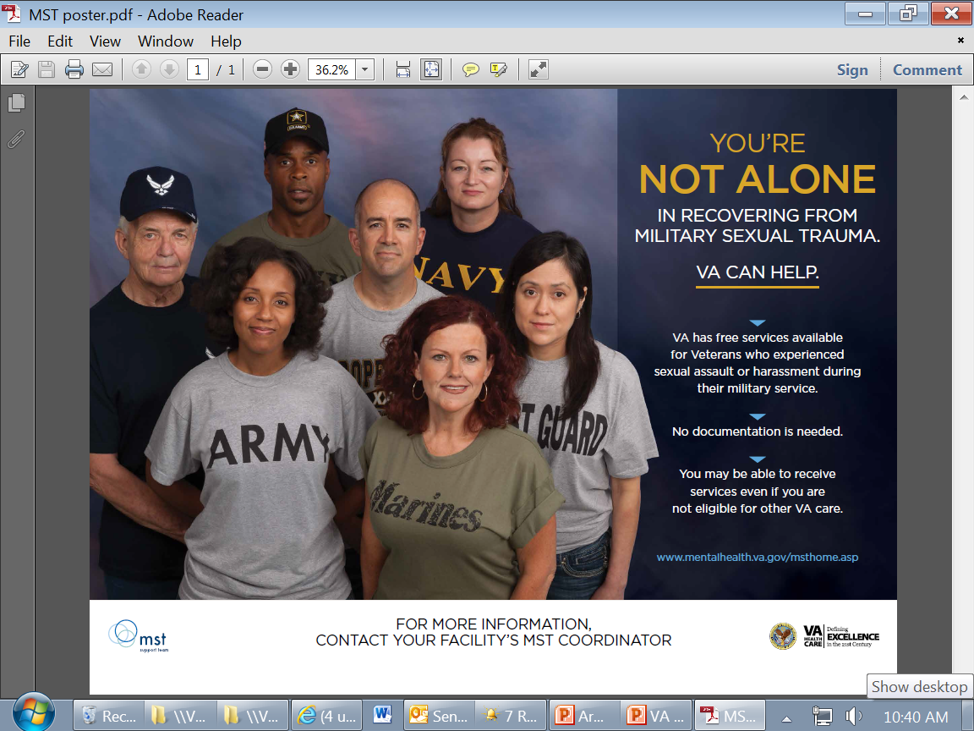
Outreach and Access to Care Initiatives
VHA has engaged in a range of efforts to ensure information about our MST-related services is readily available to Veterans
Outreach posters, handouts, and educational documents
Internet website (www.mentalhealth.va.gov/msthome.asp)
Presentations for groups outside of VA
Inclusion of information on va.gov websites
Tips sheets to facilitate MST Coordinators’ outreach efforts
MST is included in “Make the Connection” and “About Face” websites featuring stories of recovery
www.maketheconnection.net
www.ptsd.va.gov/aboutface

Slide 22
Outreach and Access to Care Initiatives
“Answer the Call” campaign
An MST Support Team campaign to support efforts by MST Coordinators to educate key frontline staff in their facility, like telephone operators and clinic clerks
The goal is to streamline the experiences of Veterans calling with MST-related questions
Campaign helps ensure frontline staff are familiar with the terms “military sexual trauma” and “MST,” are readily able to identify and direct callers to the MST Coordinator, and are sensitive to Veterans’ privacy concerns
Partnership with Department of Defense to ensure Transitioning Servicemembers are aware of VA’s MST-related services
Inclusion of information in Transition Assistance Program and Separation Health Assessment
Inclusion of information on SafeHelpline and other Department of Defense websites
Trainings of Sexual Assault Response Coordinators and other staff

Slide 23
What Can You Do?
23

Slide 24
So What Can You Do?
Convey VA‘s commitment to the issue of MST

Slide 25
So What Can You Do?
Remember that you play a key role in ensuring MST survivors have access to services
Small efforts can reduce barriers to receiving care; for example, have mechanisms built-in to provide information about MST-related services
Consider the impact that a Veteran’s trauma history might have on his/her behavior
Every VA staff member has the power to help Veterans recover from MST.
Respond sensitively to inquiries about MST
Remain knowledgeable about VA’s MST-related resources
Attend carefully to confidentiality and privacy issues

Slide 26
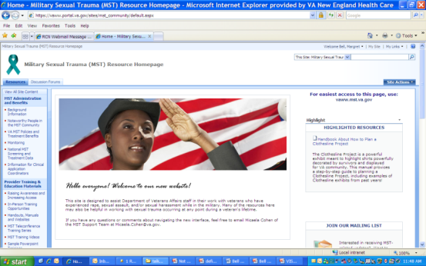
Resources to Learn More
MST Coordinator at your VA Medical Center
VA Intranet MST Resource Homepage
vaww.mst.va.gov
Accessible to all VA staff/individuals with access to the VA intranet
Training opportunities and educational handouts for staff
Veteran outreach/informational materials
List of facility MST Coordinators

Slide 27
Resources to Learn More
VA Internet website
www.mentalhealth.va.gov/msthome.asp
Accessible to Veterans
MST Support Team listservs
Receive emails about training opportunities
Email James.Leathem@va.gov to join

Slide 28
Thank you for your
commitment to assist Veterans!
Contact information:
Kerry.Makin-Byrd@va.gov

