Slide 1
Overview
Who is Student Veterans of America?
SVA’s Critical Role
Core Focus
SVA and the VA
Contacting SVA
Keeping in Touch
Closing Remarks
Notes:
Poll Question 1: Have you heard of Student Veterans of America previously?
<yes> <no>
SVA is a nonprofit organization headquartered in Washington, D.C.
Founded in Chicago in 2008, SVA is a coalition of on-campus student veteran groups called SVA Chapters
Our mission is to provide veterans with the resources, support, and advocacy needed to succeed in higher education and following graduation
Our vision is that all veterans will succeed in higher education, achieve their academic goals, and gain meaningful employment

Slide 2
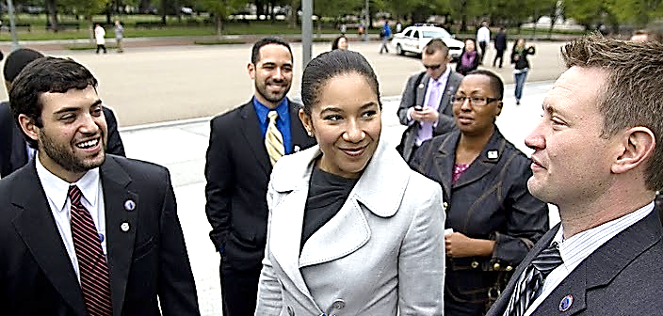
Overview of Student Veterans of America
Notes:
With nearly 1,000 chapters on campuses in all 50 states and three foreign countries, SVA is creating a powerful network for student veteran advocacy
SVA was instrumental in achieving the passage of the Post 9/11 GI Bill
SVA is focused on using a data-based approach to promote programs that empower student veterans to succeed in higher education and beyond graduation
Their most recent research initiative – the Million Records Project – provides an unprecedented snapshot of exactly how effectively GI Bill education benefits are being used

Slide 3
Who is Student Veterans of America?
Mission
SVA provides military veterans with the resources, support, and advocacy needed to succeed in higher education and after graduation.
History
SVA was founded as a 501(c)(3) nonprofit in 2008 by returning Iraq and Afghanistan veterans who personally struggled with the transition from combat to college.
The grassroots coalition was born from the military ethos of “leave no one behind,” as its founders discovered that institutions were ill-prepared to support these new, nontraditional students.
From the original 20 chapters, SVA’s network has grown to more than 1,000 institutions of higher learning in all 50 states and three countries.
Vision
SVA envisions a nation where all student veterans succeed in postsecondary programs and contribute to civilian society in meaningful ways.
Model
SVA delivers programs and services to student veterans via a campus-based peer support network made up of SVA chapters.
This peer-to-peer network continues to thrive today and is poised for growth
Notes:
SVA chapters are the “boots on the ground” that help member veterans reintegrate into campus life and succeed academically
Each chapter must be an officially recognized student group by their university or college
SVA chapters provide a peer-to-peer network for veterans attending the school
SVA chapters often coordinate campus activities, provide pre-professional networking, and give members a “home on campus” where they can find camaraderie and support
SVA chapters are also the “voice of the student veteran” on campus, and can advocate for change within the college or university’s administrative system

Slide 4
SVA’s Critical Role in Shaping the Future of Current Generation Student Veterans
SVA directly improves upon the opportunities for all Veterans through advocacy
SVA’s role was essential in the passage of the transformational Post-9/11 GI Bill
SVA envisions a nation where all student Veterans succeed in post-secondary programs and contribute to civilian society in meaningful ways
SVA is the best-suited Veterans’ organization to lead this much needed charge
Notes:
SVA plays a critical role in shaping the future of the current generation student Veterans
SVA has also directly improved opportunities for all veterans through its advocacy work, including playing a key role in the passage of the transformational Post-9/11 GI Bill
SVA partners with several organizations to offer a variety of great scholarship opportunities in several fields
SVA also offers the Leadership Institute Leadership Summits, which are intensive programs that help give chapter leaders the necessary skills to run and grow a successful chapter
These skills can be passed on to chapter members, and carries with student veterans into the their future employment

Slide 5
Supporting Veterans to Overcome Common Challenges
Core Focus: Supporting Student Veterans to Overcome Challenges
In the next five years, SVA seeks to support all student Veterans enrolled in two and four year institutions by helping them graduate with market-valued credentials and be job-ready.
Notes:
Poll Question 2: Does your institution have an Student Veterans of America chapter on-campus?
<yes> <no>
SVA’s core focus is to help student veterans overcome the often unique and significant barriers to degree attainment that they face
SVA classifies these barriers into 3 categories: administrative, reintegration, and academic
Administrative challenges include navigating the bureaucracy and accessing benefits necessary to transition into academic life
Reintegration challenges often include finding a “sense of belonging” on a campus where most of their fellow students are much younger and have very different life experiences
Academic challenges can be addressed by helping the student veteran connect with academic resources and continuing to support them throughout their academic life
Identifying and overcoming these barriers can lead to post-graduation success by helping the student veteran network and connect with job opportunities in the professional environment
When a veteran graduates with market-ready credentials, they are more likely to be employed and contributing to society in meaningful ways

Slide 6
The SVA-VA Relationship: Seeking to Build Better Outcomes Together
Institutions
Individuals
Communities
With programs like the Department of Veterans Affairs’ ‘VetSuccess On Campus’ (VSOC), ‘Veterans Integration to Academic Leadership’ (VITAL), and institutional support from postsecondary institutions, veterans are operating in environments where they are prone to excel.

Slide 7
Million Records Project: SVA and Support from Key Partners
Notes:
After WWII, it is estimated that for every $1 invested in veteran education through the GI Bill, $7 were returned to the American economy
In the 70 years since, no further data has been collected and studied to truly understand the Return on Investment (ROI) for subsequent veteran education programs
The MRP is the first comprehensive study to examine important data points, such as time to completion, highest level of degree reached, fields studied, and overall persistence in education
The VA pulled records for 1 million randomly selected student veterans who were receiving Montgomery or Post 9/11 GI Bill benefits between 2002 and 2010
Those records were sent to the National Student Clearinghouse, which pulled corresponding records from their own files
Personal and institutional identifying information were removed before the records were sent to SVA for analysis

Slide 8
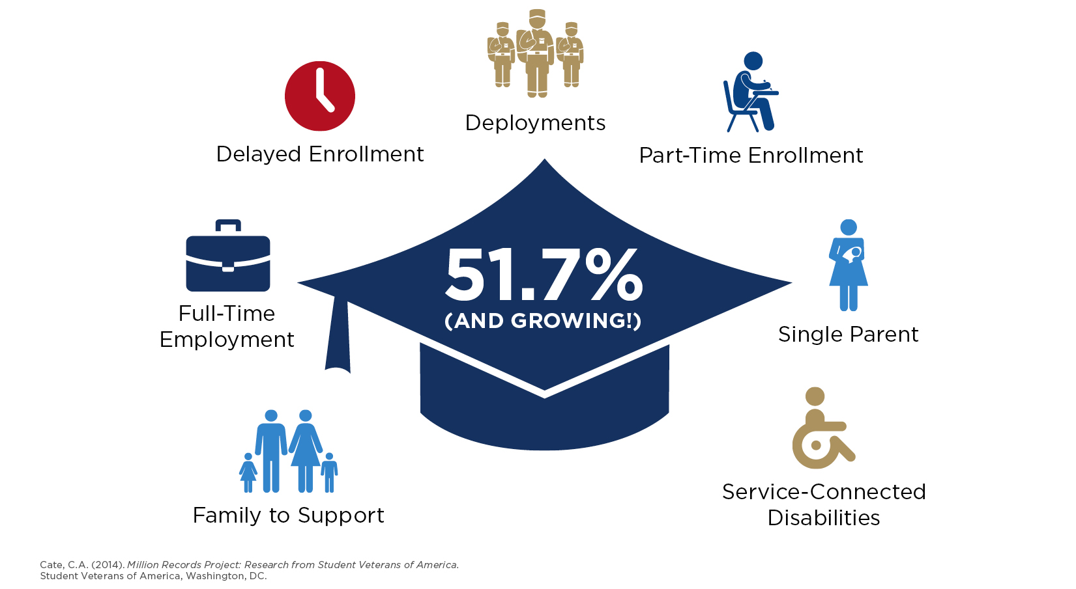
Million Records Project: The Nontraditional Student Veteran Experience
Cate, C.A. (2014).Million Records Project: Research from Student Veterans of America.
Student Veterans of America, Washington, DC.
Notes:
Poll Question 3: Does you institution currently track veteran completion, graduation, or retention rates?
<yes> <no>
The student veteran experience is nontraditional compared to that of many other students
Their enrollment is often delayed and/or interrupted due to deployment or rehabilitation from service-connected injuries
They can feel out of place amongst a campus of much younger students who have not had the same life experiences
Student veterans are often older, and many have family and work responsibilities to balance with their education
Yet with all of these challenges, the MRP has shown that 51.7% of student veterans are persisting through to graduation
This rate is comparable to that of traditional students, and ahead of the rate for other non-traditional students

Slide 9
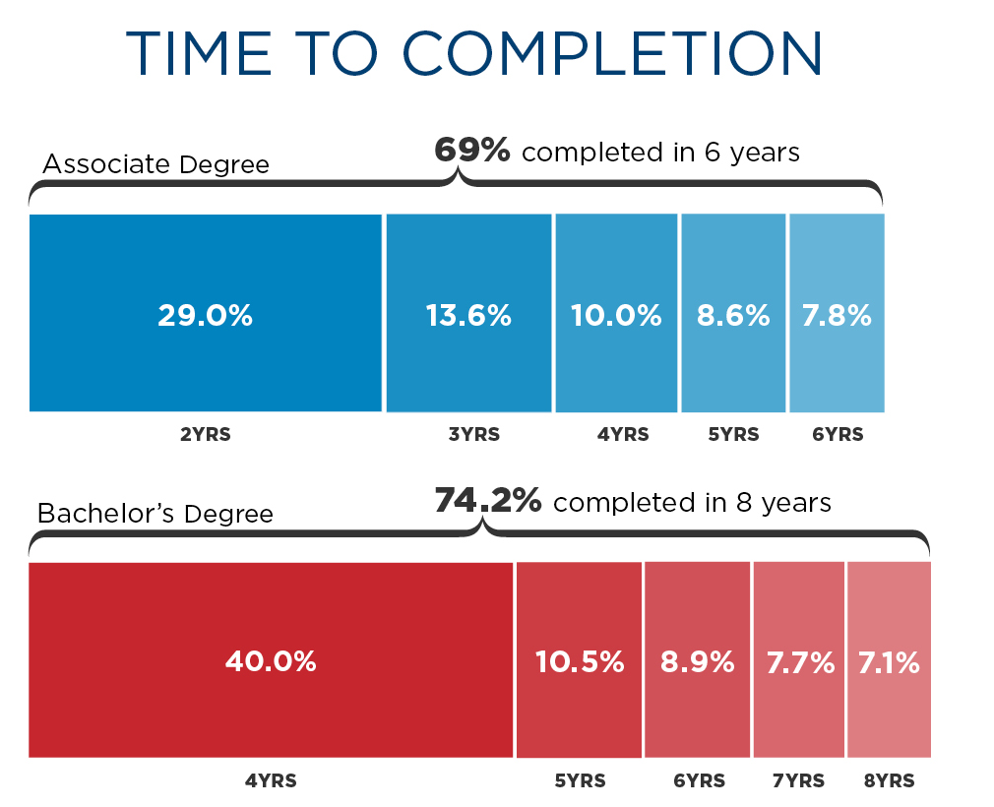
Million Records Project: Time to Degree Completion
Cate, C.A. (2014).Million Records Project: Research from Student Veterans of America.
Student Veterans of America, Washington, DC.
Notes:
Nearly one-third of student veterans complete an associate degree within 2 years
Over half of the student veterans that complete a bachelor’s degree do so in 5 years or less
Many of the student veterans that complete one certificate or degree program go on to pursue an even higher level of education
Again, student veterans show great persistence in completing their degrees despite the delayed time-to-completion
Even though a single deployment can interrupt a student veteran’s education for at least 9 to 13 months, they ultimately return to the classroom to finish what they have started

Slide 10
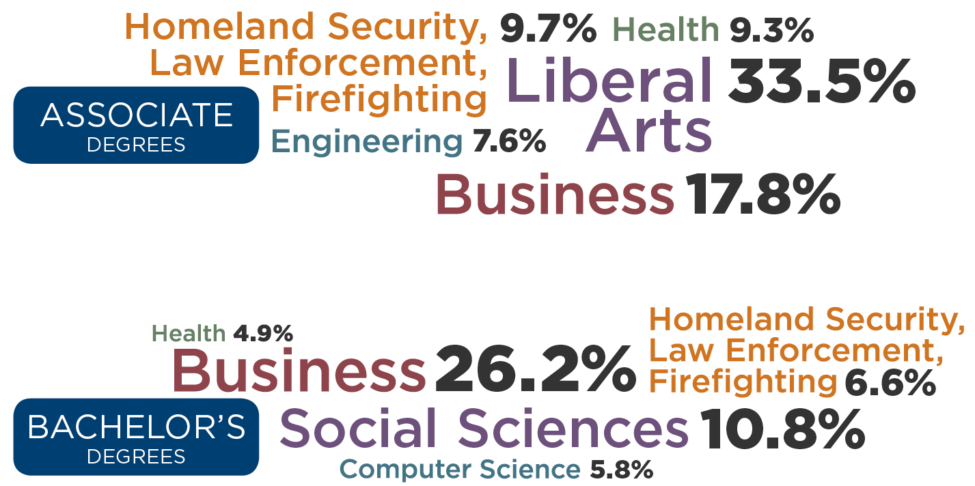
Million Records Project: Pursuing High-Growth in High-Demand Fields
Cate, C.A. (2014).Million Records Project: Research from Student Veterans of America.
Student Veterans of America, Washington, DC.
Notes:
Student veterans are pursuing degrees in high-growth fields with long-term earning potential
Over one third of the associate degrees were in liberal arts and nearly 20 percent pursued were in business
In comparison, nearly 30 percent of Veterans pursued a degree in business, while over 10 percent pursued a 4-year degree in the social sciences.

Slide 11
Measuring Impact
Individual-Level Metrics
Network-Level Metrics
Indicators related to key challenges:
Administration: Number of veterans accessing GI Bill benefits
Integration: Satisfaction with campus experience
Academic: Veteran graduation rates
Post-graduate success: Employment rates
Indicators related to strength of network:
Number of chapters
Number of active members in each chapter
Number of student veterans on campuses with chapters
Number of chapters in each tier of grading rubric
SVA’s approach using data-driven decisions is a cornerstone of the organization
Notes:
Basic close-out
“don’t hesitate to reach out if you have a chapter or are interested in learning about establishing one on your campus…..”
Voice Track:
Slide ## – ELO [PRESENTER #]

Slide 12
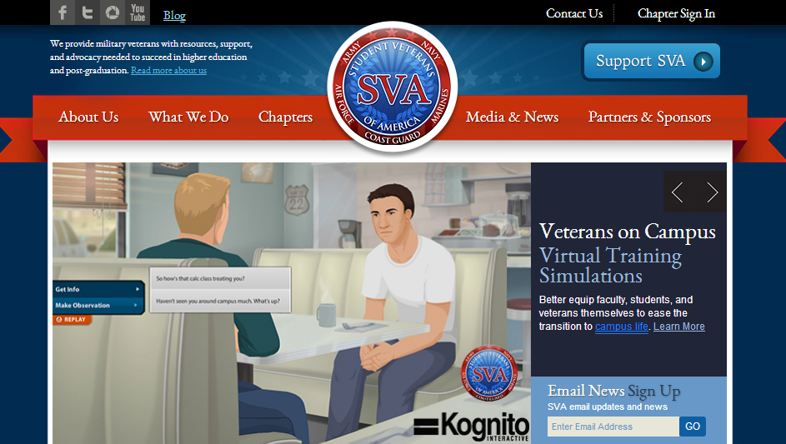
Contacting SVA
On the web at www.studentveterans.org
Notes:
Poll Question 3: What are the top issues related to student veterans at your institution?
<open-ended response>
The full report on the first phase of the MRP can be found on the SVA website
You can also find more information about our many programs, such as the Leadership Institute and Leadership Summits, scholarships, and the Chapter Grants program
We also have an SVA Chapter Map and Directory, and out In-State Tuition Map, which tracks in-state tuition availability for veterans
Additionally, there are links to several helpful sites, such as the VA’s Post 9/11 GI Bill Comparison Tool, and to partnership programs, such as the “Veterans on Campus: Support Training” interactive simulations from SVA and Kognito

Slide 13
Keeping In Touch
Email us at outreach@studverans.org
@ studentvets
Student Veterans of America
Student Veterans of America
Notes:
Basic close-out
“don’t hesitate to reach out if you have a chapter or are interested in learning about establishing one on your campus…..”
Voice Track:
Slide ## – ELO [PRESENTER #]

Slide 14
SVA Closing Remarks – Thank you!
Notes:
Voice Track:
Slide ## – ELO [PRESENTER #]

