Slide 1
VRE VBA Web Communications: Crafting the Right Message
A Training Course for
VSOC VRCs
TMS # VA 3860225
October 2014

Slide 2
Learning Objectives
What/Where/Who is Social Media, and Why is it important?
How VA is using, Who it interacts with
Examples of failure/success stories
How is Social Media relevant or beneficial to VSOC?
What do you do next?

Slide 3
The Who, What, Where, & Why
Social media refers to the means of interactions among people in which they create and exchange information and ideas in virtual communities and networks… it’s a group of Internet-based applications that allow the creation and exchange of user-generated content.

Slide 4
It Goes Where You Are
Platforms, Apps are places to gather—wherever you are
Facebook/YouTube/Twitter/Instagram/Tumblr/Reddit/Google+/Pinterest/LinkedIn/Flickr/Pandora/SnapChat/Runkeeper/Foursquare/Last.fm—and THOUSANDS more
Spawned its own language, practices, customs: “Selfie”/LOL/Memes/#hashtag

Slide 5
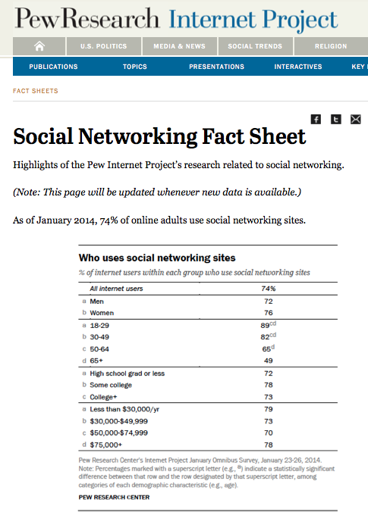
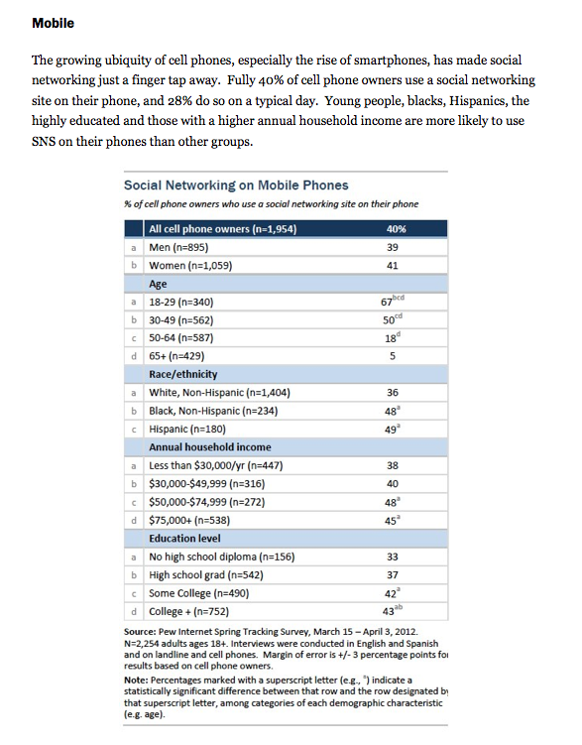
SM is Mobile
SM is mobile – 40 percent of Americans use smartphones, 28 percent use mobile SM daily:

Slide 6
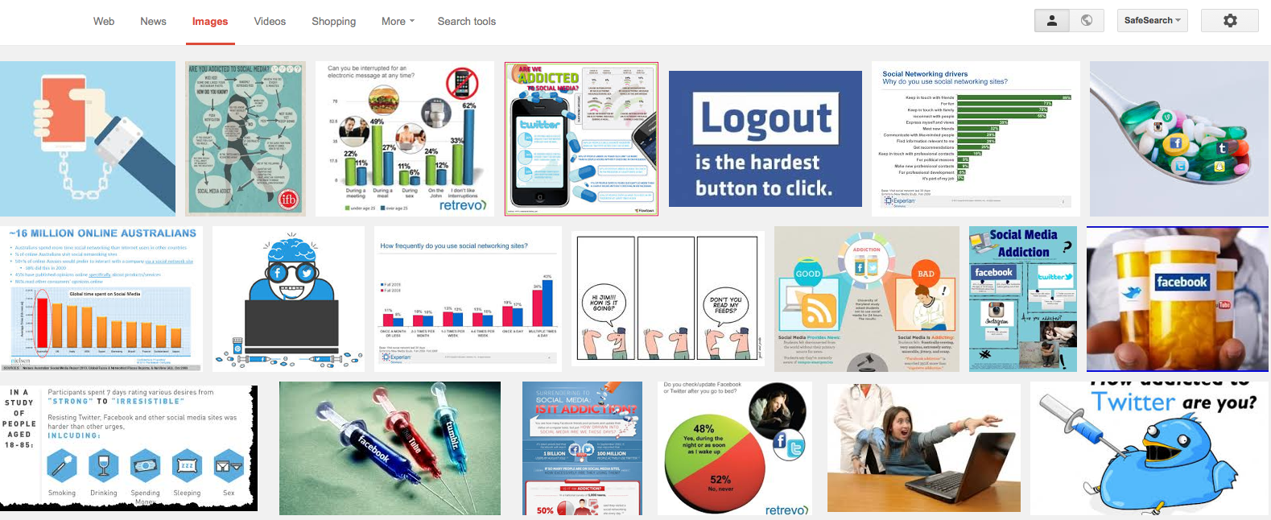
If Mobile, then always On
Highly interactive (ADDICTIVE):

Slide 7
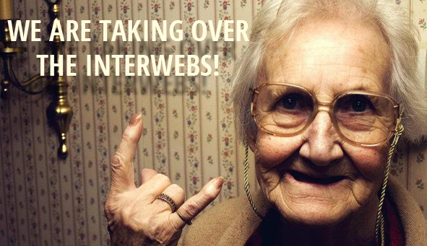
Who Uses Social Media?
For better or worse, MY GRANDMOTHER

Slide 8
AND THIS GUY

Slide 9
And Everyone Else
Celebrities/Science and Technology Experts and Influencers/Journalist’s and Media/Businesses and Brands and Attractions/Marketers/Recruiters/Major Sporting Events and Teams/Politicians/local, state, and FEDERAL GOVERNMENT/PUSA/even ISIL and AQ/and Parodies of them all (Internet #ftw)
Probably YOU
Consumers – product comparisons, user reviews, dating services, recalls, driving directions, streaming movies and music, discount and coupon services

Slide 10
Content is King
What kind, How Important, and Why?
Use relevant, targeted, and timely information
Strong photo and video content dominates SM
Infographics and shareable content generate interest in your product or plan
Do you go to Facebook to read press releases and long blocks of text? (No, you don’t)
Thus, you and your content has to be real; but be as social as you are also professional

Slide 11
Most Re-Tweeted Photo

Slide 12
Targeted Infographs

Slide 13
Open Data

Slide 14
Social Responsibility

Slide 15
How has SM influenced our lives?
https://www.youtube.com/watch?v=QUCfFcchw1w

Slide 16
How VA is Using SM, and who do we interact with?
VBA Web Communications duty for Outreach (38 U.S.C. 6303)
VBA Web Communications duty to assist (M21-1MR, Part I, Chapter 1, Section A)
The social media team uses these directives to find, contact, and assist Veterans in the digital arena

Slide 17
Our Web Presence
Among the too many to list
http://www.benefits.va.gov/
https://www.ebenefits.va.gov/
http://www.benefits.va.gov/vocrehab/index.asp
Blog: http://www.blogs.va.gov/VAntage/8876/sva-develops-a-clearer-picture-of-veteran-graduation-rates/
Internal Blog: http://vaww.blog.va.gov/heyvba/ http://vaww.blog.va.gov/heyvba/3008/creating-vrap-success-in-georgia/

Slide 18
Facebook
VBA uses Facebook to share Benefits programs news and information to its Stakeholders, as well as refer them to other VA SM services
VBA: https://www.facebook.com/VeteransBenefits
Post-9/11 GI Bill: https://www.facebook.com/gibillEducation
Yes, VA is hiring: https://www.facebook.com/vacareers
Many of our stakeholders are not aware that VBA doesn’t have hospitals and medical doctors: https://www.facebook.com/VeteransHealth

Slide 19
Twitter
VBA uses Twitter to connect with Media, SM Influencers, Stakeholders, etc.
https://twitter.com/VAVetBenefits
Student Veterans of America: https://twitter.com/studentvets
Florida State University: https://twitter.com/FSUSVC
Craig Newmark (Craigslist, big VA supporter) https://twitter.com/craignewmark
Leo Shane, Stars&Stripes: https://twitter.com/LeoShane

Slide 20
YouTube
VBA uses YouTube for video hosting; the videos live on YouTube, but we share them on other platforms, like Facebook, Twitter, G+
http://www.youtube.com/playlist?list=PLA93A5833057D78B7
http://www.youtube.com/watch?v=mdDWdgClSPY&list=PLA93A5833057D78B7&index=2
http://www.youtube.com/watch?v=HPKRw88Zqoo
http://www.youtube.com/watch?v=GdoqPObM8dg
http://www.youtube.com/watch?v=EN5QMihyuhY&list=PLA93A5833057D78B7&index=10

Slide 21
Flickr
VA uses Flickr for photo hosting and event documentation rather than as a standalone social platform
http://www.flickr.com/photos/VeteransAffairs/

Slide 22
Google+
VBA uses Google+ mostly the same way and with same content as on Facebook, but G+ has different features (Hangouts) and tech more inclined for Google backend algorithm searches
VBA: google.com/+VAVetBenefits
Hangouts: http://www.youtube.com/watch?v=m5JCGqzLDgI

Slide 23
Pinterest
VBA uses Pinterest to connect with an historically high rate of women users; though it’s still in development, it can be used as an outreach tool, or just another “Happy Space”
www.pinterest.com/VAVetBenefits

Slide 24
SM Failures
It’s one thing to have social media platforms; it’s another thing to use them well
Be prepared for when your product or plan fails (when, not if)
Don’t be scripted or formulaic (be REAL, be YOU)
Monitor the auto pilot! (can’t predict a tragedy, but if one occurs, make sure scheduled posts/tweets aren’t insensitive to trending news)
Own a mistake, DON’T delete it (lest the deletion becomes the bigger story)
Be responsible and aware of which account you’re using (personal vs. professional)

Slide 25
Deliver

Slide 26
Scripted

Slide 27
Scheduled

Slide 28
Delete

Slide 29
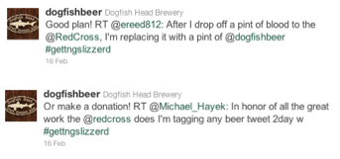
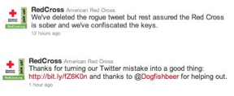
Know which Account: Personal vs. Professional

Slide 30
SM Successes
Think outside the cookie box; know your audience
Understand and accept your responsibility to do good things
Be surprised and flattered when something you wrote is seen by 2.2 million people; don’t be surprised that that doesn’t happen again

Slide 31
Honey Boo Boo’s Cookie Box

Slide 32
You can help

Slide 33
Create or curate content that you yourself would consume (Did you know Maude was a Marine?!!)

Slide 34
Social Media & VSOC
How is SM relevant or beneficial to VSOC?
Partner with your schools to get the word out about events and other news related to student Veterans
Learn and share VA news and success stories from other VSOC sites (following and engaging is as important as sharing)
Learn who else is serving Veterans in your community – SVA, student Veterans groups, community non-profits, etc.

Slide 35
What’s Next?
What do you do next?
Follow VA social media accounts on Facebook and Twitter to learn more about social media, and to keep up to date on VA news and information
Follow your school, local partners, and SVA chapters
Connect with your school public affairs officer and, if applicable, your local student Veterans organizations; ask them to also share VA news and information through their own accounts
Consider new ways to use SM (think outside the cookie box!)

Slide 36
In Closing: Have Fun

Slide 37
Questions?
Email Field Liaisons
AREA | PRIMARY | ALTERNATE | E-MAIL
Eastern | Vacant | Veronica Brown | VAVBAWAS/CO/VRE/EA
Southern | Veronica Brown | Vacant | VAVBAWAS/CO/VRE/SA
Central | Marisa Liuzzi | Vacant | VAVBAWAS/CO/VRE/CA
Western | Vacant | Marisa Liuzzi | VAVBAWAS/CO/VRE/WA
Thanks for Your Participation!

