Slide 1
On Site- Misuse Allegation

Slide 2
Topics
Laws and Manual References
Useful Handouts
Background Information
Improper Use versus Misuse
Establish the Work Process Code (WPC)
Reviewing the Misuse Allegation
Misuse Allegation Memo
Misuse Allegation Memo, Merit Not Found
Common Mistakes in Allegations
Future of the Program
Questions

Slide 3
Laws and Manual References
38 U.S.C. 6102
38 U.S.C. 6106
38 U.S.C. 6106(b)
38 U.S.C. 6107
Fiduciary Program Manual, 5.A.
2. Responsibilities
a. Misuse allegations
b. Misuse investigations
Fiduciary Program Manual, 5.B.

Slide 4
Laws and Manual References, continued
Fiduciary Program Manual, 5.C.
10. Investigating the Misuse Allegation
a. Timeliness of investigation
b. Required contacts
c. Evidence
d. Purpose and intent of the investigation

Slide 5
Useful Handouts
Laws Governing Misuse
Misuse Red Flags
Common Indicators of Misuse
Sample Misuse Allegation Memo - Merit Found
Sample Misuse Allegation Memo - Merit not Found
Misuse Documentation Error Checklist

Slide 6
Background Information
All parts of the protocol must be followed.
The beneficiary's ability to be made whole can be compromised if all elements of the misuse protocol are not followed.
Each person in the fiduciary hub has a responsibility regarding the misuse protocol.
LIE
Field Examiner
Hub Management
FSR

Slide 7
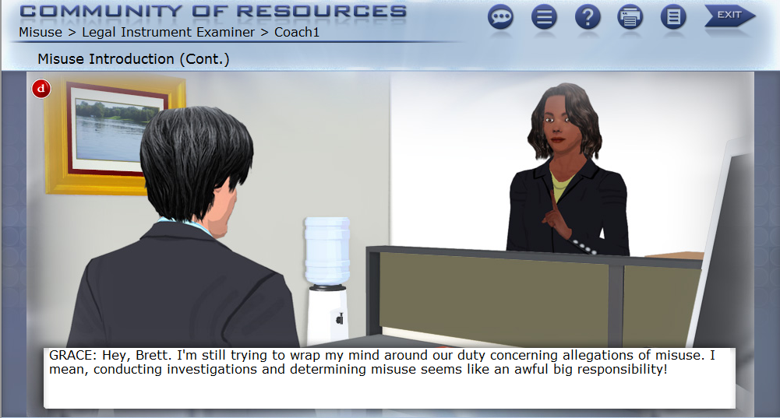
Background Information, continued

Slide 8
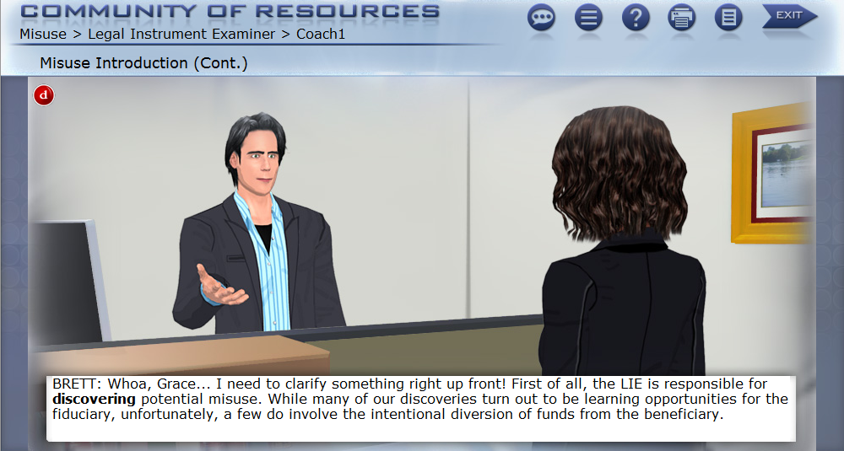
Background Information, Continued
While the LIE is not the only person able to discover misuse, they are the most likely to discover it.

Slide 9
Background Information, continued

Slide 10
Background Information, continued

Slide 11
Improper Use versus Misuse
Improper Use versus Misuse
Improper use of benefits results when a fiduciary makes an unwise expenditure of benefits in a manner that is not in the beneficiary’s best interest. It is generally a result of poor judgment. It is usually not considered misuse if the beneficiary benefits from the expenditure. Fees and gifts are generally not considered misuse.
Misuse, as defined, is generally intentional and involves the diversion of funds for the use of anyone other than the beneficiary and/or his or her VA recognized dependents.

Slide 12
Improper Use vs. Misuse, Continued
Repeated instances of inappropriate use of VA benefits reflect a general disregard for the beneficiary’s funds. Multiple instances of inappropriate use of funds may be classified as a misuse of funds.

Slide 13
Improper Use versus Misuse, continued

Slide 14
Establish the Work Process Code (WPC)

Slide 15
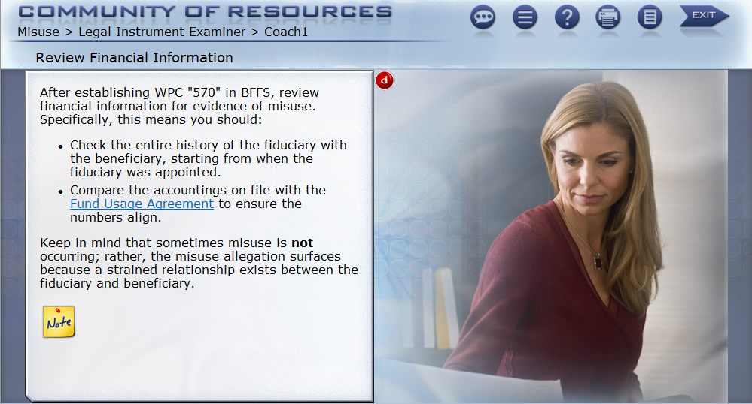
Reviewing the Misuse Allegation

Slide 16
Reviewing the Misuse Allegation, continued
While review of all financial information should be performed, timeliness standards must be followed. A cursory review of the facts must be performed during the allegation phase. The object is to review the case for merit, not to make a definitive finding of misuse. An investigation is not conducted during the allegation phase.
For example:
A misuse allegation based on a delinquent accounting.
A misuse allegation based on discrepancies within the accounting.

Slide 17
Misuse Allegation Memo

Slide 18
Misuse Allegation Memo, continued
The hub manager or coach must consider all facts developed to decide if an allegation has merit.
The Misuse Allegation Memo must include the following:
Allegation
Facts and circumstances about the allegation
Information concerning the income and expenditures and, if developed, an estimation of the misuse amount
Summary of the findings
The WPC 570 pends during the remainder of the misuse protocol.

Slide 19
Misuse Allegation Memo, Merit Not Found

Slide 20
Misuse Allegation Memo, Merit Not Found, continued
The Merit Not Found Memo must include the following:
Allegation
Facts and Circumstances around the allegation
Information concerning the money and expenditure and if possible, an estimation of the misuse amount
Summary of the findings, with the statement that an investigation not needed.

Slide 21
Misuse Allegation Memo, Merit Not Found, continued
Once concurrence is received from the approving authority:
Upload the document to Virtual VA
Close the WPC, “Investigation not Warranted”
Do not cancel the WPC based on merit not found

Slide 22
Misuse Allegation Memo, Merit Not Found, Continued

Slide 23
Common Mistakes in Allegations
Exceeding the 14 day timeliness standard
Lacking clear documentation in Virtual VA
Performing a full investigation during the allegation phase.
Advancing the misuse protocol without concurrence from management.

Slide 24
Future of the Program

Slide 25
Questions

