Slide 1
Compensation Service
March 2015
Requesting Reserve and National Guard Service Treatment Records (STRs)

Slide 2
Requesting Reserve and National Guard Service Treatment Records (STRs)
Presented By
Andrew Bodyk
Compensation Service - External Liaison
Phone: 202-461-9654
Email: Andrew.Bodyk@va.gov

Slide 3
Requesting Reserve and National Guard Service Treatment Records (STRs)
Procedural Change:
Effective immediately, development letters for Service Treatment Records (STRs) will no longer be sent through the Safe Access File Exchange (SAFE) Application.
Development will be conducted through the VA application titled Personnel Information Exchange System (PIES)
This includes all branches of military service (Air Force, Army, Coast Guard, Marine Corps, and Navy)
This change in procedure only applies to:
Veterans still actively serving in a Reserve or National Guard unit, or
Veterans who have separated or retired from the Reserves or National Guard and their former units may still be holding onto their STRs. (If the veteran has separated from the Reserves within the last 12 months and no other STRs can be found).
This change in procedure does not apply to Veterans that have separated from military service and:
STRs are located at the National Personnel Records Center (NPRC),
STRS are located at the VA Records Management Center (VA RMC),
STRS are located in the DoD Healthcare Artifacts and Image Management Solution (HAIMS),
If the Veteran has the complete “original” STR, or
Veteran retired or separated and placed in the Inactive Ready Reserves (IRR) status without evidence of additional recall to active service

Slide 4
Requesting Reserve and National Guard Service Treatment Records (STRs)
Procedure:
Reserve and National Guard members who have separated/retired from military service:
Based on the date of separation/retirement from military service:
If the STRs and Official Military Personnel File (OMPF) should be at NPRC then submit a PIES request to Address Code 13 via PIES.
If the STRs should be located at the VA Records Management Center (VA RMC), check BIRLS to ensure the ‘SMR’ is In-Transit after CEST. If it is not In-Transit, submit a email to the VA RMC at VAVBASTL/RMC/RCD.
If the OMPFs should be located in the military services’ image repositories, then submit a request via the Defense Personnel Records Information Retrieval System (DPRIS).
If the STR meets the criteria for the automated STR request from Department of Defense (DoD) Healthcare Artifacts and Image Management Solution (HAIMS), it should be retrieved automatically and no development is required.
Determination on where STRs and OMPFs are located is in M21-1MR Part III, Subpart iii, Chapter 2, Section B “Service Record Migration”

Slide 5
Requesting Reserve and National Guard Service Treatment Records (STRs)
Procedure:
Reserve and National Guard Members who have separated/retired from military service:
Negative responses from NPRC, RMC, DPRIS, HAIMS
If a negative response is received from NPRC for STRs, submit request to VA RMC (based upon service dates).
If a negative response for the STR is received from VA RMC, submit a RV1 or NG1 PIES request code to Address Code 7 via PIES (submission process outlined further in this briefing)
If DPRIS does not provide the needed OMPF images documentation, submit a follow-up request via DPRIS. Process for submitting DPRIS follow-ups is outlined in the DPRIS User Guide located on the DPRIS website at https://www.dpris.dod.mil/
If the STR has not been received from HAIMS within 45 days from the date of separation, submit a follow-up email to GR5 team (located within the VA Liaison Office (VALO) in St. Louis) at VAVBASTL/RMC/NGRV
GR5 will reach out to the DoD Single Point of Entry (SPoE) and inquire about the STR
In the subject line of the email place “45 day follow-up on HAIMS STRs”
If the STRs are not in HAIMS submit a PIES request to CODE 7
DO NOT submit multiple requests at the same time - Based on the date of separation, a negative response should be obtained prior to moving on to the next location (do not send all locations the request at the same time)
NOTE: A Veteran may have records in several locations based upon service periods – Multiple location submissions are applicable when the Veteran has had a break in service and are currently in the National Guard or the Reserve. The DoD SPoE for Department of Veterans Affairs Requests agreement signed November 8, 2013 states: “ (STRs) are transferred to VA within 45 days of the date of Service Member’s separation.”

Slide 6
Requesting Reserve and National Guard Service Treatment Records (STRs)
Procedure:
Reserve and National Guard Members who have separated/retired from military service:
When submitting an RV1 or NG1 PIES request code to Address Code 7 via PIES:
In VBMS create a custom tracked item after the PIES request has been submitted
Label the custom track item as:
RV1 – Reserve Records Request, or
NG1 – National Guard Records Request
Requirements for standardized tracked items for PIES request codes for RV1 and NG1 have been submitted to VBMS
Anticipated implementation of the standardized tracked items for RV1 and NG1 PIES request codes in VBMS is June 2015
Once the standardized tracked items for RV1 and NG1 PIES request codes are implemented, discontinue creating custom track items for these request codes.

Slide 7
Requesting Reserve and National Guard Service Treatment Records (STRs)
Procedure:
Reserve and National Guard Members who are still serving in the military service:
Based on military service information, the Reserve/National Guard member is still serving and:
Latest Release from Active Duty (RAD) is prior to January 1, 2014, then
For STRs, submit a RV1 or NG1 PIES request code to Address Code 7 via PIES
If there is not a break in service submit a RV1 or BG1 to Address Code 7 for STRs
If there was a complete separation from service, you will also need to submit to the RMC for Active Duty STRs
For OMPFs submit a DPRIS request
Latest RAD is on or after January 1, 2014
The automated STR request from DoD HAIMS will be generated, STRs in HAIMS should be retrieved automatically
If there is not a break in service submit a RV1 or NG1 to Address Code 7 for STRs
For OMPFs submit a DPRIS request

Slide 8
Requesting Reserve and National Guard Service Treatment Records (STRs)
Procedure continued:
Reserve and National Guard Members who are still serving in the military service:
Based on military service information, the Reserve/National Guard member is still serving and:
If the STR has not been received from HAIMS within 45 days from the date of when the STR request* was submitted, submit a follow-up email at GR5 at VAVBASTL/RMC/NGRV. GR5 will reach out to the DoD SPoE and inquire about the STR.
In the subject line of the email place “45 day follow-up on HAIMS STRs”
If the STRs are not in HAIMS submit a PIES request to Address Code 7
If DPRIS does not provide the needed OMPF images documentation, submit a DPRIS follow-up request via DPRIS.
Process for submitting DPRIS follow-ups is outlined in the DPRIS User Guide located on the DPRIS website.
Note that the date to begin the 45 day time limit is different for those Reserve/National Guard members who have separated from military service versus those who are still participating in the Reserves and National Guard.
*See Fast Letter 14-04 “Transition to Electronic Service Treatment Records (STRs) for VBMS Status Messages and their location.

Slide 9
Utilizing the Personnel Information Exchange System (PIES) to Request Reserve and National Guard Records
Procedure for Transition Process:
If a 30 day development letter has been sent to the DoD SPoE via SAFE and:
The 30 day suspense has expired with no response from the SPoE.
Do not send a 15 day development letter to the SPoE
Submit a RV1 or NG1 PIES request code via PIES to Address Code 7
If a 30 day letter and 15 day letter has been sent to the DoD SPoE via SAFE and:
The 15 day suspense has expired with no response from the SPoE.
Submit a RV1 or NG1 PIES request code via PIES to Address Code 7
The GR5 team will process the PIES request and respond accordingly
After submitting the PIES request, create a custom tracked item in VBMS with the appropriate suspense date
RV1 – Reserve Records Request, or
NG1 – National Guard Records Request

Slide 10
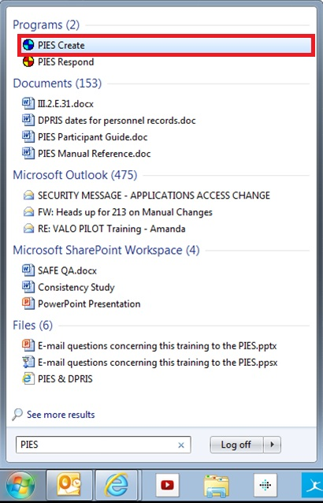
Utilizing the Personnel Information Exchange System (PIES) to Request Reserve and National Guard Records
Submitting the PIES request:
Search for PIES in the Windows Start-up menu. Select PIES Create, not PIES Respond.

Slide 11
Utilizing the Personnel Information Exchange System (PIES) to Request Reserve and National Guard Records
Submitting the PIES request:
Enter your password and verify your station #

Slide 12
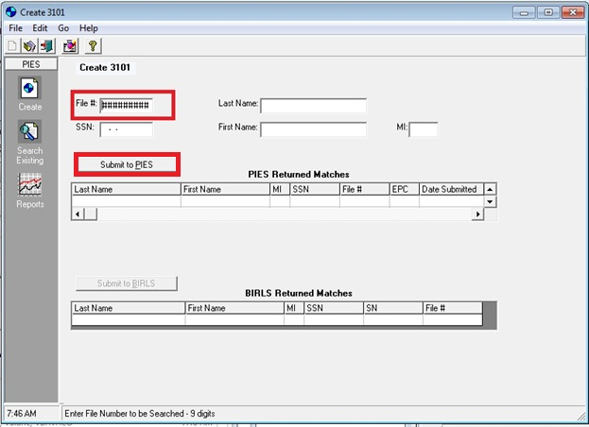
Utilizing the Personnel Information Exchange System (PIES) to Request Reserve and National Guard Records
Submitting the PIES request:
Enter the Veteran’s file # and select “Submit to PIES”.

Slide 13
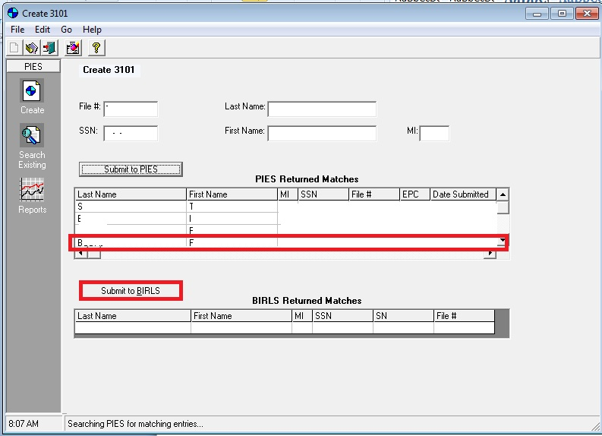
Utilizing the Personnel Information Exchange System (PIES) to Request Reserve and National Guard Records
Submitting the PIES request:
If the Veteran exists, then select the Veteran’s name and hit “Select to BIRLS”

Slide 14
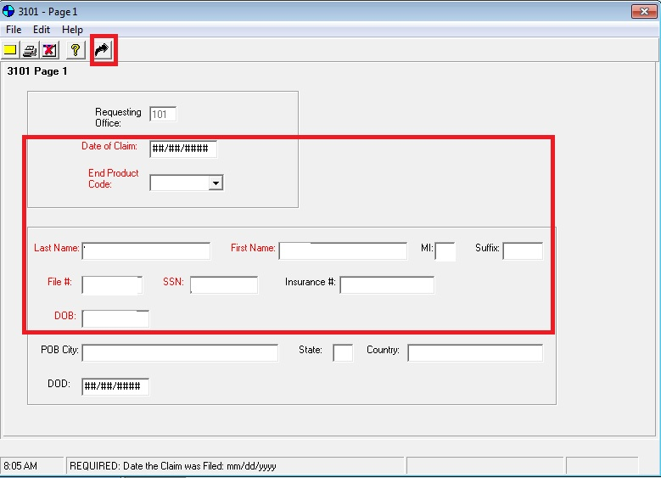
Utilizing the Personnel Information Exchange System (PIES) to Request Reserve and National Guard Records
Submitting the PIES request:
Complete the missing blocks on information on “3101-Page 1” to include the date of claim, end product code and the Veteran’s correct name, file #, and DOB. Once all blanks are completed, select the black arrow.
Notes:
EPC Code problem with multiple requests for veterans in Guard and Reserve for utilizing the same “RV1” Or “NG1” and the same EPC code it causes an error and will not allow submission. Contact Mona.

Slide 15
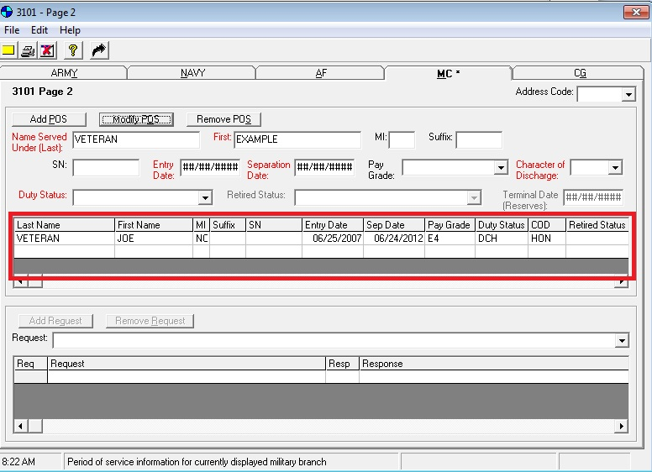
Utilizing the Personnel Information Exchange System (PIES) to Request Reserve and National Guard Records
Submitting the PIES request:
Make sure that all information already on “3101 – Page 2” is correct. If the information is incorrect, select Modify POS and correct the erroneous information.
Enter all of National Guard/Reserve service onto the correct branch of service tab. So if a Veteran has Marine Reserve service, select “Marine Corps”.
IMPORTANT:
There must be a RSV and/or NG period in PIES in order to submit the request for Reserve/National Guard records
Notes:
“Marine Corps” change to “Army”

Slide 16
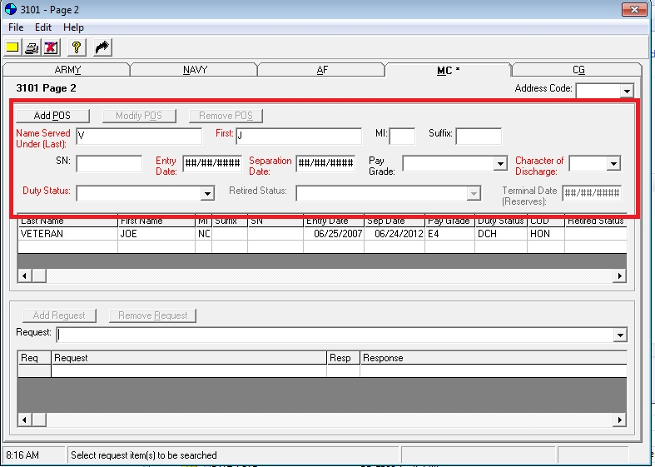
Utilizing the Personnel Information Exchange System (PIES) to Request Reserve and National Guard Records
Submitting the PIES request:
Then completing the required information and select “Add POS”.

Slide 17
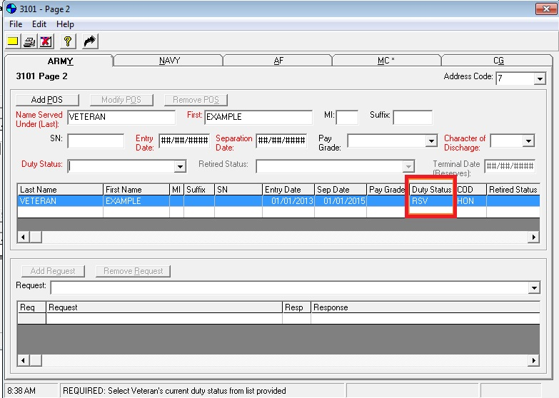
Utilizing the Personnel Information Exchange System (PIES) to Request Reserve and National Guard Records
Submitting the PIES request:
Review the newly added periods of service. Ensure that Reserve shows a duty status of RSV and National Guard shows NG.
IMPORTANT:
There must be a RSV and/or NG period in PIES in order to submit the request for Reserve/National Guard records

Slide 18
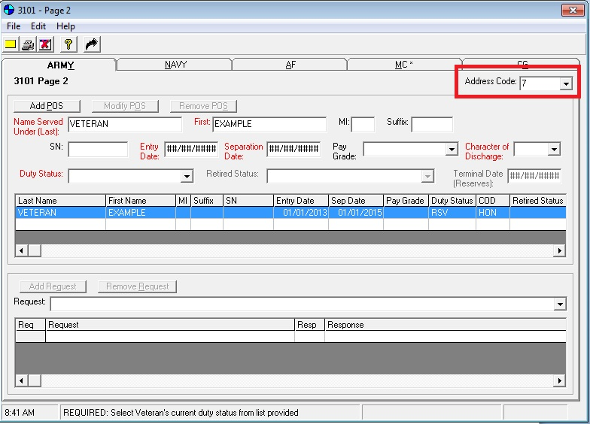
Utilizing the Personnel Information Exchange System (PIES) to Request Reserve and National Guard Records
Submitting the PIES request:
Verify that the Address Code” is 7. If it is not, then manually input the “Address Code” to 7.
IMPORTANT:
Do not submit RV1 or NG1 requests to Address Code 13.
Do not submit any request codes other than RV1 or NG1 to Address Code 7, (i.e. M01, 050…)
Do not submit two different Address Codes under the same PIES ID number. (one to Address Code 13 and one to Address Code 7)
If all STRs for Veteran’s periods of service are uploaded into VBMS do not submit an RV1 or NG1 request for a specific STR. Example: Discharge physical, LOD, MEB, PEB, etc.

Slide 19
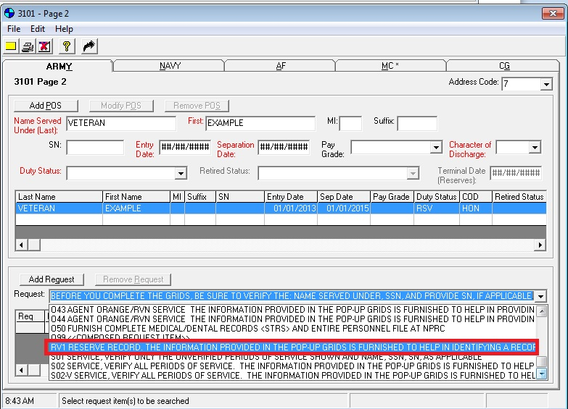
Utilizing the Personnel Information Exchange System (PIES) to Request Reserve and National Guard Records
Submitting the PIES request:
Select “request” as RV1 for Reserve or NG1 for National Guard.

Slide 20
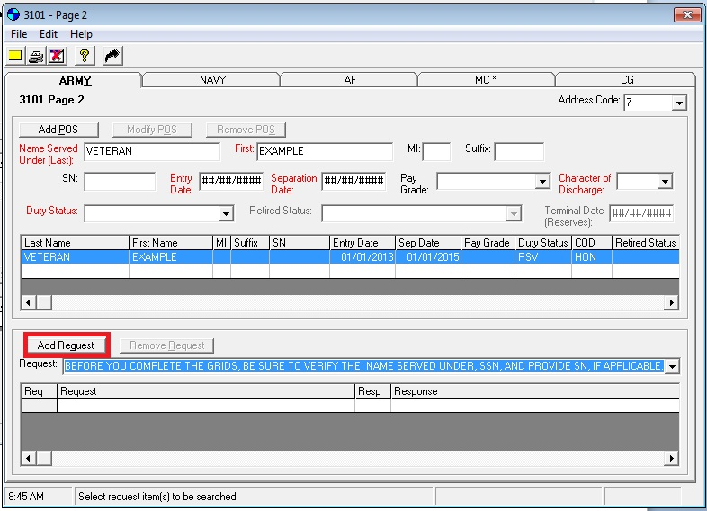
Utilizing the Personnel Information Exchange System (PIES) to Request Reserve and National Guard Records
Submitting the PIES request:
Then select “add request.

Slide 21
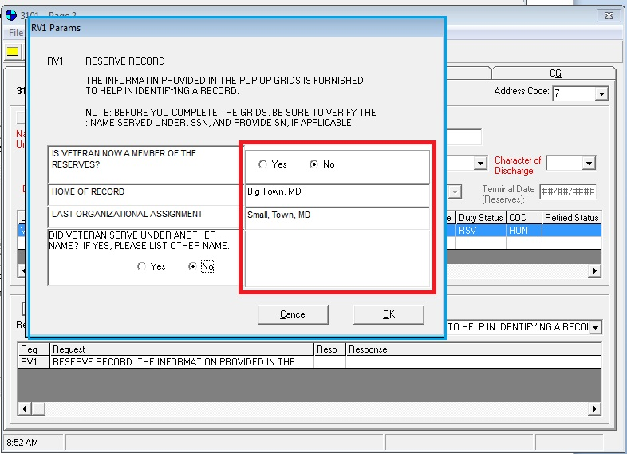
Utilizing the Personnel Information Exchange System (PIES) to Request Reserve and National Guard Records
Submitting the PIES request:
Complete the information requested in the pop-up dialogue box. Then select “OK”.
Note:
“Last Organizational Assignment”
Verify with the Veteran or personnel documents (DPRIS) the last National Guard or Reserve unit serving in or served.
This information enables the SPoE to go to the last unit to obtain the latest information
Especially important for the National Guard and the Marine Corps

Slide 22
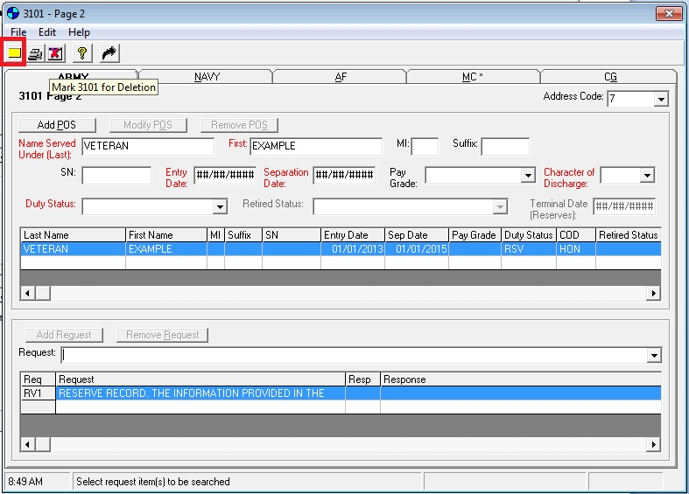
Utilizing the Personnel Information Exchange System (PIES) to Request Reserve and National Guard Records
Submitting the PIES request:
After final review, select the yellow notepad to submit request.

Slide 23
Utilizing the Personnel Information Exchange System (PIES) to Request Reserve and National Guard Records
Responses from GR5 on the PIES request:
82 – ALL AVAILABLE STRS WERE PREVIOUSLY UPLOADED INTO VBMS.
84 – Code 7 HAS CONDUCTED A THOROUGH SEARCH FOR THE REQUESTED RECORDS, AND WE WERE UNABLE TO LOCATE THE RECORDS IDENTIFIED IN YOUR REQUEST.
87 – RECORD LOCATED AT CODE 13. Suggest record BE REQUESTED THROUGH PIES CODE 13.
88 - THIS REQUEST DOES NOT FIT INTO THE PARAMETERS OF CODE 7. SUBMIT YOUR REQUEST TO CODE 13.
89 - PLEASE SUBMIT YOUR REQUEST UNDER PROPER REQUEST CODE (NG1 OR RV1).
90 - PLEASE DO NOT SUBMIT SINGLE PIES FOR MULTIPLE ADDRESS CODES. PLEASE RESUBMIT YOUR REQUEST UNDER CODE 7 AND/OR CODE 13 SEPARATELY.
91 – REQUESTED RECORDS UPLOADED INTO VBMS ON <<DATE>>.
92 - CODE 7 HAS CONDUCTED A THOROUGH SEARCH FOR THE REQUESTED RECORDS, NO STRS WERE LOCATED. RECORDS SHOULD BE LOCATED AT THE RECORD MANAGEMENT CENTER. SUGGEST RECORD BE REQUESTED FROM 376.
93 - CODE 7 HAS CONDUCTED A THOROUGH SEARCH FOR THE REQUESTED RECORDS, NO STRS WERE LOCATED. ACCORDING TO THE <<BRANCH>>, THE MEMBER HAD POSSESSION OF THEIR STRS AT THE TIME OF SEPARATION.
94 - THIS REQUEST DOES NOT FIT INTO THE PARAMETERS OF CODE 7. SUBMIT YOUR REQUEST TO CODE 13.

Slide 24
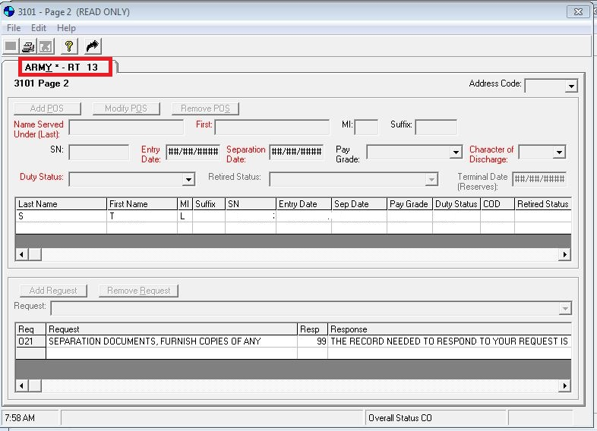
Utilizing the Personnel Information Exchange System (PIES) to Request Reserve and National Guard Records
Responses from GR5 on the PIES request:
In PIES Create to show the Branch Status code on the TAB in the upper left corner

Slide 25
Utilizing the Personnel Information Exchange System (PIES) to Request Reserve and National Guard Records
Responses from GR5 on the PIES request:
List of types of Branch Status code on the TAB in the upper left corner are below:
P1 = FIRST REQUEST SUBMITTED (Initial Request)
P2 = SECOND REQUEST SUBMITTED (30 day follow-up)
P3 = THIRD REQUEST (45 day Follow-up)
ER = RECORD IN ROUTE (SPoE has indicated that the records are being sent to HAIMS)
PC = PARTIAL REQUEST RECEIVED (VALO has received some STRs but the SPoE has indicated that there may be more coming)
PL = SUBMIT DEVELOPMENT LETTER TO VETERAN (It has been 60 days and the SPoE has not given any indication of where the STRs are located. Issue the development letter to the Veteran. GR5 will notify you if any STRs are received in the future. There is no need to follow-up any longer)
SU = Submitted
RT = Response Provided and Returned to RO
IP = In Process

Slide 26
Follow-ups and Additional Information
For follow-ups to requests submitted to Code 7 for NG and Reserve STRs:
If internal message (i.e., Int Msg Technician Date…..) is more than 30 days old, send an email to the VAVBASTL/RMC/NGRV mailbox
If the Branch status code is PL:
Send the development request letter to the Veteran
GR5 will notify the RO when that status changes.
Do not submit a new PIES request for a follow-up request

Slide 27
Questions

