Slide 1
March 11, 2015
Compensation Service Quality Call
1-855-767-1051
Conf. ID # 83817351

Slide 2
Opening Remarks
Diana Williard
Quality Assurance Officer (QAO)
Program Review

Slide 3
Changes to STAR Sampling & Call-Up Procedures
Rachel Harwood
Data Analyst
Quality Assurance

Slide 4
Changes to STAR Sampling
New rating EPs added: 405, 409, 681, and 687
Appeal EPs 070, 172, and 174 were NOT removed
EP 320 was NOT added
Pension 120, 140, and 180 series EPs were NOT added

Slide 5
Changes to STAR Sampling (continued)
STAR samples now generated bi-monthly instead of monthly, to reduce time between PCLR; review of EP; and, reporting
Reduction in rating and authorization sample sizes
  Sample size no longer a standardized 246/year for every station
  Now based on average of FY13 and FY14 accuracy and workload figures, per guidance from GAO and OIG
  Higher accuracy = smaller sample / Lower accuracy = larger sample
  Smaller workload = smaller sample
  Effective with Jan 15 DISPs for rating; with Feb 15 DISPs for authorization

Slide 6
New STAR Sample Sizes by Station - Compensation
 |  | Compensation - Rating |  |  | Compensation - Authorization |  |  |  |  |  | Compensation - Rating |  |  | Compensation - Authorization
RO Name | RO Number | Monthly Sample | Bi-monthly Sample #1 | Bi-monthly Sample #2 | Monthly Sample | Bi-monthly Sample #1 | Bi-monthly Sample #2 |  | RO Name | RO Number | Monthly Sample | Bi-monthly Sample #1 | Bi-monthly Sample #2 | Monthly Sample | Bi-monthly Sample #1 | Bi-monthly Sample #2
Boston | 301 | 14 | 7 | 7 | 11 | 5 | 6 |  | Denver | 339 | 14 | 7 | 7 | 13 | 6 | 7
Providence | 304 | 10 | 5 | 5 | 13 | 6 | 7 |  | Albuquerque | 340 | 11 | 5 | 6 | 11 | 5 | 6
New York | 306 | 13 | 6 | 7 | 12 | 6 | 6 |  | Salt Lake City | 341 | 14 | 7 | 7 | 11 | 5 | 6
Buffalo | 307 | 13 | 6 | 7 | 13 | 6 | 7 |  | Oakland | 343 | 14 | 7 | 7 | 12 | 6 | 6
Hartford | 308 | 12 | 6 | 6 | 10 | 5 | 5 |  | Los Angeles | 344 | 16 | 8 | 8 | 13 | 6 | 7
Newark | 309 | 18 | 9 | 9 | 17 | 8 | 9 |  | Phoenix | 345 | 12 | 6 | 6 | 11 | 5 | 6
Philadelphia | 310 | 15 | 7 | 8 | 11 | 5 | 6 |  | Seattle | 346 | 15 | 7 | 8 | 11 | 5 | 6
Pittsburgh | 311 | 14 | 7 | 7 | 10 | 5 | 5 |  | Boise | 347 | 9 | 4 | 5 | 11 | 5 | 6
Baltimore | 313 | 22 | 11 | 11 | 17 | 8 | 9 |  | Portland | 348 | 11 | 5 | 6 | 12 | 6 | 6
Roanoke | 314 | 12 | 6 | 6 | 10 | 5 | 5 |  | Waco | 349 | 14 | 7 | 7 | 12 | 6 | 6
Huntington | 315 | 15 | 7 | 8 | 12 | 6 | 6 |  | Little Rock | 350 | 12 | 6 | 6 | 11 | 5 | 6
Atlanta | 316 | 14 | 7 | 7 | 14 | 7 | 7 |  | Muskogee | 351 | 12 | 6 | 6 | 11 | 5 | 6
St. Petersburg | 317 | 12 | 6 | 6 | 12 | 6 | 6 |  | Reno | 354 | 12 | 6 | 6 | 12 | 6 | 6
Winston-Salem | 318 | 16 | 8 | 8 | 12 | 6 | 6 |  | San Juan | 355 | 16 | 8 | 8 | 12 | 6 | 6
Columbia | 319 | 9 | 4 | 5 | 9 | 4 | 5 |  | Manila | 358 | 11 | 5 | 6 | 10 | 5 | 5
Nashville | 320 | 11 | 5 | 6 | 12 | 6 | 6 |  | Houston | 362 | 17 | 8 | 9 | 12 | 6 | 6
New Orleans | 321 | 13 | 6 | 7 | 12 | 6 | 6 |  | Washington | 372 | 12 | 6 | 6 | 9 | 4 | 5
Montgomery | 322 | 15 | 7 | 8 | 10 | 5 | 5 |  | Manchester | 373 | 15 | 7 | 8 | 10 | 5 | 5
Jackson | 323 | 16 | 8 | 8 | 14 | 7 | 7 |  | San Diego | 377 | 17 | 8 | 9 | 13 | 6 | 7
Cleveland | 325 | 13 | 6 | 7 | 11 | 5 | 6 |  | Togus | 402 | 11 | 5 | 6 | 9 | 4 | 5
Indianapolis | 326 | 12 | 6 | 6 | 14 | 7 | 7 |  | White River Jct | 405 | 15 | 7 | 8 | 13 | 6 | 7
Louisville | 327 | 13 | 6 | 7 | 14 | 7 | 7 |  | Fort Harrison | 436 | 10 | 5 | 5 | 10 | 5 | 5
Chicago | 328 | 13 | 6 | 7 | 14 | 7 | 7 |  | Fargo | 437 | 12 | 6 | 6 | 10 | 5 | 5
Detroit | 329 | 15 | 7 | 8 | 11 | 5 | 6 |  | Sioux Falls | 438 | 10 | 5 | 5 | 10 | 5 | 5
Milwaukee | 330 | 10 | 5 | 5 | 11 | 5 | 6 |  | Cheyenne | 442 | 11 | 5 | 6 | 12 | 6 | 6
St. Louis | 331 | 15 | 7 | 8 | 11 | 5 | 6 |  | Wichita | 452 | 12 | 6 | 6 | 10 | 5 | 5
Des Moines | 333 | 10 | 5 | 5 | 11 | 5 | 6 |  | Honolulu | 459 | 14 | 7 | 7 | 10 | 5 | 5
Lincoln | 334 | 9 | 4 | 5 | 12 | 6 | 6 |  | Wilmington | 460 | 15 | 7 | 8 | 12 | 6 | 6
St. Paul | 335 | 11 | 5 | 6 | 12 | 6 | 6 |  | Anchorage | 463 | 14 | 7 | 7 | 11 | 5 | 6

Slide 7
Changes to STAR Procedures (Call-Up List)
Quality Assurance (QA) will no longer publish call-up lists to our SharePoint site for station review and status responses
QA Consultants will assume all folders are available electronically and will attempt to review in VBMS/VVA every EP selected for STAR assessment
  QA will only request the paper folder from your station after trying to review the EP electronically and finding that the paper folder really is needed
  EPs for which QA needs the paper folder will be added to a SharePoint list (much like previous call-up lists) specifically for paper folders
  Stations will be responsible for monitoring this list and sending folders timely

Slide 8
Changes to STAR Procedures (Review)
EPs cleared at DRAS will be reviewed and counted toward station accuracy
at ROs 304 and 346
EPs cleared by Fid Hubs will be reviewed and counted toward station accuracy
at ROs 319, 326, 327, 330, 334, and 341
EP 299 for automated MOD payments will be deselected
Review of EP 298 for batch CRDP/CRSC payments is on hold
EPs cleared by RBPS will be deselected…
  …but re-input into STAR Database under jurisdiction of RO 372; reviewed; and, counted toward national accuracy, not individual station accuracy (unless case was entered into RBPS manually and there is no error)
  Station for which the EP was called will still be responsible for any necessary corrective action

Slide 9
Issue-based Review (IBR) / Claim-based Review (CBR)
David Hannigan
QRT Chief
Program Review

Slide 10
Issue-based vs Claim-based Quality
The purpose of issue-based quality reviews is to determine the accuracy of the individual decisions associated with the end product (EP) selected for review
For issue-based reviews, each decision is essentially a claim on its own and must be reviewed for accuracy
Every issue claimed by the claimant or inferred would constitute a separate issue for review, as would the required award action

Slide 11
Issue-based vs Claim-based Quality (continued)
Traditional Systemic Technical Accuracy Reviews (STAR) focus on the end result of the claim as a whole, without regard for the multiple actions and decisions associated with the claim; referred to as claim-based quality
The EP selected for STAR review is the same for claim-based and issue-based reviews. There is no separate STAR call-up list for issue-based reviews

Slide 12
Issue-based vs Claim-based Quality (continued)
It is possible that the traditional claim-based checklist will not show any BE errors, even though the issue-based checklist does show a BE error
In most instances, even if the claim-based checklist does not reflect a BE error, the error narrative will still be recorded in another category, such as J2

Slide 13
Interactive Poll Question
Poll question will be displayed in a moment
Using your mouse , select the correct answer
  Note: If you are in a group setting using only one computer,
  poll the group and have somebody use the mouse at the computer to select the correct answer
Poll results will be revealed after everybody has selected an answer

Slide 14
Question – Input Into Lync
There are 3 issues, and 2 of them are correct; however, the 3rd issue should have a 10% evaluation instead of a 0% evaluation. This error does not change the overall combined evaluation. Question: Should errors be cited? If so, what errors should be cited?
A – J2 claim-based with no issue-based errors
B – C2 claim-based with C2 issue-based
C – J2 claim-based with C2 issue-based
D – No errors should be cited

Slide 15
Answer - Poll Question
There are 3 issues, and 2 of them are correct; however, the 3rd issue should have a 10% evaluation instead of a 0% evaluation. This error does not change the overall combined evaluation.
Question: Should errors be cited? If so, what errors should be cited?
  J2 claim-based corrective action error
  C2 issue-based error for the incorrect evaluation
Remember, issue-based reviews focus on the accuracy of specific diagnostic codes (DCs)

Slide 16
Due Process Letters
Cindy Windham
Senior Authorization Quality Review Specialist
Quality Review Team
Program Review

Slide 17
Necessary Elements in Due Process Letters
Statement of proposed decision, including new rates
Proposed effective date
Overpayment information
Detailed reasons for the proposed decision
The right to —
  Present evidence
  Personal hearing
  Representation
  Manual I.2.B.5.a&b (WARMS) & 38 CFR 3.103

Slide 18
Necessary Elements in Due Process Letters
  Incomplete: “We propose to withhold $1,602.00 from your monthly benefit for a period of 46 days.”
  Complete:

Slide 19
Veterans Benefits Management System (VBMS)
Christopher Whynock
Program Analyst
VBMS Program Management Office (PMO)

Slide 20
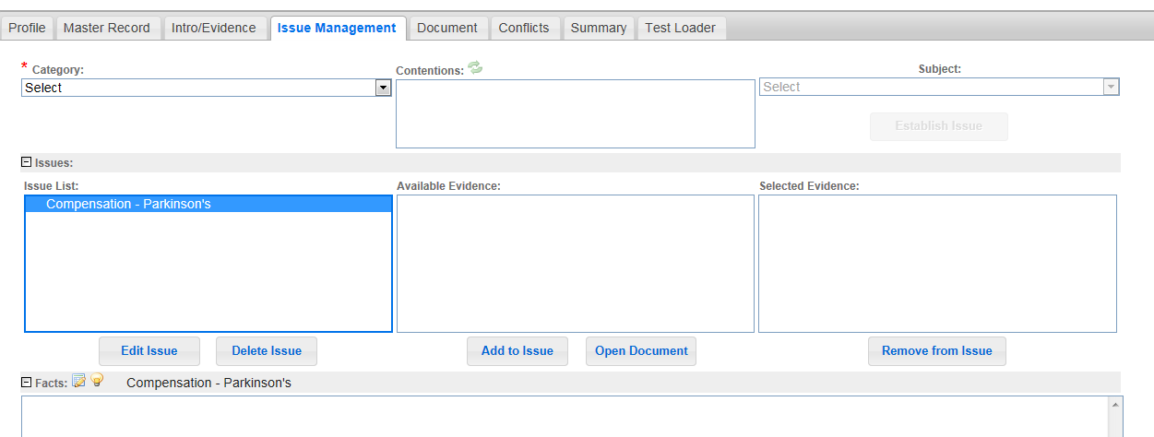
Evaluating Parkinson’s in VBMS-R Without Overriding

Slide 21
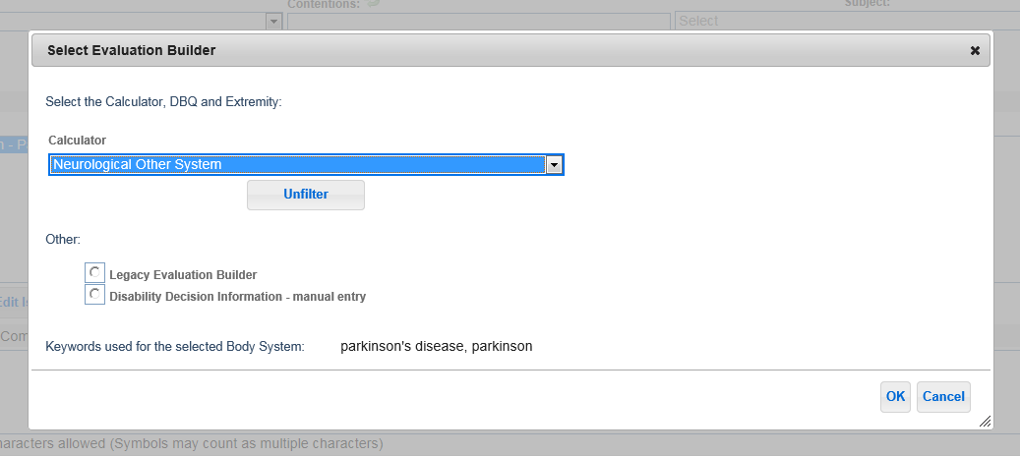
Evaluating Parkinson’s in VBMS-R (continued)

Slide 22
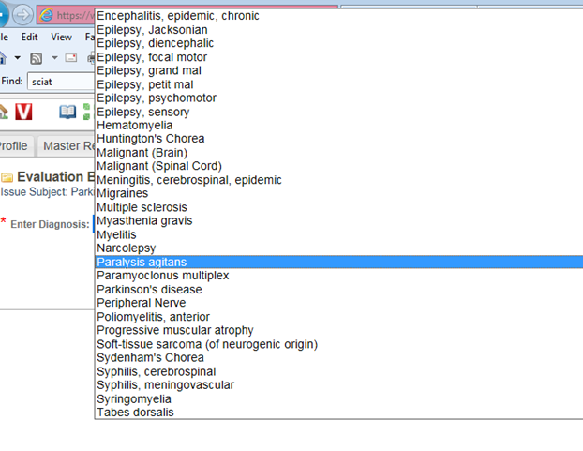
Evaluating Parkinson’s in VBMS-R (continued)

Slide 23
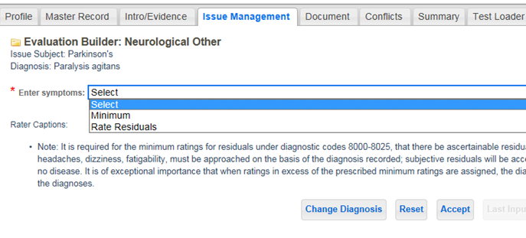
Evaluating Parkinson’s in VBMS-R (continued)

Slide 24
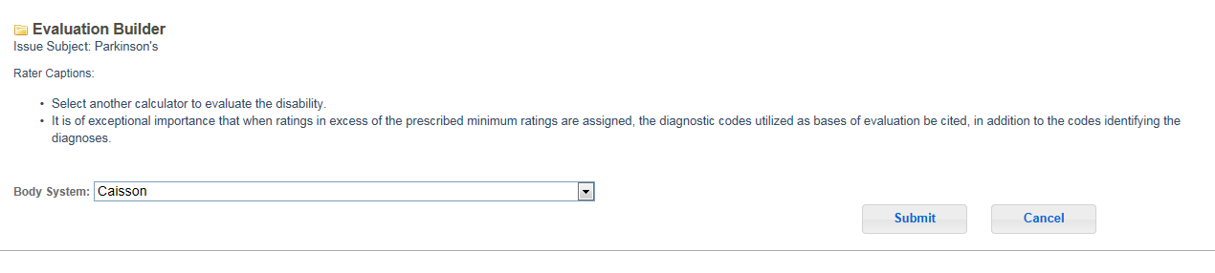
Evaluating Parkinson’s in VBMS-R (continued)

Slide 25
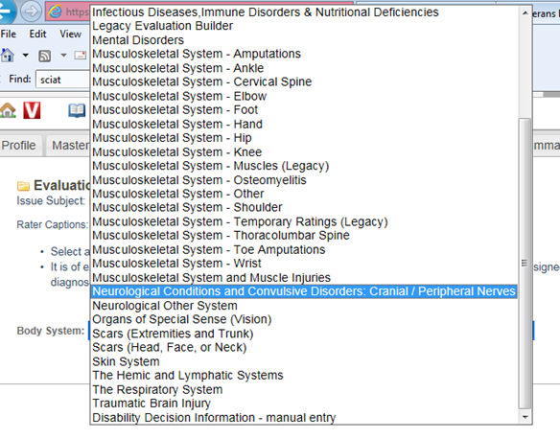
Evaluating Parkinson’s in VBMS-R (continued)

Slide 26
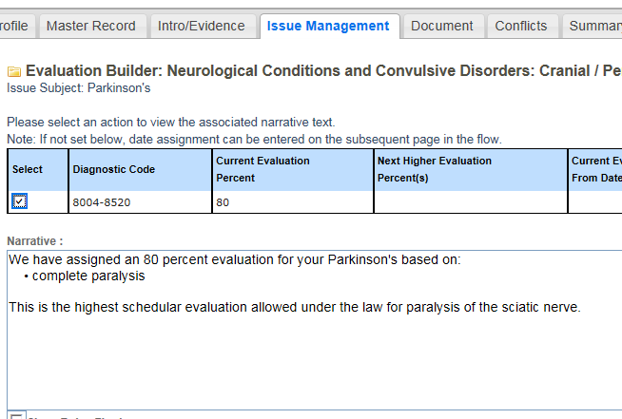
Evaluating Parkinson’s in VBMS-R (continued)

Slide 27
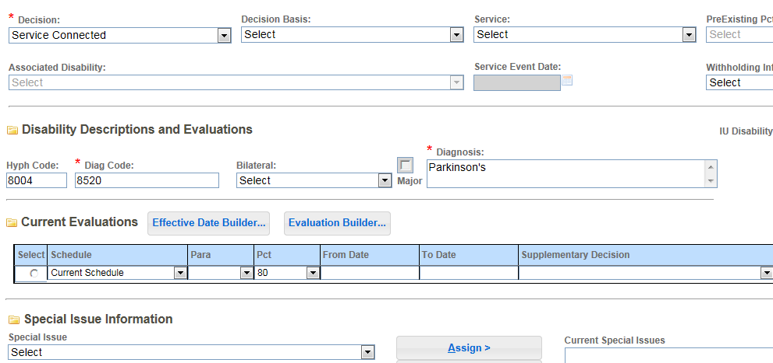
Evaluating Parkinson’s in VBMS-R (continued)

Slide 28
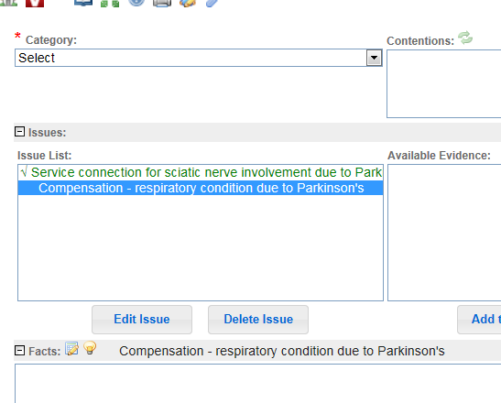
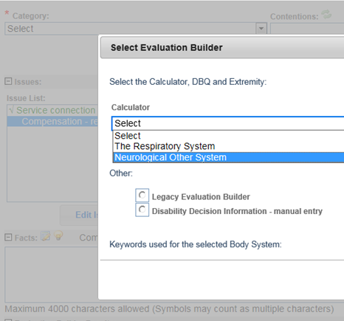
Evaluating Parkinson’s in VBMS-R (continued)

Slide 29
Rating Tips
VBMS-R is not completely built
If a disability being evaluated has an embedded calculator in VBMS-R, that embedded calculator must be used
If a disability being evaluated does not have an embedded calculator in VBMS-R, user must use the Legacy Evaluation Builder
  Example: Shin Splints
Exception: Tips & Tricks
Why?
  Assists in preparing users’ transition for retirement of Legacy tools

Slide 30
Quality Review Team (QRT) Updates
Jeff Henderson
Chief
Quality Review & Consistency

Slide 31
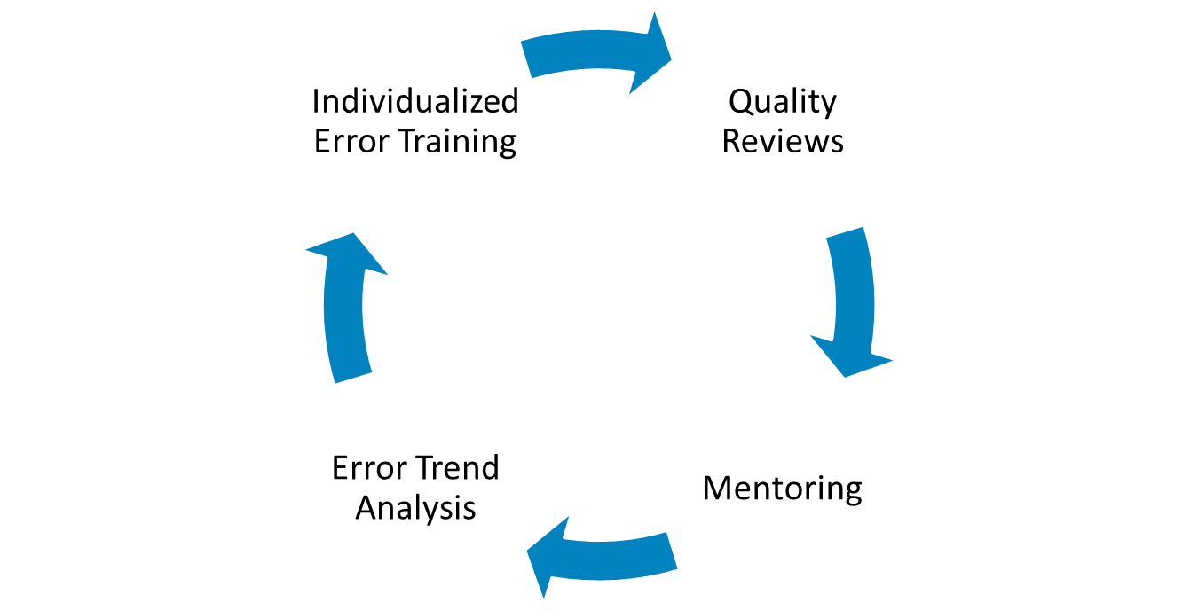
Quality Improvement

Slide 32
FY 2015 QRT Challenge
May 2015: RQRS Challenge
June 2015: AQRS Challenge
Planning for July and August 2015 Challenge sessions

Slide 33
FY 2015 Consistency Studies
Consistency studies will resume in April 2015
Training is now provided immediately after completing the study
Study takes 30 minutes
Training takes 30-45 minutes

Slide 34
FY 2015 1st Quarter IB Trends

Slide 35
Preventing Errors
Review your code sheets and proofread
Quick explanation for out-of-the-box or complex decisions
Remember 38 CFR 3.102 and 38 CFR 4.6
DBQ / Rating Schedule / Evaluation Builder
Review all records in VBMS
Network and Collaboration
“Get the examination” is rarely the wrong answer

Slide 36
Quality Assurance Internal Quality Review Team
David Hannigan
Chief, Quality Review Team
Program Review

Slide 37


Exciting way to share ideas in a simple tip format
Your Q-Tips are welcome and requested
We will provide service of the highest quality to our Veterans by sharing knowledge with each other
Send your ideas to David Hannigan and Get your name on the big screen!
  david.hannigan@va.gov

Slide 38
Sources of This Month’s Q-Tips
Todd Benson, Coach, Lincoln
Michael E. Fraser, AQRS, Columbia
Procedures (212) and Jeff Henderson, Chief, 214C
  My thanks to Todd, Michael, Procedures Staff, and Jeff for sharing these
  important reminders!
  Thanks for the submissions – please keep submitting them!

Slide 39

Q-Tip # 1
Please remember that effective February 25, 2015, VA grants the automobile allowance under 38 CFR 3.808 for any Veteran with amyotrophic lateral sclerosis (ALS) (Lou Gehrig’s Disease)
  Manual IX.i.2.1.a (WARMS)

Slide 40

Q-Tip #2
Communicate, don’t speculate!
  Manual I.1.C.6.e & III.iii.1.B.2.c (WARMS)

Slide 41
Q-Tip # 3
Clarified Guidance – Exclusion from the FDC Program
Manual will be updated in the near future to reflect:
Manual III.i.3.B.5.b (WARMS) – VA should later exclude the claim from the program if the claimant submits additional evidence that would require further development after submitting the FDC

Slide 42
Reconsideration Request
Robert Johnson
Senior Rating Quality Review Specialist
Quality Review Team
Program Review

Slide 43
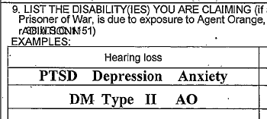
A1 Error – Were All Claimed Issues Addressed?
PTSD previously denied years ago
2014: Claim on VA Form 21-526EZ
VAE – no mental disorder exists
Rating Decision & Award Letter:
Depression and anxiety not addressed

Slide 44
A1 Error – Basis for Reconsideration
RO states depression and anxiety are considered only symptoms
Boggs v Peake: “Factual basis” of a claim for SC is the underlying disease or injury, rather than the symptoms of that disease or injury
RO states decision correctly denied SC for PTSD
No need to distinguish the claim based on subjective symptomatology
Failing to address depression and anxiety does not rise to CUE

Slide 45
A1 – Quality Assurance’s Response
Veteran’s form lists the disabilities being claimed
Depression and anxiety could be symptoms, but are also diagnosed disabilities under DCs 9400, 9413, and 9434
No indication on form that depression and anxiety were symptoms
Ingram v Nicholson: Pro se claimant must be able to realize that their claims were adjudicated
Andrews v Nicholson: Missed issue corrected through CUE motion
Manual III.iv.6.C.7.b (WARMS): Must address all contentions

Slide 46


Questions?
The phone lines have been unmuted 
  Remember to personally unmute your phone line
  or USB headset microphone if you have a question
    To unmute your phone line, press , then press 6

Slide 47
Closing Remarks
Karen Townsend
Assistant Director (AD)
Quality Assurance

Slide 48


VA Talent Management System (TMS)
The TMS number for the February 2015 Quality Call is 3901551.
If you listened to the call live, click the video link, then immediately return to Content Structure to complete the survey to receive credit for the call in TMS.
The TMS number for this call (March 2015 Quality Call)
is 3903688. In the near future, a Calendar Blast will be issued showing when the TMS number has been activated.

Slide 49

Next Quality Call
Quality Assurance (QA) Staff conducts a Quality Call each month
Next Quality Call will be held on Wednesday, April 8th at 1:30 PM

Slide 50
Suggestions?
Please feel free to forward suggested topics to VAVBAWAS/CO/214B
Quality Call Notes can be found on the Compensation Service Intranet site at http://vbaw.vba.va.gov/bl/21/star/star_call.htm
It may take a little time to get where you want to be,
but if you pause and think for a moment,
you will notice that you are no longer where you were.
Do not stop – keep going!
~ Rodolfo Costa

