Slide 1
Compensation Service Training Staff
October 2014
Dependency Award Actions

Slide 2
Objectives
Know how to add dependents into the Veterans Corporate Record
Know how to add dependents and to process an award by using VBMS-A
Notes:
2

Slide 3
Types of Dependents
Spouse –38 CFR 3.1(j) & 3.50(a)
Children –38 CFR 3.57 & 3.210
Parents – 38 CFR 3.59
Notes:
3

Slide 4
Dependency Reference List
38 CFR 3.1(j) – Definition of Marriage
38 CFR 3.4(b)(2) – Additional Compensation
38 CFR 3.50 – Spouse & Surviving Spouse
38 CFR 3.57 – Child
38 CFR 3.204 – Evidence Dep./Age
38 CFR 3.210 – Child Relationship
M21-1MR.III.iii – Dependency
Notes:
4

Slide 5
Adding Dependents: Reference List
38 CFR 3.31– Effective Dates
38 CFR 3.401(b) – Add Dates
38 CFR 3.403(a)(5) – School Attendance
M21-1MR III.iii.5.F.35– Retroactive Adjustment
M21-1MR III.v.2 – Award/Denial Auth.
Notes:
5

Slide 6
When to Add Dependents
38 CFR 3.401(b)
Latest of the following dates:
Date of claim
Date dependency arises
Effective date of qualifying disability
Date of commencement of veteran’s award
Notes:
6
DOC: Date of event

Slide 7
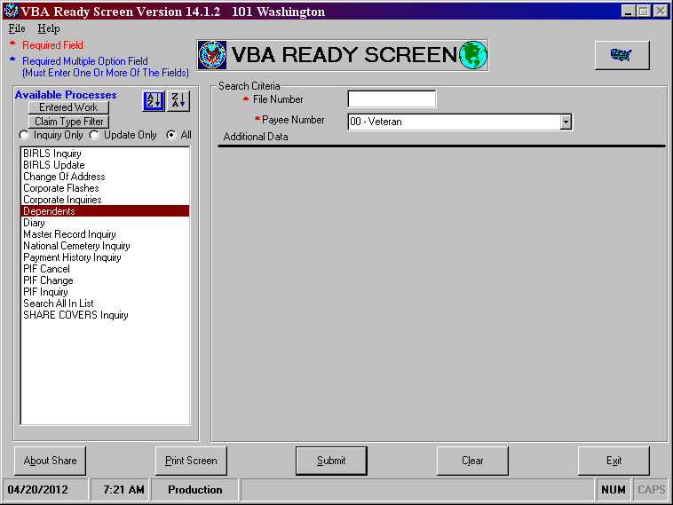
Using the “Dependents” Option on Share VBA Ready Screen
Dependent must be recorded in Corporate Record
Select “Dependents” from Available Processes menu then enter File/Claim Number and select “Submit
Notes:
7
7

Slide 8
Select “Add” to Continue
This is the screen you start from when you select “Dependents” option on the VBA READY SCREEN
Notes:
8
8

Slide 9
Input Dependent Details
Input the required information
When finished select “Update”
Notes:
9
9

Slide 10
Dependent Updated Successfully
Select “Ok” and then “Close”
You now have the dependent spouse added to the Corporate Record using Share
Notes:
10
10

Slide 11
All Dependents are Recorded
We can see that all dependents are now showing in Corporate Record
We are ready to access VBMS-A
Notes:
11
11

Slide 12
Adding the Dependents in VBMS-A
To access the VBMS-A select: Start > VBAPPS > VBMS > VBMS-A
Notes:
12
12

Slide 13
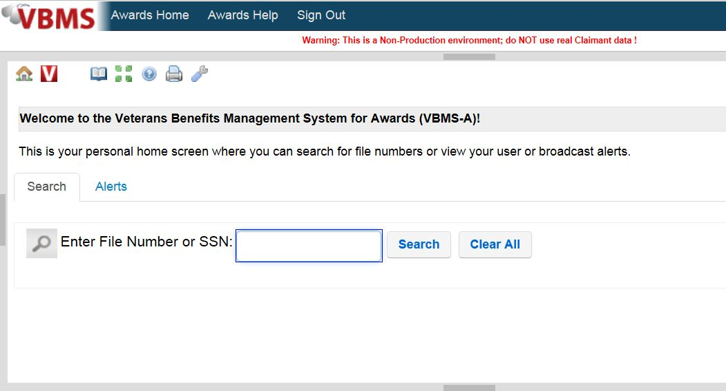
Enter Claim Number and Select Search
Notes:
13

Slide 14
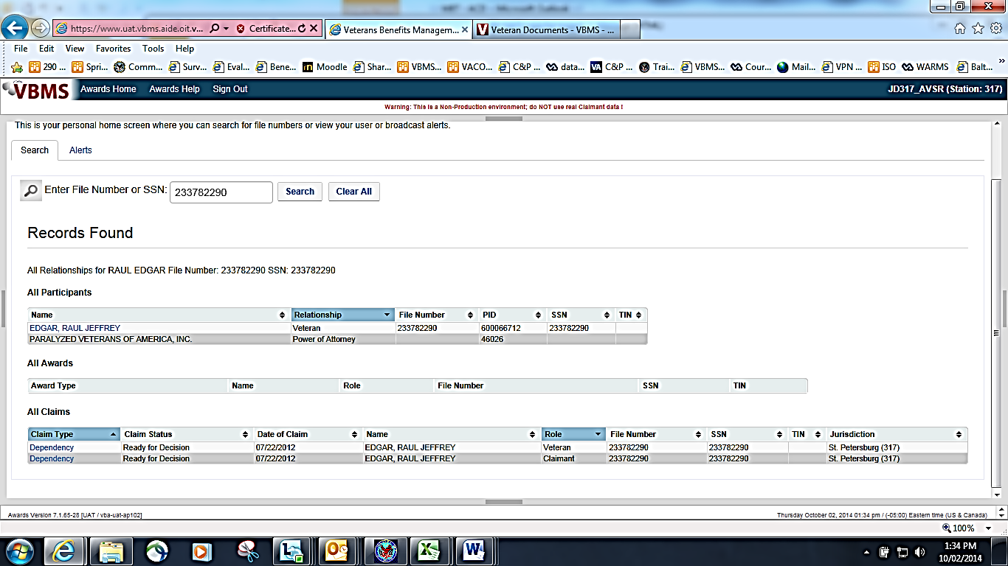
Double Click the Claim under “All Claims”
Notes:
14
14

Slide 15
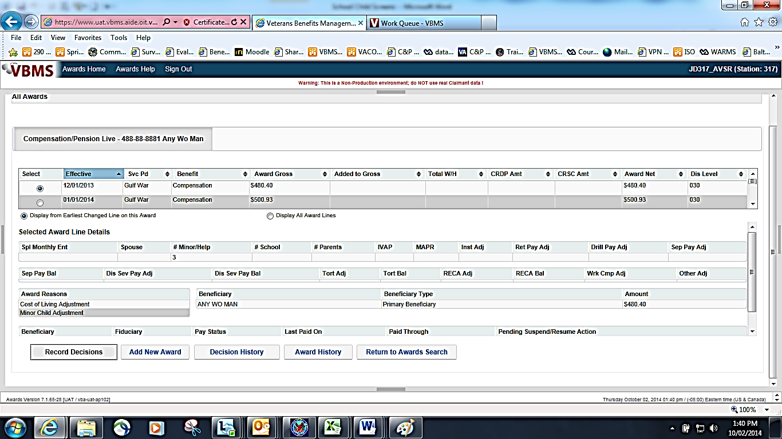
Select “Record Decisions”
Notes:
15
15

Slide 16
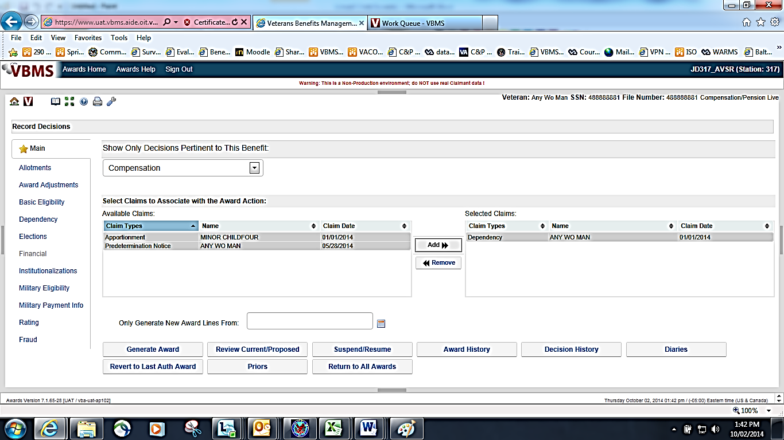
Select “Dependency”
Notes:
16
16

Slide 17
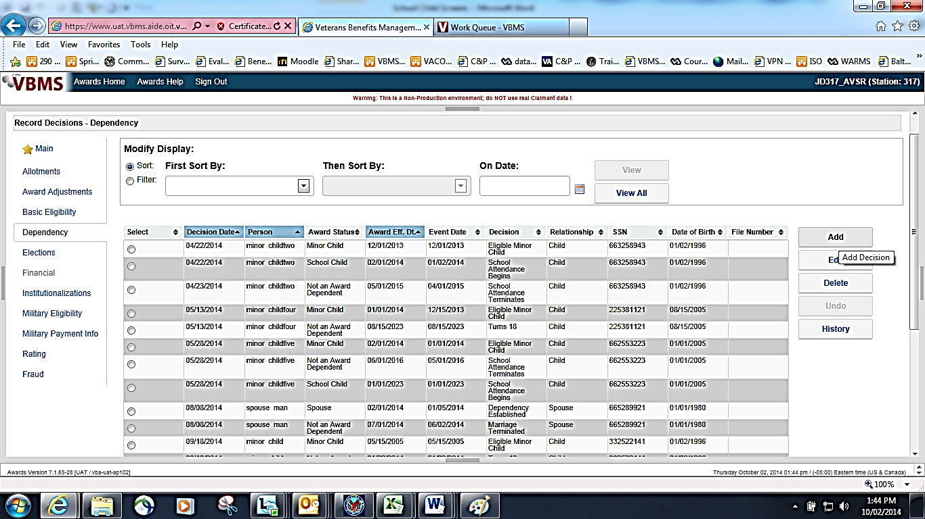
Select “Add” to Record Dependency Decisions
Notes:
17
If no dependents have been added, the screen will display as shown.

Slide 18
Identify the Dependent and Dates
-Select the persons name you wish to add to the award
-Insert the Event Date
-Select the appropriate Award Status for the dependent
-Select the Decision
-Award Effective Date will automatically populate

Slide 19
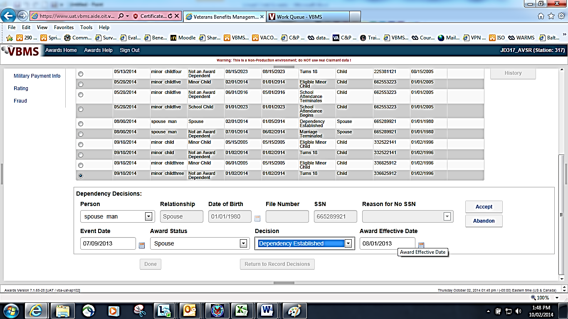
Verify Award Effective Date then select “Accept” then “Done”
After all information has been populated, select “Accept”.
You have to select “Done” for the dependent to be reflected on the Veteran’s award.
Notes:
19

Slide 20
Dependent is added to the award
If you have more dependents then select “Add”
Complete the “Dependency Decisions” section the same as the previous steps
Notes:
20

Slide 21
Adding a minor child will populate end date at 18
A minor child will always have an end date – This can be changed for school attendance after turning 18, or if they are found to be incompetent by Rating Decision
Notes:
21

Slide 22
Review Dependency Data for Accuracy
If all information is complete and correct then you select “Done”
Notes:
22
22

Slide 23
Dependents are added in VBMS-A
Select the “Generate Award” button to complete the award process
Notes:
23
23

Slide 24
What Have We Covered?
How to use Share to add dependents to the Corporate Record
How to add dependents in VBMS-A to process the award

Slide 25
Removing Dependents - References
38 CFR 3.660
M21-1MR III.iii.5.F.36
M21-1MR III.v.2.A
Notes:
25

Slide 26
Removing Dependents
38 CFR 3.660
Effective dates for removing dependents:
End of month rule.
Marriage
Annulment
Divorce, or death
Notes:
26

Slide 27
Removing Dependents
First party vs. Third party notification
Notice of proposed adverse action (due process) is not required if the information is provided by the beneficiary or his/her custodian. Otherwise, due process is required.
Notes:
27

Slide 28
Removing Depends from VBMS-A
Two ways to remove a dependent from an award
-From the initial eligibility date, delete the line
adding the dependent to the award
-After the initial eligibility date, add a new line,
select the dependent, input the “Event Date”,
change the status to “Not an Award Dependent”,
select the “Decision”

Slide 29
Questions

