Slide 1
January 21, 2015
Rating Quality Call (RQC) 1-855-767-1051 Conf. ID # 77896139

Slide 2
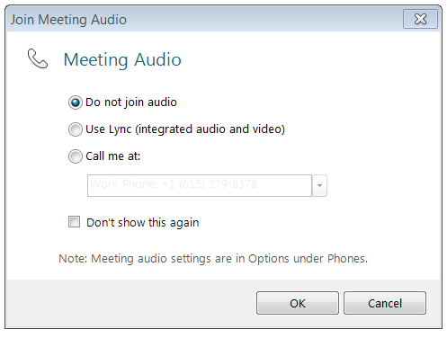
Rating Quality Call (RQC) Reminder
If you are using a USB headset connected to your computer to listen to this meeting:
Select “Use Lync (integrated audio and video)” when joining the meeting
If you are using a telephone line to listen to this meeting:
Dial 1-855-767-1051, enter the Conference ID code 77896139, press #, then select “Do not join audio” when joining the Lync meeting

Slide 3
RQC Agenda
Opening Remarks
Fully Developed Claim (FDC) Guidance Update
Automated Decision Letter (ADL) Rating Decision Notices
VBMS Updates
Date of Claim (DOC) for End Product (EP) 600
Tools Used to Request Examinations
Quality Review Team (QRT) Q-Tips
Reconsideration Request
Questions & Answers
Closing Remarks
TMS and Next Quality Call Information
Reminder – All Phone Lines Are Muted Until The End Of The Call

Slide 4
Opening Remarks
Diana Williard
Quality Assurance Officer (QAO)
Program Review

Slide 5
RQC Roll Call Procedures
RO’s VSCM or AVSCM or QRT Coach should type their attendance in the IM “Chat Box”
Only one person from each RO should type their RO’s attendance

Slide 6
General Quality Call Information
Quality Call consists of a visual PowerPoint presentation along with presenters talking
Thank you for completing the TMS surveys and providing your comments
Recording of today’s call, Call Notes (transcript), and a copy of this PowerPoint will be posted into TMS
Call Notes will also be posted to Intranet STAR homepage

Slide 7
Fully Developed Claim (FDC) Guidance Update
Dan Markey
Legal Consultant
Policy Staff

Slide 8
Response to Questions on FDC Guidance
Question: If an informal claim pertaining to a FDC is received within the liberalizing period, and the FDC application is received beyond the one year period, it would be to the Veteran's benefit to exclude the claim from FDC and consider the informal claim receipt date. Is it permissible to exclude the claim from FDC if it would be to the Veteran's benefit?
Answer: You may assign an effective date based on the liberalizing law change even though the formal FDC claim was received more than one year following the liberalizing law change.
It is not permissible to exclude the claim from the FDC program. Instead, the proper course of action is to assign the most advantageous effective date rule allowable by law.

Slide 9
Response to Questions on FDC Guidance (continued)
Question: Traditionally, the only evidence we have is a claim and VA examination several months later. I think the crux of the reason this issue was addressed in the VSCM call is to address how liberal we should be viewing these types of situations where the evidence seems to indicate the Veteran had the same severity level for the last year but not concrete medical evidence from over a year back confirming this. Is it acceptable in these cases to grant a one-year retroactive effective date since the evidence seems consistent or is this too liberal of an interpretation?

Slide 10
Response to Questions on FDC Guidance (continued)
Answer: The essential inquiry is “What is the earliest date for which it is ascertainable that the disability existed?” As discussed in the Addendum to the May 2014 Compensation Service Bulletin, unless there is affirmative evidence showing that the disability did not exist during the entire retroactive one-year period, reasonable doubt should be resolved in favor of the Veteran and the full one-year retroactive effective date should be assigned. Once the effective date has been assigned, the decision-maker must then determine what disability rating(s) the evidence supports throughout the applicable rating period, again affording any reasonable doubt in favor of the Veteran.

Slide 11
Automated Decision Letter (ADL) for Rating Decisions
Paul Shute
Program Analyst
Procedures Staff

Slide 12
Automated Decision Letter (ADL)
Rating Decision Data Drives ADL Language
“Are You Entitled To Additional Benefits” Section Logic
Free Text Usage
Rating Decision and ADL System Generated Language
Super User Review
National Service Desk (NSD) Trouble Ticket
Language Change Control Board (LCCB) - LCCB.VBAVACO@va.gov
Data Accuracy and Automation

Slide 13
Veterans Benefits Management System (VBMS)
Christopher Whynock
Program Analyst
VBMS Program Management Office (PMO)

Slide 14
Separate Evaluations for DCs 5206/5207 and 5213
Scenario: Veteran demonstrates painful flexion and supination of his arm/elbow on examination.
Question: What evaluation(s) should be granted?

Slide 15
Interactive Poll Question
Poll question will be displayed in a moment
Using your mouse , select the correct answer
Note: If you are in a group setting using only one computer, poll the group and have somebody use the mouse at the computer to select the correct answer
Poll results will be revealed after everybody has selected an answer

Slide 16
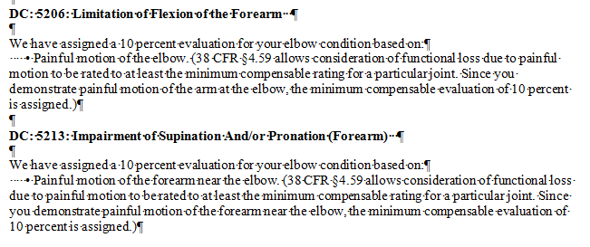
Separate Evaluations for DCs 5206/5207 and 5213 (continued)
Two 10% evaluations should be granted
One under DC 5206 and
a second under DC 5213
Pyramiding?
July 2013 Compensation Service Bulletin

Slide 17
Separate Evaluations for 5206/5207 and 5213 (continued)
July 2013 Compensation Service Bulletin
DC 5213 – forearm
DC 5206/5207 – elbow
Humero-radial joint
Different anatomical entities
Notes:
The pronation/supination excursions under DC 5213 more closely approximate motion of the forearm, rather than the elbow motion rated under DC 5206 or 5207.
While the humero-radial joint is involved slightly in supination/pronation, most of the rotary movement is between the radius and ulna at their upper and lower ends.
As the motions under DC 5206/5207 and DC 5213 are clinically viewed as separate and distinct, separate evaluations for elbow flexion/extension under DC 5206/5207 and supination/pronation under DC 5213 may be granted.
Also, 38 C.F.R. § 4.59 may be applied to grant separate compensable evaluations for painful motion for flexion/extension of the elbow apart from painful supination/pronation of the forearm, as it has been determined that the motions represented under DC 5206/5207 and DC 5213 represent different anatomical entities.
Although a forearm is not identified as a joint under 38 C.F.R. § 4.45, the general principle of assigning a compensable evaluation for painful motion under § 4.59 may be applied in such a scenario to grant a compensable evaluation for painful supination/pronation of the forearm.

Slide 18
Date of Claim (DOC) for End Product (EP) 600
Cindy Windham
Senior Authorization Quality Review Specialist
Quality Review Team
Program Review

Slide 19
DOC Errors for EP 600
VBMS Release 8.0
Change on how letters are dated
Standardized to be the next business day
DOC errors not cited when DOC does not match date of due process letter
Effective December 15, 2014
M21-4 will be updated later to reflect this change

Slide 20
Tools Used to Request Examinations
Maruta Grean
Performance Specialist
Disability Examination Management Office (DEMO)

Slide 21
Tools Used to Request Examinations (continued)
The Examination Request Routing Assistance (ERRA) identifies which VHA facility can conduct the examinations required for the pending claim
Google Maps, Bing Maps, Yahoo! Maps, MapQuest, Rand McNally, etc.
C&P Clinic Point of Contact (POC) List
Disability Benefits Questionnaire (DBQ) Lookup
Examination Request Builder (ERB)
Use of ERB mandatory by end of February 2015

Slide 22
Tools Used to Request Examinations (continued)
ERRA is a guide – it is not a rigid indicator of the only facility to which an examination request may be sent
Compensation Service (CS) Intranet Home Page; Miscellaneous; Search CS Intranet; ERRA-C&P Examination Request Routing Assistant
ZIP Code: __________ Submit
Takes local agreements, geography, etc. into account
Uses a third-party map software to identify point-to-point driving directions for the Veteran
Telephone the VHA clinic to request clarification

Slide 23
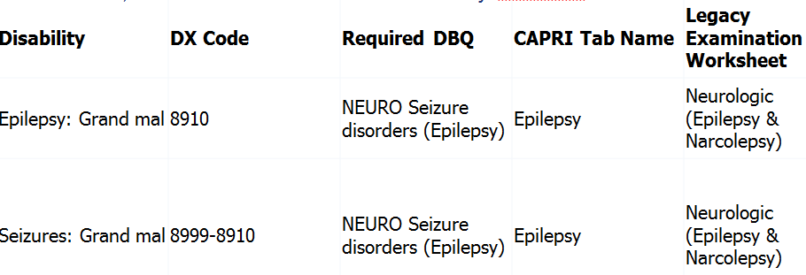
Tools Used to Request Examinations (continued)
The DBQ Lookup identifies the correct worksheet to use when requesting examinations
CS Intranet Home Page; Miscellaneous; Rating Job Aids; Search Index of DBQ/Exams by Disability

Slide 24
Tools Used to Request Examinations (continued)
The Examination Request Builder (ERB)
Compensation Service Intranet Home Page; Miscellaneous; Rating Job Aids; VA References; ERB
Improves the quality of the examination request by using consistent language designed to minimize insufficiency in the examination reports

Slide 25
Tools Used to Request Examinations (continued)
Recommendations
Use the ERRA Quick Search Accelerator for Microsoft Internet Explorer designed and developed by Compensation Service because ERRA Quick Search makes it easier to search ERRA for any Zip code you can highlight inside Internet Explorer
Use the DBQ lookup to select the correct worksheet for a VA examination
Use the ERB tool to improve the quality of the examination requests by using consistent language designed to minimize insufficiency in the examination reports
Use examination request tools to improve examination management and communication between VBA and VHA regarding examinations

Slide 26
Quality Assurance Internal Quality Review Team
David Hannigan
Chief, Quality Review Team
Program Review

Slide 27
Exciting way to share ideas in a simple tip format
Your Q-Tips are welcome and requested
We will achieve 125/98% together by sharing knowledge with each other
Send your ideas to David Hannigan and Get your name on the big screen!
david.hannigan@va.gov

Slide 28
Sources of This Month’s Q-Tips
The first Q-Tip comes from Kerry Schafer, SRQRS, Quality Assurance, Compensation Service
The second Q-Tip comes from Sam Arreza, RQRS, VARO, Honolulu
My thanks to Kerry and Sam for sharing these important reminders!
Thanks for the submissions – please keep them coming!

Slide 29
Q-Tip # 1
38 CFR 3.309(a): This reference lists endocarditis as a chronic presumptive disability, and notes this term includes all forms of valvular heart disease

Slide 30
Q-Tip # 2
For purposes of entitlement to a schedular total evaluation for 12 months following one month of convalescence under 38 CFR 4.30, a total joint replacement is necessary
Orthopedics has progressed exponentially since the advent of prosthetic joint replacements
Surgical procedures named “joint replacement” can be as simple as the insertion of a prosthetic spacer in place of a meniscus
Surgical procedures that involve only “partial joint replacement” generally do not warrant the 13 month temporary total evaluation

Slide 31
Q-Tip # 2 (continued)
Partial joint replacement should be evaluated based on the facts found and any period of convalescence under 38 CFR 4.30 based on the recommended convalescent period required for that Veteran
Reference: February 2009 Compensation Service Bulletin

Slide 32
Reconsideration Request
Kerry Schafer
Senior Rating Quality Review Specialist
Quality Review Team
Program Review

Slide 33
STAR B2 Error
Claim for left knee, left wrist, and right shoulder disabilities
STRs show complaints involving all three joints
VAE noted objective evidence of left knee and right shoulder painful motion, and limitation of motion of the left wrist
VAE results noted no diagnosis for these three disabilities nor provided any explanation as to why a diagnosis could not be rendered
Rating decision denied service connection for all three conditions

Slide 34
STAR B2 Error (continued)
B2 error cited – VAE should have been returned as inadequate
Error notes the examiner is to either provide a diagnosis for the three claimed conditions or explain why a diagnosis cannot be rendered in spite of objective evidence of painful motion and limitation of motion
Reference cited: M21-1 MR III.iv.3.D.18.f

Slide 35
STAR B2 Error (continued)
RO contended the VAE was sufficient as it was presumed the examiner used medical expertise to determine there was no diagnosis for the three claimed disabilities

Slide 36
STAR B2 Error (continued)
Per M21-1 MR III.iv.3.D.18.f, the exam report must provide:
A diagnosis for each described condition
A diagnosis or notation that a chronic disability or disease was ruled out for each disability, complaint, or symptom listed on the exam report

Slide 37
STAR B2 Error (continued)
The B2 error was upheld as the RO failed to return the exam as inadequate, as it failed to meet the requirements per cited M21-1 MR reference.

Slide 38
Questions?
The phone lines have been unmuted 
Remember to personally unmute your phone line or USB headset microphone if you have a question
To unmute your phone line, press , then press 6

Slide 39
Closing Remarks
Karen Townsend
Assistant Director (AD)
Quality Assurance

Slide 40
VA Talent Management System (TMS)
The TMS number for the November 2014 Rating Quality Call is 3894279. If you listened to the call live, click the video link, then immediately return to Content Structure to complete the survey to receive credit for the call in TMS.
The TMS number for this call (January 2015 Rating Quality Call) is 3897823. In the near future, a Calendar Blast will be issued showing the TMS number has been activated.

Slide 41
Rating and Authorization Quality Calls
Quality Assurance (QA) Staff conducts a Quality Call each month
QA Staff rotates the focus of the call each month
Next Authorization Quality Call (AQC) will be held on Wednesday, February 11th at 1:30 PM EST

Slide 42
Next Rating Quality Call (RQC)
The next Rating Quality Call (RQC) will be held on Wednesday, March 11th at 1:30 PM EST
Please feel free to forward suggested topics to VAVBAWAS/CO/214B
Quality Call Notes can be found on the Compensation Service Intranet site: http://vbaw.vba.va.gov/bl/21/star/star_call.htm
One person can make a difference,
and everyone should try. ~ John F. Kennedy

