Slide 1
Adjudicating Gulf War Claims
Sept 2014

Slide 2

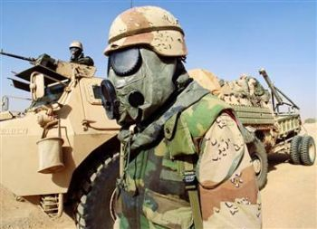
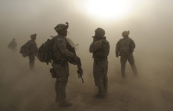
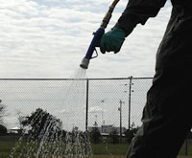
Gulf War Exposures

Slide 3
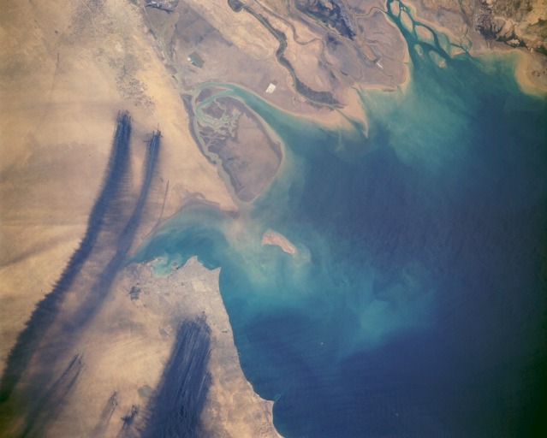

Slide 4
Objectives
Gain a better understanding of the history of the Gulf War
Understand how to use the available references to adjudicate claims based on service in the Gulf War and Southwest Asia, and environmental hazards in Iraq and Afghanistan
Determine the proper decision when adjudicating claims involving Gulf War Veterans

Slide 5
REFERENCES
38 USC § 1117
38 CFR § 3.317
M21-1 III.iv.6.D
M21-1 IV.ii.1.E
M21-1 IV.ii.2.D
FL 10-26
FL 11-09
TL 10-01
TL 10-01

Slide 6
Background
November 2, 1994 - Persian Gulf War Veterans’ Benefits Act initially enacted.
February 1995 - New 38 C.F.R. § 3.317 promulgated.
  Original version included a 2-year presumptive period after last service in Southwest Asia.
March 2002 - § 3.317 expanded to include chronic multi-symptom illness defined by a cluster of signs and symptoms (e.g., Chronic Fatigue Syndrome, Fibromyalgia; and Functional Gastrointestinal Disorders as of July 2011)
September 2010 - § 3.317 expanded to include presumptive service connection for certain infectious diseases based on service in Southwest Asia or Afghanistan.

Slide 7
Ongoing Efforts
Contracts with NAS’s Institute of Medicine for scientific review.
VA and DoD research studies on the cause and treatment of Gulf War Illness.
VA epidemiology studies

Slide 8
Veterans Services
Gulf War Registry health exam
  Available to Veterans of the first Gulf War, Operation Desert Shield, Operation Desert Storm, Operation Iraqi Freedom, or Operation New Dawn
  Alerts Veterans to possible long-term health problems that may be related to environmental exposures.

Slide 9
Veterans Services
Gulf War Registry health exam
  Data helps VA understand and respond to these health problems more effectively.
  Free and do not require enrollment in the VA health care system
  Not a disability compensation exam (based on Veterans’ recollection of service, not on their military records)

Slide 10
Regulatory Criteria
38 USC §1117
38 CFR §3.317

Slide 11
Basic Criteria
Service Connection under 38 C.F.R. § 3.317 requires the Veteran be:
  A Persian Gulf Veteran;
  who exhibits objective indications

Slide 12
Basic Criteria
  of a qualifying chronic disability that:
    Became manifest during active service in the Southwest Asia theater of operations during the Persian Gulf War or to a degree of 10 percent or more not later than December 31, 2016;
    AND
    b. By history, examination, and laboratory tests cannot be attributed to a known clinical diagnosis.

Slide 13
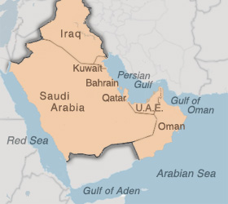
What is a “Persian Gulf Veteran”?
A Veteran with service in the Southwest Asia theater of operations beginning August 2, 1990, through the present.

Slide 14
Southwest Asia Theater of Operations
Iraq
Kuwait
Saudi Arabia
the neutral zone between Iraq and Saudi Arabia
United Arab Emirates
Bahrain
Qatar
Oman
the Gulf of Aden
the Gulf of Oman
the Persian Gulf
the Arabian Sea, and
the Red Sea.

Slide 15
Don’t Forget
Service in Southwest Asia also includes the airspace above these locations.
A Veteran with service in Afghanistan is not a “Persian Gulf Veteran.”*
*There was a new exception added for Veterans who served in Afghanistan for consideration of infectious diseases (see 38 C.F.R. § 3.317(c)).

Slide 16



Verification of Service
Generally Sufficient
Service in SWA – exact dates of service listed in the “Remarks” section of DD Form 214.
Kuwait Liberation Medal or Iraq Campaign Medal

Slide 17

Verification of Service
Potentially Sufficient
Southwest Asia Service Medal
  Also available to individuals serving in Israel, Egypt, Turkey, Syria and Jordan* in direct support of combat operations from 1/17/91 to 11/30/95.
  *Note that these countries do not fall under the definition of the Southwest Asia theater of operations

Slide 18

Verification of Service
Generally NOT Sufficient
Global War on Terrorism Service/Expeditionary Medals
Likely warrants remand for personnel records to determine specific area(s) of assignment.

Slide 19
“Objective Indications”
Includes both “signs” AND “symptoms”
Fatigue
Skin
Headache
Muscle Pain
Joint Pain
Neurological
Neuropsychological
Upper or Lower Respiratory System
Sleep Disturbances
Gastrointestinal symptoms
Cardiovascular Symptoms
Abnormal Weight Loss
Menstrual Disorders

Slide 20
Don’t Forget
The list provided in § 3.317(b) is not exhaustive.
Objective medical evidence is not required for an award of service connection; symptoms capable of lay observation are presumed to be related to service.

Slide 21
Qualifying Chronic Disability
Undiagnosed Illness; or
Medically Unexplained Chronic Multi-symptom Illness

Slide 22
Qualifying Chronic Disability
Medically Unexplained Chronic Multi-symptom Illness
Diagnosed illness without conclusive pathophysiology or etiology characterized by overlapping symptoms and signs.
Includes (but not limited to):
  Chronic Fatigue Syndrome
  Fibromyalgia
  Functional gastrointestinal disorders

Slide 23
Don’t Forget
Chronic multi-symptom illnesses of partially understood etiology WILL NOT be considered “medically unexplained.”
The claims adjudicator has the authority in the first instance to determine whether any other condition constitutes a “medically unexplained chronic multi-symptom illness.”*
* Effective October 7, 2010, retroactive to all pending claims.

Slide 24
Medical
Viewpoint
What we know and what we don’t

Slide 25
Symptoms = subjective
What the patient reports
Veterans and their families and friends are
competent to report symptoms

Slide 26
Signs = objective
The things an examiner can see, feel, hear

Slide 27
Functional disorders impair normal bodily function but on examination, even including dissection and microscopy, everything is normal
Structural disorders are conditions where some body part can be seen to be abnormal

Slide 28
Fibromyalgia (myofascial pain syndrome)
A functional disorder characterized by widespread pain and a heightened and painful response to pressure.
Often also debilitating fatigue, disturbed sleep, joint stiffness, numbness and tingling, difficulty swallowing, bowel or bladder difficulties
Psychiatric symptoms of depression, anxiety, and PTSD
Female to male ratio of 9:1

Slide 29
Chronic Fatigue Syndrome
Post exertional malaise
Unrefreshing sleep
Widespread muscle and joint pain
Unique headaches
Cognitive difficulties
6 or more months
Much more common in women

Slide 30
Functional GI Disorders
Functional heartburn (pyrosis)
Functional chest pain (presumed esophageal)
Functional dysphagia (difficulty swallowing)
Functional vomiting
Rumination syndrome (effortless regurgitation)
Functional bowel syndrome
Functional constipation/diarrhea
Functional rectal pain

Slide 31
Adjudicating Claims

Slide 32
Records
Service Treatment Records
Service Personnel Records (if needed to determine Gulf War service)
National Guard/Reserves
Post-service treatment
Gulf War Registry Examination

Slide 33
VA Examinations
Generally required for all claims.
Four Disability Patterns (for each disability):
  Undiagnosed illness
  Diagnosable but medically unexplained chronic multi-symptom illness of unknown etiology
  Diagnosable chronic multi-symptom illness of partially explained etiology
  Disease with a clear and specific etiology

Slide 34

VA Examinations
If the examiner determines the Veteran’s disability pattern to be…
Then
An undiagnosed illness; or
A diagnosable but medically unexplained chronic multi-symptom illness of unknown etiology
GRANT service connection under § 3.317 (if otherwise eligible)

Slide 35

VA Examinations
If the examiner determines the Veteran’s disability pattern to be…
Then
A diagnosable chronic multi-symptom illness of partially understood etiology; or
A disease with a clear and specific etiology
We are unable to Grant service connection on a presumptive basis under
§ 3.317

Slide 36

Adjudication

Slide 37
Don’t Forget
Service connection may still be awarded on a direct basis with sufficient evidence of a medical nexus.
If the VA examiner did not offer an opinion/rationale regarding direct service connection, a remand may be necessary.

Slide 38
Medical Evidence
Physicians are expected to provide a diagnosis where possible. There is no need for a diagnosis of “undiagnosed illness.”
Determine whether findings may be attributed to a known clinical diagnosis in your particular case. What could be under a different, hypothetical set of facts is irrelevant.

Slide 39
Medical Evidence
With conflicting medical opinions, you must weigh the medical evidence of record and provide a full explanation and rationale for favoring one opinion over another.
The simple fact that one opinion assigns a clinical diagnosis while another does not is NOT a sufficient basis to determine that 38 C.F.R. § 3.317 does not apply.

Slide 40
Don’t Forget
With a diagnosis of chronic fatigue syndrome, fibromyalgia, or a functional gastrointestinal disorder, there is no requirement of a medical nexus.
Subject to exceptions outlined below, GRANT service connection.

Slide 41
Manifestation to 10 Percent
Examine symptoms under all potentially applicable Diagnostic Codes.
If denying based on symptoms not manifest to 10 percent, fully explain why particular Diagnostic Code is chosen.

Slide 42
Don’t Forget
Any manifestation of symptoms during active service in Southwest Asia can suffice to establish the presence of a qualifying chronic disability.*
*Subject to other regulatory requirements.

Slide 43
Lay Evidence
Lay evidence is VERY IMPORTANT.
Lay evidence may be sufficient to establish service connection if symptomatology is capable of lay observation.
  For example:
  Fatigue
  Joint pain
  Skin rash

Slide 44
Lay Evidence
Other examples of lay evidence:
  Employment records showing increased absenteeism;
  Medical treatment for symptoms without diagnosis;
  Relevant observations of appearance, physical abilities or mental/emotional state.

Slide 45
Don’t Forget
Under 38 U.S.C.A. § 1117 and 38 C.F.R. § 3.317, lay evidence alone may support a grant of service connection subject to…

Slide 46
Don’t Forget
…a determination of the credibility of any lay statements regarding symptomatology.

Slide 47
Don’t Forget
BE SPECIFIC in your credibility analysis if denying a claim based on lay evidence that is found to be not credible.

Slide 48
Exceptions to Presumption
Service connection is not warranted if there is affirmative evidence the otherwise qualifying disability:
  Was not incurred during active service in Southwest Asia during the Persian Gulf War; or
  Was caused by a supervening condition or event; or
  Is the result of willful misconduct or the abuse of alcohol or drugs.

Slide 49
Exceptions to Presumption
Affirmative evidence:
  Does not require a conclusive showing
  Must be competent to indicate the time of existence or inception of a disease
  Must support a conclusion that a disease was not incurred in service.

Slide 50
Exceptions to Presumption
VA has determined the Secretary does not have the authority to compensate for aggravation of disabilities resulting from pre-existing undiagnosed illness.

Slide 51
Service Connection under 38 CFR 3.317
If you grant service connection under 38 CFR 3.317, be sure to include the Gulf War special issue in the Disability Decision Input screen of VBMS-R.
Note the earliest effective date for entitlement to service connection under the provisions of 38 CFR 3.317 is November 2, 1994
Note second signatures may be required for GW ratings at the discretion of the VSCM/PMCM at your duty station.

Slide 52
Evaluating Gulf War Disabilities
In order to properly identify and track disabilities for the Persian Gulf War Veterans' Act, a DC series beginning with "88" has been established.
Examples:
  Chronic fatigue syndrome (CFS) DC 8863-6354
  Fibromyalgia DC 8850-5025
  Irritable Bowel Syndrome (IBS) DC 8873-7319
For undiagnosed conditions rate by analogy to existing Diagnostic Codes, utilizing hyphenated codes.

Slide 53
Evaluating Gulf War Disabilities
Examples:
  Cardiovascular symptoms DC 8870-7005 (CAD)
  Muscle pain DC 8850-5021 (myositis)
  Seizures DC 8889-8910 (grand mal epilepsy)
  Joint pain DC 8850-5002 (rheumatoid arthritis)
  Headaches DC 8881-8100 (migraine headaches)
REMEMBER: To schedule a routine future examination (RFE) for 24 months after an initial grant of service connection. After that please give consideration to the current guidance on RFE.

Slide 54
Infectious Diseases under 38 CFR 3.317
Effective September 29, 2010, the following disabilities there were some additional conditions added to 38 CFR 3.317 :
• Brucellosis
• Campylobacter jejuni
• Coxiella burnetii (Q fever)
• Mycobacterium tuberculosis*
• Nontyphoid Salmonella
• Shigella
• Visceral leishmaniasis*
• West Nile virus
• Malaria**
*no time limit
**one year time limit OR at a time when standard or accepted treatises indicate the incubation period began during a qualifying period of service

Slide 55
Key Takeaways

Slide 56
Key Takeaways
A VA examination is generally necessary in all Gulf War claims.

Slide 57

Key Takeaways
Service connection is warranted if an eligible Veteran can demonstrate signs or symptoms of a qualifying chronic disability manifest to a degree of at least 10 percent for a period of at least six months.

Slide 58
Key Takeaways
There is NO requirement of a medical nexus between the Veteran’s identified symptoms and active service.

Slide 59
Key Takeaways
Subject to a credibility analysis, lay evidence may be sufficient in many cases to grant service connection if there is no diagnosed disability.

Slide 60
Key Takeaways
If a Veteran has been diagnosed with chronic fatigue syndrome, fibromyalgia, or a functional gastrointestinal disorder, there is NO requirement of a medical nexus.

Slide 61
Questions?
Thank you for your time today

