Slide 1
Authorization Quality Call October 15, 2014

Slide 2
Agenda
Opening Comments
TDIU
Updates and Reminders
Uploading Documents
Recent Manual Changes
Counting Active Duty Days Demo
Quality Review & Consistency Topics
Reconsideration Discussion
QRT Q-Tips
Closing Comments

Slide 3
Authorization Accuracy
As of October 1, 2014, the 12-month cumulative national accuracy rate for authorization claims is
92.56%

Slide 4
Best Practices
Quality Training Officer (QTO) at Boston Regional Office
  RQRS or AQRS are assigned on a rotating basis
  QTOs answer questions from RVSR/VSRs
  RVSR/VSRs consider the QTOs are a valuable resource

Slide 5
Common Findings
Clarification of FL 13-13, Claims for Total Disability Based on Individual Unemployability (TDIU)
  Provided procedures for administratively denying IU claims
    Veteran fails to return VA Form 21-8940
    Veteran fails to identify service-connected disabilities
  OFO provided guidance to stop administratively denying IU claims due to systems issues

Slide 6
Updates and Reminders
Due process is not required if a reduction does not change the Veteran’s payment.
  38 CFR 3.105(e)

Slide 7
Updates and Reminders
Date of claim reminders:
  For EP 600s, the date of claim is the date of the due process letter. If the due process letter is returned as undeliverable, follow the steps in M21-1 MR I.2.B.6.b. Once a new due process letter is issued, establish a new EP 600. The date of claim is the date the new letter is mailed.
  For EPs established as a result of an electronic work item (or writeout), the date of claim is the date of the electronic work item. The electronic work items can be found on the Corporate Claim tab, VBMS Notes, or MAP-D notes at the bottom of the page.
M21-4, App. B

Slide 8
Uploading Documents
Remember to conduct a preliminary review of the claim or virtual claim folder prior to sending for review by QA staff.
Focus of the review: To ensure all documents associated with the claim have been uploaded into the electronic record (VBMS/VVA).
Goal of the preliminary review:
  To decrease the number of cases deselected by QA staff because there is “no documented basis for the EP”, which leads to a replacement case being requested on the next month’s call up list.

Slide 9
Uploading Documents
If all contents of the paper file have been scanned into VBMS or VVA, it is not necessary to ship the paper file to QA for the review. In this case, the review will be completed on the basis of the electronic record.
REF: M21-4, Chapter 3; Adding Documents Into VBMS eFolders Job Aid and Uploading Documents into VBMS Job Aid.

Slide 10
Recent Manual Rewrite (MR) Changes
M21-1MR,I.3.C.17.a Change Date: 9/15/2014
Subject: Attorney Fee Payments – Waiver of appeal period
  The appeal period cannot be waived by a claimant.
M21-1MR,III.v.9.B.5&6 Change Date: 9/16/2014
Subject: Hearing requests for Issue of Incompetency
  Time limit for hearing requests related to incompetency proposals changed from 30 day to 60 days.
  New sample language for proposed rating of incompetency provided.
  If a beneficiary requests a hearing at any time before VA makes a final decision on the beneficiary’s competency, VA will postpone making final decision until after the hearing is held.

Slide 11
Recent Manual Rewrite (MR) Changes
M21-1MR, III.5.F.31.a Change Date: 8/21/2014
Subject: Development when child does not live with claimant
  If required information cannot be obtained by telephone, then request through a development letter.
M21-1MR, III.5.F.32.a Change Date: 8/21/2014
Subject: Information claimant must provide to VA for a child
  Must provide the day of birth as well as the month and year.
  Must provide city and state; or city and country (for foreign births). However, state is not required if the city is well known (i.e. Chicago).

Slide 12
Recent Manual Rewrite (MR) Changes
M21-1MR, III.5.F.35.a Change Date: 8/21/2014
Subject: Notification requirements when VA assigns a disability rating of 30% or more
  Decision notices are no longer required to contain the names of dependents for which VA is paying additional benefits.
  VA Form 21-686c is not required to be included with a notification letter if action is being taken to add the Veteran’s dependents to his/her award concurrently with the promulgation of a rating decision.
  Telephone development is to be attempted for missing dependency information when promulgating a rating decision granting a combined disability rating of 30% or more.

Slide 13
Recent Manual Rewrite (MR) Changes
M21-1MR, III.5.F.36.e Change Date: 8/21/2014
Subject: Action to take when beneficiary fails to provide date of event resulting in loss of a dependent.
  If attempts to obtain by telephone are unsuccessful, reduce/terminate DLP; and
  send letter advising that unless information is provided within 60 days, VA will reduce/terminate his/her benefits first of month following date dependents were last verified.

Slide 14
New Automobile Allowance Rate
38 U.S.C. §4303 allows for annual increases to the automobile allowance for Veterans. Effective October 1, 2014, the new rate is $20,114.34, and any awards processed after that date will receive the new rate.
The rate tables will be updated to reflect the new rate.
This item will also be addressed in an upcoming VSCM call.

Slide 15
Counting Active Duty Days When Processing Drill Pay Waivers – Date Calculator
Cases with drill pay adjustment for the same fiscal year the Veteran had an active duty service period.
Sometimes the amount of days of active duty is miscalculated.
When counting the days the Veteran was on active duty, we must include the last day of service.
Use the Date to Date Calculator found in www.timeanddate.com and include the end date.

Slide 16
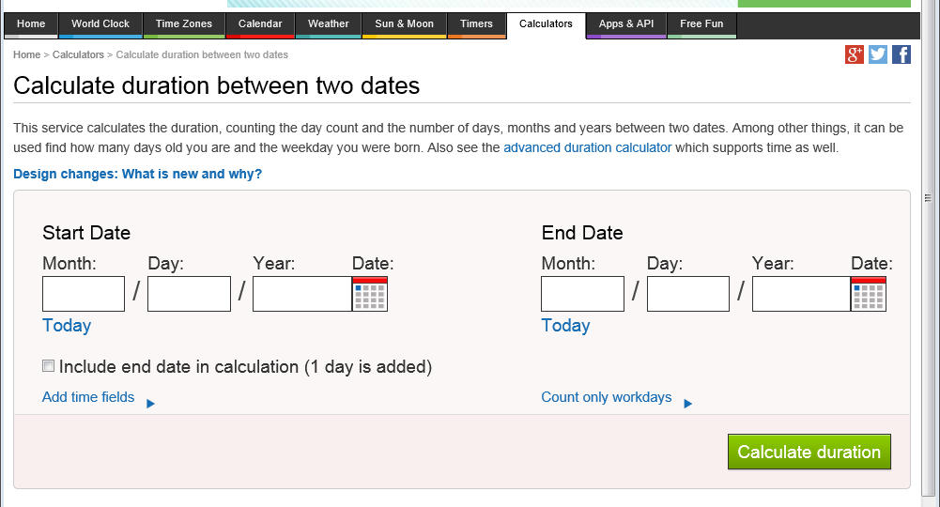
Counting Active Duty Days When Processing Drill Pay Waivers – Date Calculator
www.timeanddate.com

Slide 17
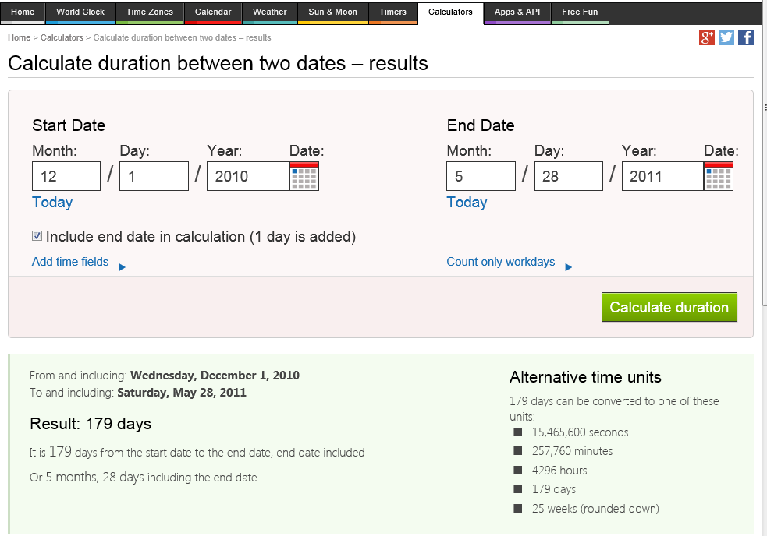
Counting Active Duty Days When Processing Drill Pay Waivers – Date Calculator
www.timeanddate.com

Slide 18
Quality Review &
Consistency Topics
AQRS/VSR Consistency Studies
  Purpose of consistency study and where topics come from
  August Results
  October Consistency Study: date and topic
  Future consistency study information
Next QRT Challenge: October
  Upcoming Challenge Training
QRT Mailbox

Slide 19
Reconsideration Discussion
EP 130 Reviewed
Veteran Contacted NCC to add spouse
VA Form 21-686c mailed to Veteran by NCC
No follow-up letter by RO
Claim to add spouse denied FTP
B2 error cited on Quality Review (STAR)
M21-1MR,III.iii.1.B.2 and 38 CFR 3.109

Slide 20
Q-tips!
Reminder: Quality tips or Q-tips serve as a format to share information in a simple tip or reminder format
Your Q-tips are welcome and requested; but they should be reminders of information in a simple tip format and are already VBA approved (i.e., we should not need Policy clarification)
Send your tips to me…. ☺ David Hannigan and Get your name on the big screen! (david.hannigan@va.gov)
This month’s authorization Q-tip comes from Joe Pollock, QRS, Boise RO. My thanks to Joe for sharing this important reminder!

Slide 21
Q-tip
65 Days for Adverse Action Proposal Period
M21-1MR I.2.C.9
The adverse action proposal period is the control period between the date the notice of proposed adverse action is mailed to the beneficiary and the date that the final notice is sent. The minimum period for the proposed adverse action is 60 days.
Important: Legally, the beneficiary has 60 days to respond. However, adverse action should not be taken until the 65th day to allow time for evidence to reach the Veteran Service Representative’s (VSR) desk.
Basic Rule = 65-day Limit: Take no adverse action; e.g., do not complete the Final rating decision until the 65th day following the date of the notice of proposed adverse action, unless the beneficiary:
  specifically asks that the award be reduced or suspended to minimize any possible overpayment, OR
  submits documentary evidence confirming earlier oral information, which is sufficient to justify the proposed adverse action.

Slide 22
Announcements
Upcoming Quality Calls
  Our next Quality Calls will be
    a rating focused call on November 12, 2014, at 1:30 EST, and
    an authorization focused call on December 10, 2014, at 1:30 EST.

Slide 23
Additional questions relating to these topics or suggestions for future topics may be sent to the QA mailbox (VAVBAWAS/CO/214B).

