Slide 1
Claims Development: Hepatitis C
Compensation Service Training Staff
August 2014

Slide 2
Lesson Objectives
Define hepatitis
Explain the history of hepatitis
Restate the legal requirements for granting service-connection of hepatitis C
2

Slide 3
Lesson Objectives (Continued)
Identify several risk factors for hepatitis C
Recognize the appropriate development requirements for hepatitis C claims
Assess the sufficiency of hepatitis C examination results
3

Slide 4
References
VBN Broadcast, “Hepatitis C Rating issues” dated April 25, 2001
Compensation Service VSCM Conference Call, “Hepatitis C Development” June 2012
Training Letter 01-02, Hepatitis C Review
Center for Disease Control, Hepatitis C General Information Fact Sheet
4

Slide 5
References (Continued)
Training Letter 00-01, Hepatitis C Infection Treatment and its side effects
FL 04-13, Relationship Between Immunization with Jet Injectors and Hepatitis C Infection as it Relates to Service Connection
FL 98-110, Infectious Hepatitis
Compensation Service VSCM Conference Call, “Guidance on FDCs” July 2014
5

Slide 6
Hepatitis: What is it?
Definition:
hēpat-: of the liver
-itis: inflammation
6

Slide 7
Hepatitis C: When Did It Begin?
Date of Origin
Date Detected
Date Recognized as a Medical Diagnosis
7

Slide 8
Knowledge Check
Main types of hepatitis?
Hepatitis A
Hepatitis B
Hepatitis C
Hepatitis D
Hepatitis E
8

Slide 9
Knowledge Check (continued)
Most common types in the US?
Hepatitis A
Hepatitis B
Hepatitis C
9

Slide 10
Knowledge Check
True or False:
There is a vaccination for each of the common types of hepatitis found in the US.
10

Slide 11
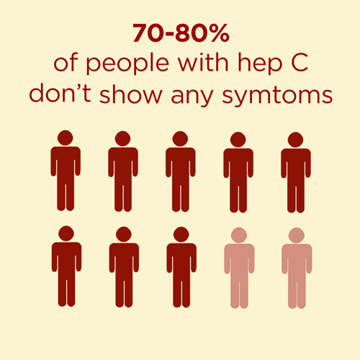
HCV: How Does it Manifest?
Symptoms:
Fever
Fatigue
Loss of appetite
Nausea
Vomiting
Jaundice
Dark urine
11

Slide 12
HCV: Types
Acute
Chronic
12

Slide 13
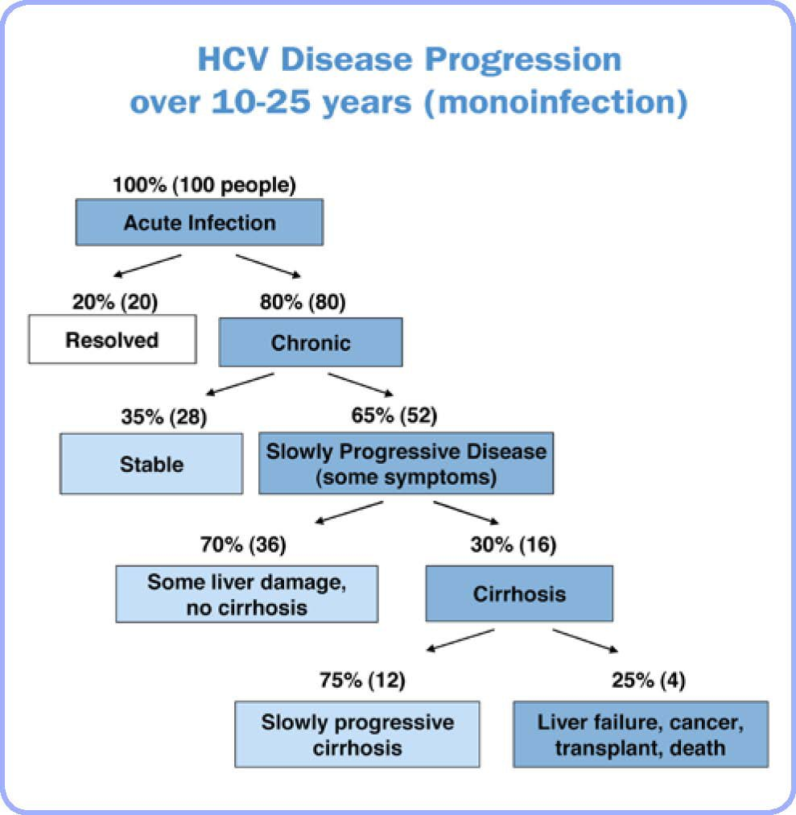
HCV: How Does it Progress?
13

Slide 14
Hepatitis C: VA Legislation?
 | Most Claims | HCV Claims
Then | In-service event or In-service injury | In-service diagnosis or In-service risk factors
Between | Nexus | (Chronicity & Relationship)
Now | Confirmed diagnosis | Current diagnosis, or Treatment of known symptoms

Slide 15
Hepatitis C: Risk Factor
Organ transplant before 1992
Transfusion of blood/blood products before 1992
Hemodialysis
Exposure to blood by health care workers
Intravenous drug use
Intranasal cocaine use
High risk sexual activity
Other direct percutaneous exposure
15

Slide 16
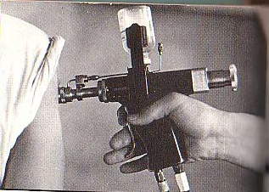
Hepatitis C: Risk Factor more
Less common, but recognized:
Religious scarification
Incarceration over three days
Intravenous air gun injections
16

Slide 17
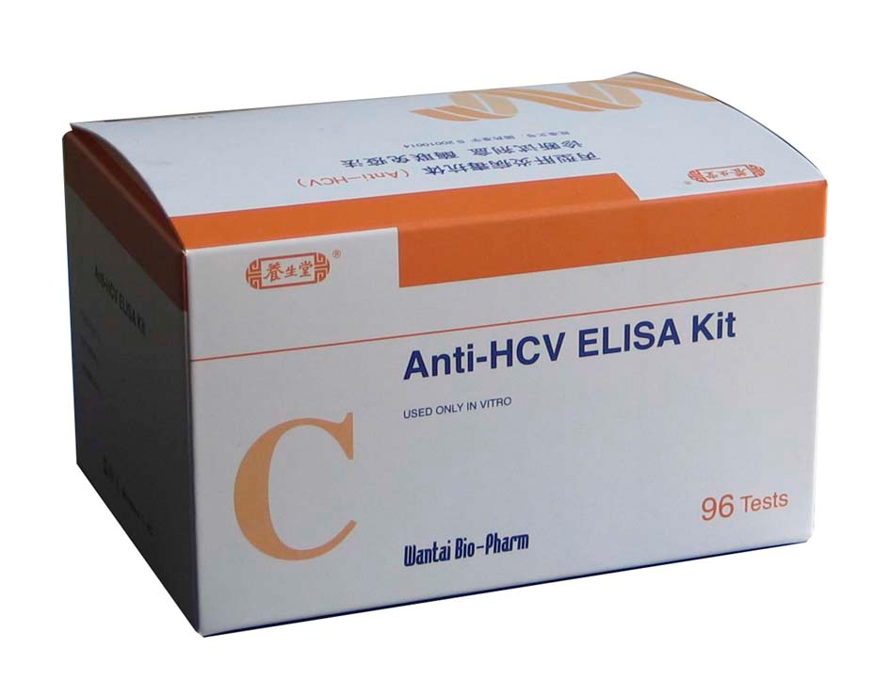
Hepatitis C: Confirmed Diagnosis
EIA
ELISA with RIBA
HCV RNA
17

Slide 18
Hepatitis C: Development
MAP-D
VBMS
EZ Forms
18

Slide 19
Hepatitis C: Exam warranted (new)
New claims for hepatitis C
Confirmed diagnosis or symptoms (now)
Risk factor/diagnosis (then)
Order the exam with a medical opinion
There is an exception…
19

Slide 20
Hepatitis C: Exam warranted (increase)?
No special actions are required
20

Slide 21
Hepatitis C: Exam warranted (reopen)?
Things to consider:
New information
Material information
No/Uncertain diagnosis
21

Slide 22
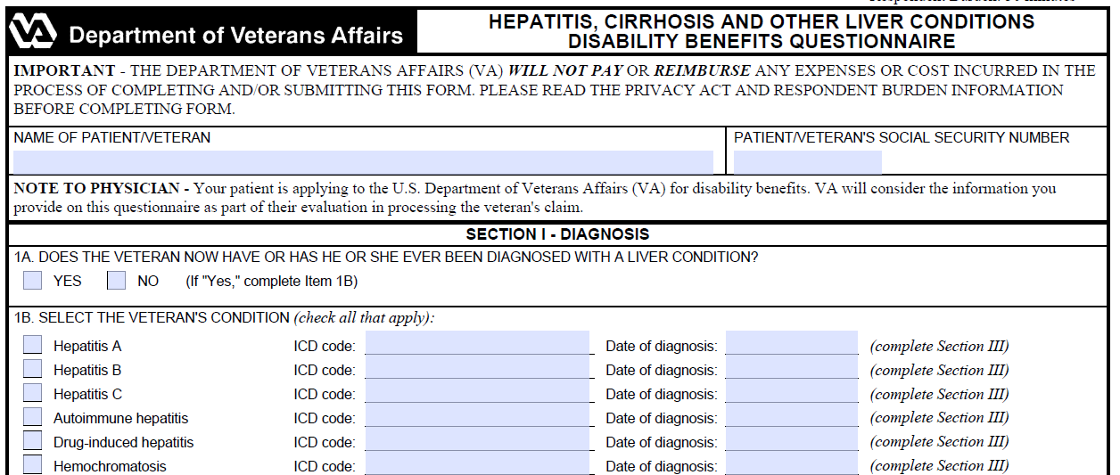
Hepatitis C: Requesting the Exam
Exam request contents
Medical opinion
22

Slide 23
Hepatitis C: Adequate Exam
Reviewed claims folder
Provided diagnostic test
Clinical findings and symptoms
Medical opinion
Discuss all risk factors
23

Slide 24
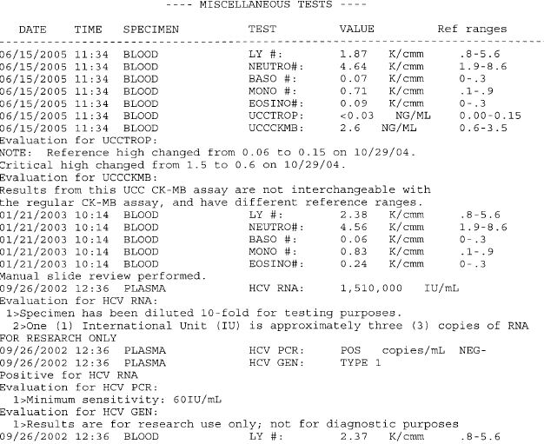

Slide 25
Questions

Slide 26
Review question 1a
Mr. Jenkins:
Combat Veteran
New claim
No confirmed diagnosis
Medical evidence of HCV symptoms
Confirmed risk factor
Exam warranted?
26

Slide 27
Review answer 1a
Yes.
In-service: Mr. Jenkins has a confirmed in-service risk factor – blood transfusion before 1992.
Now: While Mr. Jenkins does not have a confirmed diagnosis, he did provide medical evidence of known symptoms of hepatitis C.
EXAM (WITH MEDICAL OPINION)
WARRANTED
27

Slide 28
Review question 1b
Mr. Jenkins, continued…
Liver function test (LFT) results provided
Clinical findings (symptoms) provided
C-file reviewed
Opinion provided
Exam sufficient?
28

Slide 29
Review answer 1b
No.
A confirmed diagnosis is not of record. Therefore, the exam is insufficient because the examiner failed to provide the necessary exam results.
EXAM INSUFFICIENT
29

Slide 30
Review question 2a
Ms. Thomas:
Reopened claim for hepatitis C.
Previously denied in January of 1991
Military personnel records confirm risk factor
In-service diagnosis hepatitis non-A, non-B
Two positive HCV RNA results of record
Exam warranted?
30

Slide 31
Review answer 2a
Yes.
In-service: Ms. Thomas was diagnosed with hepatitis non-A, non-B during service.
Now: Ms. Thomas has a confirmed diagnosis.
EXAM (WITH MEDICAL OPINION)
WARRANTED
31

Slide 32
Review question 2b
Ms. Thomas, continued:
Liver function test (LFT) results provided
C-file reviewed
Opinion and rationale provided
Clinical findings (symptoms) provided
32

Slide 33
Review answer 2b
Yes.
Laboratory and clinical findings provided
C-file reviewed
Opinions with rationales provided.
EXAM SUFFICIENT
33

Slide 34
Review question 3a
Mr. Shaw:
New claim for hepatitis C
Due to hugging an infected friend
Positive ELISA along with a positive RIBA of record
Exam warranted?
34

Slide 35
Review answer 3a
No.
In-service: Mr. Shaw does not have an in-service diagnosis and has failed to provide an in-service risk factor that can be confirmed.
Now: Mr. Shaw has a confirmed diagnosis.
EXAM NOT WARRANTED
35

Slide 36
Review question 3a(2)
Within two months of receiving his notification letter (denial), Mr. Shaw submits a statement that while he was active duty, he received an organ transplant in 1991 at a private medical facility with the medical evidence of his surgery.
Exam warranted?
36

Slide 37
Review answer 3a(2)
Yes.
In-service: Mr. Shaw has now provided evidence of an organ transplant that happened during military service and before 1992.
Now: Mr. Shaw has a confirmed diagnosis.
EXAM WARRANTED
37

Slide 38
Review question 3b
Mr. Shaw:
C-file reviewed
Opinions and rationales provided
38

Slide 39
Review answer 3b
No.
Opinions and Rationales
Confirmed HCV diagnosis
Laboratory or clinical findings
EXAM INSUFFICIENT
39

Slide 40
Review
Define hepatitis
Explain the history of hepatitis
Restate the legal requirements for granting service-connection of hepatitis C
40

Slide 41
Review
Identify several risk factors for hepatitis C
Recognize the appropriate development requirements for hepatitis C claims
Assess the sufficiency of hepatitis C examination results
41

