Slide 1
(VSR VIP Pre-D) VA Terminology
Compensation Service
September
2020

Slide 2
Lesson Objectives
Identify and define VA acronyms, abbreviations, and initialisms utilizing VA Acronym Lookup and Medical Electronic Performance Support System (Medical EPSS)
Appropriate utilization of acronyms, abbreviations, and initialisms in correspondence
Given the online VA acronym lookup tool, identify and define VA acronyms, abbreviations, and initialisms, and discuss how to use them appropriately in correspondence.
Given the online “Tools” found in Medical Electronic Performance Support System (MEPSS), identify and define medical acronyms, abbreviations, and symbols utilized in medical records and MEPSS.

Slide 3
References
VA Acronym Lookup Tool
https://vaww.va.gov/acronyms/
Medical EPSS
Acronyms & Abbreviation tool
Symbols tool
Job Aids
Medical References
Medical Abbreviations
Notes:
If

Slide 4
Abbreviations
Abbreviation
An abbreviation is a shortened form of a word or phrase
Examples:
eFolder stands for electronic folder
HON stands for honorable service

Slide 5
Acronyms
Acronym
An acronym is an abbreviation formed from the initial components in a phrase or a word
Examples:
VIS – Veterans Information System
CAPRI – Compensation and Pension Record Interchange

Slide 6
Initialisms
Initialism
An initialism is an abbreviation consisting of initial letters pronounced separately.
Examples:
VBMS, which stands for Veterans Benefits Management System and is pronounced “V-B-M-S”
EPSS, which stands for Electronic Performance Support System is pronounced “E-P-S-S”

Slide 7
Proper Application
Avoid VA jargon in all letters to Veterans and claimants
Never use an acronym, abbreviation, or initialism without first writing the word or words out completely, followed by the abbreviation or acronym in parenthesis
Example:
Incorrect: Please send us any copies of your STRs.
Correct: Please send us any copies of your Service Treatment Records (STRs).

Slide 8
Navigation to Acronym Lookup Tool
Open the Compensation Services Intranet Home Page
Click “Employee Resources” in the upper right-hand corner
Under “Reference” section, click “VA Acronym Lookup”

Slide 9
VA Acronym Lookup
Select Reference

Slide 10
VA Acronym Lookup
Under VA Reference section, select VA Acronym Lookup

Slide 11
VA Acronym Lookup
Direct Link to VA Acronym Lookup:
https://vaww.va.gov/
acronyms/

Slide 12
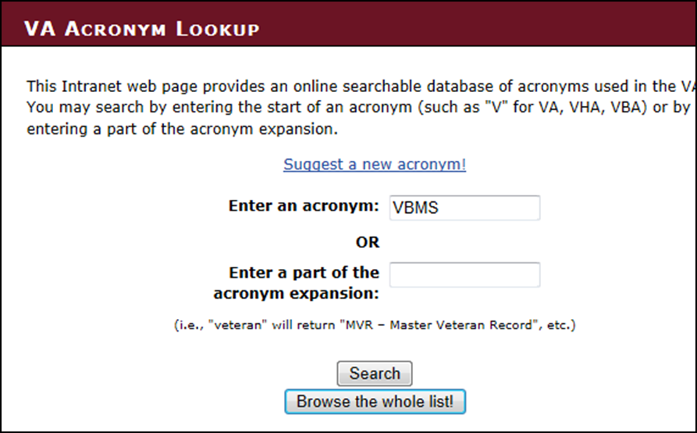
Exercise
Use the VA Acronym Lookup tool to search for “VBMS”

Slide 13
Search Results for “VBMS”

Slide 14
Common VA acronyms
What do these Acronyms Stand for?
SC | SVSR | PCGL | VBMS-R
NSC | COD | MAP-D | FDC
BVA | VSCM | VETSNET | ADL
NOD CEST | DRO CAPRI | VBMS VBMS-A | AMA

Slide 15
Medical Terminology
VSRs are responsible for reviewing medical records, which often contain common medical abbreviations and symbols.
Several tools are available to help you learn the meaning of these abbreviations and symbols, and build a working knowledge.
Medical EPSS
Note that a complete course on Medical EPSS is provided in a separate lesson.

Slide 16
Navigating to MEPSS
Below is one method to access Medical EPSS.
Job Aids
From the Job Aids page, click the Medical References link in the left hand column.
From there, click the Medical Abbreviations link.

Slide 17
Lesson Review and Wrap-Up
Identify and define VA acronyms, abbreviations, and initialisms using the on-line Lookup tool and discuss how to use them appropriately in correspondence.
Identify and define medical acronyms, abbreviations, and symbols using the online “Tools” found in Medical EPSS.

Slide 18
Review
Questions

