Slide 1
Compensation Offsets: Retired Pay
Compensation Service Training Staff
September 2014

Slide 2
Lesson Objectives
Learn “CPIN”
How to Confirm/verify receipt of retired pay
How to Prepare an award
How to Input the award and notify the Veteran in the appropriate system
How to Notify a veteran using PCGL and/or VBMS-A ADL (Automated Decision Letter)
2

Slide 3
References
38 U.S.C. 5304
38 CFR 3.750
M21-1MR(III)(v)(5)
April 2011 C&P Bulletin Addendum
Rate Tables
Compensation Service Calendar Page
3

Slide 4
Prohibition Against Duplication of Benefits
38 U.S.C. 5304
(a)(1) …..not more than one award of pension, compensation, emergency officers’, regular, or reserve retirement pay, or initial award of naval pension granted after July 13, 1943, shall be made concurrently to any person based on such person’s own service or concurrently to any person based on the service of any other person.
4

Slide 5
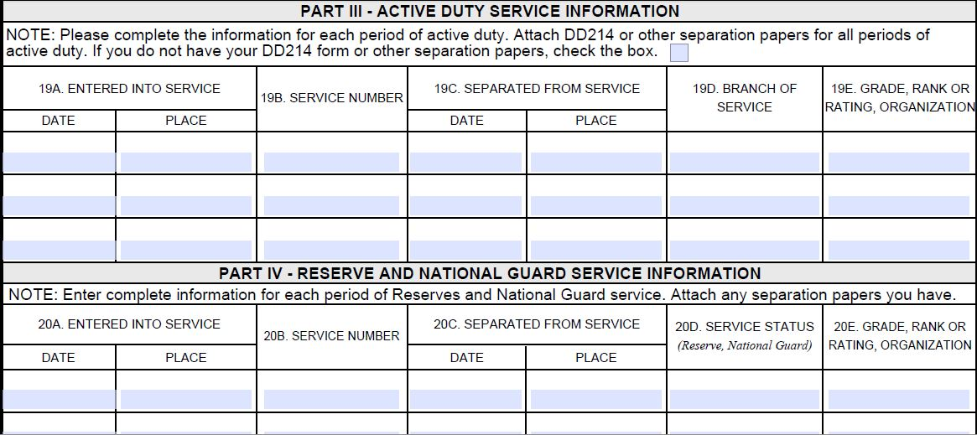
Confirm
DD Form 214, Certificate of Release or Discharge from Active Duty, or other reports of separation
Review VA Form 21-526 or evidence in C-file
Part III - Active Duty Service Information
Part IV – Reserve and National Guard Service Information
Part V – Military Retired/Severance Pay
5

Slide 6
Confirm cont.
Review VA Form 21-526, VA Form 21-526EZ, or evidence in C-file or VBMS e-folder
VA Form 21-526, Part V – Military Retired/Severance Pay
6

Slide 7
Review
VA Form 21-526EZ, Section III: Service Pay
7

Slide 8
Review cont.
“In order for an entitled Veteran to receive VA compensation, he/she must submit an election of VA benefits or waiver of military retirement pay.” M21-1MR(III)(v)(5)(A)(2)
On this version, a mark in this box would mean the Veteran does NOT want to receive VA compensation. Older versions may differ.
8

Slide 9
Verify
*A mark in this box would mean the Veteran does NOT want to receive VA compensation.
9

Slide 10
Verify cont.
VA Form 21-651, Election of Compensation In Lieu of Retired Pay or Waiver of Retired Pay to Secure Compensation From Department of Veterans Affairs
10

Slide 11
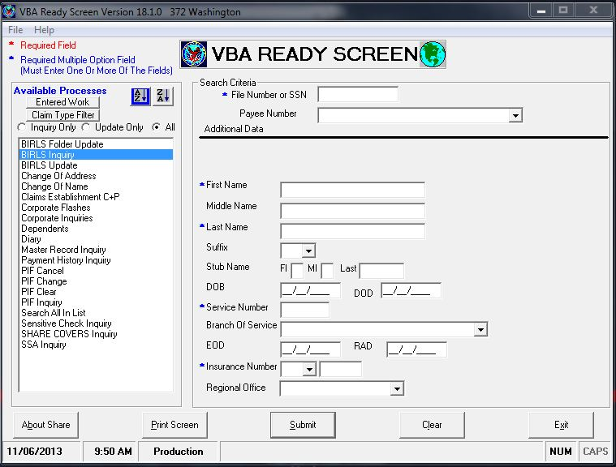
Birls MSC Screen
Review BIRLS MSC Screen
11

Slide 12
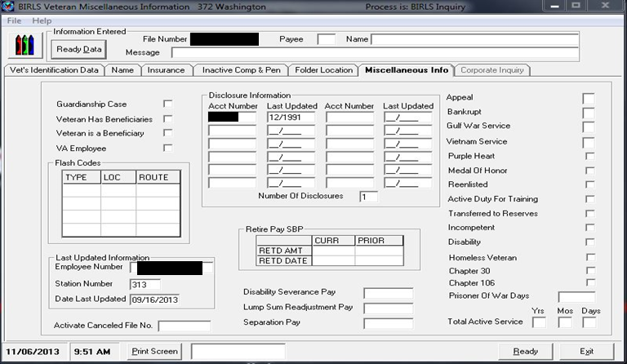
Birls MSC Screen cont.
Review BIRLS MSC Screen for additional payments
12

Slide 13
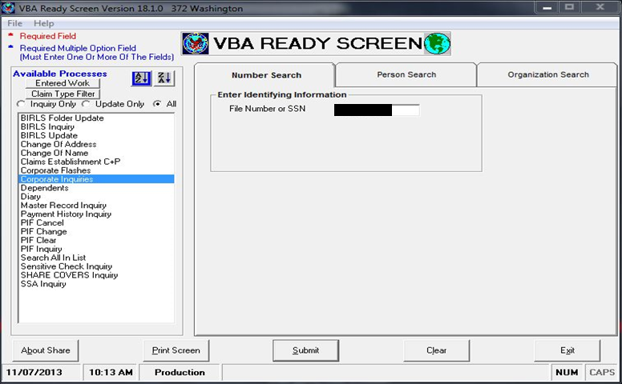
Review the Corporate Record
13

Slide 14
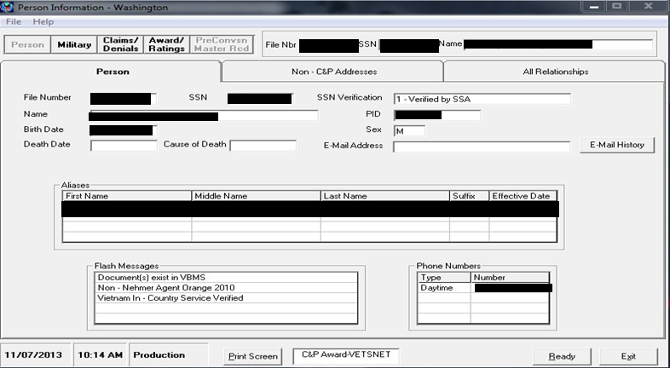
Review the Corporate Record cont.
Select the Military Tab
14

Slide 15
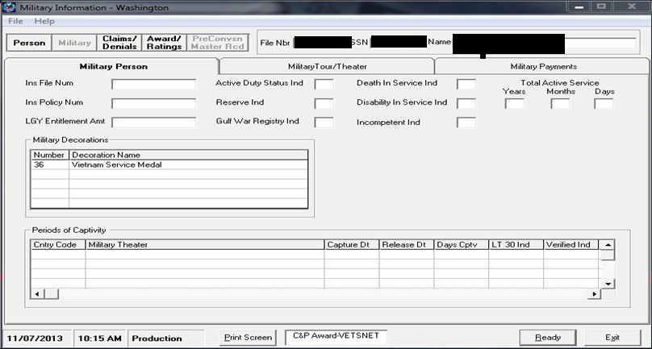
Review the Military Payments Screen
Select the Military Payments tab
15

Slide 16
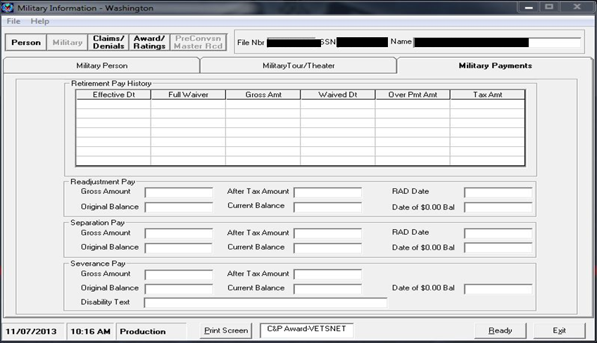
Review the Retired Pay History
16

Slide 17
Additional Ways to Confirm Payments
Or….call Defense, Finance and Accounting System (DFAS) 1-800-321-1080
Contact your local Retired Casualty Pay Subsystem (RCPS) Liaison
17

Slide 18
Prepare Award
Consider factors
Determine withholding end date
Determine amount to withhold
Is a waiver of record?
Is it an original award or an increase?
Is dependency an issue?
Is VA compensation or Military Retired Pay (MRP) greater?
18

Slide 19
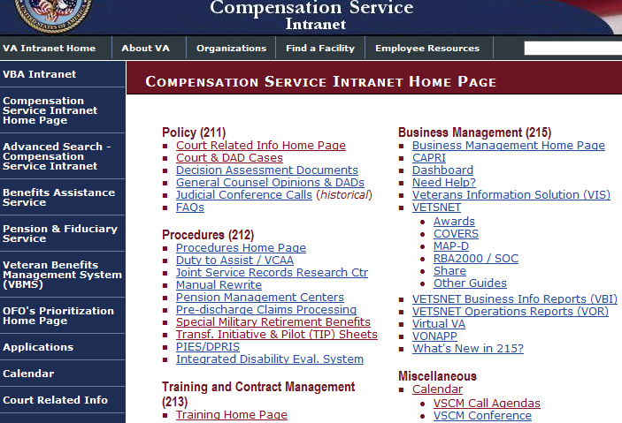
Determine the Cutoff (end) Date
Select the “Calendar” from the Compensation Service Intranet
19

Slide 20
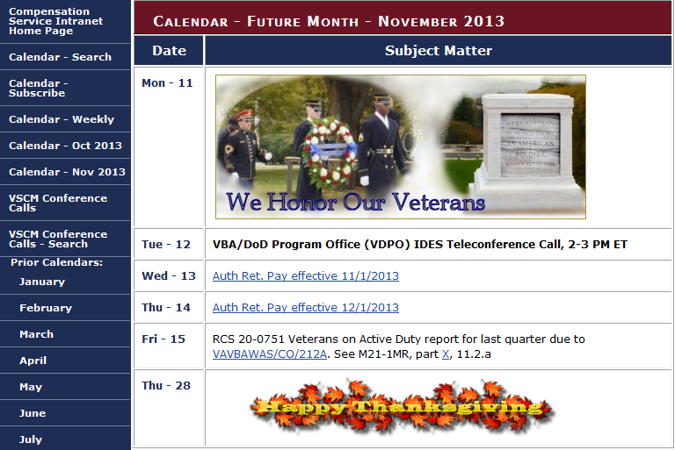
Prepare Cutoff (end) Date
20

Slide 21
Determine the Amount to Withhold
When Retired Pay is Greater:
Withhold VA compensation in an amount equal to the MRP until DFAS has had time to reduce the Veteran’s MRP by an amount equaling the compensation paid by VA. M21-1MR(III)(v)(5)(B)(9)(a)
21

Slide 22
Calculate the Amount to Withhold
To calculate the withholding for an original award you need the Veterans:
Gross Retired Pay amount
New Gross VA payment amount from the rate chart {slow way}, or by generating a dummy award {fast way}.
Original Example:
Vet receives MRP of $950. He is granted 10% in the amount of $129.00 per month, effective 3/14/13. How much will we withhold, when will the withholding start, and when will the withholding end based on the current calendar?
Answer: $129 from April 1, 2013 to (Current Month)
22

Slide 23
Calculate the Amount to withhold pt. 2
To calculate the withholding for an increased award you need the Veterans:
Gross Retired Pay amount
Prior NET VA payment (old rate) from the Awards/Ratings tab of the Corporate Inquiry in SHARE.
Prior VA withholding amount from the Awards/Ratings tab of the Corporate Inquiry in SHARE.
New Gross VA payment (new rate) amount from the rate chart {slow way}, or by generating a dummy award {fast way}
23

Slide 24
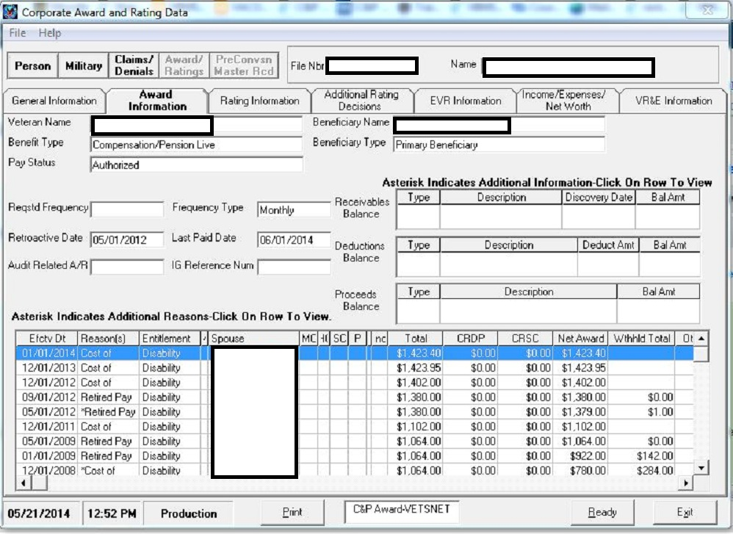
Prior Net VA Payment
24

Slide 25
Increased Award Adjustments
To calculate the withholding for an increased award you need the Veterans:
Gross Retired Pay amount
Prior NET VA payment (old rate) from the Awards/Ratings tab of the Corporate Inquiry in SHARE.
Prior VA withholding amount from the Awards/Ratings tab of the Corporate Inquiry in SHARE.
New Gross VA payment (new rate) amount from the rate chart {slow way}, or by generating a dummy award {fast way}
25

Slide 26
Increased Award Adjustments cont.
Increased example:
Veteran was previously 10% ($129) from 2/1/98. Increased to 20% ($255) effective 6/10/13. He receives $1200 per month for MRP. How much will with withhold, when will the withholding start, and when will the withholding stop based on the current calendar?
Answer: $126 from July 1, 2013 to (Current Month)
New Rate: $255
- Old Rate: $129
Withholding $126
**Whenever MRP is greater, the award should have a $0.00 Net Effect**
26

Slide 27
Increased Award Example
Increased example:
Veterans was previously 50% ($810)from 6/1/2005. Increased to 90% ($1,689) effective 2/13/13. He receives $1588 per month for MRP. How much will with withhold, when will the withholding start, and when will the withholding stop based on the current calendar?
Answer: $778 from March 1, 2013 to (Current Month)
MRP: $1,588
-Prior Net VA: $ 810
Withholding $ 778 Paying: $911
**Whenever VA compensation is greater than MRP, the award will release a retro payment**
27

Slide 28
Award Adjustments
When VA compensation is greater:
Pay the difference between the rate of compensation and the rate of MRP M21-1MR(III)(v)(5)(B)(9)(a)
28

Slide 29
Original Award Adjustments
To calculate the withholding for an original award you need the Veterans:
Gross Retired Pay amount
New Gross VA payment amount from the rate chart {slow way}, or by generating a dummy award {fast way}.
Original Example:
Vet receives MRP of $350. He is granted 60% in the amount of $1,026.00 per month, effective 3/14/13. How much will we withhold, when will the withholding start, and when will the withholding end based on the current calendar?
Answer: $350 from April 1, 2013 to (Current Month)
29

Slide 30
Input
Launch VBMS-A
Input award data
VETSNET Awards Handbook
VBMS-A User Guide
30

Slide 31
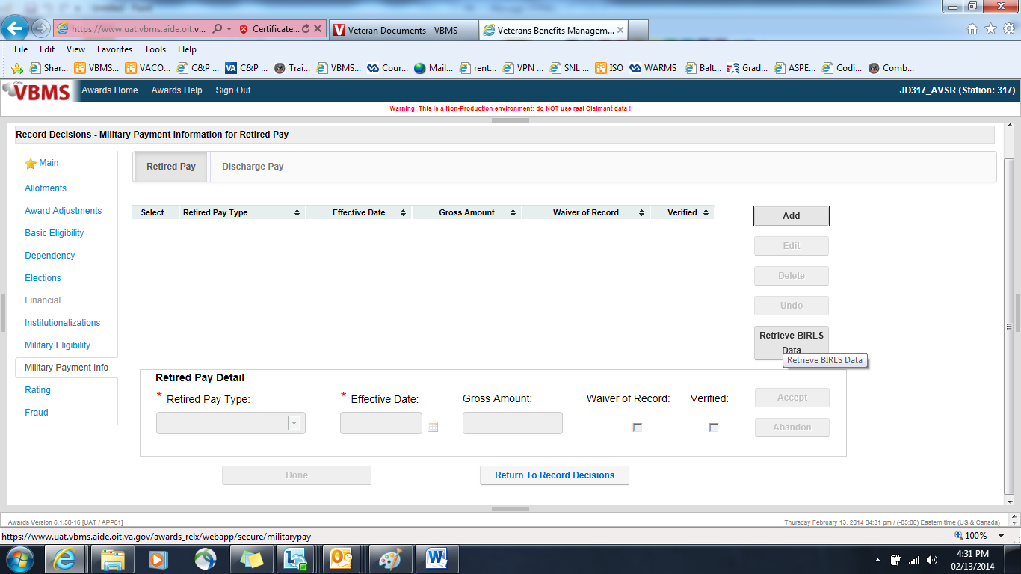
Military Payment Information Screen
The Veterans Retired Pay amounts have to be recorded in the “Military Payment Information” screen if it is not already in the record.
1) Military Pay Info
2) Select “Retired Pay” at top of screen
3) Select “Retrieve BIRLS Data”
4) If no record in BIRLS, select “Add”
5) Select “Retired Pay Type”, effective date,
and amount.
6) Select “Accept”
7) Select “Done”
31

Slide 32
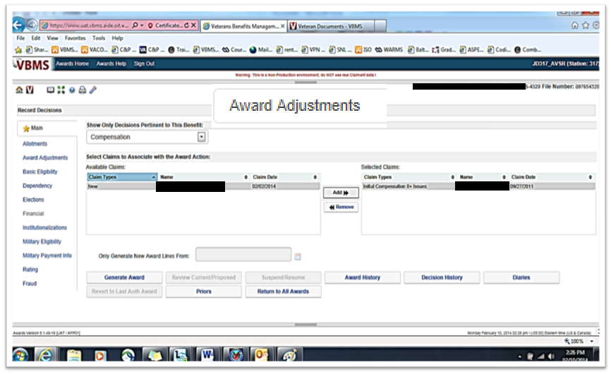
Award Adjustments Tab
32

Slide 33
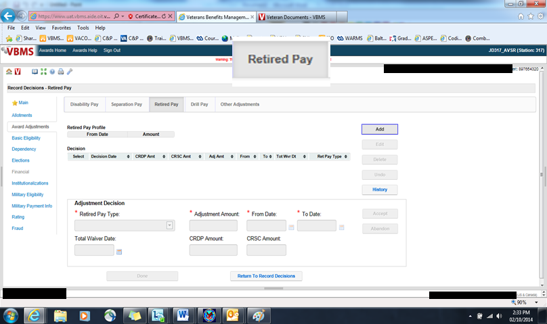
Retired Pay Tab
33

Slide 34
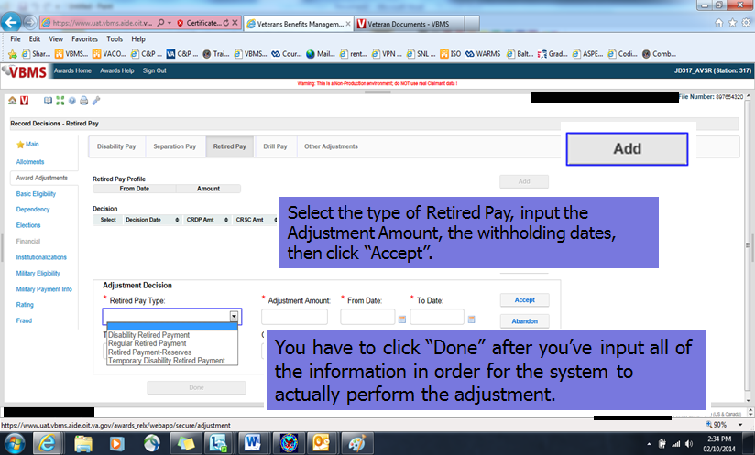
Inputting Award Adjustments
34

Slide 35
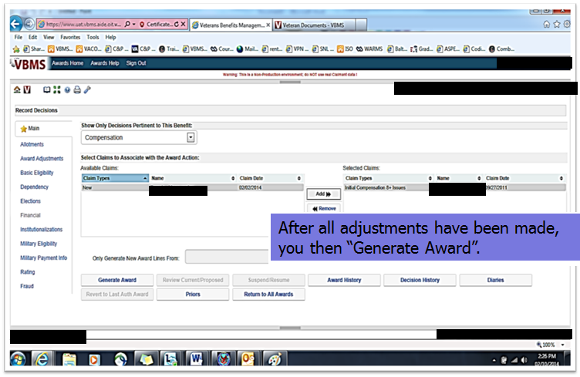
Generating an Award
35

Slide 36
Notify
M21-1MR(III)(v)(2)(B)(8)(b)
Effective dates of payments
Amounts withheld
Withholding: Full or Partial
April, 2011 Addendum to Compensation Service Bulletin
36

Slide 37
Notification Letter Directives
If the EP is one that is approved for ADL, the system will identify the withholding and adjust the notification letter accordingly.
If the EP is not approved for ADL, or you have encountered an error, you will create the notification letter in PCGL.
37

Slide 38
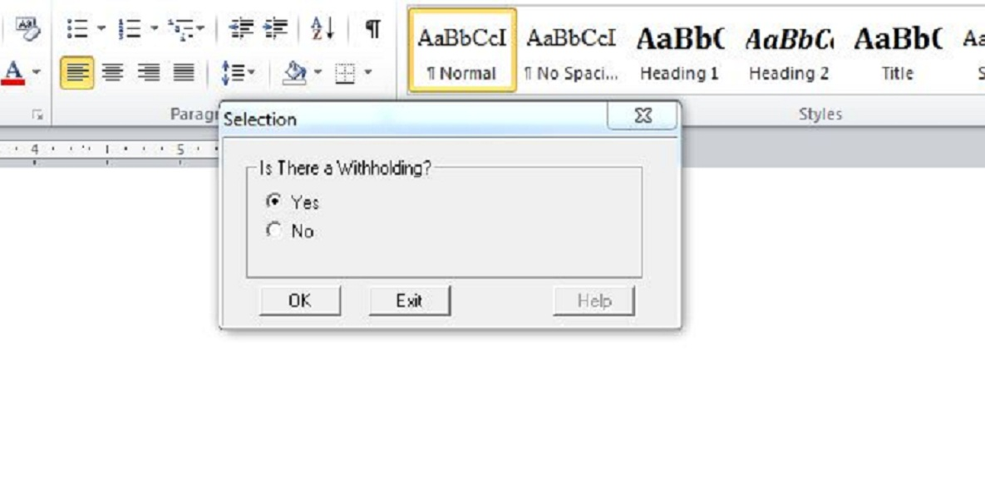
PCGL Notification
CG4 letter in PCGL for Rating Decisions
Withholding text is not an option in AB11 dependency letter
38

Slide 39
The Withholding Chart
39

Slide 40
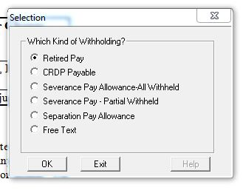
Withholding Selections
40

Slide 41
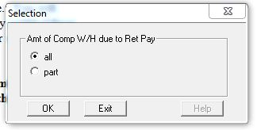
Amount to withhold
41

Slide 42
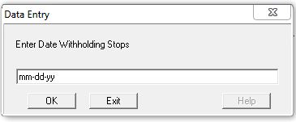
Entering the Cutoff (end) Date
42

Slide 43
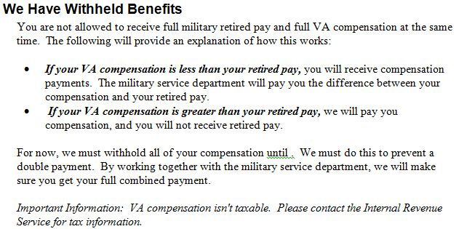
Notification of Cutoff (end) Date
43

Slide 44
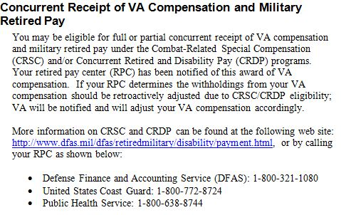
Addendum of April 2011
Per the addendum of the April, 2011 Compensation Service Bulletin
44

Slide 45
Summary
Confirm receipt of retired pay
Prepare to input award data
Input award data in VBMS-A
Notify by using PCGL
45

Slide 46
Review
Review

