Slide 1
(VSR VIP Pre-D) Introduction to End Product Controls and Claims Establishment
Compensation Service
September 2020

Slide 2
Lesson Objectives
Identify how End Product (EP) controls affect claim management, productivity, and staffing
Establish a claim using Veteran Benefits Management System Core (VBMS Core)
Describe procedures for adding contentions and special issues into VBMS Core
Define procedures for creating Corporate Flashes (RO Flashes and VACO Flashes)

Slide 3
References
M21-1, Part III, Subpart ii.1.C, Initial Screening Policies
M21-1, Part III, Subpart ii.3.B, Claims Establishment
M21-1, Part III, Subpart iii, 1.F, Record Maintenance During the Development Process
M21-1, Part III, Subpart iii.5.L, Adjusting Awards for Dependents
M21-4, Appendix B, End Product Codes and Work-Rate Standards for Quantitative Measurements
M21-4, Appendix C, Index of Claim Attributes
Share User’s Guide
VBMS Core User Guide
VBMS Core Online Help

Slide 4
End Products
The End Product (EP) system is the primary workload monitoring and management tool for the Veterans Service Center (VSC)
Correct use of the EP system facilitates proper control of pending workloads and appropriate work measurement credit.
Correct work measurement is essential to substantiate proper staffing requirements and determine productive capacity.
Received and completed Eps are used to formulate the annual budget submission to the Secretary, Office of Management and Budget (OMB), the President, and Congress

Slide 5
Establishing and Maintaining EP Controls
Each claim should be promptly placed under EP control
For claims establishment purposes, the date of claim (DOC) is the earliest date the claim or information is received in any VA facility
EP associated with a claim is used to control all development, rating and any award actions needed to the claimed issue.
EP should remain pending until all required actions on that claim have been completed.
Effective August 23, 2019, separate rating EPs are required to control compensation and pension claims pending simultaneously.

Slide 6
Examples of EPs
EP 010 – Initial disability compensation claim containing eight issues or more.
EP 110 – Initial disability compensation claim containing seven issues or less.
EP 020 – Compensation claims received after the initial eligibility decision.
EP 030 – Higher level review claims “de novo review” of the issue(s) identified by the requester. Can be both rating and non-rating issues.
EP 040 – Supplemental claims submitted when claimant disagrees with the decision VA made. Can be both rating and non-rating issues.
EP 130 – Applies to all actions involving dependency determinations to benefits based on relationship or dependency.
EP 400 – Correspondence and information actions usually handled on the basis of existing records and decisions, and a rating or authorization determination is not required for final disposition of the issue.

Slide 7
EP Controls – General Policies
Third digit modifiers
  Some EPs have designated modifiers
  Unless otherwise noted, an incremental (or sequential) EP is not authorized for rating purposes
  Incremental Appeals Modernization Act EPs (e.g. 031, 032, 033) are used to process multiple distinct copies of decision review requests
EP 130 and a rating EP representing an original claim for benefits may never run concurrently

Slide 8
Establishing Claims in VBMS Core
VBMS Core is used to establish:
All initial claims for compensation
Pension and survivor claims
Claims where the claimant has a VA appointed fiduciary
Most claim types for which a VBMS record already exists.

Slide 9
Establishing Claims in Share
Share is a legacy system. VA is moving the functionality to establish claims to VBMS Core and Caseflow. The following are the types of claims that must be established in Share.
Any claim where the claimant is an organization, unless the organization is a state cemetery
Discovered legacy appeals where the applicant is not a child, spouse, or parent of the Veteran
Accrued claims upon the death of a surviving spouse or child
You will not be processing these types of claims during VIP training.

Slide 10
Establishing Claims in Caseflow
The Veterans Appeals Improvement and Modernization Act authorized two new decision review options.
Higher Leve Review (HLR) EP 030
Supplemental Claims EP 040
Both types claims must be established using Caseflow

Slide 11
Preparing for Claims Establishment (CEST)
Check for a previously established claims folder number
Determine the current claims folder location and request scanning of paper claim folder (if necessary)
Review the VBMS exclusions to determine the system in which to place the claim under control
Place EP under control using the appropriate system

Slide 12
Establishing a New EP in VBMS Core
Navigate to the Veteran’s Profile and select New Claim from the ACTIONS drop down menu
On the NEW CLAIM screen verify the Veteran’s name, address, telephone number and email are correct
Check for open claims in the EXISTING CLAIMS field
Complete the required CLAIM INFORMATION fields (indicated by red *) all applicable optional fields and click SUBMIT
Enter claimant’s contentions, completing the required fields

Slide 13
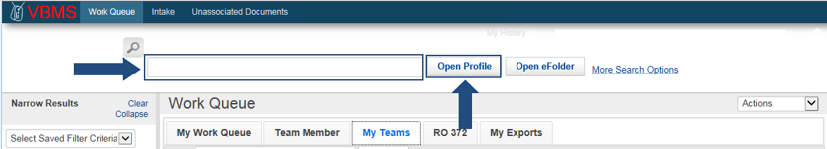
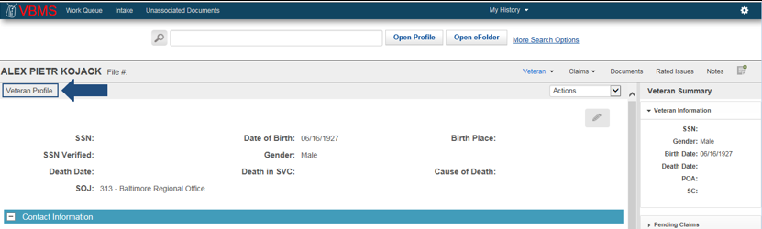
Veteran’s Profile Screen
Navigate to the Veteran’s profile via entry of the claim number or social security number in the search box and selecting Open Profile.

Slide 14
Date of Claim (DOC)
For CEST purposes, the DOC is the earliest date the claim was received by a VA facility. Examples include, but are not limited to:
  eBenefits
  VA Regional Office
  VA Centralized Mail Facility
  VA employee at an outreach event
  VA Public Contact team
  VA Call Center
  VA Medical Center
  All documents submitted to VA must receive an electronic or manual date stamp showing the date of receipt
  Critical to make sure the DOC is correct as it can impact benefit entitlement

Slide 15
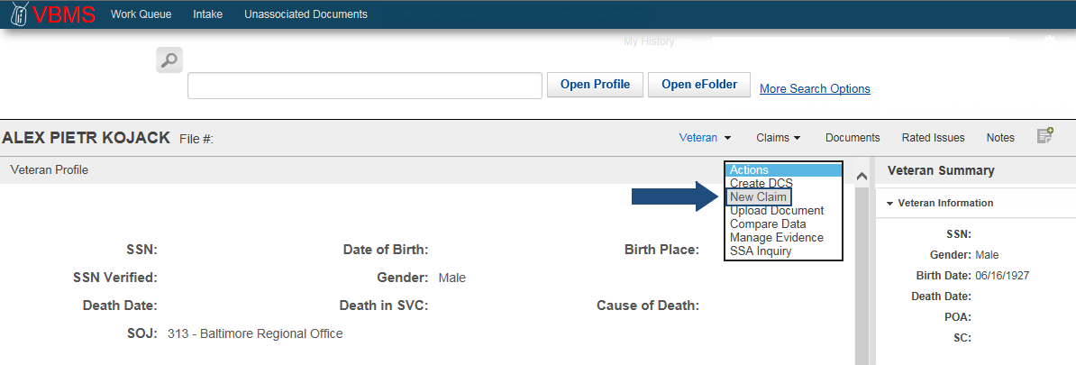
Establishing a New Claim
Click Actions and select New Claim. The Claim Establishment page opens to the New Claim Information section.

Slide 16
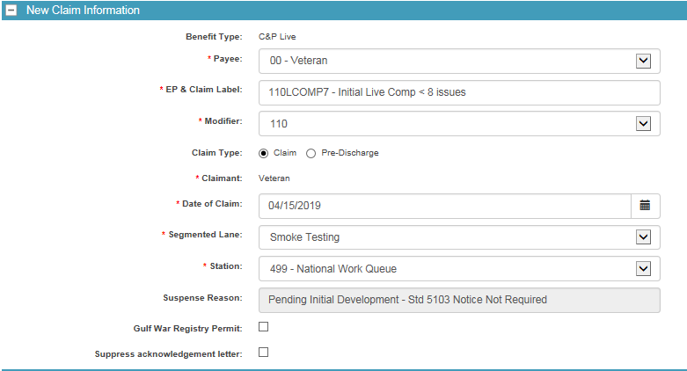
New Claim Information Screen
Complete all the entries noted by the red asterisk.

Slide 17
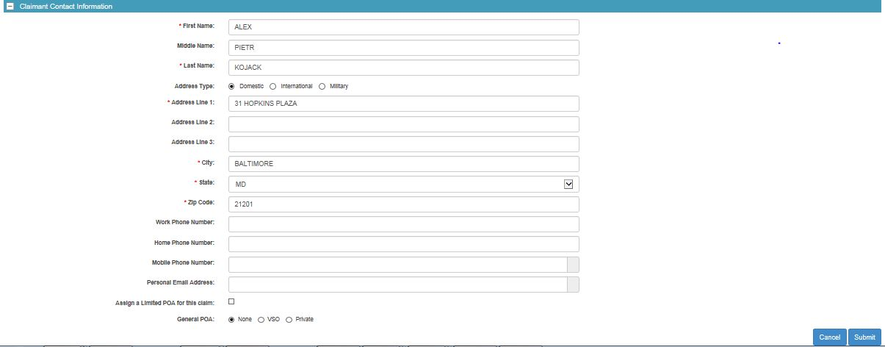
Claimant Contact Information
Verify Veteran’s contact information and POA and update as needed. Click Submit.

Slide 18
New Contentions at Claims Establishment
Once claims establishment is complete, the system automatically goes to the Contentions list
This information is available via eBenefits and should be easy to understand and in the claimant’s own words, as appropriate
Each claimed issue, including non-rating issues, must be entered as a separate contention
Non-rating contentions must relate to the specific benefit being sought

Slide 19
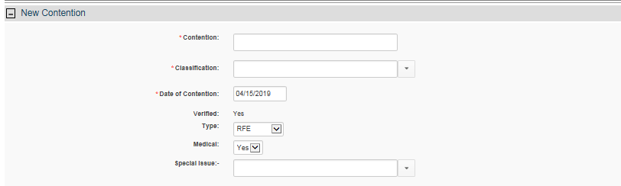
Adding Contentions
Click Add Contention
Add the contention, classification, date of contention, type, medical and any special issues

Slide 20
Examples of Appropriate Naming
Scenario: A Veteran submits an initial claim for service connected compensation for hearing loss due to acoustic trauma and ringing in the ears, along with a claim to add a spouse and a child. Contentions should be:
dependency claim for [name of spouse]
dependency claim for [name of child]
hearing loss due to acoustic trauma
ringing in the ears

Slide 21
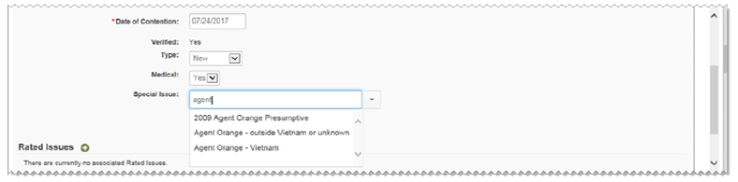

Special Issues
Special issues may apply to the contention and/or a claim. When applicable, select an issue from the drop-down menu that applies. Click on the [X] next to the special issue to remove, if applicable.

Slide 22
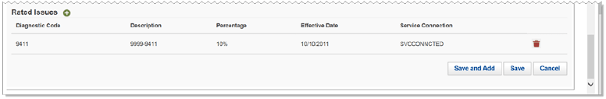
Rated Issues
Contentions with a claim type of secondary or increase are often associated with issues that have been previously determined.
Increase and Routine Future Exam (RFE ) contentions must be associated to a rated issue before you can add them to an exam scheduling request
Click the green add icon next to Rated Issues and follow prompts to add.

Slide 23
Reviewing Established Contentions
Electronically entered contentions (eBenefits, Stakeholder Enterprise Portal (SEP), etc.) will be marked unverified with an alert icon
  Click the plus sign [+] next to the contention to view and/or edit the contentions
  All contentions must be verified in order to be available for viewing via eBenefits
To add additional contentions, follow New Contentions at Claims Establishment procedures

Slide 24
Adding Flashes in Share
Claimant flashes are claimant-specific indicators that represent an attribute, fact, or status that may occasionally change, such as:
  Prisoner of War (POW)
  Homeless
  Hardship
  Blind Veteran
  Third Party Release
Flashes can be reviewed in reviewed in the Veteran Summary or Veteran Profile screen in VBMS Core but must be entered through Share if they are entered manually

Slide 25
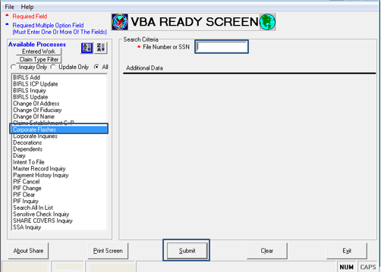
How to Add a Flash in Share
Open Share from your Start menu
Select Corporate Flash from the Available Processes list on the Ready Screen
Under Search Criteria, enter the File Number
Select the Submit button

Slide 26
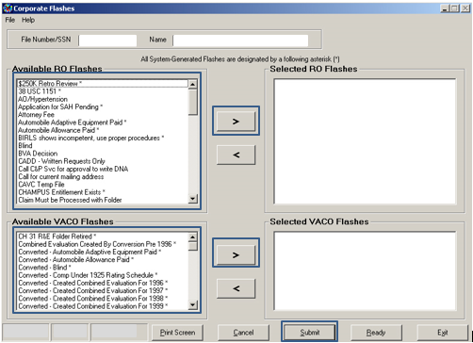
How to Add a Flash in Share (Cont.)
Select desired flashes
Use the > button to add flashes to the Selected Flashes boxes
Repeat as needed, then click Submit
A message will be displayed stating the updates are complete

Slide 27
Questions

