Slide 1
Administrative Decision: Continuous Cohabitation
Compensation Service
November 2015

Slide 2
Lesson Objectives
Understand why VA makes continuous cohabitation decisions
Identify when continuous cohabitation is at issue
Determine when to initiate development and identify evidence needed
Discuss the effects of misconduct by either spouse in the creation of a separation
Assess evidence and write continuous cohabitation administrative decisions if necessary
2

Slide 3
Why Is It Important?
You are responsible for deciding if someone is entitled to benefits or not.
Our level of commitment, admiration, and response for those who served us in times of war, conflict, and peace
3

Slide 4
References
38 CFR 3.50 through 3.55, specifically 3.53, Continuous Cohabitation
M21-1 III.iii.5.E.6, Continuous Cohabitation
M21-1 III.iii.5.B.1.a, Requirements for Establishing Marital Relationship
M21-1 III.v.1.A, Administrative Decisions
Gregory v. Brown, 5 Vet. App. 108, (1993)
Alpough v. Nicholson, June 18, 2007, No. 2006-7304
4

Slide 5
Why Do We Have to Make a Decision?
Entitlement to survivor’s benefits is contingent on establishing the relationship with the Veteran.
If there is a question about the relationship, we must resolve it.
5

Slide 6
Elements of Continuous Cohabitation
The claimant must meet the continuous cohabitation requirement of 38 CFR 3.50(b)(1) to qualify as the surviving spouse of a Veteran for VA purposes.
6

Slide 7
38 CFR 3.50(b)(1)
Except as provided in §3.52, "surviving spouse" means a person of the opposite sex whose marriage to the veteran meets the requirements of §3.1(j) and who was the spouse of the veteran at the time of the veteran's death and:
(1) Who lived with the veteran continuously from the date of marriage to the date of the veteran's death except where there was a separation which was due to the misconduct of, or procured by, the veteran without the fault of the spouse; and
(2) Except as provided in §3.55, has not remarried or has not since the death of the veteran and after September 19, 1962, lived with another person of the opposite sex and held himself or herself out openly to the public to be the spouse of such other person.
7

Slide 8
Establishing a Marriage
M21-1 III.iii.5.B.1.a
A marriage (between members of the same or opposite sex) may be established for VA purposes if the marriage is valid under the law of the locality where the parties resided
At the time of the marriage OR
When the claimant filed a valid claim (or became eligible for benefits, if eligibility arose after the date of claim)
8

Slide 9
Same Sex Marriage Does Not Exclude
Per VBA Letter 20-15-16, Administration of Same-Sex Spousal Benefits, in accordance with the U.S. Supreme Court decision in Obergefell v. Hodges, the marriage does not have to be between persons of the opposite sex.
9

Slide 10
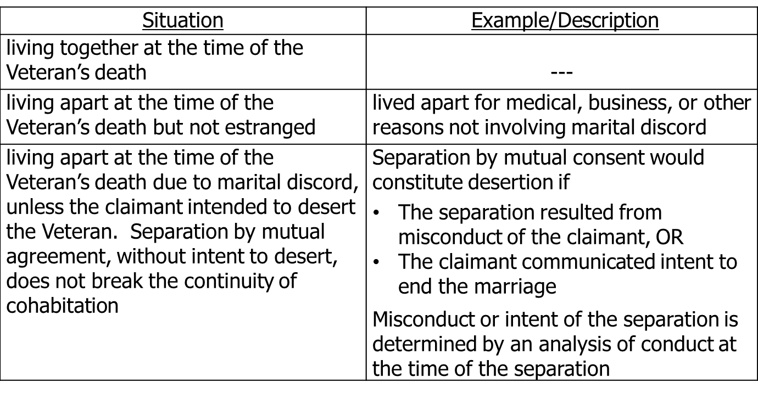
Elements of Continuous Cohabitation
The requirement of continuous cohabitation is met if any of the following occurred.
10

Slide 11
Important Points to Remember
Continuous cohabitation is found if separation was:
due to the misconduct of the Veteran
Without the fault of the surviving spouse
Fault must lie with the Veteran, even if the surviving spouse initiated the separation.
Temporary separations which ordinarily occur do not count
Separations during the marriage are irrelevant if not separated at the time of death.
Events are related to specific time and reason--not later conduct.
Be aware of a “holding out publicly as the spouse of another person” issue (38 CFR 3.50(b)(2)).

Slide 12
Claimant’s Obligation to Reconcile
The spouse of a deceased Veteran who was separated from the Veteran due to the fault of the Veteran has no affirmative obligation to attempt to reconcile with the Veteran.
As long as the spouse is not materially at fault in the separation, the continuous cohabitation requirement is met.
It is irrelevant that the parties lived apart for many years prior to the Veteran’s death, as long as the claimant did not intend to desert the Veteran.
12

Slide 13
When to Initiate Development
If there is an indication that the Veteran and claimant were not living together immediately prior to the Veteran’s death.
If there is no contradictory evidence of record, accept the claimant’s statement as to the reasons for the separation without further development.
13

Slide 14
Development
Use MAP-D to develop to claimant. Ask the claimant to submit a certified statement on VA Form 21-4138, Statement in Support of Claim, and statements from at least two (2) persons showing:
The date, place, and explanation of each separation
Whether or not there was a written agreement or court order of separation (if so, a copy should be submitted, AND
Whether the claimant or veteran ever applied for divorce or annulment (if so, a copy of the decree should be submitted).

Slide 15
Development (cont.)
Also request relatives of the Veteran to furnish statements concerning their understanding of the circumstances surrounding the separation if their names and current addresses are of record.

Slide 16
Findings of Fact
38 CFR 3.53(b)
What evidence we will accept.
Second explanation of separation and fault.
The difference between federal and state laws.

Slide 17
Making a Decision
Once response is received, or after 30 days elapse, whichever is earlier, review the evidence:
If… | Then…
Continuous cohabitation established | No administrative decision
Continuous cohabitation not established | Two signature administrative decision needed
Lack of continuous cohabitation and question as to the validity of the marriage | No administrative decision and deny the claim without resolving the question of legality of the marriage.

Slide 18
Making a Decision (cont.)
Common to have continuous cohabitation, deemed valid marriage, and/or contested claim issues simultaneously.
Okay to address all issues in one decision.

Slide 19
Review Exercise
Please review and complete the exercise in your handout. Please be prepared to discuss.

Slide 20
QUESTIONS

