Slide 1
Claims Based on Service in Southwest Asia
Compensation Service
November 2020

Slide 2
Objectives
Demonstrate a comprehensive understanding of developing claims for disabilities based on the provisions of 38 CFR 3.317, to include:
undiagnosed illness,
medically unexplained chronic multi-symptom illness (MUCMI), and
presumptive infectious diseases

Slide 3
References
38 CFR §3.317 - Compensation for certain disabilities occurring in Persian Gulf veterans
M21-1 IV.ii.1.E - Claims Based on Service in Southwest Asia
M21-1 IV.ii.2.D - Service Connection (SC) for Qualifying Disabilities Associated with Service in Southwest Asia

Slide 4
Application in the Workplace
Becoming familiar with these types of claim will:
Improve your own personal quality and the quality of your office
Ensure the accuracy of decisions rendered in connection with claims submitted for conditions resulting from service in Southwest Asia
Prevent unnecessary delays in the claims process which may result from over or under development

Slide 5
Provisions of the Persian Gulf War Veterans’ Benefits Act of 1994
Enacted on November 2, 1994, this provision added a new section, 38 U.S.C. 1117, which authorized the VA to compensate any Gulf War (GW) Veteran suffering from a chronic disability resulting from an undiagnosed illness or combination of undiagnosed illnesses which manifested either:
during active duty in the Southwest Asia theater of operations during the GW, or
to a degree of 10 percent or more within a presumptive period following service in the Southwest Asia theater of operations during the GW

Slide 6
Provisions of 38 CFR 3.317
Defines certain key terms and provides for presumptive service connection for:
undiagnosed illness or MUCMI, and
a list of infectious diseases

Slide 7
Provisions of the Persian Gulf War Veterans’ Act of 1998
Authorized the VA to compensate GW Veterans for diagnosed or undiagnosed disabilities that are determined by VA regulation to warrant a presumption of service connection based on a positive association with exposure to one of the following as a result of GW service:
a toxic agent
an environmental or wartime hazard, or
a preventive medication or vaccine

Slide 8
Provisions of the Veterans Education and Benefits Expansion Act of 2001
Effective March 1, 2002, this provision expanded the definition of “qualifying chronic disability” to include, not only a disability resulting from an undiagnosed illness but also:
a medically unexplained chronic multi-symptom illness (MUCMI) that is defined by a cluster of signs and symptoms, and
any diagnosed illness that is determined by VA regulation to warrant presumption of SC

Slide 9
Knowledge Check
What are the provisions of 38 CFR 3.317?
Defines certain key terms and provides for presumptive service connection for undiagnosed illness or MUCMI and a list of infectious diseases.

Slide 10
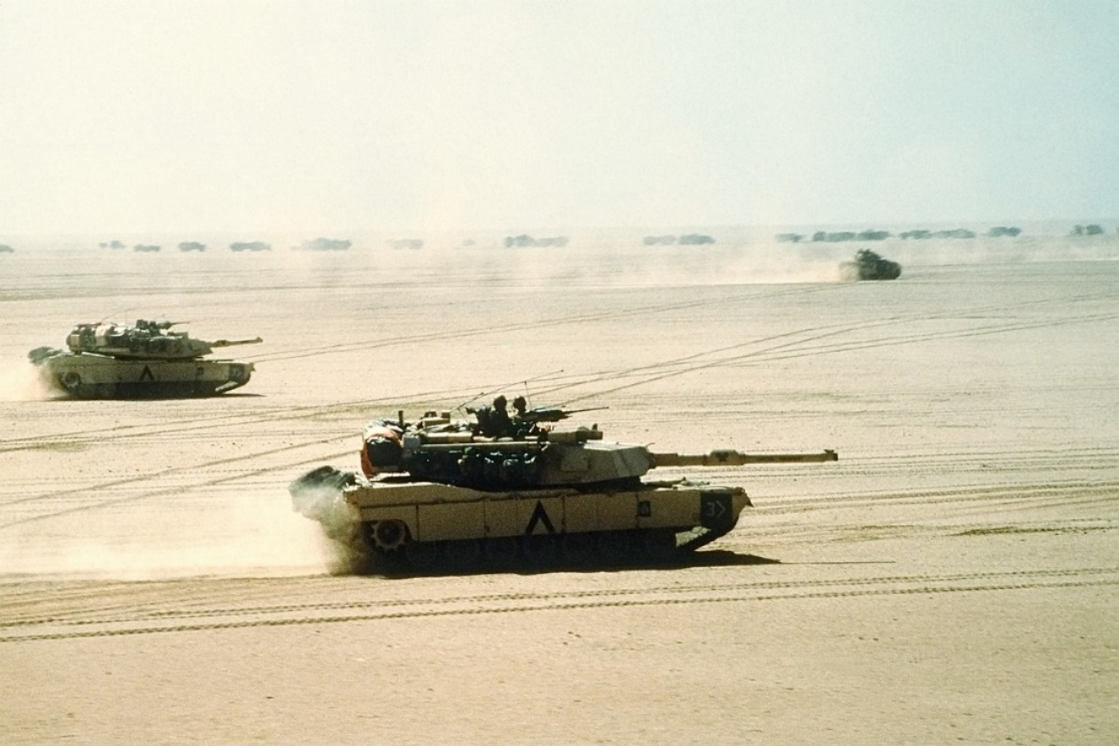
Presumptive SC for Undiagnosed Illness and MUCMIs Under §3.317 (A&B)
Notes:
The focus of this topic will be on Gulf War presumptive conditions as defined by §3.317. The topic does not cover specific Gulf War environmental hazards such as burn pits, particulate matter, sulfur fire, or Chromium VI. For more information on those topics, see the training titled “Claims Based on Exposure to Environmental Hazards in Iraq, Afghanistan, and Djibouti.” Or other (non-GW) environmental hazards, such as Camp Lejeune and Atsugi.

Slide 11
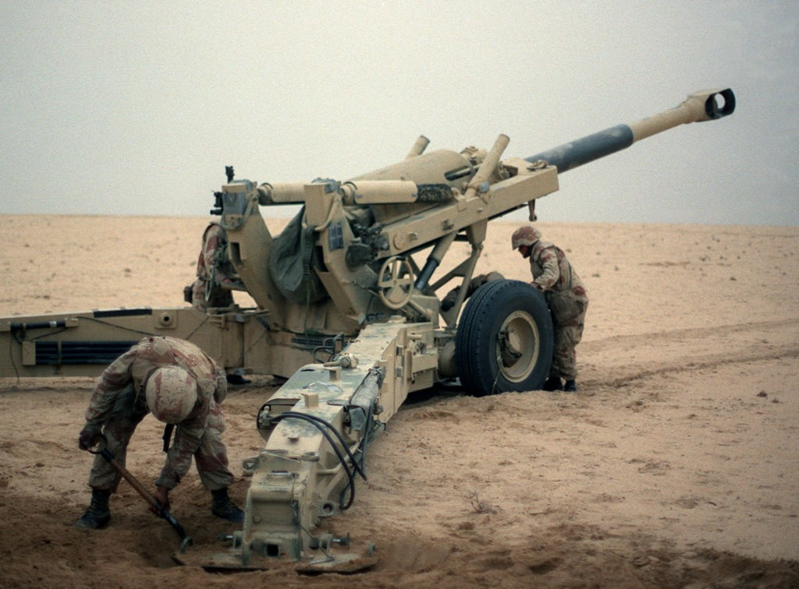
Qualifying Veteran for Undiagnosed Illness and MUCMIs
A Veteran who served on active military, naval, or air service in the Southwest Asia theater of operations during the GW period:
The GW period extends from August 2, 1990, through a date yet to be determined by law or Presidential proclamation
Notes:
Explain: Only Veterans who are eligible for consideration of service connection for Undiagnosed Illness and MUCMIs are those who have qualifying service.
First step when you receive one of these claims is to develop for verification of qualifying service.

Slide 12
Definition: Southwest Asia Theater of Operations
The Southwest Asia theater of operations includes the following locations and the airspace above them:
Iraq
Kuwait
Saudi Arabia
the neutral zone between Iraq and Saudi Arabia
United Arab Emirates
Bahrain
Qatar
Oman
the Gulf of Aden
the Gulf of Oman
the Persian Gulf
the Arabian Sea
the Red Sea
NOTE: Afghanistan is NOT considered a part of the Southwest Asia theater of operations
Notes:
Explain: this is an inclusive list of the areas that the Veteran must have served in to qualify for service connection for Undiagnosed Illness and MUCMIs.
Reiterate: the first thing you want to do in these cases, is verify service in one these locations. (We will cover development after we discuss what conditions qualify.)

Slide 13
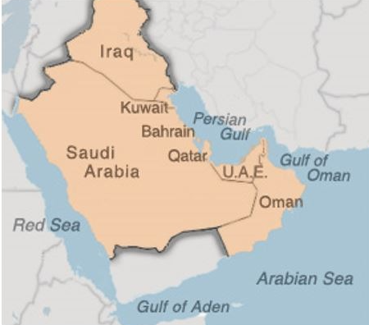
Presumptive Period for Manifestation of Disability
The date following last performance of active military, naval, or air service in the Southwest Asia theater of operations during the GW through December 31, 2021.
Notes:
Explain: this date might be extended, but until (or unless) it is, this is what the regulation states.

Slide 14
Qualifying Chronic Disability
A chronic disability resulting from any of the following or any combination of the following:
an undiagnosed illness, or
a MUCMI
Notes:
Explain: The Veteran does not have to identify a claimed disability as due to Gulf War service. It is our duty to recognize the potential entitlement based on the criteria being met. If you see a Veteran has qualifying Southwest Asia service, and claims anything that could possibly be considered under this regulation, we must pursue appropriate development

Slide 15
Signs and Symptoms of Undiagnosed Illnesses or MUCMIs
joint pain
muscle pain
neurological signs or symptoms
headache
neuropsychological signs or symptoms
gastrointestinal signs or symptoms
abnormal weight loss
fatigue
sleep disturbances
respiratory signs and symptoms (upper or lower)
cardiovascular signs or symptoms
signs and symptoms involving skin
menstrual disorders
Note: The list of categories is not exclusive; signs or symptoms not represented by one of the listed categories may also qualify
Notes:
Explain: Whenever you see a claim for service connection for any of these types of conditions from a Veteran who has qualifying service, order a GW general medical examination. (AND any applicable specialty examinations that might also be necessary.)

Slide 16
Definition: Undiagnosed Illness
A type of chronic qualifying disability where qualifying signs and/or symptoms cannot be attributed to any known clinical diagnosis by history, physical examination and laboratory tests
Notes:
Note: The existence of a clinical diagnosis with specific etiology, which may weigh against §3.317 entitlement, does not preclude the ordering of a Gulf War examination unless all symptoms claimed by the Veteran are clearly attributable to the diagnosis, such as a condition like sleep apnea that is definitely diagnosed via sleep study.

Slide 17
Definition: MUCMI
A type of chronic qualifying disability in which there is a diagnosed illness that has:
An inconclusive pathophysiology and etiology,
overlapping symptoms and signs, and
features such as
fatigue and pain
disability out of proportion to physical findings, and
inconsistent demonstration of laboratory abnormalities
Notes:
Explain: It will be the examiner’s job to make the determination if what the Veteran has is considered undiagnosed versus MUCMI, versus a diagnosable condition with a known etioliogy, etc. It is all a part of the GW general medical examination.

Slide 18
MUCMIs include, but are not limited to
chronic fatigue syndrome
fibromyalgia, or
functional gastrointestinal disorders (FGIDs), excluding structural gastrointestinal diseases
Notes:
Explain These specifically identified MUCMIs are presumptive, but that does not mean that ones that are not cited here could not also be service connected.
Stress as the title states, this list is not limited to just these conditions as this is not an all exclusive list.

Slide 19
Definition: FGIDs
A group of diagnosed conditions that are a type of MUCMI. They are characterized by chronic or recurrent symptoms that are:
unexplained by any structural, endoscopic, laboratory, or other objective signs of injury or disease, and
may be related to any part of the gastrointestinal tract
Notes:
Explain: The regulation used to just specify irritable bowel syndrome, but it has been amended to broaden the scope and now defines such conditions as FGIDs.

Slide 20
Characteristic FGID symptoms include
abdominal pain
substernal burning or pain
nausea
vomiting
altered bowel habits (including diarrhea, constipation)
indigestion
bloating
postprandial fullness
painful or difficult swallowing
Notes:
Explain: again, any time a Veteran claims any of these type of symptoms, and has qualifying service, we will order the GW general medical examination. It is up to you to recognize the signs/symptoms that might be associated to GW service.

Slide 21
FGID (cont.)
Diagnosis of a FGID under generally accepted medical principles normally requires:
symptom onset at least six months prior to diagnosis, and
the presence of symptoms sufficient to diagnose the specific disorder at least three months prior to diagnosis
FGID diagnoses include but are not limited to:
irritable bowel syndrome, and
functional
dyspepsia,
vomiting,
constipation,
bloating,
abdominal pain syndrome, or
dysphagia
Notes:
Explain again, this will be the doctor’s determination. Not the VSR or RVSR.

Slide 22
FGID (cont.)
Important: FGIDs do not include structural gastrointestinal diseases, such as:
inflammatory bowel disease (such as ulcerative colitis or Crohn's disease), and
gastroesophageal reflux disease (GERD),
as these conditions are considered to be organic or structural diseases characterized by abnormalities seen on x-ray, endoscopy, or through laboratory tests
Notes:
Reiterate: Keep in mind that just because a Veteran claims, or has a diagnosis of GERD, you do not want to just discount their claim (under §3.317) based on the existence of that diagnosis. The symptoms of GERD can also be consistent with those under FGIDs. It is common for a doctor to document a diagnosis based on the symptoms, however unless there is evidence that there has been comprehensive testing (as noted on the slide) conducted which resulted in the clinical diagnosis with specific etiology, order the GW general medical examination so that a VA doctor can review all evidence and make the determination.

Slide 23
Partially Understood Chronic Multi-symptom Illnesses
Chronic multi-symptom illnesses of partially explained etiology and pathophysiology, such as:
diabetes and
multiple sclerosis
are not considered medically unexplained and cannot be considered a qualifying chronic disability for purposes of 38 CFR 3.317.
Notes:
Explain keep in mind that these are §3.309(a) conditions, so consideration under presumptive service connection still may apply, just not under §3.317.

Slide 24
Knowledge Check
How does a Veteran qualify to be considered for an Undiagnosed Illness and/or MUCMI?
The Veteran must have served on active military, naval, or air service in the Southwest Asia theater of operations during the GW period from August 2, 1990, through a date yet to be determined.
M21-1 IV.ii.2.D.1.e. - Definition: Qualifying Veteran
Under 38 CFR 3.317

Slide 25
Knowledge Check (cont.)
The Southwest Asia Theatre of Operations include what locations?
M21-1 IV.ii.2.D.1.f. - Definition: Southwest Asia Theater of Operations
Iraq Kuwait Saudi Arabia the neutral zone between Iraq and Saudi Arabia United Arab Emirates Bahrain Qatar | Oman the Gulf of Aden the Gulf of Oman the Persian Gulf the Arabian Sea the Red Sea

Slide 26
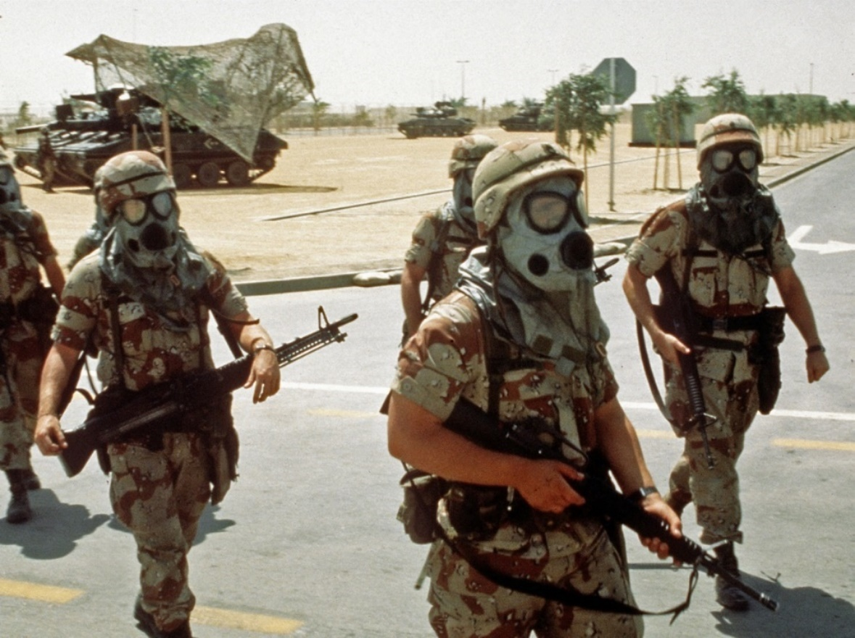
Presumptive SC for Infectious Diseases Under §3.317(c)
Notes:
Explain that although the infectious diseases are also listed under §3.317, they are separate and distinct from the undiagnosed illness and MUCMIs.

Slide 27
Qualifying Veteran for Infectious Diseases
The Veteran served on active duty:
in the Southwest Asia theater of operations during the GW (as previously defined), OR
in Afghanistan on or after September 19, 2001
Please note for claims for infectious disease, Veterans who served
on active duty in Afghanistan can qualify for presumption under 38 CFR 3.317(c).
Notes:
Important: Notice the inclusion of Afghanistan!!!

Slide 28
Qualifying Infectious Diseases
Infectious Disease | Time Limit for Manifestation
Brucellosis | one year
Campylobacter jejuni | one year
Coxiella burnetii (Q fever) | one year
Malaria | one year, or at a time when standard or accepted treatises indicate that the incubation period began during a qualifying period of service
Mycobacterium tuberculosis | no time limit
Nontyphoid Salmonella | one year
Shigella | one year
Visceral leishmaniasis | no time limit
West Nile virus | one year
The disease must manifest to a compensable degree within the time limit specified in the table.
Notes:
Note: There must be actual clinical/medical evidence of a diagnosis of one of the above. Immunization for infectious diseases, or tests for them, are not the same as actually having/contracting them.
Emphasize: The one year time period specified in the table means within one year from the date of separation from a qualifying period of service as specified in 38 CFR 3.317 (c)(3)(ii).

Slide 29
Long-Term Health Effects Potentially Associated with Infectious Diseases
The Institute of Medicine of the National Academy of Sciences has identified the conditions listed in column B in the table below as potential long-term health effects associated with the infectious diseases (column A). See §3.317 and M21-1 IV.ii.2.D.1.q. for complete table.
Column A – Infectious Disease | Column B – Associated Condition(s)
Malaria | demyelinating polyneuropathy Guillain-Barre syndrome hematologic manifestations (particularly anemia after falciparum malaria and splenic rupture after vivax malaria) immune-complex glomerulonephritis neurologic disease, neuropsychiatric disease, or both ophthalmologic manifestations, particularly retinal hemorrhage and scarring Plasmodium falciparum Plasmodium ovale Plasmodium vivax renal disease, especially nephrotic syndrome
If a Veteran who is presumed SC for a disease listed in column A is diagnosed with a disease in column B within the time period specified in the table (if no time period is specified, at any time), VA will request a medical opinion as to whether it is at least as likely as not that the condition was caused by the Veteran having had the associated disease in column A.
Notes:
Explain: If the evidence shows that a Veteran actually did contract an infectious disease, this could lead to a plethora of secondary conditions. As noted on the slide, there is an extensive chart located in the Manual, that should be referred to any/every time this type of claim is being processed. You would need to locate the specific disease the Veteran had (in column A) and then consider all potentially associated conditions shown (in column B) as possibly service connected on a secondary basis.

Slide 30
Knowledge Check
Veterans who served on active duty in Afghanistan can qualify for presumption of what type of disease under 3.317 (c)?
Infectious

Slide 31
Developing Southwest Asia Claims
Notes:
Explain that development for claims based on service in Southwest Asia is not significantly different than developing other types of claims. If anything, they should be handled with as liberal of an approach as possible.

Slide 32
Claim for Exposure to Environmental Hazards
An allegation of exposure to an environmental hazards during service without an associated claim for service connection for a specific disability resulting from the exposure is not a substantially complete claim. In cases such as these:
Inform the Veteran exposure in and of itself is not a disability, and
Ask the Veteran to identify the disability(ies) that resulted from exposure to environmental hazards during service.
Important: In situations where exposure has been alleged but no specific disability has been identified as resulting from exposure, it would be erroneous to process the claim as a denial or establish EP control for the incomplete claim unless there were other complete claims also submitted.
Notes:
A claim is not substantially complete if a Veteran alleges exposure to environmental hazards during service, but does not identify the medical condition or symptom for which service connection (SC) is claimed.
Important: Whenever possible, telephone the Veteran to obtain the information needed to substantiate the claim. Do not establish a pending EP until the Veteran has identified a disability that has resulted from exposure to the environmental hazard. Do not process the claim as a denial. (There is NO rating jurisdiction without a disability identified!) M21-1 Part IV, Subpart ii.1.E.1.a

Slide 33
Initial Development Action
There is no requirement for a specialized Section 5103 notice.
Important: Send a standard Section 5103 notice if the Veteran files a substantially complete application on a non-EZ form.
Notes:
Explain For any new claim for SC for a qualifying disability under 38 CFR 3.317 resulting from service in Southwest Asia, additional development to the Veteran is not required as the evidence requirements are covered under the Disability Service Connection evidence table of the VA Form 21-526EZ, Application for Disability Compensation and Related Compensation Benefits.
Note: If multiple joint and/or muscle pain is alleged, request that the Veteran specify the joints and/or area(s) affected. M21-1 Part IV, Subpart ii.1.E.1.b & c
Reiterate: Whenever possible, telephone the Veteran to obtain the information needed to substantiate the claim.

Slide 34
Verifying Southwest Asia Service Using DD Form 214
If the DD Form 214 shows… | Then consider …
service in Southwest Asia with exact dates listed in remarks section Iraq Campaign Medal, or Kuwait Liberation Medal | service in Southwest Asia verified.
Southwest Asia Service Medal | service in Southwest Asia potentially verified. Important: Review DD Form 214 and/or personnel records to ensure that this medal was not awarded solely for service in Israel, Egypt, Turkey, Syria, or Jordan (including the airspace above and the territorial waters) from January 17, 199,1 through November 30, 1995.
Global War on Terrorism Service/Expeditionary Medal | service in Southwest Asia not verified, and request service personnel records, if not already of record, for verification of Southwest Asia service.
The Afghanistan Campaign Medal | service in Afghanistan verified for the sole purpose of a claim for presumptive SC for infectious diseases listed under 38 CFR 3.317(c), and Southwest Asia service not verified for the purpose of compensation for undiagnosed illness or medically unexplained chronic multi-symptom illnesses.
Notes:
Important: Look at the DD214, personnel records, and STRs for service in any of the qualifying locations.

Slide 35
Requesting Service Department Records
In addition to service treatment records (STRs), request:
clinical records, if the Veteran furnishes information on the application about specific inpatient treatment, and
service personnel records, if the dates of service in Southwest Asia during the Gulf War period that began on August 2, 1990, are not already of record.
Note: Concurrently request clinical records, service personnel records, and STRs, if all are needed.

Slide 36
Knowledge Check
Veteran submits a VA Form 21-526EZ, Application for Disability Compensation and Related Compensation Benefits, listing exposure to environmental hazards due to service in Southwest Asia as a contention and an EP 110 was established. His DD214 shows that he served on multiple tours in Iraq. The EP has been assigned to you to work. What should your next steps be?
Either call or write the veteran and inform him that he must identify a specific disability since exposure in and of itself is not a disability. Ask him to provide you with the name of the condition that resulted from his exposure.
If you are unable to reach the veteran via the phone and you have taken action to send the veteran a letter, you will need to dispose of the EP 110. Since an indication of exposure to environmental hazards in and of itself is not a substantially complete claim, an EP should not have been established.
Notes:
Have the students read and complete the Knowledge Check found in the PowerPoint. Have them discuss their responses.

Slide 37
Considering VHA Persian Gulf Health Registry Examinations
In all cases when the Veteran has been examined as part of the Veterans Heath Administration (VHA) Persian Gulf Health Registry, ensure those results have been obtained.
Notes:
Important: Check the box in the GULF WAR REGISTRY PERMIT field (in VBMS) when claimants indicate they were included in the Veterans Heath Administration (VHA) Persian Gulf Health Registry. If you are unsure whether the Veteran had one, there is a pick in VBMS (Special Issues: GW-registry exam?) providing language asking the Veteran. (Do not send a development letter solely for this information, this is merely something you should add to your letter if you have to develop for other necessary information.)

Slide 38
When an Examination is Necessary
An examination is necessary in cases falling under §3.317 when there is:
Competent lay or medical evidence of a chronic disease (or chronic signs or symptoms of a disease) listed in §3.317 manifesting within the period specified in §3.317, and
Service required by §3.317
Important:
The threshold for requiring an examination is low.
The Veteran does not have to specifically indicate that the condition he or she is claiming is due to Gulf War service. If we have competent lay or medical evidence of a chronic disease or any of the chronic signs and symptoms listed in §3.317, and the required GW Service is of record, we order an exam.
Notes:
Important: A claimant’s own statement, covering in sufficient detail a condition that is within his/her ability to describe, such as his/her own symptoms, may to that extent constitute evidence. The claimant is often the most qualified source to describe the circumstances of the disabling effects of the disease or injury. M21-1 Part III, Subpart ii.2.D.3.g

Slide 39
Gulf War General Medical Examination
Identifies what signs and symptoms the Veteran has, what other examinations are needed, and provides a medical statement explaining whether the Veteran’s disability pattern is:
(1) an undiagnosed illness
(2) a diagnosable but medically unexplained chronic multi-symptom illness of unknown etiology
(3) a diagnosable chronic multi-symptom illness with a partially explained etiology, or
(4) a disease with a clear and specific etiology and diagnosis.
Notes:
Important: There is no limit on the number of Gulf War General Medical examinations that we may order. You will need to determine based on the facts of the case whether a Gulf War General Medical examination is appropriate, or if a specialty examination based on the specific body system would be sufficient.

Slide 40
When a Gulf War Examination is not Necessary
Do not order a Gulf War examination when the evidence is adequate to substantiate the claim under §3.317 or on another basis - even if the threshold for an examination is met.
For example, if a review of the file of a Veteran with qualifying service in the Southwest Asia theater of operations shows a competent medical assessment of chronic fatigue syndrome (CFS), and also shows that said condition developed to a compensable degree after service but before December 31, 2021, then a GW Examination would not be necessary.
Since the evidence of record include an assessment showing the veteran has been diagnosed with CFS, and CFS is a medically unexplained chronic multi-symptom illness (MUCMI) the VA presumes to be related to service in SW Asia, a GW Examination is not necessary.
Notes:
Explain: A Chronic Fatigue Syndrome DBQ (21-0960Q-1) would be ordered, if the evidence of record does not contain enough information to assign an evaluation for chronic fatigue syndrome. But regardless, the GW gen med would not be necessary.

Slide 41
When a Gulf War Examination is not Necessary (cont.)
Do not order a Gulf War examination if one has been completed in response to a pending claim or a decision that has not yet become final. In these cases, only order the specialty DBQ specific to the claimed condition.
Do not request a Gulf War examination when the claim is for a single joint injury – not an undiagnosed illness or medically explained multi-symptom illness – and the evidence shows
trauma to the joint in service or thereafter, and
a known clinical diagnosis such as traumatic arthritis or meniscal tear indicating an injury etiology.
Notes:
Explain Specific language will need to be included in the non-GW gen med, which will be addressed later in this presentation.
Note: For the joint injury, it is the same concept as the previous slide, where there is no potential entitlement under §3.317. There is potential entitlement to service connection on a direct and/or secondary basis, and that is how the claim should be processed.

Slide 42
When an Examination is not Necessary
An examination is not necessary in a limited variety of cases where there is no potential entitlement under §3.317.
Do not order an examination when a Southwest Asia Veteran claims neurological symptoms manifesting within the period specified in §3.317 but there is a competent medical diagnosis of multiple sclerosis (MS) and competent medical evidence attributing the symptoms to MS.
Do not order an examination for obstructive sleep apnea diagnosed by sleep study, as this is not a recognized qualifying chronic disability under the provisions of §3.317.
Notes:
Explain: MS is listed in §3.317(a)(2)(ii) as a chronic multi-symptom illness of partially understood etiology and pathophysiology that cannot be considered medically unexplained. The same goes for diabetes, as explained on slide 21.
Explain Sleep apnea cannot be presumptively service-connected (SC) under the provisions of 38 CFR 3.317 since it is a diagnosable condition. If claimed, sleep apnea must be considered on a non-presumptive SC basis. (M21-1 IV.ii.2.D.1.n.)

Slide 43
Knowledge Check
Veteran files a claim for chronic fatigue syndrome based on service in Afghanistan during the Gulf War. His personnel records confirm that he was stationed in Afghanistan in 2006, and current treatment records show a diagnosis of chronic fatigue syndrome. Should an exam be ordered? Why or Why not?
No, an exam should not be ordered! While the threshold for an exam is low, and the veteran does have a condition that is presumed to be related to service in the Southwest Asia theater, the veteran does not have qualifying service. Remember, Afghanistan is NOT considered a part of the Southwest Asia theater of operation.

Slide 44
Knowledge Check (cont.)
Veteran files a claim for muscle pain and joint pain based on service during the Gulf War. Her personnel records show that she was stationed in Iraq in 2006 and discharged from the military in 2008. Should an exam be ordered? Why or Why not?
Yes, the veteran is entitled to a GW Exam! The veteran has documented SW Asia service and has signs and symptoms of an undiagnosed illness or MUCMIs, and as a result, a Gulf War Examination should be ordered.

Slide 45
Impact of Known Clinical Diagnoses
The existence of a clinical diagnosis with specific etiology, which may weigh against §3.317 entitlement, does not preclude the ordering of a Gulf War examination unless all symptoms claimed by the Veteran are clearly attributable to the diagnosis.
If there is a question as to whether the claimed signs and symptoms are attributable to an established clinical diagnosis, a Gulf War examination is necessary.

Slide 46
Requesting an Examination in a Southwest Asia Claim
When an examination is necessary
Request a Gulf War General Medical Examination DBQ or specific specialty examination (whichever is appropriate) AND any required specialist DBQs
Plus, request a South West Asia Infectious diseases DBQ (if applicable)
Send the claims folder to the examiner to review.
Note: DO NOT prepare a separate medical opinion DBQ. The exam request builder provides the required language.
Notes:
Ask: What examinations must be performed by specialists?
Answer: hearing, vision, dental, and psychiatric. (M21-1 Part III, Subpart iv.3.A.6.a.) (I find it easy to remember this as eyes, ears, mental, dental.)

Slide 47
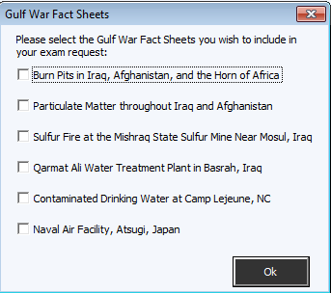
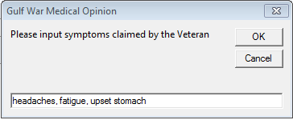
Exam Request Builder for Gulf War Examination
*
Note: You may also need to include specific fact sheets for consideration if the claim can be considered on both basis.
*
*
*
Notes:
Explain: Always ensure to develop for all applicable theories of entitlement (i.e. direct, presumptive, etc.). For more information on service connection based on exposure to specific Gulf War environmental hazards, see training titled “Claims Based on Exposure to Environmental Hazards in Iraq, Afghanistan, and Djibouti.”
Example: Veterans who served in Iraq have service location which qualifies them for consideration under §3.317, but they also may be considered based on Burn Pit and Particulate Matter exposures, which require the attachment of the Fact Sheets. (Iraq is just an example, consideration under both basis is not limited to Veterans with service in Iraq, but is limited to Veterans with service in the SWA theatre of operations with the specific location identified to also have exposure based on specific environmental hazards.)

Slide 48
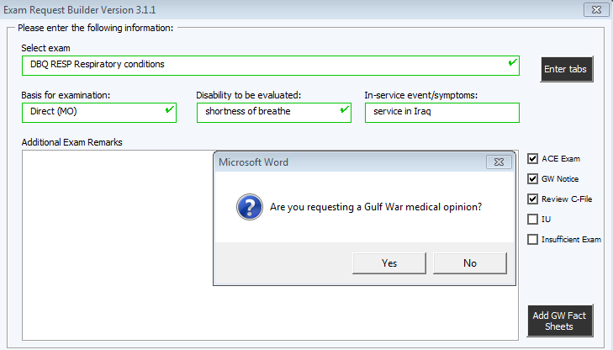
Exam Request Builder for Specific Body System DBQ
Making the correct selections in ERB will generate
ALL appropriate text necessary for the examination request!
Notes:
Explain: Checking the GW Notice box generates all of the wording shown/required in M21-1 IV.ii.1.E.2.m & n.

Slide 49
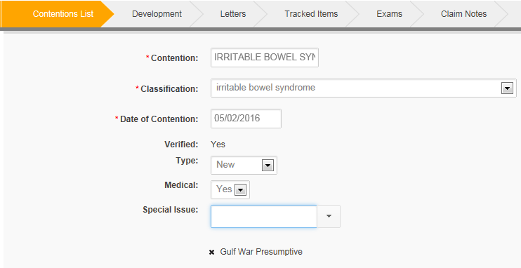
Special Issue Indicators
Gulf War Presumptive

Slide 50
Practical Exercise

