Slide 1
Compensation Service
October
2015
REQUESTING MEDICAL OPINIONS

Slide 2
Prerequisites for This Course
Prior to this lesson the trainees must have completed the following lessons:
VSR Compensation: Request a VA Exam, TPSS Module, TMS 3940820
CAATS Video 4111523
Examination Request Builder Video, TMS 4093560
Recognizing When to Request a Medical Opinion, TMS 1386326, and
Disability Benefit Questionnaires (DBQs) and Medical Opinions, TMS 3630994

Slide 3
Objectives
Indicate who may request a medical opinion
Identify the regulation governing requesting medical opinions
Identify evidence for medical opinions
Identify the tools and steps required to request medical opinions
Differentiate the types of medical opinions

Slide 4
References
38 CFR 3.159(c)(4) Providing medical examinations or obtaining medical opinions
McLendon v. Nicholson, June 5, 2006, No 04-0185
M21-1, Part III, Subpart iv, Chapter 3, Section A - Examination Requests

Slide 5
Maintaining Objectivity In Medical Opinion Requests
When requesting medical opinions, RO employees should identify all relevant evidence for the examiner’s review, both favorable and unfavorable. However, maintain objectivity when preparing medical opinion requests.
Use a neutral and unbiased tone.
Do not slant the facts.
Do not communicate that VA prefers one answer or outcome over another.

Slide 6
Avoiding Asking For Legal Conclusions In Medical Opinion Requests
Do not request a medical authority to make conclusions of law, which is a responsibility inherent to the rating activity. To prevent confusion, avoid using the word “opinion” when asking the examiner a question about any issue that does not require a formal medical opinion.

Slide 7
Examples
Do not request the medical authority to opine if there is loss of use of an extremity; ask for a description of the remaining function of the extremity.
Do not ask the medical authority to determine if a particular disability is “service-connected” or “SC.” Instead, identify the in-service injury, event, or illness, as well as current disability, and ask the examiner to provide an opinion as to whether or not the current disability was caused by or the result of the identified in-service injury, event, or illness.

Slide 8
Example
Do not ask the medical authority to provide an opinion as to whether a Veteran is “unemployable” or “entitled to individual unemployability.” Instead, in the Remarks section of the examination request, ask the examiner to comment on the Veteran’s ability to function in an occupational environment and to describe functional limitations.

Slide 9
Who May Request a Medical Opinion
Journey-level VSRs who have completed training specified by Central Office (CO) may prepare basic or straightforward medical opinion requests without RVSR or DRO review.

Slide 10
Complex Medical Opinions by RVSRs and DROs
Exception: Only RVSRs or DROs may prepare complex medical opinion requests. These include issues involving:
compensation under 38 U.S.C. 1151
aggravation (including Allen aggravation)
diagnostic variation or conflicting medical evidence
questions of credibility of evidence presented to the examiner, or
any other matters specified by the VSCM such as
rare disorders/rare etiologies, or
sensitive or high priority claims.

Slide 11
38 CFR 3.159(c)(4)
1. Contains competent lay or medical evidence of a current diagnosed disability or persistent or recurrent symptoms of disability.
2. Establishes that the service member suffered an event, injury or disease in service, or has a disease or symptoms of a disease listed in §3.309, §3.313, §3.316, and §3.317 manifesting during an applicable presumptive period provided the claimant has the required service or triggering event to qualify for that presumption; and
3. Indicates that the claimed disability or symptoms may be associated with the established event, injury, or disease in service or with another service-connected disability.

Slide 12
McLendon v. Nicholson, No 04-0185, June 5, 2006
The Court held that medical evidence that suggests a nexus but is too equivocal or lacking in specificity to support a decision on the merits still triggers the duty to assist regarding medical examinations/opinions if it indicates that the veteran’s condition “may be associated” with service.

Slide 13
Evidence in the Claim Folder
Ensure all pertinent records are uploaded into VBMS, Virtual VA or in the paper claims folder, and
all relevant records are annotated and/or bookmarked in the eFolder, or
tabbed in the paper claims folder.

Slide 14
Recognizing Pertinent Evidence in the Claim Folder
Identify all evidence which is related to the claimed disability such as:
Competent lay evidence which describes persistent or recurrent symptoms of disability, and/or
Competent medical evidence which provides a current diagnosis of the claimed disability, and
The evidence of an in-service event, injury or disease related to the claimed disability.
Recommendation: Complete the Evaluating Lay Evidence Course, TMS 3879907

Slide 15
Bookmarking Documents for Examiner Review
While there are multiple bookmark types available in VBMS, when bookmarking evidence for an examiner’s review, ROs must use the medical bookmark.
The bookmark steps in the handout are also found in M21-1, Part III, Subpart iv, Chapter 3.A.15.a

Slide 16
Bookmark Tool in VBMS
Locate the document in which you want to add a bookmark.
Click on the bookmark icon in the TOOLS column. The BOOKMARKS prompt box appears.

Slide 17
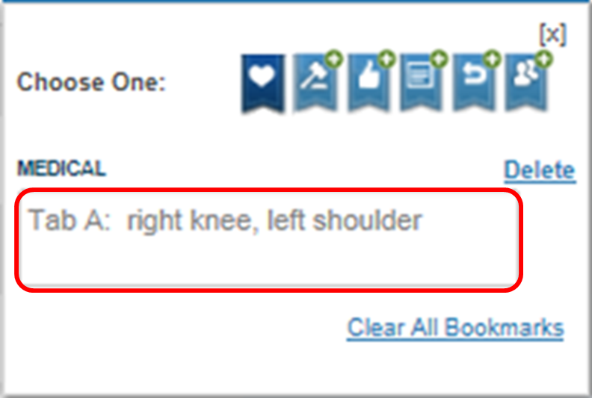
Bookmark Tool in VBMS, continued
In the expanded prompt box that appears, type the
tab name, and
contention(s) name.

Slide 18
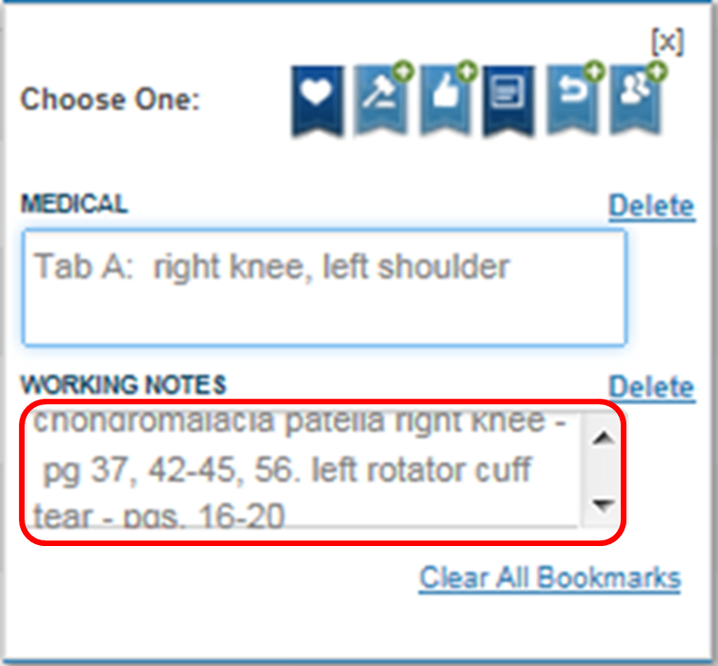
Bookmark Tool in VBMS, continued
Click the working notes bookmark (note paper icon).
In the expanded prompt box list
the condition treated, and
the pages where treatment can be found for the relevant conditions.

Slide 19
Annotating Documents in VBMS
There are many available styles of annotations. For the purpose of promoting consistency, use only the note annotation when tabbing evidence for the examiner’s review.
Locate the document you want to annotate.
Click on the annotator view icon next to the document name.
Reference: M21-1, Part III, Subpart iv, Chapter 3.A.15.f.

Slide 20
Annotating Documents in VBMS, continued
The document will open with an additional toolbar located at the top. Click on the add an annotation button.
Hold down the left mouse button and drag the cursor over a small area where you want the annotation to appear. This action will bring up the text box that allows you to type out notes or details for consideration.

Slide 21
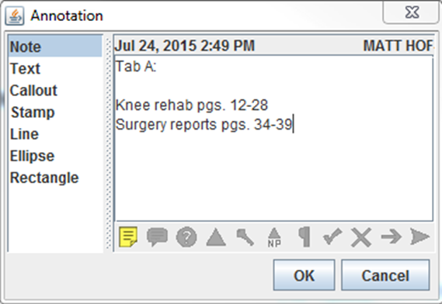
Annotating Documents in VBMS, continued
In the ANNOTATION text box, select Note.
In the text field, list the
tab name
relevant contentions, and
page numbers where treatment can be found in the document, THEN
Click the SAVE button in the toolbar.

Slide 22
Note the Evidence to be Reviewed in a Medical Opinion Request
Write down or take notes of all the evidence you will be identifying to the examiner. The following information will be entered into the Tab field in the Exam Request Builder.
associated exam field
evidence field
tab name field
date field
description field, and
location field.

Slide 23
Topic 3: Medical Opinion Templates
Direct Service Connection Template
Secondary Service Connection Template
Aggravation of a pre-service disability
Aggravation of Nonservice-Connected Disability
Opinion Regarding Conflicting Medical Evidence
Requesting Medical Opinions in 1151 Claims
Medical Opinions Required For Remands
Independent Medical Opinions
Processing Requests for an Independent Medical Opinion

Slide 24
Direct Service Connection
Type of medical opinion(s) requested: Direct service connection
Contention: Claimed Condition: _____________________________
The Veteran is claiming that his/her (insert “claimed condition”) was incurred in or caused by (insert “claimed in-service injury, event, or illness”) that occurred (insert “estimated date or time frame”).
Opinion request:
Is the Veteran’s (insert “claimed condition”) at least as likely as not (50 percent or greater probability) incurred in or caused by (insert “claimed in-service injury, event, or illness”) that occurred (insert “estimated date or time frame”). Rationale must be provided in the appropriate section below. Your review is not limited to the evidence identified on this request form, or tabbed in the claims folder. If an examination or additional testing is required, obtain them prior to rendering your opinion.
Potentially relevant evidence:
Tab A: ________________________
Tab B: _________________________

Slide 25
Secondary Service Connection
Type of medical opinion(s) requested: Secondary service connection
Contention: Claimed Condition: _____________________________
The Veteran is claiming that his/her (insert “claimed condition”) was proximately due to or the result of his or her (insert “service connected condition”).
Opinion request:
Is the Veteran’s (insert “claimed condition”) at least as likely as not (50 percent or greater probability) proximately due to or the result of (insert “service connected condition”). Rationale must be provided in the appropriate section below. Your review is not limited to the evidence identified on this request form, or tabbed in the claims folder. If an examination or additional testing is required, obtain them prior to rendering your opinion.
Potentially relevant evidence:
Tab A: ________________________
Tab B: _________________________

Slide 26
Aggravation of a pre-service disability
Type of medical opinion(s) requested: Aggravation of a pre-service disability
Contention: Claimed Condition: _____________________________
The Veteran is claiming that his/her (insert “claimed condition”) existed prior to service and was aggravated beyond its natural progression by (insert “claimed in-service injury, event, or illness”).
Opinion request:
Was the Veteran’s (insert “claimed condition”), which clearly and unmistakably existed prior to service, aggravated beyond its natural progression by (insert “claimed in-service injury, event, or illness”) during service? Rationale must be provided in the appropriate section below. Your review is not limited to the evidence identified on this request form, or tabbed in the claims folder. If an examination or additional testing is required, obtain them prior to rendering your opinion.
Potentially relevant evidence:
Tab A: _________________________
Tab B: _________________________

Slide 27
Aggravation of nonservice-connected disability
Type of medical opinion(s) requested: Aggravation of nonservice-connected disability
Contention: Claimed Condition: _____________________________
The Veteran contends that his/her (insert “claimed condition”) was aggravated beyond natural progression by his or her (insert “service connected condition”).
Opinion request:
Was the Veteran’s (insert “claimed condition”) at least as likely as not aggravated beyond its natural progression by (insert “service connected condition”)? Rationale must be provided in the appropriate section below. Your review is not limited to the evidence identified on this request form, or tabbed in the claims folder. If an examination or additional testing is required, obtain them prior to rendering your opinion.
Potentially relevant evidence:
Tab A: ________________________
Tab B: _________________________

Slide 28
Opinion Regarding Conflicting Medical Evidence
There is conflicting medical evidence. We are asking that you review this medical evidence and provide an opinion. The following is a summary of the conflicting medical evidence as it relates to the Veteran’s claim:________________________________________
Potentially relevant evidence:
Tab A: _________________________
Tab B: _________________________

Slide 29
Requesting Medical Opinions in 1151 Claims
To clarify whether the care, treatment, or examination at issue resulted in additional disability or death, it may be necessary to obtain
a medical opinion from a VA medical facility
independent medical evidence, such as
a medical statement provided by a regional office (RO) rating specialist who is a qualified medical professional, such as a physician, physician’s assistant, or registered nurse, and not a signatory to the rating, or
information from a medical treatise, such as The Merck Manual of Diagnosis and Therapy, Cecil Textbook of Medicine, or Physician’s Desk Reference (PDR), and/or
an independent medical opinion under 38 CFR 3.328, but only when warranted by the medical complexity or controversy involved in the case.

Slide 30
Requesting Medical Opinions in 1151 Claims
Remember, only RVSRs and DROs are authorized to request medical opinions in 1151 Claims.

Slide 31
Medical Opinions Required For Remands
When requesting an opinion in compliance with BVA remand instructions explain specifically what is needed.
Quoting the instructions from BVA on the medical opinion request may be helpful, but try to avoid legal jargon.
Important: Do not simply refer the examiner to the claims folder containing the remand instructions.
Note: Only RVSRs and DROs are authorized to request medical opinions for BVA remands.

Slide 32
Independent Medical Opinions
If warranted by the medical complexity or the controversy of a pending claim, an independent medical opinion (IMO) under 38 CFR 3.328 may be obtained from medical experts who are not VA employees.
Notes:
Only RVSRs and DROs are authorized to start the process to request IMOs.
If the claimant or claimant’s representative request an IMO, then refer the case to a RVSR or DRO.

Slide 33
Processing Requests for an Independent Medical Opinion
Stage | Who is Responsible | Description
1 | RVSR DRO, or service organization representative | Brings the request for an independent medical opinion to the attention of the VSCM.
2 | VSCM | Decides whether the request has merit.
3 | VSCM | Does the request have merit? If yes, refers the request to Compensation Service (211) for review. If no, denies the request without the need for referral to Compensation Service. Important: This determination may be contested as part of an appeal on the primary issue under consideration.
4 | Compensation Service | Decides whether the request has merit.
5 | Compensation Service | Does the request have merit? If yes notifies the claimant that the request has been approved obtains the opinion from the appropriate medical expert, and sends a copy of the opinion when it is available. If no, denies the request. Important: This determination may be contested as part of an appeal on the primary issue under consideration.

Slide 34
Medical Opinion Tools
The following tools are utilized when requesting examinations and medical opinions:
Compensation and Pension Examination Request Routing Assistant (ERRA) web tool
Index of DBQ/Exams by Disability Tool
Exam Request Builder (ERB) Tool
Compensation and Pension Record Interchange (CAPRI) – VHA
the Centralized Administrative Accounting Transaction System (CAATS) – Contract exams

Slide 35
Step 1: Determine the Examination Facility
Compensation and Pension Examination Request Routing Assistant (ERRA) web tool

Slide 36
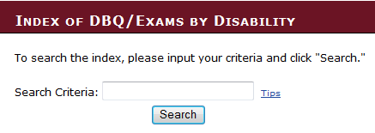
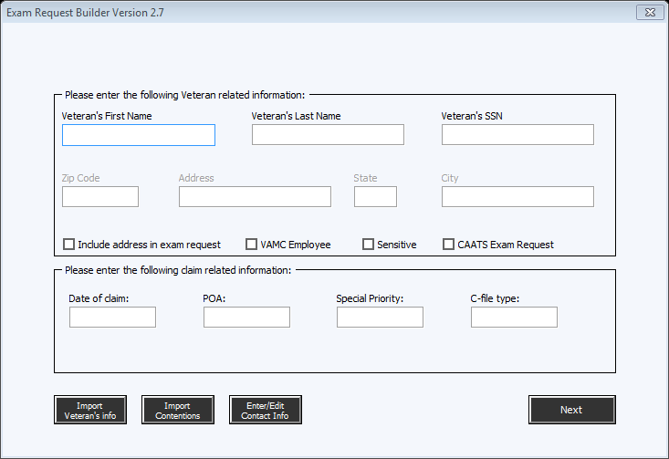
Step 2
Select the appropriate medical opinion template, and
Populate all required fields in the ERB tool.

Slide 37
Step 3
Edit the generated medical opinion language to ensure it is case-specific and will result in the necessary opinion.

Slide 38
Step 4
Create all required tracked items in the appropriate claims-processing system.
Reference: For more information on creating a tracked item, see
VBMS User’s Guide, or
MAP-D User’s Guide.

Slide 39
Step 5
Open either the CAPRI or CAATs application.

Slide 40
Step 6
Select all required exams and medical opinion DBQs.

Slide 41
Step 7
To reduce the chance that a medical opinion request is missed by an examiner, always type in ALL CAPS “MEDICAL OPINION” as the first line in the exam request remarks field.

Slide 42
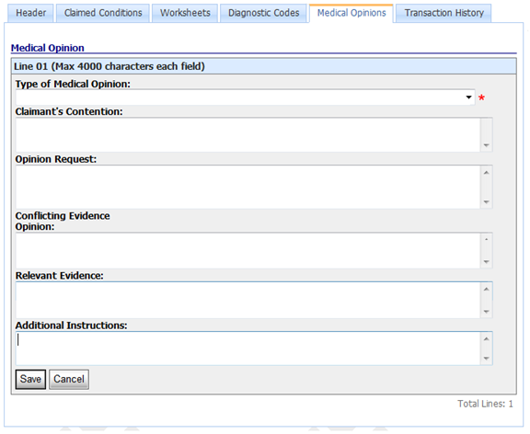
Step 8
Paste the appropriate medical opinion request language into the REMARKS field in CAPRI, or the appropriate fields in CAATS.
CAATS Screen

Slide 43
QUESTIONS

