Slide 1
Power of Attorneys (POAs)/ Service Organizations
Compensation Service
January 2018

Slide 2
Lesson Objectives
Identify types of POAs that may be appointed by claimants for VA purposes and their authority
Describe the requirements when processing VA Form 21-22 and VA Form 21-22a
Discuss the requirements for exclusive contact, revocation, or termination of a POA
Determine when paper copies of notification letters must be mailed to the POA

Slide 3
References
38 U.S. Code 7332, Confidentiality of Certain Medical Records
38 CFR 14.628, Recognition of Organizations
38 CFR 14.630, Authorization for a Particular Claim
38 CFR 14.631, Powers of Attorney; Disclosure of Claimant Information
38 CFR 14.633, Termination of accreditation or authority to provide representation under §14.630
38 CFR 20.204, Rule 204. Withdrawal of Appeal

Slide 4
References
M21-1, Part I, 3.A, General Information on Power of Attorney (POA)
M21-1, Part I, 3.B, Power of Attorney (POA) Rights to Notification and Review of Records
M21-1, Part III, Subpart i, 4.B, The Stakeholder Enterprise Portal (SEP) Role in the Veterans Online Application (VONAPP) Direct Connect (VDC) Process
M21-1, Part III, Subpart i,4.B.2.a, Overview of Original Claims Submission Through SEP
M21-1, Part III, Subpart ii, 1.A.2.d, Processing On-Line Applications Without a Signature
M-21-1, Part III, Subpart ii, 1.C.7, Handling Outdated Forms
M21-1, Part III, Subpart ii, 3.C, System Updates
M-21-1, Part III, Subpart ii, 1.C.8, Handling Outdated Forms

Slide 5
Types of POAs
There are three types of POAs:
Accredited representative of a Veterans service organization
Attorney or accredited agent in good standing with state bar
Non-licensed individual

Slide 6
Requirements to Represent Claimants as POA
An accredited representative of a service organization, agent, or attorney must obtain recognition from VA’s Office of General Counsel in order to represent claimants.
A non-licensed individual may represent a claimant on a one-time, one claim basis per the provisions of 38 CFR 14.630.

Slide 7
POA Authority and Limitations
POAs have the authority to prepare, present, and prosecute a claimant’s claim. A POA may:
review the claimant’s records
present evidence on behalf of the claimant
submit an intent to file, non-original claim, a notice of disagreement (NOD), or a substantive appeal on behalf of the claimant, and
withdraw an appeal

Slide 8
POA Authority and Limitations
POAs may not sign forms requiring claimant certification or signature, such as (but not limited to):
Original applications for benefits*
VA Form 21-4142, Authorization to Disclose Information to the Department of Veterans Affairs (VA)
VA Form 21-0538, Status of Dependents Questionnaire
VA Form 21-4140, Employment Questionnaire
*Exception: Claims may be submitted by powers of attorney (POAs) through the Stakeholder Enterprise Portal (SEP). Original claims submitted through SEP involve additional signature requirements to be substantially complete. III.ii.1 (For additional information, see III.i.4.B)

Slide 9
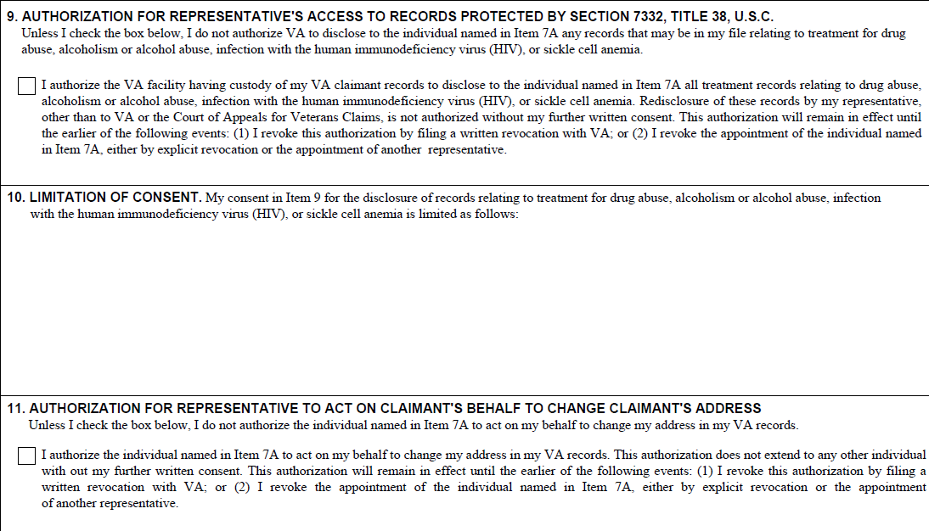
POA Authority and Limitations
Blocks 12 through 14 on VA Form 21-22 and blocks 9 through 11 on VA Form 21-22a authorize or limit certain authorizations to the appointed POA.
VA Form 21-22a Blocks 9-11
VA Form 21-22 Blocks 12-14

Slide 10
Forms to Establish POAs
The following forms are used to establish a POA for VA purposes:
VA Form 21-22, Appointment of Veterans Service Organization as Claimant’s Representative
This form is for VSO appointments only
VA Form 21-22a, Appointment of Individual as Claimant’s Representative
This form is for attorneys, agents, and non-accredited individuals

Slide 11
Processing VA Form 21-22
Upon receipt of VA Form 21-22 or 21-22a:
Ensure the form is complete and signed by the claimant and POA
Check for authorization to access protected record (38 USC 7332)
Check for authorization to change the claimant’s address
Update Systems to reflect POA
Note: ANY limitation to a Veteran’s records on either form will result in no access to view the eFolder.

Slide 12
Requests for Exclusive Contact
The term exclusive contact refers to sending communications with the claimant directly to a representative and generally not communicating directly with the claimant.
*** VA no longer honors requests for exclusive contact to restrict the communication between VA and the claimant. ***
If you have a VA Form 21-22a requesting exclusive contact, send the agent or attorney a letter with the verbiage found in M21-1, Part I, Chapter 3, Section A

Slide 13
Revoking and Terminating Representation
An unlimited declaration of representation on VA Form 21-22 or VA Form 21-22a can be terminated or revoked by:
A claimant at any time by simply informing the VA.
Attorney fees may still be payable in certain circumstances
The representative by notifying the VA and the claimant in writing
When doing so does not adversely impact the claimant’s interests
When BVA has jurisdiction, the representative must obtain permission from BVA to revoke or terminate

Slide 14
Revoking and Terminating Representation
Representation is automatically revoked in two instances:
When a new unlimited declaration of representation is received
When the claimant dies
Important: A limited declaration, i.e. representation for one claim under the provisions of 38 CFR 14.630, does not automatically revoke or terminate any prior unlimited declaration of representation.

Slide 15
When Paper Copies of Notification Letters MUST be Mailed to the POA
The representative/POA is to be furnished copies of all correspondence sent to the claimant when no restrictions are noted on the appointment form.
VSOs with eFolder access will review documents in the eFolder and do not require paper copies of correspondence.
Mail paper copies of correspondence not addressing restricted issues to:
VSOs (with restricted access shown on VA Form 21-22),
non-licensed individuals (representing claimants under 38 CFR 14.630),
attorneys, and
agents will be mailed paper copies of correspondence not addressing restricted issues.

Slide 16
When Paper Copies of Notification Letters MUST be Mailed to the POA
Unless representation is limited by the claimant, power of attorney (POA) representatives are entitled to notice of any VA decisions effecting the payment of benefits or relief sought by claimants whom they represent. Representatives also must receive other forms of correspondence sent to claimants. These include:
decision notices
statements of the case and supplemental statements of the case
notice of certification and transfer of appeals to the Board of Veterans’ Appeals (BVA)
intent to file a claim notices
incomplete application notices, and
requests for information and evidence needed to substantiate a claim (e.g. development letters).

Slide 17
When Paper Copies of Notification Letters MUST be Mailed to the POA
When RO personnel generate correspondence associated with a claimant represented by a private attorney or claims agent, they must include the address of the private attorney or claims agent in the carbon copy (cc) line of the correspondence.
Including the full address in the cc line will allow mail processors to quickly and accurately address outgoing private attorney or claims agent copies of correspondence.

Slide 18
When Paper Copies of Notification Letters MUST be Mailed to the POA
Best Practice Tips to ensure POAs are properly notified:
Always double check the VA Form 21-22/21-22a prior to finalizing any correspondence to avoid missing correspondence
Use a “Working Notes” bookmark in VBMS to indicate the POA must receive paper copies of correspondence
Use the subject line in VBMS to indicate that correspondence has been mailed
When in doubt – refer to M21-1 Part I, 3.B for clarification

Slide 19
Lesson Review and Wrap Up

Slide 20
Questions

