Slide 1
(VSR VIP Pre-D) Tour of the Compensation Intranet Home Page
Compensation Service
December 2020
Notes:
Welcome to Tour of the Compensation Intranet Home Page course. To advance each slide, click anywhere on the screen.

Slide 2
Lesson Objectives
Demonstrate the ability to navigate the Compensation Service Intranet Home Page
Demonstrate the ability to access and navigate the M21-1 Adjudication Procedures Manual and other resources on the Compensation Service Intranet Home Page
Notes:
Lesson Objectives
Upon completion of this lesson, you will be able to:
Accurately locate and review the Calendar, Publications, M21 dash 1 CPKM, F A Qs, Rating Job Aids, and Training links on the Compensation Service Intranet Home Page
Accurately open and explore other resources on the Compensation Service Intranet Home Page

Slide 3
References
The Compensation Service Intranet Home Page:
https://vbaw.vba.va.gov/bl/21/index.htm
Notes:
References
The references for this course are listed on the screen. You may click any hyperlinked references for further details.
The Compensation Intranet Home Page homepage:
http://vbaw.vba.va.gov/bl/21/index.htm

Slide 4
Accessing the Compensation Service Home Page
Here are at least two ways to access the Compensation Service Intranet Home Page:
Type in the web address https://vbaw.vba.va.gov/bl/21/index.htm
Open Internet Explorer or other search engine - Use the Favorites menu
Notes:
Accessing the Compensation Service Home Page
Access the Compensation Service Intranet Home Page by any of the following:
Type in the web address http://vbaw.vba.va.gov/bl/21/index.htm
Type Compensation and Pension Home Page if you are using a search engine through the VA intranet
Use the Favorites menu
Access to the Compensation Service Intranet Home Page is possible from any computer in VA

Slide 5
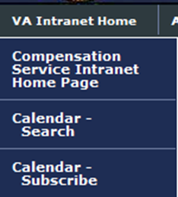
Calendar
Using the Calendar
Provides weekly “What’s New in Compensation Service”
Lists past, present, and future events that are important to employees
Posts any New or changed references as they occur
Updates will be emailed to those who subscribe to the Calendar
Notes:
Calendar
Using the Calendar
Who can list the first topic listed under Subjects Covered for the July 2015 Comp Service Bulletin?
Notice the Calendar-Search Feature on the Left column.
Subscribe to the calendar.

Slide 6
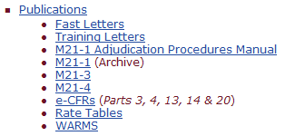
Publications
The Publications site contains all commonly used references
Commonly used references include M21-1 Adjudication Procedures Manual, 38 CFRs, and Rate Tables
NOTE:
Fast Letters and Training Letters have been incorporated into the M21-1 Adjudication Procedures Manual
Notes:
Publications
The Publications site contains electronic versions of all commonly used references.
Commonly used references include Fast Letters, Training Letters, M21 dash 1 CPKM, 38 CFRs and Rate Tables.

Slide 7
M21-1 Adjudication Procedures Manual
M21-1 Adjudication Procedures Manual tool organizes references in a searchable format.
Contains a search bar option that can search entire Knowledge Base or can search within a certain topic.
The manual is a living document that is regularly updated.
“Browse Topics” includes quick access to search publications such as 38 CFRs, Compensation Service Bulletins (CSB), other training manuals and Rate Tables.
Notes:
M21 dash 1 CPKM
VA now uses the M21 dash 1 CPKM tool organizes references in a searchable format.
Includes immediate access to search publications such as Training Letters (TL), Fast Letters (FL), Manual References, CFR’s, Compensation Bulletins.
Please note the information within this reference is the most updated material available.

Slide 8
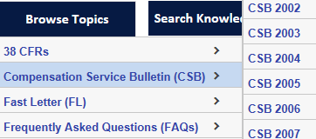
Compensation Service Bulletin
Provides updates regarding procedures (within M21-1 Adjudication Procedures Manual)
Provides information on upcoming Quality Calls, Skills Certification Events, VIP Training, and other useful information
Notes:
Compensation Service Bulletin
Compensation Service Bulletins provide monthly updates regarding procedures (within M21 dash 1 CPKM)
It would be useful to routinely check this page for changes in policy and procedures as it relates to your daily work tasks.

Slide 9
Job Aids
Various quick links within the bookshelf.
Exam Request Builder (ERB), Letter Creator, Combinator, Vietnam Era Navy Ship AO Exposure Development Site
Notes:
Rating Job Aids
Various quick links within the bookshelf.
Exam Worksheets, PTSD Rating Job aid and Stressor Verification Site.

Slide 10
Training Home Page
Contains VSR and RVSR training curriculum and helpful job aids
Contains links to Medical EPSS, VSR Assistant, and the VBA Learning Catalog
Notes:
Training Home Page
Contains VSR and RVSR training curriculum and helpful job aids.
This tool contains the link to Medical EPSS, Talent Management System (TMS), VSR Assistant and the VBA Learning Catalog.

Slide 11
Other References of Interest
Court Related Info
Court & DAD cases
PIES/DPRIS
Quality Assurance Home Page
STAR
Veterans Information Solution (VIS)
User Guides
VBMS Exam Management System Information
Medical Disability Examination Program Office-Quick Links
CAPRI
ERRA
Search Compensation Service Intranet
Notes:
Other References of Interest
Court Related Info
Transf. Initiative & Pilot (TIP) Sheets
P I E S/D P R I S
Quality Assurance home Page
Program Operations
Site Visits
Business Management Home Page (system help guides)
Directories
Search Compensation Service Intranet

Slide 12
Questions?
Notes:
Questions?

