Slide 1
Compensation Service
April 2018
PIES Demo

Slide 2
Lesson Objectives
Understand the functionality of the PIES application
Identify how to request the 3 types of service records from records facilities
Differentiate between the various PIES address and status codes
2

Slide 3
References
M21-1, Part III, Subpart iii, 2.D, Requesting Information and Records Through the Personnel Information Exchange System (PIES)
M21-1, Part III, Subpart iii, 2.E, Unique Claims and Situations That Require Special Handling
PIES User Guide
3

Slide 4
PIES Information
PIES consists of the following two executable programs:
PIES Create program, and
PIES Respond program
staffed by RMC employees,
collocated with NPRC, and
responsible for responding to requests submitted through PIES Create.

Slide 5
PIES Help
PIES Help screens – Click on the yellow question mark icon, once logged in to PIES. Information regarding:
Military and related records
How to use PIES
PIES User Guide – Compensation Service Intranet site
Procedures (212), PIES/DPRIS
DPRIS Web to PIES Cross Reference Guide – Compensation Service Intranet site
Procedures (212), PIES/DPRIS

Slide 6
Service Records
Service records refer to not only all records kept by the military, but also for non-medical and non-financial service records, also known as personnel records. These include but are not limited to:
Dates of Service
Character of Service
Line of Duty (LOD) Reports
Facts and Circumstances
Conditional Discharge Info
Travel Time
Personnel Records
DD Form 214
DD Form 1300
Morning Reports

Slide 7
Health Records
Also known as Service Treatment Records (STRs), the following may be included:
Medical Treatment Records
Dental Records
Clinical Records
Other (i.e. Army Surgeon General’s Office (SGO))

Slide 8
Financial Records
Financial Records
Maintained separately from other military service information (service and health records)
Requests for financial information cannot be combined with requests for service and/or medical information
Exception: PIES O50 – entire STR and OMPF, to include financial records

Slide 9
Where Records are Stored – NPRC
National Personnel Records Center (NPRC)
Under auspices of the National Archives and Records Administration (NARA)
Neither a VA nor military facility
Maintains military records for the Department of Defense (DoD)
STRs
Service personnel records
Clinical records

Slide 10
Where Records are Stored – NPRC (cont.)
Service Treatment Records at NPRC:
Service Personnel Records at NPRC:
Branch of Service | Service ended prior to…
Army | October 16, 1992
Navy | January 31, 1994
Air Force | May 1, 1994 (Reserves or NG – June 1, 1994)
Marine Corps | May 1, 1994
Coast Guard | May 1, 1998
Branch of Service | Had no service (active duty or otherwise) on or after…
Army | October 1, 1994
Navy | January 1, 1995
Air Force | October 1, 2004
Marine Corps | January 1, 1999

Slide 11
Where Records are Stored – RMC
VA Records Management Center (RMC) (station locations in Beneficiary Identification and Records Locator Subsystem (BIRLS) – 375, 376, St. Louis RMC, RPC, and SMRC)
Inactive VA claims folders
All original STRs (not personnel records) – former service members whose service ended between the dates for NPRC records and December 31, 2013
*As of January 1, 2014, records are electronically scanned and accessible through Healthcare Artifacts and Images Management Solution (HAIMS) (Coast Guard records effective September 1, 2014)

Slide 12
Using PIES – BIRLS Information
Ensure information on the Veteran Identification Data (VID) screen in BIRLS via the SHARE application is accurate/complete.
This includes inputting Veteran’s service number if applicable
Note: PIES programming logic relies on this data to function properly.

Slide 13
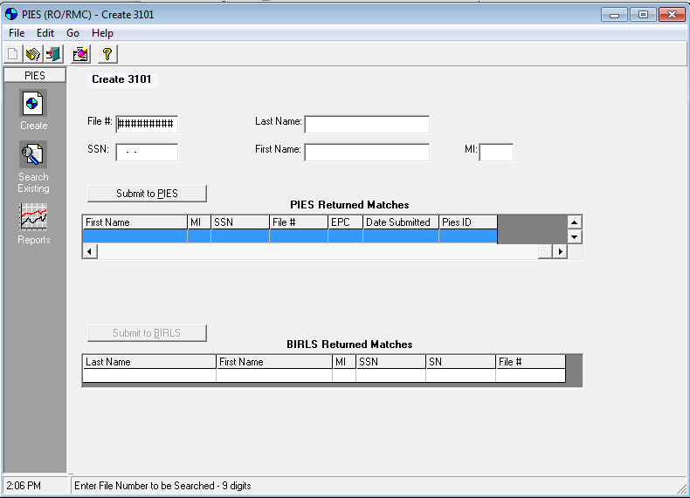
Using PIES – Create Request
Click “Create”
Enter file # and SSN; click “Submit to PIES.”
If this is the 1st request for the Veteran, you will be asked if you want to search BIRLS. Click “Yes.”
If this is not the 1st request for the Veteran, his/her info will show in the “PIES Returned Matches” block. You will then need to click “Submit to BIRLS,” to create a new request.
“There are no 3101 records that match your search criteria. Do you wish to execute a BIRLS inquiry?
NOTE: You will not be able to create a new 3101 without searching BIRLS”

Slide 14
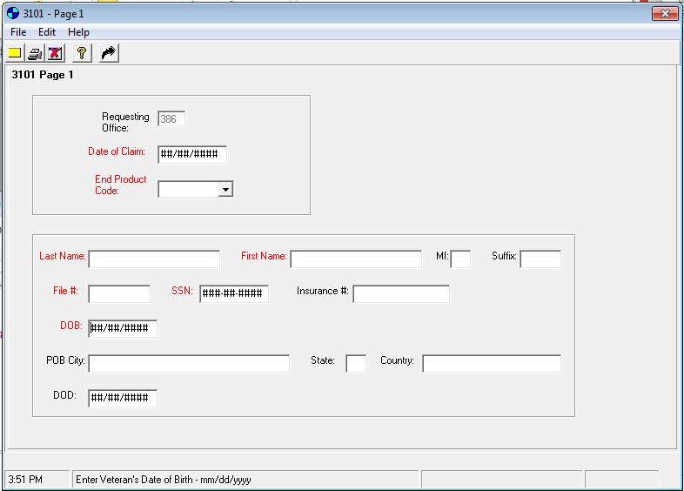
Using PIES – Create Request: 3101 Page 1
Input the date of claim and the end product
Click on the curved black arrow at the top of the screen
Note: the Veteran’s information will show in the lower section based on the file # entered on the previous screen. If it doesn’t, you will need to manually enter the info before you can move forward.

Slide 15
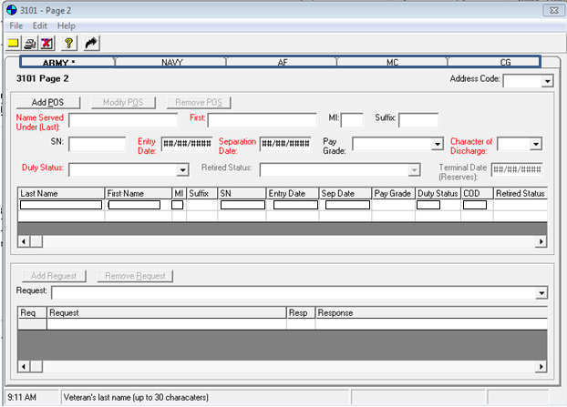
Using PIES – Create Request: 3101 Page 2
Ensure you’re on the correct branch of service tab
Select the applicable request (usually O50) from the drop down and click “Add Request.” The request will then show in the block below.
Click on the yellow “Submit 3101” box icon in the upper left corner. Message – “Request Submitted Successfully.”
Note: you only need to use the Add/Modify/Remove POS buttons if the information populated is incomplete/incorrect.

Slide 16
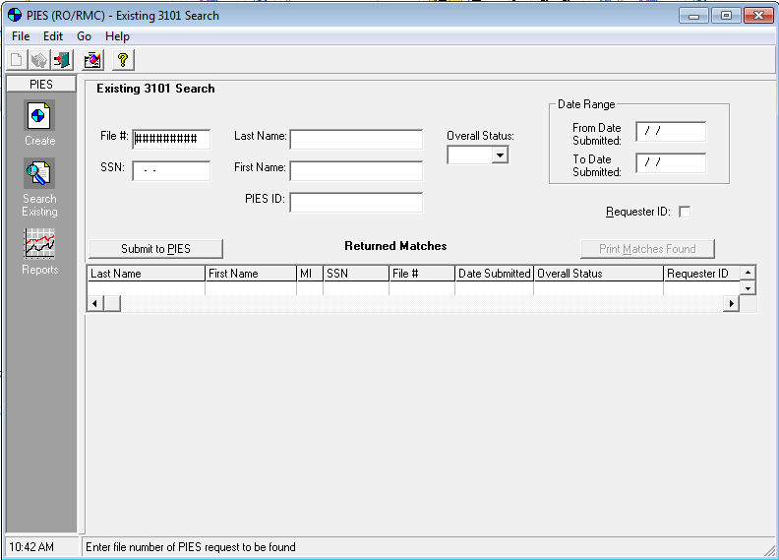
Using PIES – Print 3101
On the main PIES screen, click “Search Existing”
Enter file # and SSN; click “Submit to PIES”
Veteran’s information will show in the block below; double click on the Veteran

Slide 17
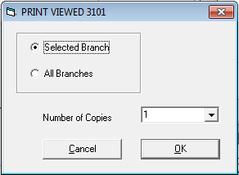
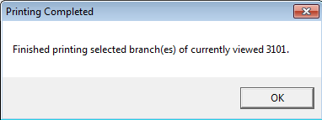
Using PIES – Print 3101 (cont.)
Important: Change your default printer (under Devices and Printers on your computer) to Adobe PDF before continuing.
Click “Print 3101” (the printer icon)
Click on the applicable option and click “OK.” Save the document when prompted.
You will receive a message when printing is complete
Upload to the eFolder and input tracked item

Slide 18
PIES Request Codes – General
PIES O50 (most common)
Results will be scanned and uploaded into VBMS
Request for all available STRs and OMPF records (Personnel)
*See the trainee handout (or M21-1) for a detailed listing of other PIES codes.
Address code will be chosen automatically by PIES programming
Exception: Users must manually enter an address code for requests they submit through PIES to
address code 51 (for certain Coast Guard records), and
service department retired pay centers.

Slide 19
PIES Request Codes – Fire Related
M05/M05-V
Only submit when an initial PIES request was made and NPRC response requests a copy of NA 13055/13075, DD214, or identifies the claim as fire-related
M05 – paper folder
M05-V – eFolder (VBMS)

Slide 20
PIES Request Codes – NG/Reserves
NG1 – requesting STRs for:
a Veteran actively serving in the National Guard, or
records not otherwise located for a Veteran recently separated/retired from a National Guard unit
RV1 – requesting STRs for:
a Veteran actively serving in the Reserves
records not otherwise located for a Veteran recently separated/retired from a Reserve unit

Slide 21
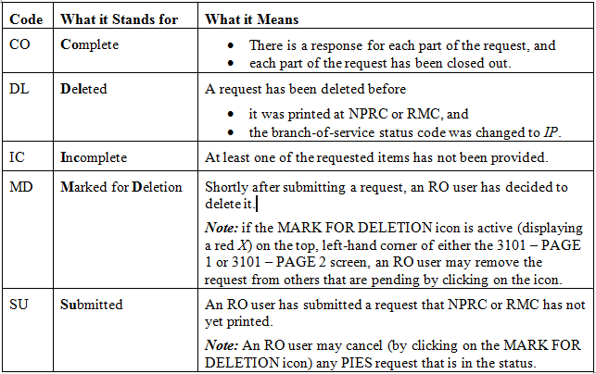
Status Codes
It is important to check the status codes of any pending requests to determine if any follow up action is required.
If status shows “Open” ≥ 45 days submit a follow-up PIES request to:
VAVBASTL/RMC/VBMS

Slide 22
Using PIES – Checking the Status
To check the status of a previously submitted claim, follow the steps for “Printing 3101.” Instead of printing, do the following:
Input the date of claim and the end product
Click on the curved black arrow at the top of the screen

Slide 23
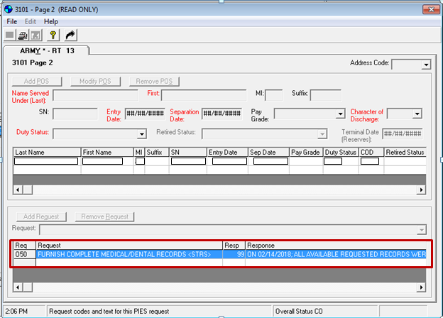
Using PIES – Checking the Status (cont.)
The status/response is shown next to the request that was previously submitted.
To review the full message, you can scroll over or print the 3101 to a PDF.

Slide 24
Questions

