Slide 1
Compensation Service
February 2016
Establishing Veteran Status

Slide 2
Objectives
Identify three elements required to establish Veteran status for VA compensation purposes
Differentiate between duty statuses for reservists and National Guard members qualification criteria
Recognize and identify acceptable evidence for verification of service
Identify discharge statuses that entitle a Veteran to compensation benefits

Slide 3
References
38 U.S.C. 101 (2) and (24), Definitions
38 C.F.R. 3.1 (b-d), Definitions
38 C.F.R. 3.4 (b), Compensation
38 C.F.R. 3.6 (a-e), Duty periods
38 C.F.R. 3.7, Individuals and groups considered to have performed active military, naval, or air service
38 C.F.R. 3.12, Character of discharge
38 C.F.R. 3.12a, Minimum active-duty service requirement
38 C.F.R. 3.13, Discharge to change status
38 C.F.R. 3.14, Validity of enlistments
38 C.F.R. 3.203, Service records as evidence of service and character of discharge

Slide 4
References Continued
M21-1, Part III, Subpart ii, 6.1, Determining Veteran status
M21-1, Part III, Subpart ii., 6.2, Duty status and eligibility of reservists
M21-1, Part III, Subpart ii, 6.3, Duty status and eligibility of personnel in the National Guard service
M21-1, Part III, Subpart ii, 6.4, Minimum active duty service requirements
M21-1, Part III, Subpart ii, 6.5, General information regarding verification of service and character of discharge
M21-1, Part III, Subpart ii, 6.6, Forms of evidence for verification of service and character of discharge
M21-1, Part III, Subpart ii, 6.7, Benefit-specific eligibility factors
M21-1, Part III, Subpart iii, 2, General information on service records
M21-1, Part III, Subpart v, 1.B, Statutory bar on benefits and character of discharge

Slide 5
References Continued
VAOPGCPREC 16-99, Effect of entry level separation based upon fraudulent enlistment on status as a Veteran
VBA Letter 20-09-14, Digitally signed separation documents and other evidence of service

Slide 6
Establishing Veteran Status
Three elements required to establish Veteran status for VA compensation purposes:
Individual must be identified as a Veteran by VA definition
Service must be verified with acceptable evidence
Character of discharge from service must be other than dishonorable

Slide 7
Definition of a Veteran
VA defines a Veteran as:
A person who served in active military, naval, or air service, and was discharged or released under conditions other than dishonorable.

Slide 8
Duty Statuses Considered for Active Duty Service
Active duty (AD)
Active duty for training (ADT) to which a person is disabled or dies from injury/disease incurred or aggravated in the line of duty (LOD)
Inactive duty for training (IDT) to which a person is disabled or dies from injury/disease incurred or aggravated in the LOD, or any of the following conditions:
Acute myocardial infarction; cardiac arrest; or cerebrovascular accident

Slide 9
Minimum Active Duty Service Requirements
Person must have completed:
Twenty-four (24) months of continuous active duty, or
Full period for which they are called or ordered to active duty
Exceptions to minimum active duty service requirements must be considered if requirements are not met (38 CFR 3.12a(d) and M21-1 III.ii.6.4.c)

Slide 10
Comprehension Check
A claimant reported for his first day of training in the Army. On the way home from the training, the claimant was injured in a vehicle collision. As a result, the claimant became permanently disabled and was discharged from the Army.
Can this claimant receive VA benefits based on the minimum Active Duty requirements?
Yes, the claimant qualifies to receive VA benefits because the claimant was injured while proceeding directly home from the training, which constitutes as Active Duty.

Slide 11
Reserve Service Qualifications
Reserve programs considered active duty for compensation purposes:
Active Guard Reserve (AGR)
Active Duty Support Program (ADS)
Active Duty for Special Work (ADSW)
Reserve programs NOT considered active duty for compensation purposes:
Initial Active Duty for Training (IADT)
Annual Training (AT)
Inactive Duty for Training (IDT)

Slide 12
National Guard Service Qualifications
National Guard Service
Army National Guard (ARNG)
Air National Guard (ANG)
Member served under Title 10 (10 U.S.C.) or Title 32 (32 U.S.C.)

Slide 13
National Guard Service
Title 10
Title 32
Guard unit or member activated for service to which reporting members service qualifies as active duty.
Full-time duty in the Armed Forces, such as unit deployment during war, including travel to and from such duty, except active duty for training.
Active duty characterized as Federal active duty
For VA Purposes, full-time operational support or service performed under 32 U.S.C. 316, 502, 503, 504, or 505
Duty performed for which member is entitled to receive pay from the Federal government, such as responding to a national emergency or performing duties
Does NOT meet VA definition of active duty

Slide 14
Verification of Service
To verify service:
Locate acceptable evidence of service
Verify active service dates
Verify character of discharge

Slide 15
Acceptable Evidence for Service Verification
The following are examples of acceptable evidence of service verification (as outlined in M21-1 III.ii.6.6):
DD Form 214 or Report of Separation (issued prior to DD-214s)
Digitally signed DD Form 214
PHS Form 1867
NOAA Form 56-16
NGB Form 22
3101 response from the service department
Veteran Identification Data (VID) screen in SHARE (BIRLS)
VIS (acceptable alternative verification of service)

Slide 16
Incomplete Service Verification
If available evidence is incomplete or appears questionable, request verification or additional data from PIES or DPRIS.
If claimant submitted alternative form of evidence of service that cannot be accepted and military service cannot be verified send a denial letter and furnish notice of procedural and appeal rights.

Slide 17
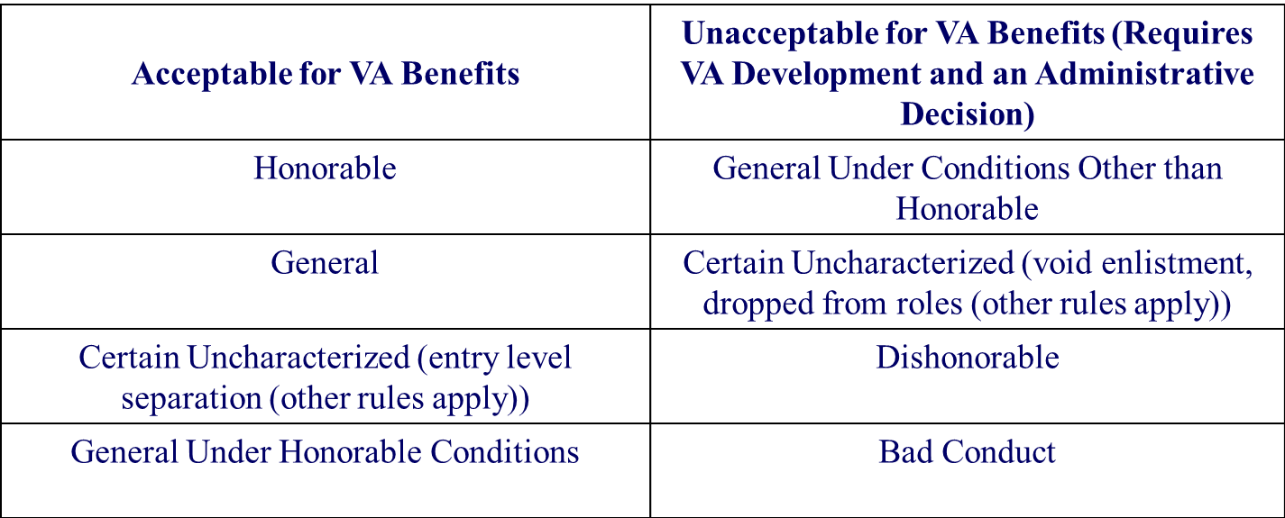
Character of Discharge Statuses
Character of discharge status could affect entitlement to VA benefits:

Slide 18
Comprehension Check
A claimant served for 3 weeks in the Army. His DD Form 214 indicates he was discharged uncharacterized as “entry level” and the reason for discharge is “Failure to meet physical fitness requirements.” The claim is developed, and the Veteran is subsequently granted service connection for a knee condition due to an injury during those 3 weeks of Active Duty.
Can the claimant receive benefits based on the minimum Active Duty requirements and the character of discharge?
Yes, the claimant can receive benefits because he has a service-connected injury, which meets one of the exceptions and the discharge is considered honorable.

Slide 19
By now, you should be able to:
Identify three elements required to establish Veteran status for VA compensation purposes
Differentiate between duty statuses for reservists and National Guard members qualification criteria
Identify discharge statuses that entitle a Veteran to compensation benefits
Recognize and identify acceptable evidence for verification of service

Slide 20
Questions

