Slide 1
Compensation Service
May 2016
DPRIS Web
Manager Lesson Plan

Slide 2
OBJECTIVES
Become familiar with DPRIS Web Site
Understand your role and responsibilities as a DPRIS Web Manager
Become a registered user of DPRIS Web
Notes:
2

Slide 3
Objectives (cont.)
Become familiar with how to submit requests and review responses using DPRIS Web
How to manage accounts as a DPRIS Web Manager
How to request assistance if needed

Slide 4
DPRIS Web Advantages
Through a single secure internet
sign-on, allows access to OMPF images contained in Services’ repositories
On average, images are received in less than 48 hrs
Many images are received within minutes

Slide 5
DPRIS Advantages (cont.)
Provides a standard index of all images contained in each of the Services’ OMPF Systems
Includes a Follow-up Message capability. This enables the user to gain additional information directly from the Services’
action officer (except Army).

Slide 6
VA-Services Interface
Without DPRIS Web
Navy
Marine Corps
Army
Air Force
VA

Slide 7
VA-Services Interface
With DPRIS Web
Marine Corps
Navy
Army
Air Force
DPRIS Web
VA

Slide 8
DPRIS Web Standard OMPF
Document Indexing Scheme

Slide 9
Personnel Records
Available Through DPRIS Web
Military Service
Army*
Navy
Marine Corps
Air Force
End of Obligated Service Dates
October 1, 1994
January 1, 1995
January 1, 1999
October 1 2004
Notes:
Per III.iii.2.I.2.g. Requesting Service Personnel Records Through DPRIS
Discrepancy between the manual and Dpris User guide in Army dates can be explained by III.iii.2.B.5.b. Location of OMPFs and the Means for Requesting Copies

Slide 10
VARO/DPRIS Access Organization
Roles & Responsibilities
Level 2 – Web Manager
Communicate with: Local users, DPRIS Web staff via User Assistance Forms, and CO to solve problems
Prior to approving each request for access to DPRIS Web, must ensure information contained on the registration form is complete and accurate. (Review User ID and email address against information in Outlook.)

Slide 11
Roles & Responsibilities (Cont.)
Level 2 – VARO Manager
Re-set passwords for Level 3 Users that you directly administer
Assign DPRIS Web Standard Index subgroup document and DPRIS Web Report access for those Level 3 Users that you directly administer
Promptly deactivate any level 3 Users that you directly administer, who no longer require DPRIS Web access in the performance of their duties

Slide 12
Roles & Responsibilities (Cont.)
Level 2 – Web Manager
Review, as warranted, retrieved personnel record information and follow-up exchanges for all agency Authorized Users that you directly administer
Initiate secure DPRIS Web follow-up messages
Initiate DPRIS Web requests for military personnel records

Slide 13
Roles & Responsibilities (cont.)
Level 2 – Web Manager
Initiate requests for approved DPRIS Web Standard Reports
Manage own personal DPRIS Web user account information
Access DPRIS Web Information, Help Website Modules, and submit automated User Reports for assistance using the Assistance Form

Slide 14
Compensation and Pension Service
The Registration Process

Slide 15
DPRIS Website
https://www.dpris.dod.mil

Slide 16
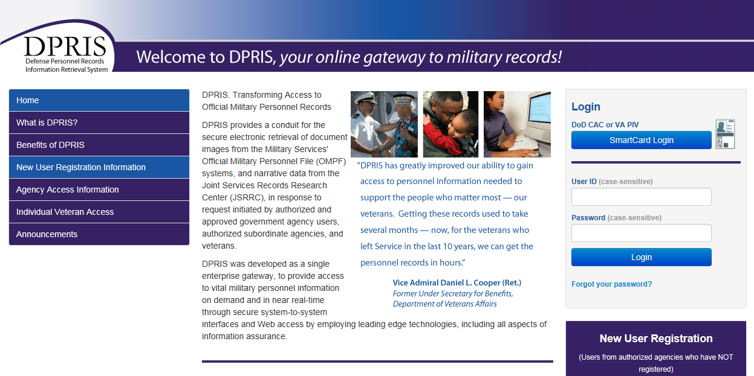
Home Page

Slide 17
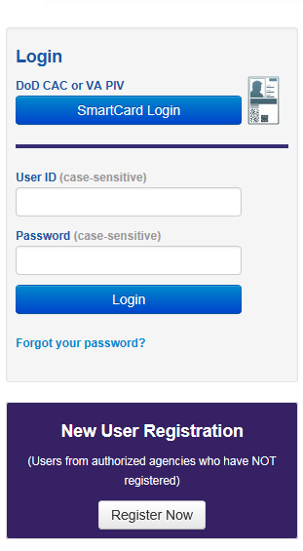
New User Registration

Slide 18
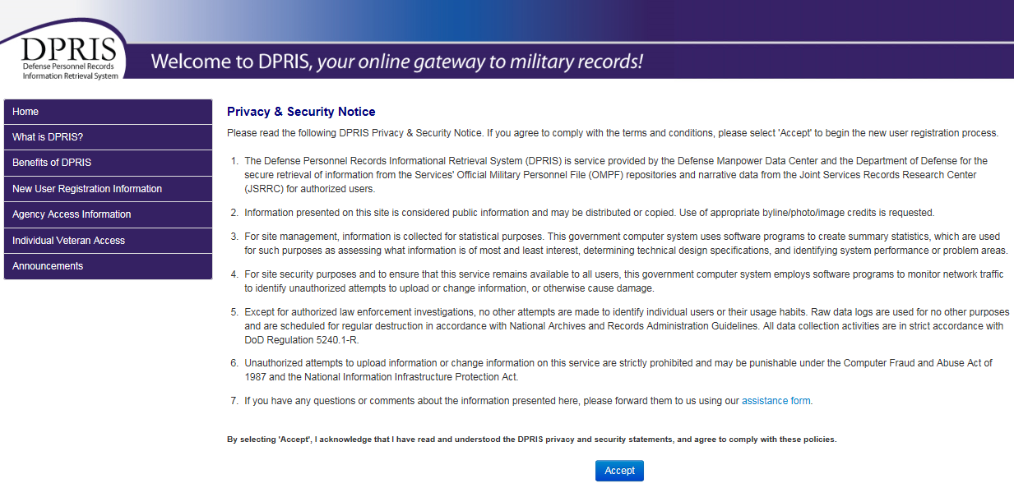
Privacy and Security Statement

Slide 19
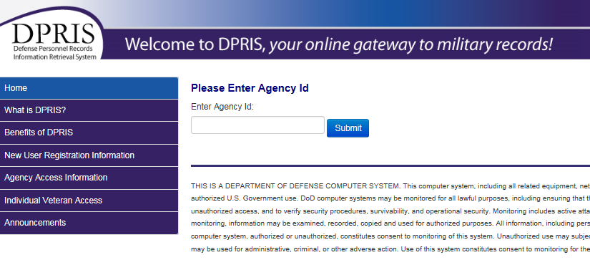
Agency ID
Notes:
This code will be provided by the instructor or your local Web Manager.

Slide 20
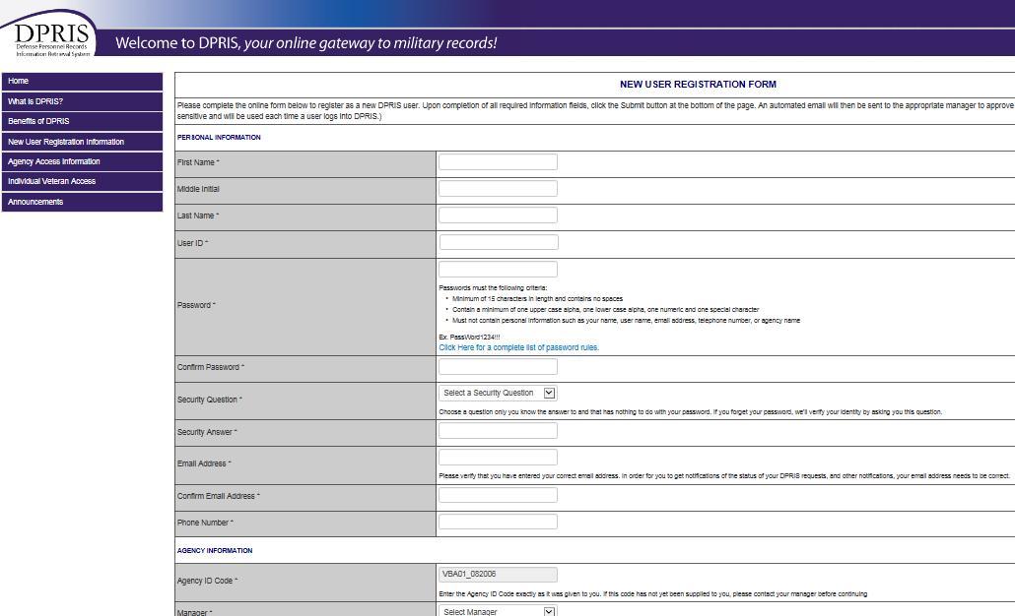
User Registration Form

Slide 21
Compensation and Pension Service
User ID and
STRONG PASSWORDS

Slide 22
User ID
VBA has determined that all VARO shall use their VA email address as their DPRIS User ID
Andrew.Bodyk@va.gov
OR
Jane.Doe@va.gov
Notes:
Note: If user transfers to another station, the original ID chosen will no longer be available for registration. The user may adjust the ID by capitalizing the first letter of the first and last name of the email as noted in the slide.

Slide 23
Strong Passwords
Must Have
Must Not Have
8 to 15 characters
Minimum of one upper case alpha character
Minimum of one lower case alpha character
Minimum of one numeric character
Minimum of one special character: ! @ # $ % & * ( ) - _ = , . ; : ’ ”
A space
  Example: US Gov
May not be changed more than once in a 24 hour period.
Must be different than the last ten (10) created by the user.

Slide 24
More About Passwords
A new password must be different from the last 10 that you created
You will be locked out of the system after three consecutive incorrect password entries
Passwords are case sensitive
(tip: do not create your password with the “CAPS LOCK” on)

Slide 25
More About Passwords (cont.)
Do not record your password in writing
Do not share your password or accept another user’s password
Do not use something anyone can guess such as names of your spouse, pets, children or words found in a dictionary

Slide 26
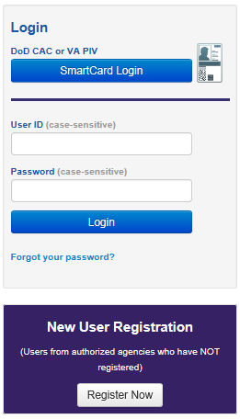
If You Forget Your Password
You will get a message when you have unsuccessfully entered a password and are about to get locked out. If you get locked out of DPRIS Web you must go to your Super User. Before you get locked out click on FORGOT PASSWORD on the DPRIS Home Page.
You will be prompted to enter your User ID and email address.

Slide 27
If You Forget Your Password
(cont.)
If both are entered correctly you will be asked your secret question. (You selected your secret question when you initially registered.)
You will be sent an email with your password.
The first time you login you must change your password to a new password. You must create a new password following the password rules.

Slide 28
Compensation and Pension Service
Using DPRIS Web

Slide 29
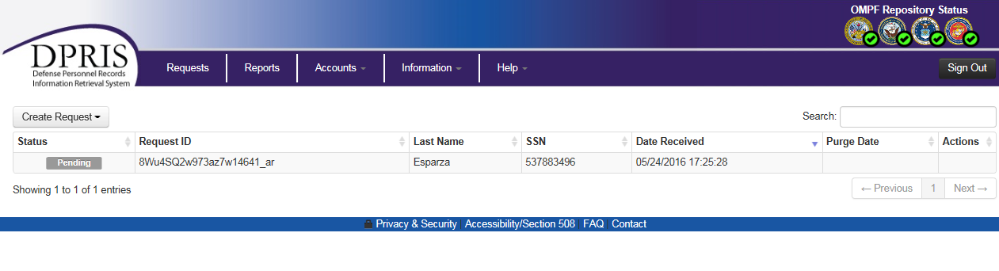
Default Screen after Login

Slide 30

Viewing Requests

Slide 31
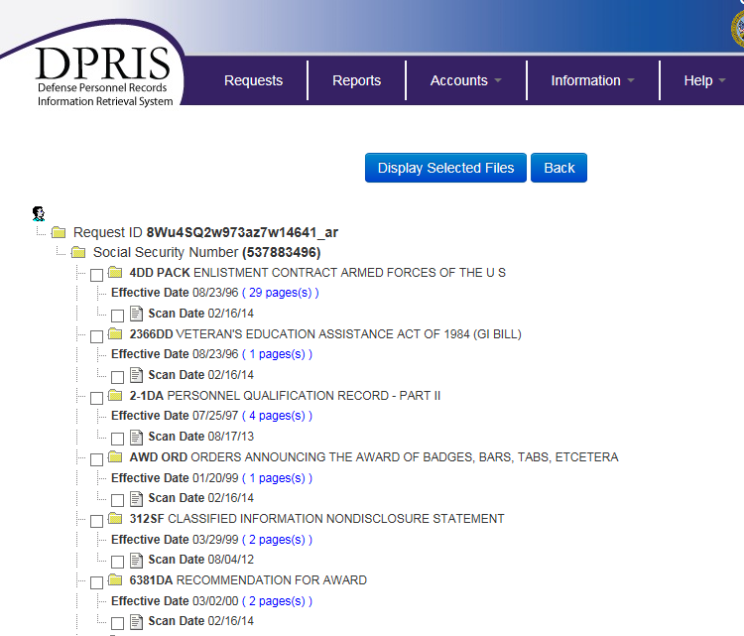
Viewing Requests

Slide 32
Compensation and Pension Service
Submitting OMPF
and
JSRRC Requests

Slide 33
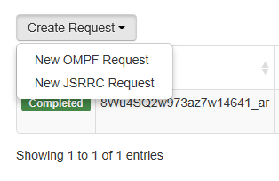
Create Request

Slide 34
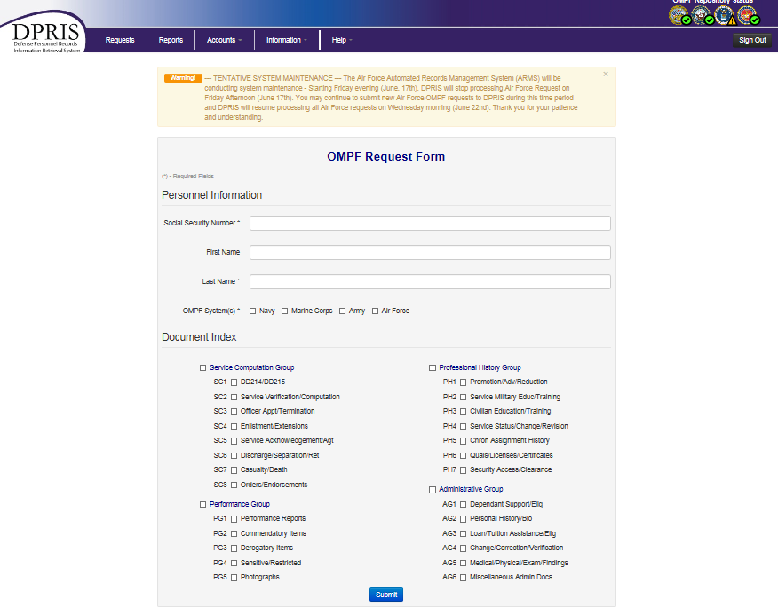
OMPF Request

Slide 35
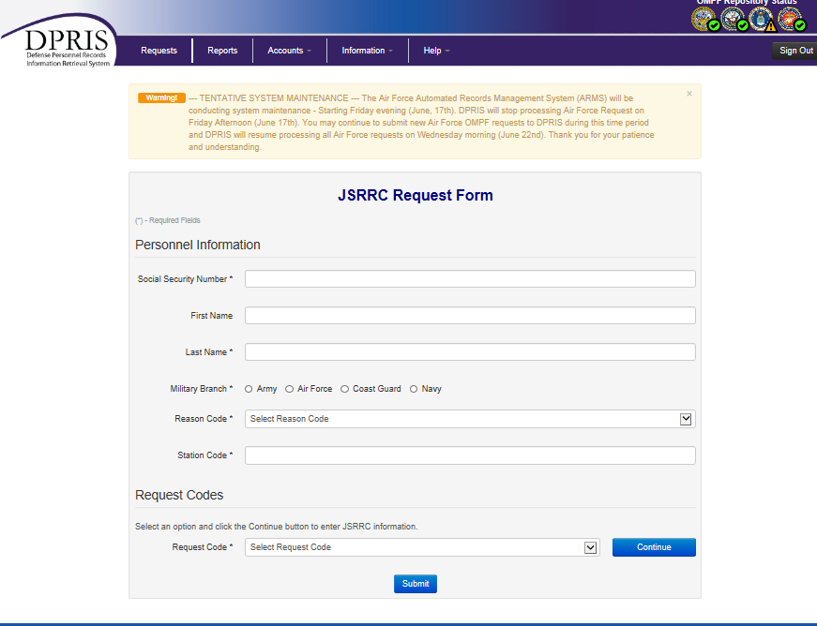
JSRRC Request

Slide 36
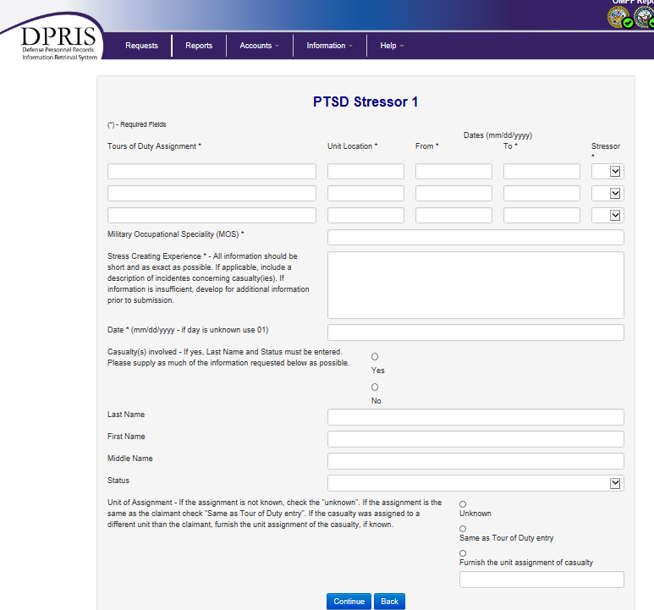
PTSD Stressor Form

Slide 37
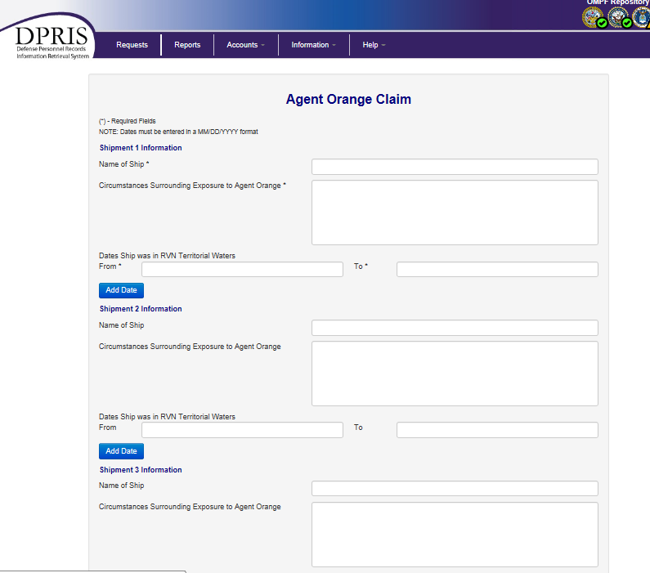
Agent Orange Form

Slide 38
Compensation and Pension Service
DPRIS Web Reports

Slide 39
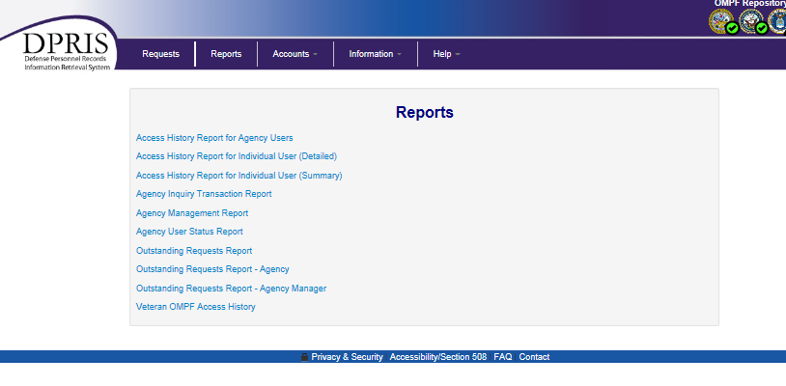
Viewing User Reports

Slide 40
Compensation and Pension Service
Account Management

Slide 41
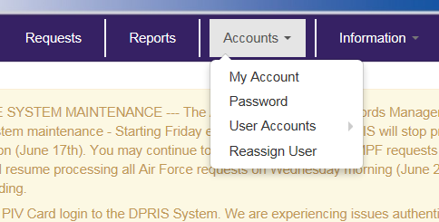
Account Management

Slide 42
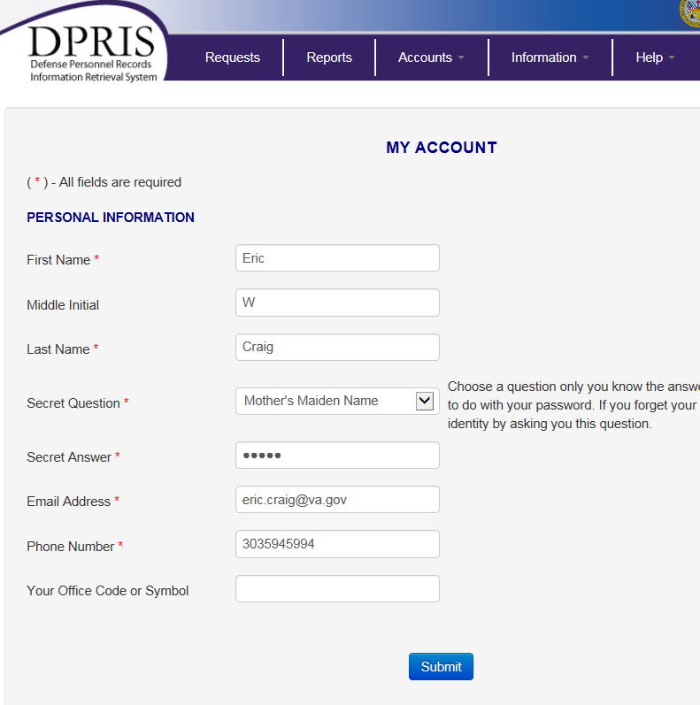
My Account Option

Slide 43
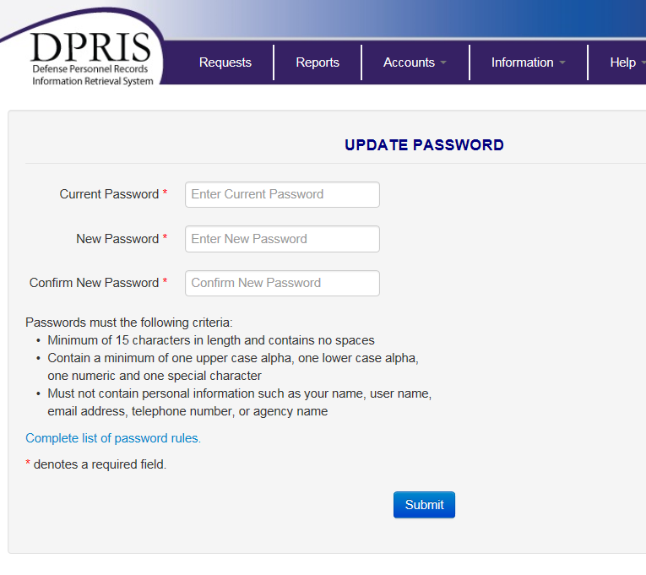
Password Option

Slide 44
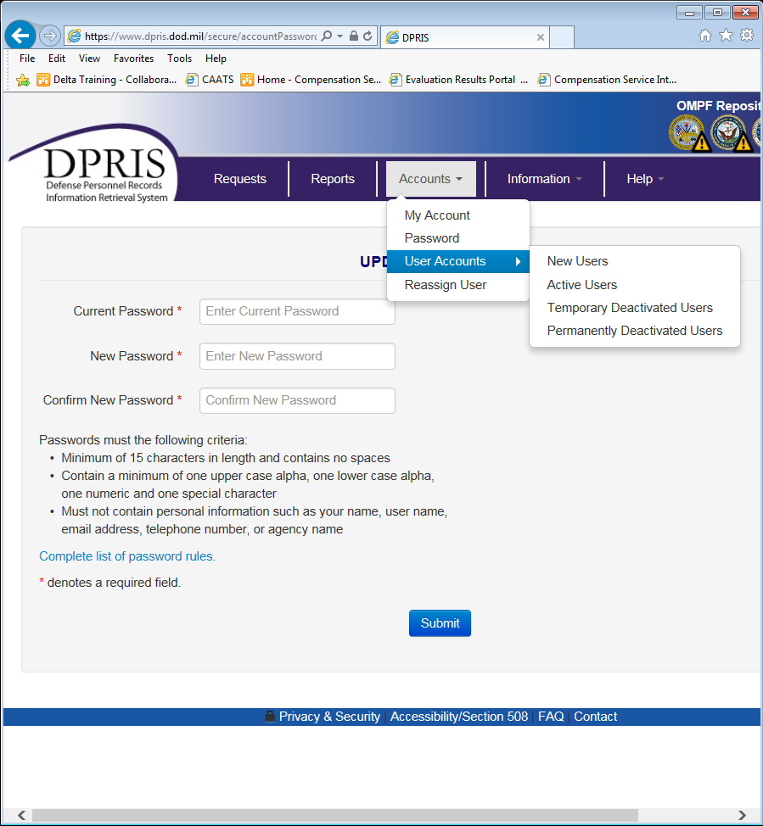
Users Accounts Option

Slide 45
Compensation and Pension Service
Activating/Rejecting New Users

Slide 46
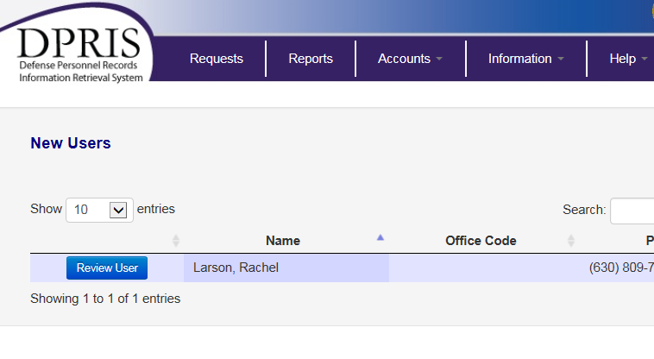
Listing of New Users

Slide 47
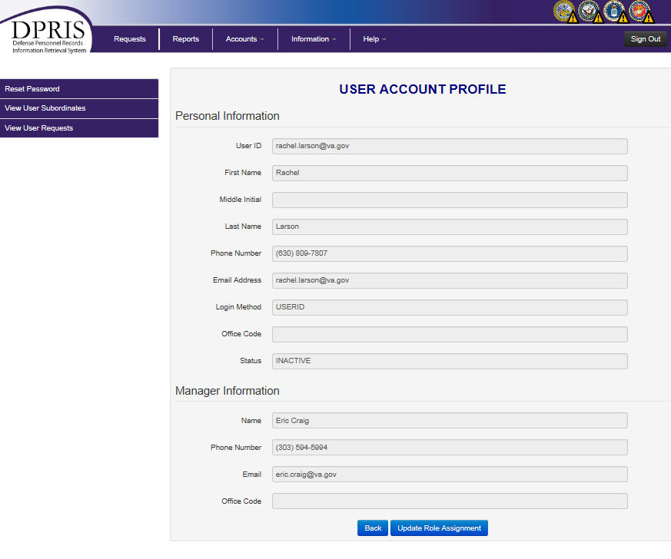
Profile of New User

Slide 48
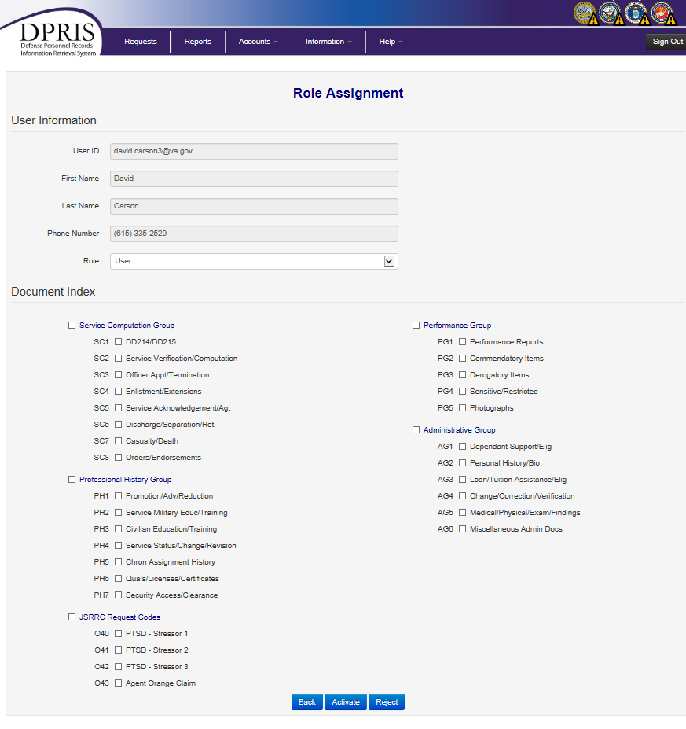
Approval / Rejection Screen

Slide 49
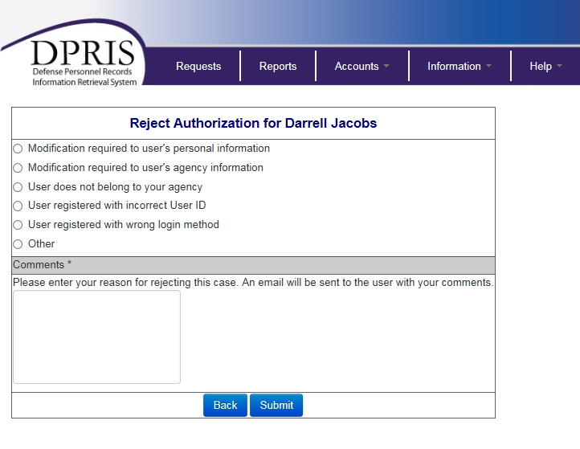
Rejection Comments Screen

Slide 50
Compensation and Pension Service
Updating Active Users Profiles
Or
Deactivating Active Users

Slide 51
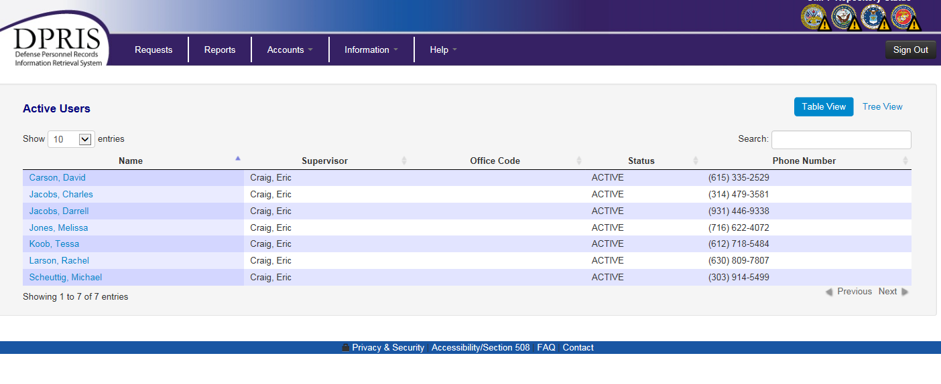
Listing of Existing Users

Slide 52
Existing User Profile

Slide 53
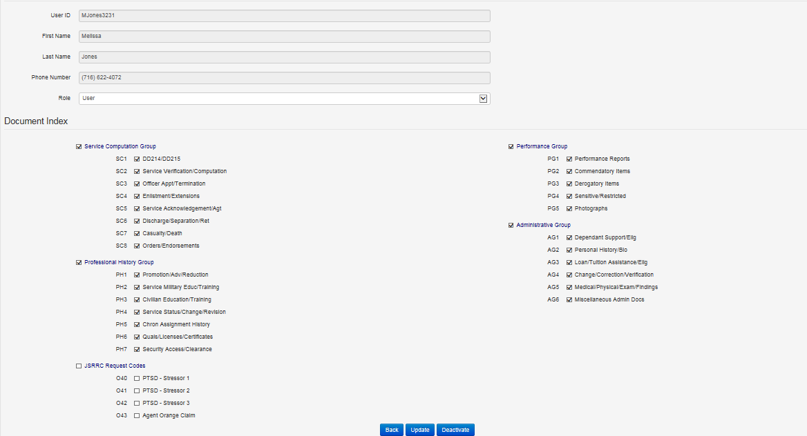
Existing User
Deactivation / Update Screen

Slide 54
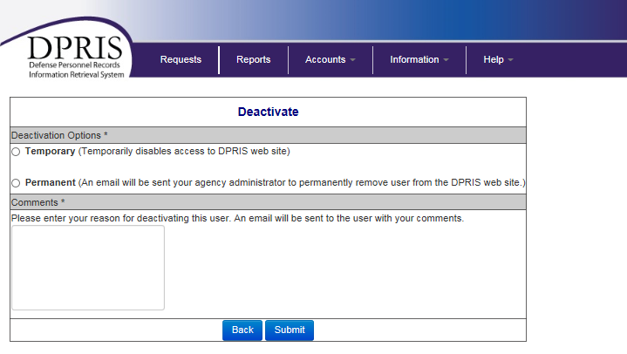
User Deactivation Screen

Slide 55
Compensation and Pension Service
Resetting Passwords

Slide 56
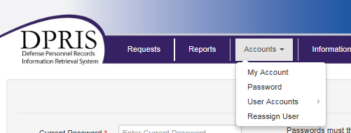
Reset Password

Slide 57
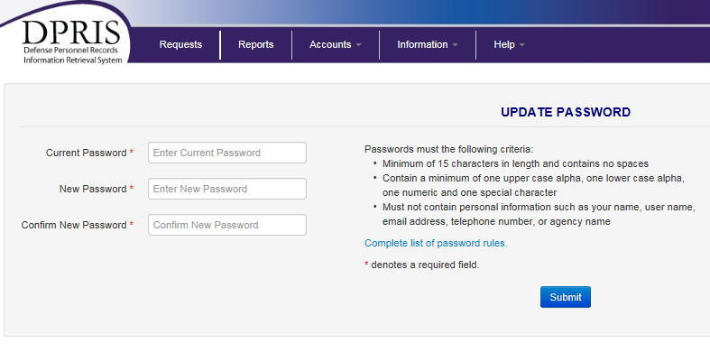
Reset Password

Slide 58
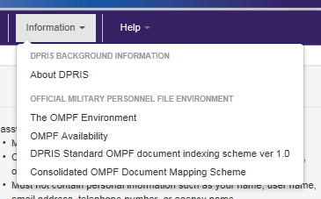
Information Page

Slide 59
Compensation and Pension Service
DPRIS WEB HELP

Slide 60
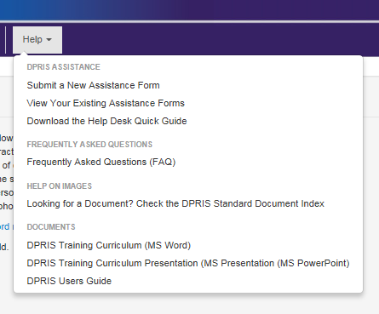
Help Page

Slide 61
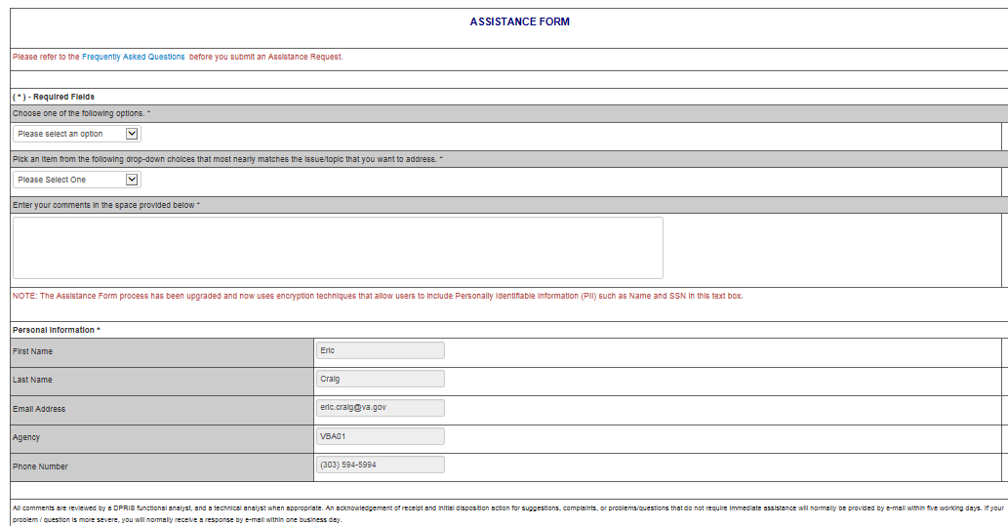
Assistance Form

Slide 62
VBA Central Office Contact
VAVBAWAS/CO/PIES

Slide 63

Questions

