Slide 1
Core Pension Training (CPT) Pension Management Center (PMC) Veterans Service Representative (VSR) New-Hire Orientation
Pension and Fiduciary Service August 2023

Slide 2
Goals
The purpose of this orientation is to:
Summarize the topics covered with the CPT program
Explain the phases and the relevance of each in developing the trainees’ knowledge and skill levels progressively
Introduce the concept of knowledge checks as a replacement for conventional lesson summaries
Explain the advantages of knowledge checks, as they support reinforcing learning and identifying areas of improvement
Defend the positioning of introductory courses throughout each phase
Define Level 1 from Level 2 Assessments
Describe the difference and importance of transitioning from traditional lesson summaries to innovative methods
Outline the required training hours and goals

Slide 3
The Purpose
This purpose of this orientation is to provide newly-hired Pension Management Center (PMC) Veterans Service Representative (VSRs) with the construct of the Core Pension Training (CPT) program, as well as to present an overview of the topics covered, the required training hours, and information regarding Level 2 Assessments, which are used to assist in equipping new hires with the knowledge and skills needed to effectively complete daily job functions.

Slide 4
The Structure of the Phases
The CPT Curriculum is a comprehensive training program designed to provide trainees with a structured learning experience that progresses through six separate phases, with each accommodating different levels of expertise.
These levels center on the following:
Basic Training
Foundational Enrichment (Phases 1-4)
Intermediate Training
Proficiency Development (Phase 5)
Advanced Training
Practical Application and Experience (Phase 6)

Slide 5
Introductory Courses: Progressive Model
Certain topics are complex and require a higher level of knowledge; therefore, many introductory courses are positioned within the intermediate phase, as well as the advanced segment to:
address potential knowledge gaps for more challenging topics and accommodates learning diversity
heighten trainees’ ability to grasp the complexities of various topics
promote trainees’ understanding of the content as they frame their foundational knowledge in a manner that attends their specific roles and responsibilities, and
enhances retention and practical application

Slide 6
About the Knowledge Checks (Level 2 Assessments)
Level 2 Assessment are mandatory and are integrated into each course as the Knowledge Check (KC).
Advantages of implementing Level 2 Assessments as Knowledge Checks include:
Improved quality
Retention Assessment
Live Feedback
Engagement

Slide 7
About the Knowledge Check Preps
Some phases within the curriculum include a Knowledge Check Prep, which serves as an additional tool for trainee development.
The purpose of the KC Prep is to assist trainees in securing a robust knowledge base, ensuring a sturdy platform for their advancement to the subsequent phase.
Utilizes a range of activities to include, practice exercises, review materials, and supplementary resources to reinforce their understanding and skills.

Slide 8
Lesson Summary Reviews
Instructors will use the assessments as a basis for live feedback during the lesson summary review.
During the lesson summary review, the instructor provides immediate feedback based on the Level 2 Assessment, which generates
a thorough assessment of trainee retention levels
interactive approach
fosters enhanced engagement, and
facilitates real-time feedback to help elevate the overall quality of the new hires’ learning experience

Slide 9
Training Hours
Hours spent in this training program is to secure knowledge acquisition, applied learning, and team collaboration.
Basic Core Phase: Introductory Courses (Phases 1-4): By the end of this segment trainees should have accumulated a total of 21 training hours. The underpinnings of the Basic Core phase are rooted in securing a solid understanding of fundamental concepts and skills.
Intermediate Core Course Phase (Phases 5.1a-5.6): The Intermediate Core Course phase contains approximately 100 training hours. This phase expands the trainees’ skill levels by introducing them to more complex subject matters and advanced techniques.
Advanced Core Course Phase (Phase 6): The final phase is the Advanced Core Course phase, which is projected to encompass 111 training hours. During this segment, trainees become more proficient via on-the-job training, to further support learning and facilitate immediate application of newly acquired skills.

Slide 10
Benefits of the Course Evaluations (Level 1 Assessments)
Survey responses contribute to the overall learning experience by implementing changes attuned to the specific needs of the trainee.
At the conclusion of each training course is a Level 1 Assessment that not only serves as an essential step in earning credit but allows each trainee to offer feedback.
Trainees can assess their learning experience, identify the strengths of each course, identify the strengths of the course, as well as highlight areas of improvement requiring additional clarification or support

Slide 11
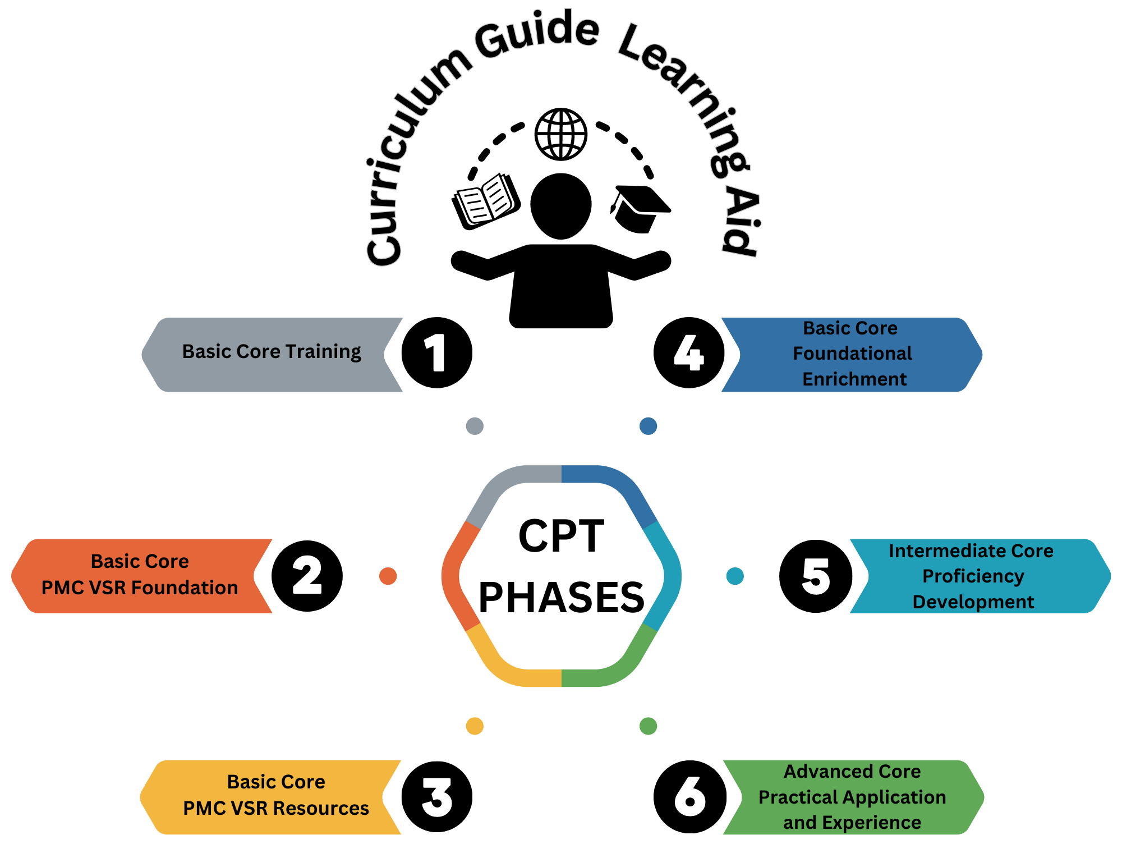
Curriculum Guide Learning Aid

Slide 12
Comprehensive Knowledge Sessions (CKS)
The Comprehensive Knowledge Session (CKS) is a two-day recap session that extends beyond the existing structure of reviews and assessments, to offer a comprehensive review that will allow trainees opportunities to revisit various course material covered; and confirm their understanding of the subject matter.
CKS permits the submission of accumulated questions, concerns, as well as present areas of confusion for additional clarification and feedback before moving forward.

Slide 13
What’s Next
Phase 3 – PMC VSR Resource CPT Training

Slide 14
Questions
Questions should be filtered through your QRT team. They will submit your questions to the Field Inquiry Tool (FIT) on your behalf.

