Slide 1
CAATS - VR&E Purchase Card Module Training – Purchase Cardholder (Initiator) and Approving Officials Dale Sagotsky, VR&E Training Specialist Christopher Scott, VR&E Procedures Analyst Alice Garrett, OFM Senior Program Analyst
Notes:
Welcome to the CAATS VR&E Purchase Card Module Training for Purchase Cardholders and Approving Officials. Today is April 4th, and this is the 1st of two sessions today. The session is slated for anyone who is a purchase card holder or approving official from the Northeast and Southeast Districts, or those from other Districts who are not able to make the afternoon call. My name is Dale Sagotsky, VR&E Training Specialist. I am joined today by Ms. Tyechia Brown, VR&E Training Specialist as well as Chris Scott (Maria Sullivan for backup) from the Procedures Team with VR&E Central Office. Our presenter today is Ms. Alice Garrett, Senior Program Analyst with the Office of Financial Management. VR&E Service in collaboration with Office of Finance Management is providing trainings for CAATS purchase card holders, approving officials, setup admins/finance approvers, and auditors. We will not be using the video option in MS Teams to minimize any bandwidth issues. Go live April 24th with CAATS.

Slide 2
Recording
Notes:
I will now begin the recording of this training session.

Slide 3
TMS & CRC
TMS Number: 4637658
Item is approved for CRC Continuing Education Credits. Go to TMS “My History” Pod, Click “View All,” locate the training, click on “View Details” and click “Print Accreditation Certificate.”​
Notes:
The TMS training item is displayed on the screen. A recording of this training will be available on the VR&E Training Team homepage under Training Resources. This training is approved for those who are Certified Rehabilitation Counselors as continuing education credits by going to TMS to the My History Pod, viewing and locating the training details and printing the accreditation certificate.

Slide 4
Virtual Training Etiquette
Notes:
We will now post the slide deck for today’s training in the chat. Read the Etiquette and Rules. I would now like to turn it over to Chris Scott with VR&E Procedures to go over improvements to the Government Purchase Card Processes.
We will have a Question-and-Answer at designated points throughout and at the end of the training. Additionally, questions may be placed in the chat during training and will be answered when we come to a pause for questions. You may also come off of mute to ask your questions at that time. You can raise your hands and we will call on you. For any questions that are taken back for the record or if we run out of time, the answers will be sent in a subsequent email to the field shortly after the completion of the trainings.
I would now like to introduce Ms. Alice Garrett, Senior Program Analyst to start the training presentation.
Roles –
Dale – TMS assignment, kickoff session, record, navigate slides (up to Slide on Agenda), facilitate Q&A
Tyechia – monitor the virtual classroom (hot mics, hands up, etc.) and capture any unanswered questions and assist Dale with organization of Q&A
Alice – Presenter and SME for questions in her purview on the CAATS System
Procedures – Assist with answering VR&E specific questions

Slide 5
Improvements to Government Purchase Card Processes
The How:
Centralized documents into one system.
No need to upload documents to VBMS.
No need to print out documents for reconciliation.
No need to send a document packet to VREO for approval; it is now incorporated into the system for the Approving Official (AO) to get an alert when approving or reconciling purchase orders.
User-friendly system with drop-down menus.
No need to maintain a purchase card log because it is now incorporated into the system.
The Why:
We are continuing to streamline and automate our systems to become a paperless environment.
The When:
April 24th is the official launch date of the new CAATS system.

Slide 6
Key Differences
1. Currently, the cardholder must create a hard copy reconciliation packet to send to the AO for review and final approval. (Creating and Maintaining a Hard Copy)
The CAATS web-based system maintains records and serves as a repository for charge card statements, acquisition checklists, order requests, order approvals, and the monthly purchase card reconciliation.
2. Currently, the VRC Completes the Purchase Card Acquisition Checklist, Appendix BW, for every micro-purchase prior to making a purchase. (Creating a Hard Copy) VRC also enters all purchase card transactions into the Government Purchase Card Log, Appendix BX. (Maintaining a Hard Copy)
Appendix BW “Purchase Card Acquisition Checklist,” and Appendix BX, “Government Purchase Log,” have been fully integrated within the CAATS system, eliminating the need to upload these documents.
3. Currently, all email notifications are manual and not automated. The notification is dependent on the user reading and responding to an email.
Cardholders and Approving Officials (AO) will receive an e-mail notification for any unreconciled purchase card charges in the CAATS system.

Slide 7
Key Differences (cont’d)
4. Currently, in most cases, the VREO is the assigned AO.
The role of an AO may be assigned to multiple users other than VREO, such as VRC or Management Analyst. (Exception: AO cannot be the approver for their own purchases.)
5. Currently, the AO completes the review transactions and reconciliation in multiple places, which results in an administrative burden.
The AO reviews transactions for all purchases and reconciliations within one centralized location in the CAATS system.
Clarification from previous training: VR&E purchase cardholders will not have the ability to purchase items without preauthorization via the Pre Approval Memo. The oversight feature built into the CAATS system requires the initiator to obtain the approval in CAATS prior to making the purchase.

Slide 8
Questions?

Slide 9
Agenda
VRE Purchase Card Module
Roles
Sub-Modules
Statuses
Process Flow
Demo
Backup Documentation

Slide 10
VRE Purchase Card - Roles
Initiator: allows the users to create a purchase card transactions.
Approver: allows users to approve purchase card created by the initiator.
Setup Admin: allows the user to establish purchase card
Finance Approver: provide a second level review of the purchase card order.
Auditor: allows the user to perform the annual and focus review audit.
Read only: allows the users to view transactions only; no input capability.

Slide 11
VRE Purchase Card Module - Submodules
9 Submodules
VRE Purchase Card Order
VRE Purchase Card Receiving
VRE Purchase Card Charge Reconciliation
VRE Purchase Card Expense Transfers
VRE Purchase Card Reconciliation Approval
VRE Purchase Card US Bank Links
VRE Purchase Card Setup List
VRE Purchase Card Audit Review
VRE Purchase Card – Reports

Slide 12
VRE Roles and Submodules

Slide 13
VRE Purchase Card Module - Statuses
All: Displays all purchase card for the station in all statuses.
All Active: All purchase card order in an active state to include Working, In Review, Finance Review, Approved, and Returned to Station.
Working: purchase card order saved and have not been submitted for approval.
In Review: purchase card order have been submitted by the initiator to the approver.
Returned to Station: purchase card order has been rejected by the approver or finance approver.

Slide 14
VRE Purchase Card Module - Statuses
Finance Review: purchase card order require a financial review prior to approving.
Approved: purchase card have been approved by the approving official and finance approver.
Deleted: purchase card order have been deleted from CAATS.
Submitted to FMS – expenditure transfers that have been submitted to FMS for processing.
Accepted in FMS: expenditure transfers that have been accepted by FMS.
Rejected by FMS: expenditure transfers that have been rejected by FMS. Correction will be made in FMS.

Slide 15
VRE Purchase Card Module - Statuses
Partially Reconciled – The purchase cardholder has reconciled the purchase card order to the purchase card charge partially
Fully Reconciled – The purchase cardholder has reconciled the purchase card order to the purchase card charge.
Reconciled Approved – The purchase card reconciliation has been approved by the approving official
Reconciled Rejected – The purchase card reconciliation has been rejected back to the purchase cardholder for corrections

Slide 16
Statuses

Slide 17
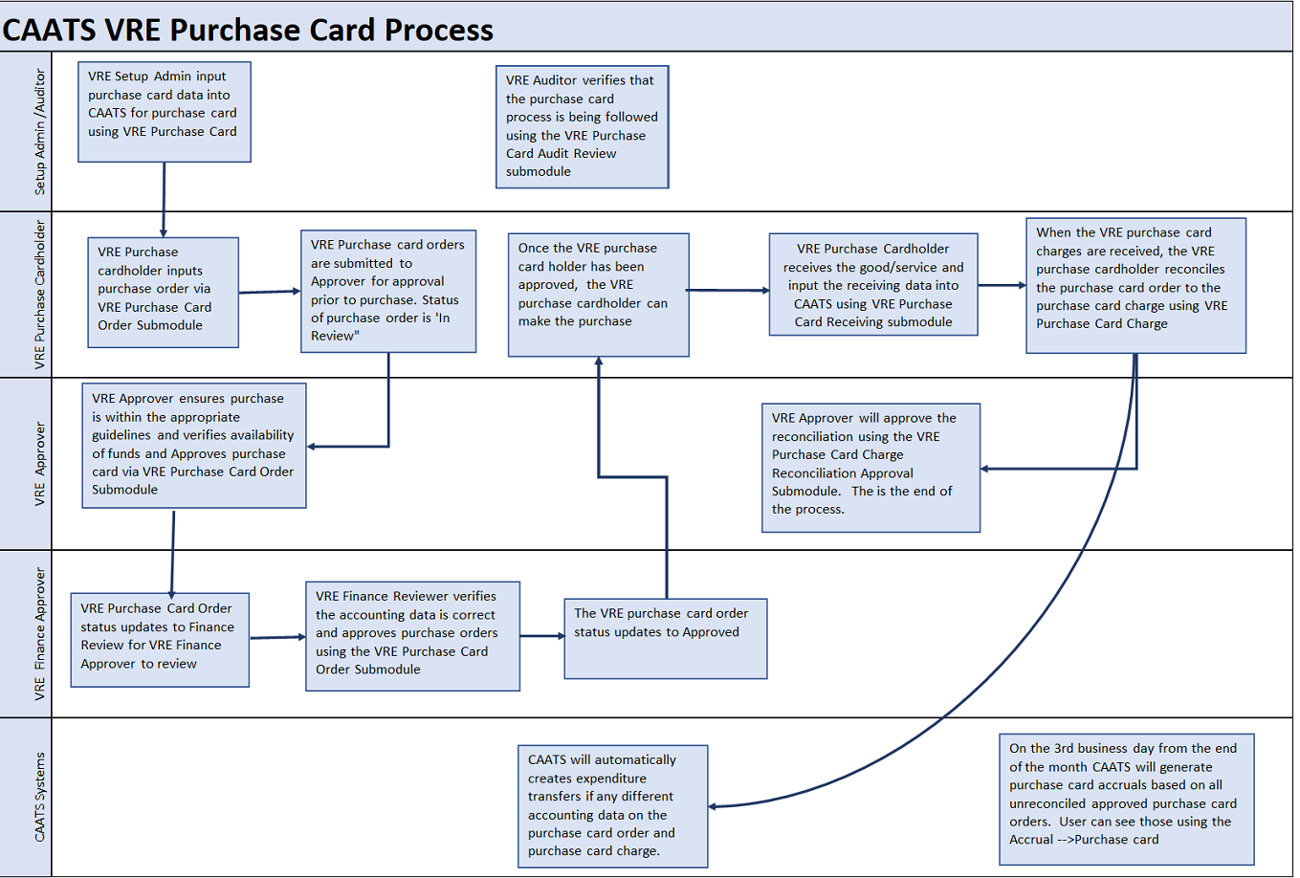
VRE Purchase Card Module - Process Flow
Notes:
There is an approval process before the Card goes to eCMS as well as before the transaction goes into FMS.

Slide 18
VRE Purchase Card Module - Process Flow
Access is granted to the purchase cardholder(initiator, approver, finance approver, setup admin, and auditor)
Setup admin establishes purchase cardholders card information using the VRE Purchase Card Setup List Submodule
Purchase Orders are input by Purchase cardholder(initiator) using VRE Purchase Card Order Submodule
Purchase cardholder (initiator) answers purchase card checklist questions prior to inputting purchase order.
Approving Official Approves Purchase Orders using same module
Finance Reviewer Approves Purchase Orders using same module
Purchase cardholder (initiator) makes the purchase.
Purchase cardholder(initiator) updates receiving information using the VRE Purchase Card Receiving Submodule once items have been received

Slide 19
VRE Purchase Card Module - Process Flow
Purchase cardholder (initiator) reconciles purchase card order with the purchase card charge using the VRE Purchase Card Reconciliation Submodule once charges have been received in CAATS from US Bank
Expenditure Transfers are created if accounting string is different on the purchase card order, then on the purchase card charge
Expenditure Transfers can be found in the submodule VRE Purchase Card Expense Transfer or link on the purchase card order
Approving Official approves reconciliation using the VRE Purchase Card Reconciliation Approval Submodule.

Slide 20
VRE Purchase Card Module

Slide 21
Demonstration
CAATS Demo – Roles: Initiator and Approving Official
Notes:
Alice will take over sharescreen here for demo.

Slide 22
Backup Documentation
Notes:
Alice will take over sharescreen here for demo.

Slide 23
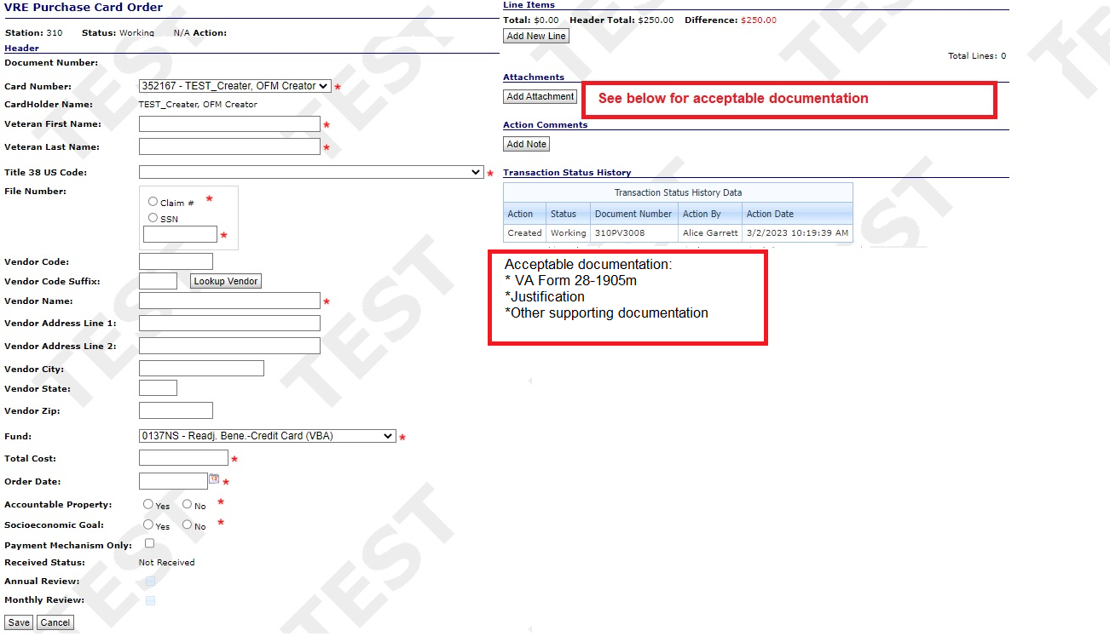
VRE Purchase Card Module - Screens
VRE Purchase Order Screen – (Initiator -Purchase Cardholder)

Slide 24
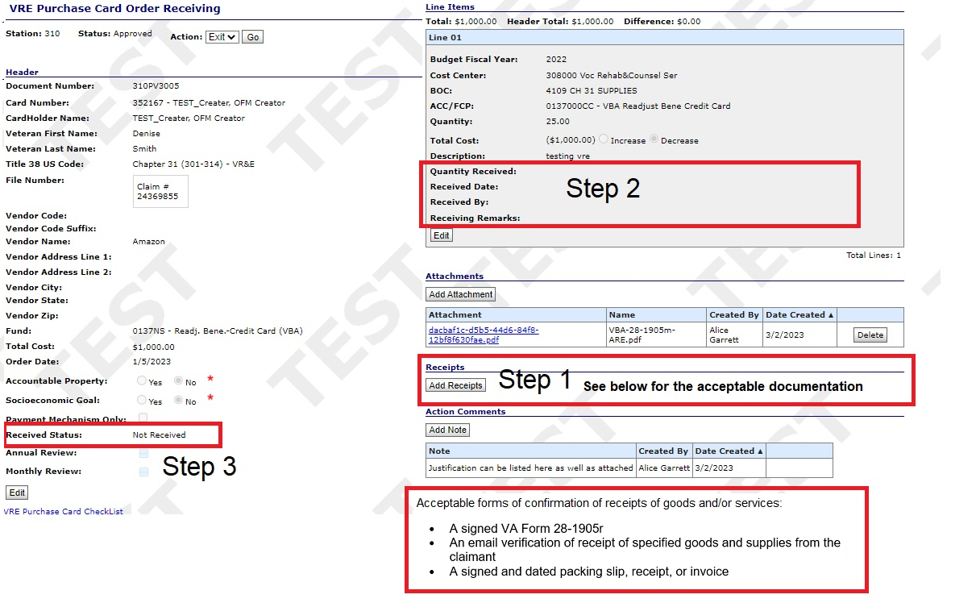
VRE Purchase Card Module - Screen Shots
Purchase Card Receiving (Initiator – Purchase Cardholder)

Slide 25
VRE Purchase Card Module - Screen Shots
Purchase Card Reconciliation (Initiator – Purchase Cardholder)

Slide 26
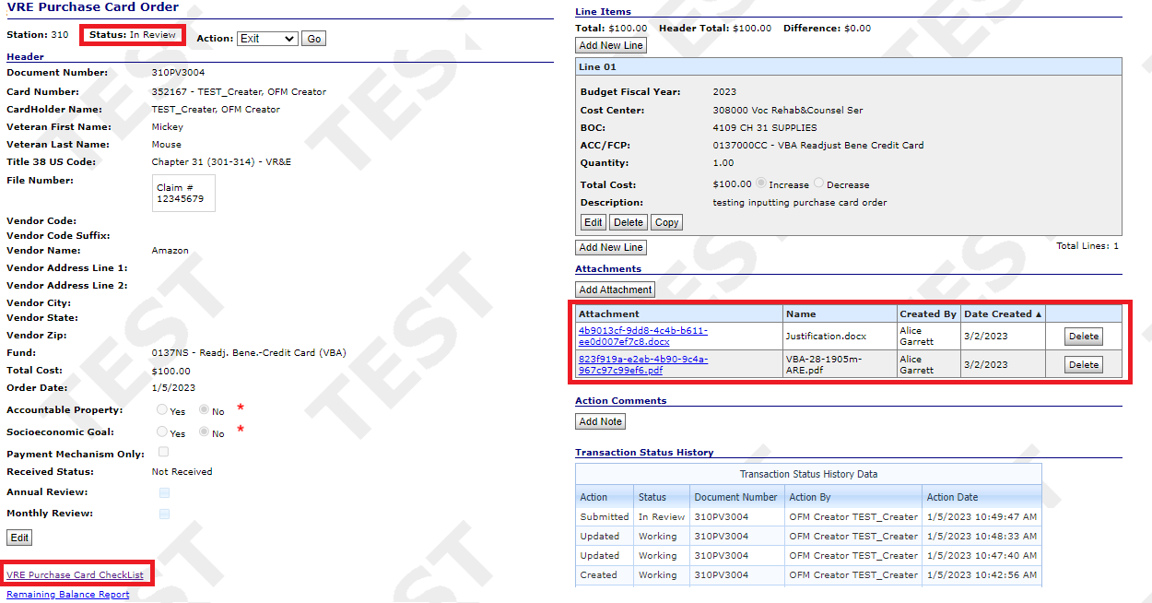
VRE Purchase Card Module
VRE Purchase Order Screen – (Approving Official - AO)

Slide 27
VRE Purchase Card Module
Purchase Card Reconciliation – (Approving Official – AO)

Slide 28
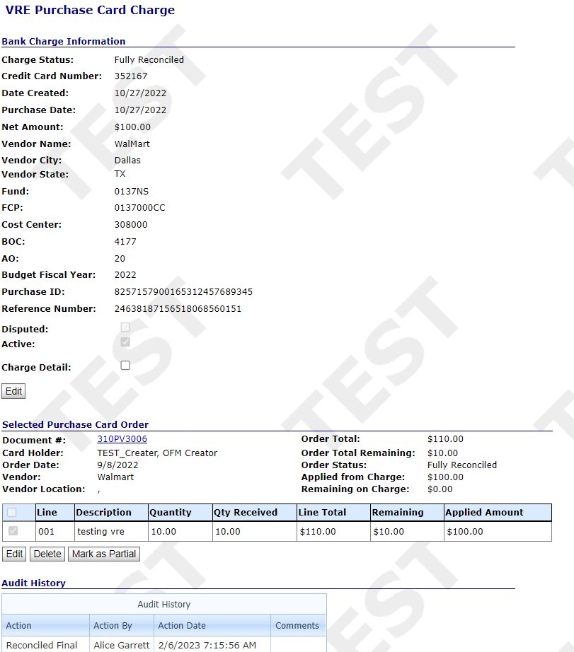
VRE Purchase Card Module – Reconciliation – Approving Official (AO)

Slide 29
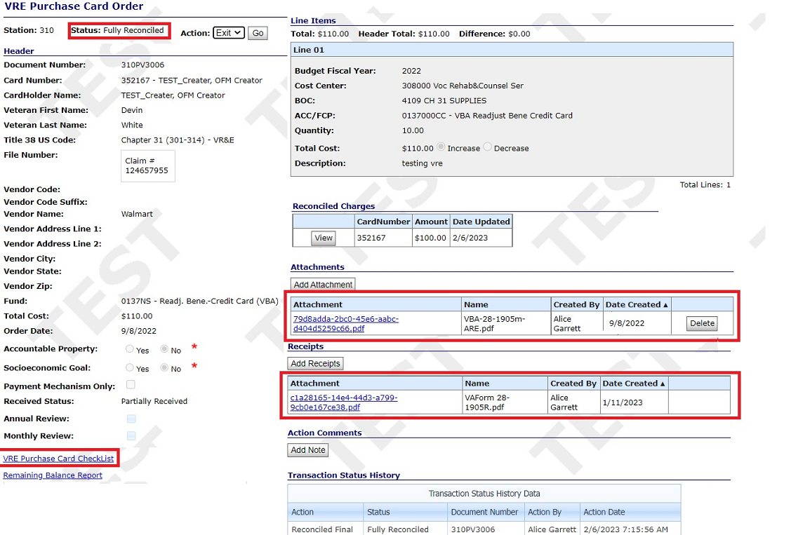
VRE Purchase Card Module – Reconciliation – Approving Official (AO)

