Slide 1
Fiduciary Hub IQR Guides
Training
June 2022
June 13, 2022
Slide Count: 17

Slide 2
Objectives
The Reviewer will understand:
FAC recommended changes
The purpose for the Review and Step-by-Step Guides
How to use the guides when completing IQRs

Slide 3
Purpose
To establish consistency when performing IQRs:
Three role specific Review Guides and Step by Step Guides created for
Field Examiner IQRs
Fiduciary Service Representative IQRs
Legal Instruments Examiner IQRs
M21-4, Chapter 8

Slide 4
FAC Recommendations
No recommended changes to IQR checklists
FEIQR (26 claim transaction types)
14 claim transactions FAC recommended removal
3 additional claim transactions removal recommended by workgroup
9 claim transactions remain
LIEIQR (28 claim transaction types)
12 claim transactions FAC recommended removal
1 non-concur by workgroup
17 claim transactions remain
FSRIQR (23 claim transaction types)
No recommended changes

Slide 5
FAC Recommended Changes - FEIQR

Slide 6
FAC Recommended Changes - LIEIQR
Notes:
.

Slide 7
FAC Recommended Changes - FSRIQR

Slide 8
Quality Action Plan Workgroup
Nine hub SMEs participated
Broken out into three position types
3 SMEs work on FEIQRs
3 SMEs work on LIEIQRs
3 SMEs work on FSRIQRs
Created Review Guide and Step by Step Guide
Eight Hub QRT Peer Reviewed Final Products

Slide 9
Review Guides
Error descriptor for IQR checklist
Created an explanation of error
Provided possible manual references
Followed style found in M21-4, Chapter 8, Appendix A.b. and B.b.
Will be published in updated M21-4, Chapter 8

Slide 10
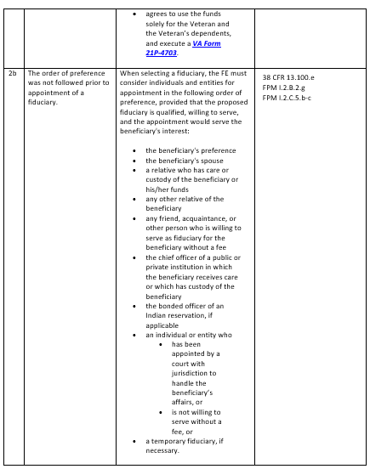
Review Guide Sample - FEIQR

Slide 11
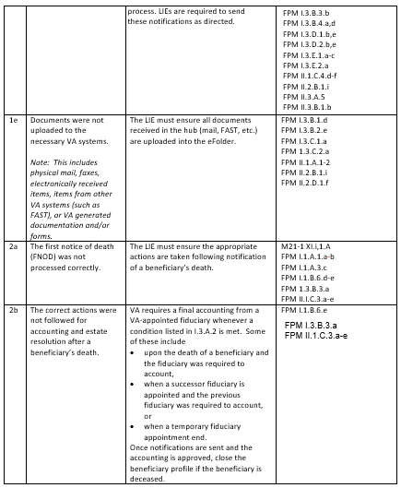
Review Guide Sample - LIEIQR

Slide 12
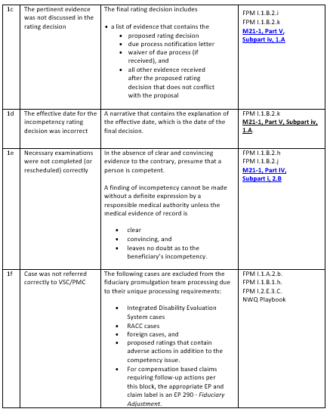
Review Guide Sample - FSRIQR

Slide 13
Step by Step Guides
Based on recommended and approved Claim Transaction Type for all IQRs
Created steps QRT would take when completing task based IQRs
Applicable checklist question
Will be published in updated M21-4, Chapter 8

Slide 14
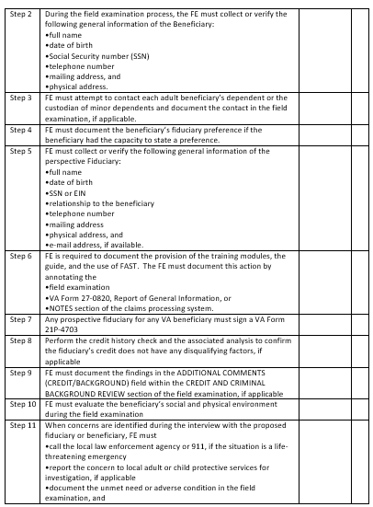
Step by Step Guide Sample - FEIQR

Slide 15
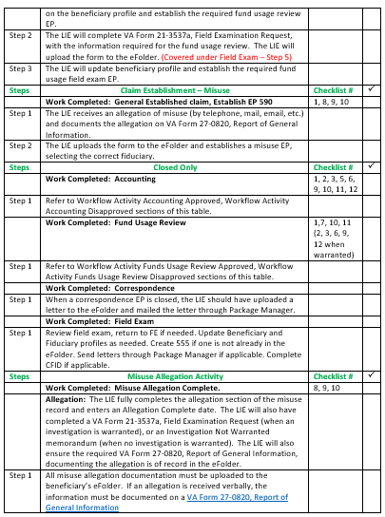
Step by Step Guide Sample - LIEIQR

Slide 16
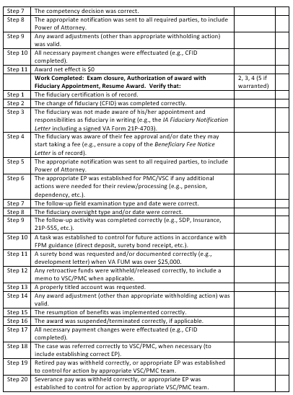
Step by Step Guide Sample - FSRIQR

Slide 17
Questions
Any questions should be directed to your local QRT or the Training, Quality and Oversight mailbox at PFTNGQUALOVRST.VBACO@va.gov
For specific Policy & Procedure related questions, email them directly at PFPOLPROC.VBACO@va.gov
TMS # VA 4626874

