Slide 1

Rating Improved Decision Notices
Module 3: Favorable Findings
February 2022
Notes:
Instructor Notes:
This course provides students with an understanding of the Appeals Modernization Act (AMA) improved decision notice element 4, favorable findings, and how to document favorable findings within a rating decision.

Slide 2

The Bottom Line
The Appeals Modernization Act (AMA) includes expanded eight-point notice requirements for VA decisions. Claims processors must understand these notice requirements and how to implement them.
A favorable finding informs the claimant of any material element that was met, despite the VA denial.
Notes:
Instructor Notes:
So, what is the bottom line with favorable findings?
The Appeals Modernization Act (AMA) includes expanded eight-point notice requirements for VA decisions. Claims processors must understand these notice requirements and how to implement them.
A favorable finding informs the claimant of any material element that was met, despite the VA denial.

Slide 3
Improved Decision Notices
References
Objectives
Summarize the eight-point notice requirements for VA decisions
Define and describe an overview of favorable findings
Discuss how to document favorable findings
Recall how to use VBMS-R to document favorable findings
Describe how to overturn favorable findings
Review examples of favorable findings
Notes:
Instructor Notes:
At the end of this training, given the training and handouts, learners will be able to successfully complete knowledge checks and pass the end-of-course assessment through instruction of the following objectives:
Summarize the eight-point notice requirements for VA decisions
Define and describe an overview of favorable findings
Discuss when and how to document favorable findings
Recall how to use VBMS-R to document favorable findings
Describe how to overturn favorable findings
Review examples of favorable findings

Slide 4
References
Public Law (PL) 115-55, Veterans Appeals Improvement and Modernization Act of 2017
38 CFR 3.103(f), Procedural due process and other rights
38 CFR 3.104(c), Favorable findings
M21-1, V.iv.1.A, Completing the Rating Decision Narrative
M21-1, X.ii.1.A.2, Favorable Findings
M21-5, 5.1.b., Authority of Higher-Level Reviewers
VBMS Rating User Guide
Favorable Findings Job Aid (VBMS-R)
Notes:
Instructor Notes:
The references for today’s training include:
Public Law (PL) 115-55, Veterans Appeals Improvement and Modernization Act of 2017
38 CFR 3.103(f), Procedural due process and other rights
38 CFR 3.104(c), Favorable findings
M21-1, V.iv.1.A, Completing the Rating Decision Narrative
M21-1, X.ii.1.A.2, Favorable Findings
M21-5, 5.1.b., Authority of Higher-Level Reviewers
VBMS Rating User Guide
Favorable Findings Job Aid (VBMS-R)

Slide 5

Objective
Summarize the eight-point notice requirements for VA decisions
Notes:
Instructor Notes:
Let’s start by summarizing the eight-point notice requirements for VA decisions.

Slide 6
Eight-Point Decision Requirements
Identification of issues adjudicated
Summary of evidence considered
Applicable laws and regulations
Favorable findings
Elements required to grant the claim(s) that were not met
Criteria for next higher level of compensation
How to obtain or access evidence
Summary of applicable review options
Notes:
Learning Objective: Summarize the eight-point notice requirements for VA decisions
Instructor Notes:
To ensure claimants receive adequate notices, the Appeals Modernization Act (AMA) requires VA to issue improved decision notifications. There are 8 elements VA must include in all decision notices.
Identification of the issues adjudicated
A summary of the evidence considered
A summary of the laws and regulations applicable to the claim
A listing of any findings made by the adjudicator that are favorable to the claimant
For denied claims, identification of the element(s) required to grant the claim(s) that were not met
If applicable, identification of the criteria required to grant the next higher level of compensation
An explanation of how to obtain or access evidence used in making the decision
A summary of the applicable review options available for the Veteran to seek review of the decision
Rating personnel must address elements 1-6 in each rating decision (using VBMS-R). Elements 7 and 8 are addressed in the decision notification letter. Today’s training reviews element #4 on findings favorable to a claimant.

Slide 7

Knowledge Check #1
Question: How many decision notification elements are required for rating decision?
Answer: Under AMA, six of eight decision notification elements are required for rating decision.
Notes:
Learning Objective: Summarize the eight-point notice requirements for VA decisions
Instructor Notes:
**IMPORTANT: Slide contains animations. Click to reveal the scenario, question and answer to students.**
Let’s take a look at a knowledge check.
Question: How many decision notification elements are required for rating decision?
Answer: Under AMA, six of eight decision notification elements are required for rating decision.

Slide 8
Objective
Define and Describe an Overview of Favorable Findings
Notes:
Instructor Notes:
Next let’s define and describe an overview of favorable findings, or element 4, which is the topic of today’s training.

Slide 9
Definition
Conclusion either on a question of fact or on an application of laws to facts made by an adjudicator concerning the issue under review
Binding on all subsequent VA and Board adjudicators unless rebutted by clear and unmistakable evidence
Relate to a material element that would be required to grant
Notes:
Learning Objective: Define and describe an overview of favorable findings
Instructor Notes:
38 C.F.R. § 3.104(c) defines a favorable finding as a conclusion either on a question of fact or on an application of laws to facts made by an adjudicator concerning the issue(s) under review.
Any finding favorable to the claimant made by either a VA adjudicator or by the Board of Veterans’ Appeals (Board) is binding on all subsequent VA and Board adjudicators, unless rebutted by evidence that identifies a clear and unmistakable error in the favorable finding.
Favorable findings relate to a material element that would be required to grant the benefit sought and should be specific.
Bottom line: A favorable finding informs the claimant of any material element that was met, despite the denial.

Slide 10
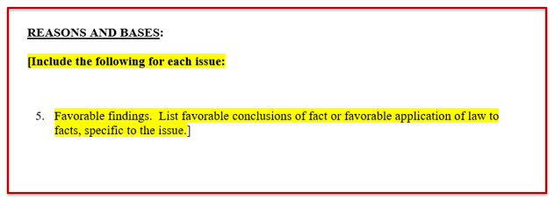
Overview of Favorable Findings
Applicable to denied claims
Identify the material element and state the evidence
List in the ‘Reasons and Bases’ section of a decision
Notes:
Learning Objective: Define and describe an overview of favorable findings
Instructor Notes:
Favorable findings are only applicable to denied claims. Although the claim (or issue) is denied – this decision requirement provides the claimant with findings that are favorable.
It is important to note that not all claims will have favorable findings. Favorable findings are only applicable to denied claims.
When documenting favorable findings, the decision maker must clearly identify the material element found to be met and briefly state the evidence used to support the finding. Only include the most relevant and recent evidence of record. It is important to know that favorable findings are not negative findings.
Lastly in our overview of what a favorable finding is –favorable findings are listed in the Reasons and Bases section of a decision.

Slide 11
Knowledge Check #2
True or False? Favorable findings are required in all decisions.
Answer: False. Favorable findings are only required for denied claims.
Notes:
Learning Objective: Define and describe an overview of favorable findings
Instructor Notes:
**IMPORTANT: Slide contains animations. Click to reveal the scenario, question and answer to students.**
Let’s consider this knowledge check.
True or False? Favorable findings are required in all decisions.
Answer: False. Favorable findings are only required for denied claims.

Slide 12
Objective
Discuss How to Document
Favorable Findings
Notes:
Instructor Notes:
Now we will discuss how to document favorable findings.

Slide 13
Improved Decision Notices
References
Documenting Favorable Findings
Clearly identify the material element met such as
  Incurrence
  Nexus
  Diagnosis
  Presumptions
Briefly state the evidence used to support the finding
Notes:
Learning Objective: Discuss when and how to document favorable findings
Instructor Notes:
When documenting favorable findings, clearly identify the material element that was met, such as incurrence, nexus, diagnosis, or presumptions (i.e., exposure to herbicides, chemical, radiation, etc.).
Briefly state the evidence used to support the finding. Only include the most relevant and recent evidence of record.
A list of pre-approved text is available for use in documenting the material element for favorable findings. (see Favorable Findings Approved Text handout)

Slide 14
Determining the Required Material Element
Depends on the claim and theories addressed
Only address favorable findings related to theories addressed
Notes:
Learning Objective: Discuss when and how to document favorable findings
Instructor Notes:
Determining the material elements for a favorable finding requires understanding the basis of the claim and the theories addressed. Only provide favorable findings related to the theories addressed in the rating decision.
For example, if denying a condition on a direct basis only, even if it is a condition which can be presumptively granted, only include direct favorable findings. Hearing loss can be denied on both a direct and presumptive basis. If the Veteran did not claim hearing loss on a presumptive basis, and presumption is not otherwise addressed in the rating decision, then presumptive favorable findings are not required. However, if presumption is addressed, then presumptive favorable findings are required.

Slide 15
Breakdown of a Favorable Finding
You have been diagnosed with a disability. The VA examination dated April 9, 2021, documents a diagnosis of right knee patellofemoral pain syndrome.
System-generated text
User-generated free text
Notes:
Learning Objective: Discuss when and how to document favorable findings
Instructor Notes:
Examine the favorable finding shown. Each favorable finding has two parts: 1) system-generated text and 2) user-generated free text.
1) The system-generated text is the material element. Here, the material element informs the Veteran that they have been diagnosed with a disability.
2) The user-generated free text provides the supporting evidence. Here, the supporting evidence is the examination dated April 9, 2021, which shows the Veteran has a diagnosis of right knee patellofemoral pain syndrome.

Slide 16
Improved Decision Notices
References
Good Examples of Favorable Findings
Element Met | Material Element Approved Text (Select from list, copy verbatim) | Supporting Evidence (Free text /use claim specific information)
Incurrence | The evidence shows that a qualifying event, injury, or disease had its onset during your service. | “Service treatment records from service period January 2016 to March 2018 show treatment for a right knee injury.”
Nexus | A nexus, or link, has been established between your claimed issue and an in-service event or injury. | “VAMC Houston examination dated March 17, 2017, established a relationship between your right knee injury in service and your currently diagnosed right knee arthritis.”
Diagnosis | You have been diagnosed with a disability. | “VAMC Houston examination dated March 17, 2017, confirms a current diagnosis of right knee arthritis.”
Notes:
Learning Objective: Discuss when and how to document favorable findings
Instructor Notes:
Good examples of favorable findings are specific and document supporting evidence.
An in-service injury is confirmed based on a right knee strain shown in service treatment records dated January 3, 1956.
A direct causal relationship between your right knee injury in service and your currently diagnosed right knee arthritis is established on VAMC Houston examination dated March 17, 2017.
Agent Orange herbicide exposure is presumed based on confirmed service in Vietnam on DD 214 for service period April 1966 to April 1972.
Your left shoulder arthritis meets the requirement for a chronic condition at a compensable degree within one year of discharge based on VAMC Bay Pines treatment reports dated January 1, 2013.
Entitlement to an earlier effective date is shown based on a diagnosis of diabetes mellitus prior to May 2001 shown in private treatment records from Dr. Smith dated January 1999.

Slide 17
Improved Decision Notices
References
Improper Examples of Favorable Findings
Improper Examples | Good Examples (material element + evidence)
Service connection is warranted. | The evidence shows that a qualifying event, injury, or disease had its onset during your service. Service treatment records from service period January 2016 to March 2018 show treatment for a right knee injury.
Private treatment records dated January 1, 2012, February 5, 2015, March 19, 2018, December 21, 2018, and January 1, 2019, show a diagnosis. | You have been diagnosed with a disability. Private treatment records from Dr. John Smith dated January 1, 2019, show a diagnosis of right knee arthritis.
There is a current diagnosis. | You have been diagnosed with a disability. “VAMC Houston examination dated March 17, 2017, confirms a diagnosis of right knee arthritis.”
Service treatment records dated January 1, 1955, show a right knee injury. Records dated March 1956, June 1956, and July 1957 show treatment for the right knee. Records from April 1958 show right knee pain. Therefore, an in-service event is conceded. | The evidence shows that a qualifying event, injury, or disease had its onset during your service. Service treatment records from January 1955 to April 1958 show treatment for a right knee injury.
Vietnam service is confirmed. | Exposure to herbicide agents is presumed. You served in the Republic of Vietnam as noted on your DD 214 for service period January 1966 to March 1966.
Notes:
Learning Objective: Discuss when and how to document favorable findings
Instructor Notes:
Favorable findings should be specific enough that a claimant, upon reading the notification and rating decision, will be able to determine what evidence was used to make the finding.
Improper examples are general and lack supporting evidence. For example:
Service connection warranted.
Current diagnosis.
Diagnosis in service treatment records.
Private treatment records show a current diagnosis.
VA Houston examination report dated March 9, 2018.
Vietnam service confirmed.
All of these need the material element plus supporting evidence to meet the standards of proper favorable findings.

Slide 18
Ancillary Benefits
Benefit | Favorable Finding
Special Monthly Compensation | “You require aid and attendance.” “You have loss of use due to a disability.” “You have anatomical loss due to a disability.” “You are housebound.”
Auto/Adaptive Equipment | “A disability is present that meets the criteria for potential entitlement for an automobile or other conveyance and/or adaptive equipment.”
Specially Adapted Housing/Special Home Adaptation | “A disability is present that meets the criteria for potential entitlement to specially adapted housing.” “A disability is present that meets the criteria for potential entitlement to special home adaptation.”
Notes:
Learning Objective: Discuss when and how to document favorable findings
Instructor Notes:
Denials of ancillary or additional benefits also have valid favorable findings. The table here shows examples of favorable findings for ancillary benefits. Use VBMS-R as needed for the specific ancillary benefit at issue.
When denying special monthly compensation (SMC), the favorable finding depends on the particular SMC at issue.
For auto/adaptive equipment, the decision should tell the Veteran that there is a disability present that meets the criteria for potential entitlement to the benefit.
For specially adapted housing and special home adaptation, the decision should tell the Veteran that there is a disability present that meets the criteria for the specific benefit.

Slide 19
Previous Denials
Add any new favorable findings
Overturn findings if necessary
Notes:
Learning Objective: Discuss when and how to document favorable findings
Instructor Notes:
If VA reviews or reconsiders a claim it previously denied and decides to change the basis of the denial, it must reprocess the denial and if necessary, add any new favorable findings related to the basis of the new denial and/or overturn all findings that were formerly found favorable but are no longer applicable. The new decision should carry forward the previous favorable findings.

Slide 20
Knowledge Check #3
Scenario: Veteran claims right knee arthritis due to in-service knee injury. The examiner diagnosed the condition in a VAMC Houston exam dated February 11, 2021 but provides a negative medical opinion. Service treatment records confirm right knee injury on March 3, 2000.
Question: Based on this information, how many favorable findings should be in the rating decision? What should the favorable findings inform the Veteran?
Notes:
Learning Objective: Discuss when and how to document favorable findings
Instructor Notes:
**IMPORTANT: Slide contains animations. Click to reveal the scenario, question and answer to students.**
Scenario: Veteran claims right knee arthritis due to in-service knee injury. The examiner diagnosed the condition in a VAMC Houston exam dated February 11, 2021 but provided a negative medical opinion. Service treatment records confirm right knee injury on March 3, 2000.
Question: How many favorable findings should be in the rating decision? What should the favorable findings inform the Veteran?

Slide 21
Knowledge Check #3 – Answer
Answer: The rating decision needs two favorable findings:
“You have been diagnosed with a disability” with the supporting evidence of “Examination from VAMC Houston dated February 11, 2021, confirms the diagnosis of right knee arthritis.”
“The evidence shows that a qualifying event, injury, or disease had its onset during your service” with the supporting evidence of “Service treatment records dated March 3, 2000, confirm a right knee injury.
Notes:
Learning Objective: Discuss when and how to document favorable findings
Instructor Notes:
**IMPORTANT: Slide contains animations. Click to reveal the scenario, question and answer to students.**
Answer: The rating decision needs two favorable findings.
The first favorable finding should be “You have been diagnosed with a disability” with the supporting evidence of “Examination from VAMC Houston dated February 11, 2021 confirms the diagnosis of right knee arthritis.”
The second favorable finding should be “The evidence shows that a qualifying event, injury, or disease had its onset during your service” with the supporting evidence of “Service treatment records dated March 3, 2000 confirm a right knee injury.”

Slide 22
Objective
Recall How to Use VBMS-R to Document Favorable Findings
Notes:
Instructor Notes:
Next, we will recall how to use VBMS-R to document favorable findings

Slide 23
Improved Decision Notices
References
How to Address Favorable Findings
If… | Then address favorable findings in the Reasons for Decision by…
awarding the claim | relying on system-generated grant language automated by VBMS-R’s Disability Decision Information (DDI) screen entries and selections.
denying the claim | adding and saving individual entries for each finding that was favorable to the claimant, if any, using the FAVORABLE FINDINGS screen under VBMS-R’s ISSUE MANAGEMENT tab.
increasing, reducing, or continuing an existing evaluation | relying on system-generated language automated by evaluation builder entry and selections.
Notes:
Learning Objective: Recall how to use VBMS-R to document favorable findings
Instructor Notes:
Decisionmakers must address any favorable findings in rating decisions based on the decision rendered as shown below:
Issues Granted
There is no requirement to separately list favorable findings. Rely on system-generated grant language automated by VBMS-R’s Disability Decision Information (DDI) screen entries and selections.
Issues Denied/Confirmed Denials
If elements are met, use the VBMS-R Favorable Findings Tab to separately identify and save any favorable findings. Adding and save individual entries for each finding that was favorable to the claimant, if any, using the FAVORABLE FINDINGS screen under VBMS-R’s ISSUE MANAGEMENT tab.
Increase Granted/Confirmed Evaluations/Reduced Evaluation
Rely on system generated language from the Evaluation Builder (separate favorable findings list is not required).

Slide 24
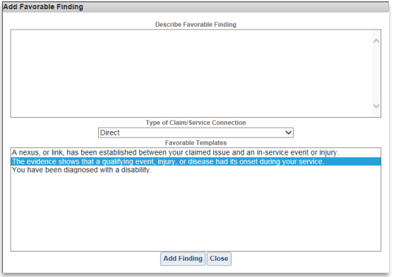
Improved Decision Notices
References
Inputting Favorable Findings
Notes:
Learning Objective: Recall how to use VBMS-R to document favorable findings
Instructor Notes:
From the Favorable Finding tab, users can add, edit, and delete favorable findings, to include free texting information for any issue that is created for a claim in VBMS-R. The rating narrative must include each favorable finding, to include free text information.
Select the Add Favorable Finding button to input favorable findings under the Favorable Findings tab. Select the applicable favorable finding from the Favorable Templates dropdown menu. Users also have the option to enter free text in the Describe Favorable Finding text box for a favorable finding that may not be available from the drop-down menu. Click the Add Finding button to add the favorable finding to the rating narrative.

Slide 25
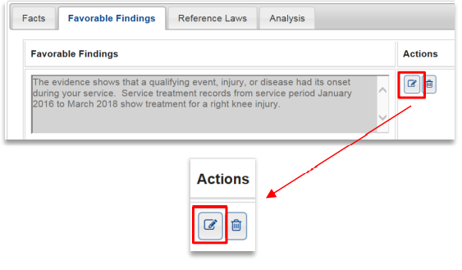
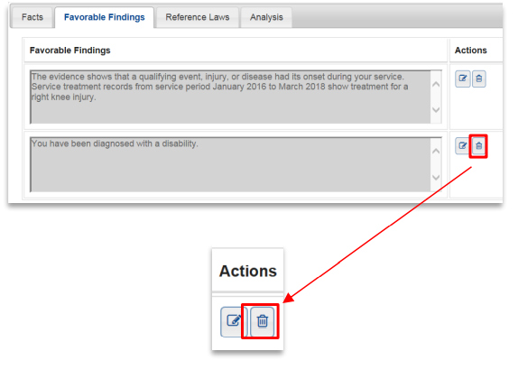
Editing and Deleting Favorable Findings
Notes:
Learning Objective: Recall how to use VBMS-R to document favorable findings
Instructor Notes:
Prior to finalizing a rating decision, users can edit favorable findings when free text is required, such as adding free text to “A stressor is conceded based on <insert free text>” or when a typo is identified.
In addition, favorable findings must be specific enough so that a claimant can determine what evidence was used to make the finding after reading the notification and rating decision. Users must edit a favorable finding to address the specific evidence that supports the finding.
To edit a favorable finding, select the pen and paper icon under the Actions column and edit as needed.
Prior to finalizing a rating decision, users can delete favorable findings.
To delete a favorable finding, select the trashcan icon under the Actions column.

Slide 26
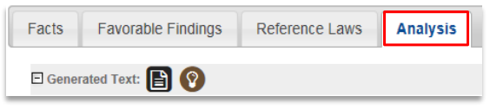
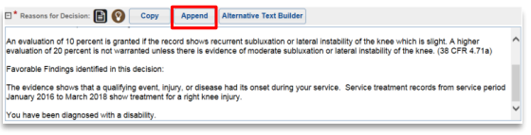
Adding Favorable Findings to Narrative
Notes:
Learning Objective: Recall how to use VBMS-R to document favorable findings
Instructor Notes:
To add the favorable findings to the rating narrative, return to the Analysis tab. From there, select Append to add the favorable finding to the rating narrative.

Slide 27
Knowledge Check #4
True or False? The premade favorable finding text is sufficient and the decisionmaker does not need to add anything else to the text.
Answer: False. The premade favorable finding test is not sufficient and the decisionmaker must edit a favorable finding to address the specific evidence that supports the finding
Notes:
Learning Objective: Recall how to use VBMS-R to document favorable findings
Instructor Notes:
**IMPORTANT: Slide contains animations. Click to reveal the scenario, question and answer to students.**
True or False? The premade favorable finding text is sufficient and the decisionmaker does not need to add anything else to the text.
Answer: False. The premade favorable finding test is not sufficient and the decisionmaker must edit a favorable finding to address the specific evidence that supports the finding

Slide 28
Objective
Describe How to Overturn
Favorable Findings
Notes:
Instructor Notes:
Next, we will describe how to overturn favorable findings.

Slide 29
Overturning Favorable Findings
Clear and unmistakable evidence
Evidentiary record lacks any plausible support for the favorable finding
Does not require additional approval signature(s)
Document within the body of the decision
Notes:
Learning Objective: Describe how to overturn favorable findings
Instructor Notes:
To overturn a favorable finding, there must be clear and unmistakable evidence to rebut the favorable finding.
The standard of clear and unmistakable rebuttal may be satisfied by a finding that the evidentiary record as a whole completely lacks any plausible support for the favorable finding. This does not require that the adjudicator determines that the outcome of the benefit adjudication itself would undebatably change.
Although CUEs require additional signature approval, the decision to overturn a previous favorable finding does not require additional signatures. If overturning the favorable finding leads to the conclusion that the previous decision to award a benefit was also clearly and unmistakably erroneous, then the normal CUE signature requirements apply as outlined in M21-1, Part X, Subpart ii.5.A.
Document the decision to overturn favorable findings within the body of the decision for the impacted issues. Any overturned favorable findings must be removed from the list of favorable findings. Claims processors must justify the reason for the overturn.

Slide 30
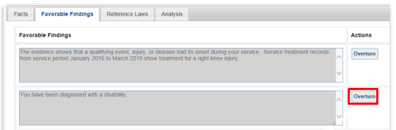
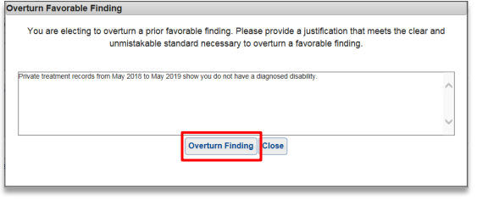
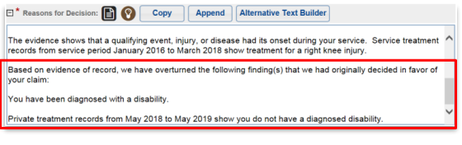
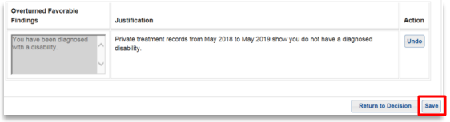
Overturning Favorable Findings in VBMS-R
Notes:
Learning Objective: Describe how to overturn favorable findings
Instructor Notes:
VBMS-R allows users to overturn favorable findings previously established by a prior rating decision.
To overturn a favorable finding in VBMS-R, select the Overturn button from the Favorable Findings tab. After you select the overturn option, a pop-up will display prompting the user to enter a justification. Enter the justification and click the Overturn Finding button. Click Save. Return to the Analysis tab and click Append. The overturn justification will display in the Reasons for Decision text box and will be denoted by the text “Based on evidence of record, we have overturned the following finding(s) that we had originally decided in favor of your claim.”
Note, if the favorable finding to overturn is not in the Favorable Findings tab because it was free text by the previous decisionmaker, then in the Reasons for Decision text box, free text the overturn text with the justification.

Slide 31
Knowledge Check #5
Question: What is the evidentiary standard for overturning a favorable finding?
Answer: The evidence must be clear and unmistakable, and the evidentiary record must lack any plausible support for the favorable finding, in order to overturn the favorable finding.
Notes:
Learning Objective: Describe how to overturn favorable findings
Instructor Notes:
**IMPORTANT: Slide contains animations. Click to reveal the scenario, question and answer to students.**
Question: What is the evidentiary standard for overturning a favorable finding?
Answer: The evidence must be clear and unmistakable, and the evidentiary record must lack any plausible support for the favorable finding, in order to overturn the favorable finding.

Slide 32
Objective
Review Examples of
Favorable Findings
Notes:
Instructor Notes:
Finally, let’s review examples of favorable findings.

Slide 33
Example #1 – Direct
Scenario: A Veteran claims service connection for a right knee condition. His service treatment records (STR) document a sport injury on active duty with treatment for a right knee sprain. A review of the current disability benefits questionnaire (DBQ) fails to show a current diagnosis, and the claim is denied.
Questions: Are favorable findings required? If so, what should the favorable findings inform the Veteran?
Notes:
Learning Objective: Review examples of favorable findings
Instructor Notes:
Scenario: A Veteran claims service connection for a right knee condition. His service treatment records (STR) document a sport injury on active duty with treatment for a right knee sprain. A review of the current disability benefits questionnaire (DBQ) fails to show a current diagnosis, and the claim is denied.
Questions: Are favorable findings required? If so, what should the favorable findings inform the Veteran?
Answer: Yes, a favorable finding is required because the claim is denied. The favorable finding should inform the Veteran that there is an in-service incurrence related to the right knee. This is a material element to the claim favorable to the Veteran.

Slide 34
Example #2 – Secondary
Scenario: A Veteran claims major depressive disorder (MDD) secondary to service-connected lumbar strain. STRs fail to show any complaints or diagnoses related to depression. The VA DBQ documents a diagnosis of MDD; however, the examiner relates the diagnosis to the Veteran’s father dying recently, not to the lumbar strain. The claim is denied.
Questions: Are favorable findings required? If so, what should the favorable findings inform the Veteran?
Notes:
Learning Objective: Review examples of favorable findings
Instructor Notes:
Scenario: A Veteran claims major depressive disorder (MDD) secondary to service-connected lumbar strain. STRs fail to show any complaints or diagnoses related to depression. The VA DBQ documents a diagnosis of MDD; however, the examiner relates the diagnosis to the Veteran’s father dying recently, not to the lumbar strain.
Questions: Are favorable findings required? If so, what should the favorable findings inform the Veteran?
Answer: Since there is no in-service event and no secondary nexus, the decisionmaker should deny the claim and add favorable findings. The favorable findings should inform the Veteran that he has been diagnosed with a disability (MDD) and the claimed primary disability (lumbar strain) is service-connected. These are both material elements to the claim and favorable to the Veteran.

Slide 35
Example #3 – Presumptive
Scenario: A Veteran claims diabetes mellitus due to Agent Orange exposure. He served from 7/18/68 to 6/2/71 with confirmed in-country service in Vietnam. STRs fail to show any findings related to diabetes. He submits his private treatment records documenting findings of glucose intolerance and pre-diabetes. There is no evidence of a diagnosis of diabetes. The claim is denied.
Questions: Are favorable findings necessary? If so, what should the favorable findings state?
Notes:
Learning Objective: Review examples of favorable findings
Instructor Notes:
Scenario: A Veteran claims diabetes mellitus due to Agent Orange exposure. He served from 7/18/68 to 6/2/71 with confirmed in-country service in Vietnam. STRs fail to show any findings related to diabetes. He submits his private treatment records documenting findings of glucose intolerance and pre-diabetes. There is no evidence of a diagnosis of diabetes.
Questions: Are favorable findings necessary? If so, what should the favorable findings state?
Answer: Favorable findings are necessary because there is no diagnosis of diabetes, therefore the claim should be denied. The favorable findings should inform the Veteran that he was exposed to Agent Orange in Vietnam. The favorable findings should also inform the Veteran that diabetes is a chronic condition which may be presumptively linked to your military service. Both are material elements to the claim and both are favorable to the Veteran.

Slide 36
Example #4 – IU
Scenario: A Veteran who is service-connected at 70 percent for posttraumatic stress disorder claims individual unemployability (IU). Evidence shows she is not working. The examiner, however, states she is capable of gainful employment. The claim is denied.
Questions: Are favorable findings necessary? If so, what should the favorable findings state?
Notes:
Learning Objective: Review examples of favorable findings
Instructor Notes:
Scenario: A Veteran who is service-connected at 70 percent for posttraumatic stress disorder claims individual unemployability (IU). Evidence shows she is not working. The examiner, however, states she is capable of gainful employment.
Questions: Are favorable findings necessary? If so, what should the favorable findings state?
Answer: The decisionmaker should deny the claim since the evidence shows the Veteran is capable of gainful employment. The favorable findings should inform the Veteran that she meets the schedular requirements for IU and the evidence shows she is not working. These are both material elements to the claim that are favorable to the Veteran.

Slide 37
Practice Exercise
Scenario: Mark Aplin, who served from 1/15/2000 to 1/14/2004 in the Army as an infantryman, filed for service connection for hearing loss. The examination confirmed the diagnosis, but the examiner provided a sufficient negative opinion.
Exercise: Brainstorm and discuss as a group which favorable findings should be included in the decision.
Notes:
Learning Objective: Review examples of favorable findings
Instructor Notes:
Scenario: Mark Aplin, who served from 1/15/2000 to 1/14/204 in the Army as an infantryman, filed for service connection for hearing loss. On the claims form, Mr. Aplin reported that his hearing loss started immediately after discharge. The examination confirmed the diagnosis, but the examiner provided a sufficient negative opinion.
Exercise: Brainstorm which favorable findings should be included in the decision.
Discussion Points/Answer: The narrative should include favorable findings stating Mr. Aplin has a diagnosis of hearing loss. In addition, the narrative should include the military occupational specialty of infantryman as that has high probability of noise exposure.

Slide 38
Course Summary
Favorable Findings:
Eight-point notice requirements
Overview of favorable findings
Document favorable findings
VBMS-R for favorable findings
Overturn favorable findings
Examples of favorable findings
Notes:
Learning Objective:
Instructor Notes:
Favorable Findings:
Summarize the eight-point notice requirements for VA decisions
Define and describe an overview of favorable findings
Discuss when and how to document favorable findings
Recall how to use VBMS-R to document favorable findings
Describe how to overturn favorable findings
Review examples of favorable findings

Slide 39

Questions?
Notes:
Instructor Notes:
Are there any additional questions?

Slide 40
Next Steps
An assessment and satisfaction survey have been assigned to you in TMS
You have unlimited attempts to complete the assessment and may answer one question incorrectly to achieve a passing score
Be sure to complete the survey and assessment to receive credit for this training
Notes:
Instructor Notes:
An assessment and satisfaction survey have been assigned to you in TMS. You have unlimited attempts to complete the assessment and may answer one question incorrectly to achieve a passing score. Completing both will allow you to receive credit for this training.

Slide 41
Additional Courses
For training on all AMA required rating decision notification elements, please review the following additional modules:
Module 1: Identify Issues and Evidence Summary
Module 2: Laws and Regulations
Module 4: Elements Required for a Grant and Criteria Required for Next Higher Evaluation
Module 5: VBMS-R and Decision Notice Elements
See the VBA Learning Catalog for these courses and other AMA required non-rating decision notification courses.
Notes:
Instructor Notes:
For training on all AMA required decision notification elements, please review the following additional modules:
Module 1: Identify Issues and Evidence Summary
Module 2: Laws and Regulations
Module 4: Elements Required for a Grant and Criteria Required for Next Higher Evaluation
Module 5 VBMS-R and Decision Notice Elements
See the VBA Learning Catalog for these courses and other AMA required non-rating decision notification courses.

