Slide 1
Legacy Content Manager
Pension and Fiduciary Service
October 2021

Slide 2
Lesson Objectives
Provided with the appropriate manual and regulatory references and handouts, the employee will be able to:
Understand What is Legacy Content Manager (LCM)
Know What Types of Records are available in LCM
Know How & When to Log into LCM
Search for a Veteran’s electronic folder (eFolder)
Access a Record within a Veteran’s eFolder
Navigate to LCM’s Learning Tools
2

Slide 3
References
Legacy Content Manager Website
Legacy Content Manager User Guide
M21-1 I.ii.1.C.1.c. eFolders
M21-1 I.ii.1.C.1.d. Mandatory Use of eFolders
M21-1 II.ii.1.A.2. Claims Folder Formats
3

Slide 4
What is Legacy Content Manager?
Legacy Content Manager (LCM) is an intranet web-based application that centers on the concept of a Veteran’s electronic claims folder, or eFolder.
In most instances you can access the LCM eFolder through the existing VBMS folder LCM tab.

Slide 5
Legacy Content Manager Use
LCM provides:
Electronic storage for outgoing & incoming Veteran’s claims correspondence and evidence
Ability to categorize, search & sort the contents of the eFolder

Slide 6
What Types of Documents are in LCM?
Pension Documents
Restricted Documents
Debt Management Center letters
Rating Decisions
PCGL Award Letters
BDN Letters
CRSC/CRDP Letters
COLA End of Year Letters
Write-outs
Marine Corp Records (Korea/Vietnam Wartime)
Federal Tax Income (FTI)

Slide 7
When to Log into LCM
1. The LCM tab within the VBMS fails to open documents.
2. When reviewing restricted documents (Ex. Federal Tax Information)
3. As directed by local management.

Slide 8
How to Log into LCM
To login to directly into LCM, you would:
1. Go to the LCM website.
2. Follow the prompts for VA Single Sign-on
_

Slide 9
LCM Sign In

Slide 10
LCM Security Information Pop Up
Upon initial login, the pop up above will appear. The end user should select OK.

Slide 11
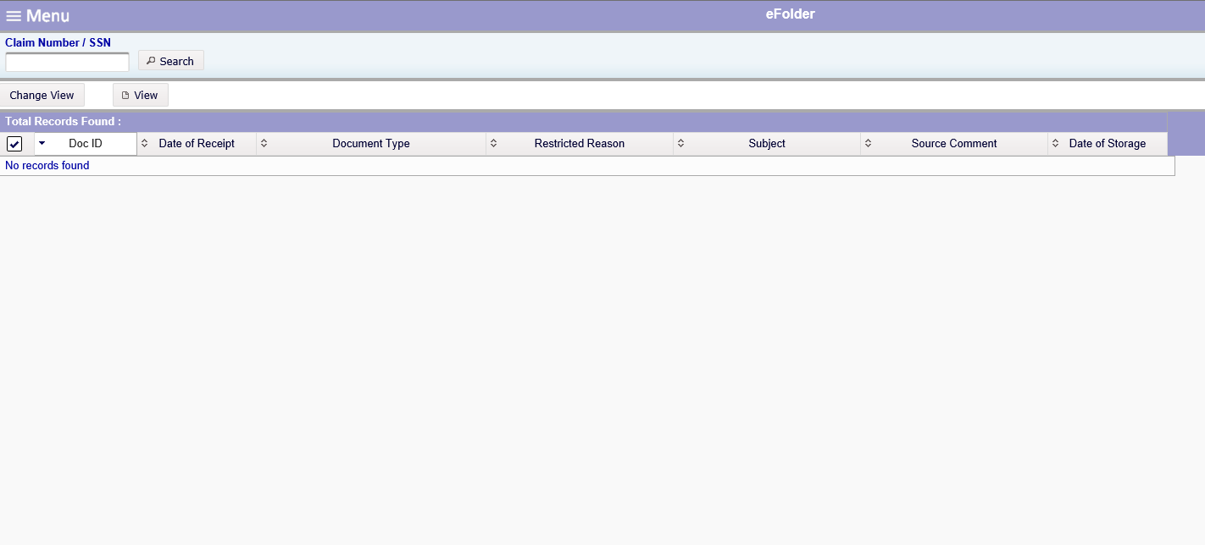
How to Search for a Veteran’s eFolder
To locate a veteran’s eFolder, enter the VA file number into the field marked “Claim Number / SSN” and hit "search" or enter.

Slide 12
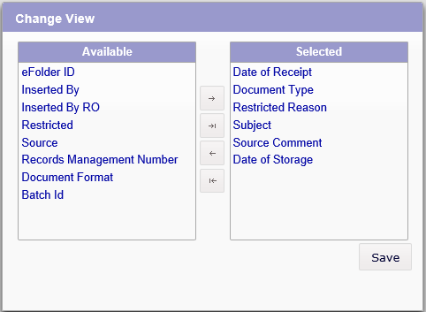
Change View Options
1. To change the default view of the eFolder, select the "Change View" option.
2. Select the view desired from the available menu and click "save".

Slide 13
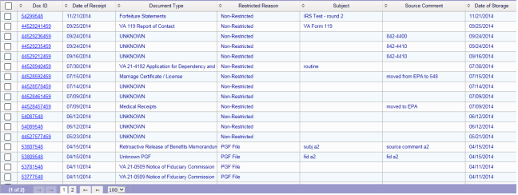
Document Grid View
The Veteran's eFolder can contain multiple documents. Over time more documents can be filed into their folder.

Slide 14
Viewing Documents
To view a document, select the specific document and click “view” or double click on the specific document ID.

Slide 15
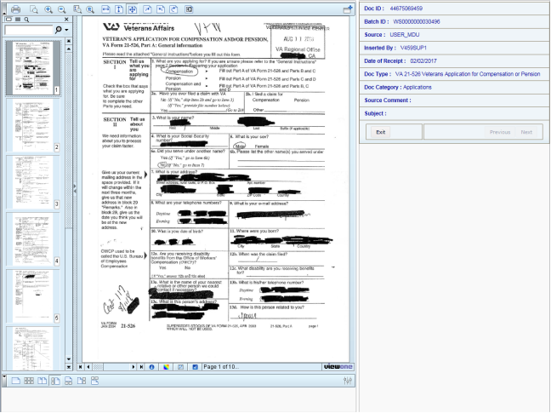
Document Viewpoint
When you display a document in LCM Document Viewer, an image of the document file is displayed on your computer’s monitor.

Slide 16
Questions

