Slide 1
Institutions of Higher Learning (IHL) with Flight Programs -Under Part 141
October 26, 2021

Slide 2
Today’s Instructor
Steven Nelle
Quality and Training Specialist

Slide 3
Learning Objectives
Upon completion of this module, you should be able to:
Examine the requirements of flight programs at an IHL that is Part 141
Identify if the need for any type of contracts listed below:
Space
Equipment
Instructors
Programs should not be contracted for in a fully IHL 141 program
Be able to see if the program is a combination of 141 and other types of programs such as 61 and contracted

Slide 4
Definitions, Acronyms, and Common Terms
AAC – Air Agency Certificate
AMEL – Airplane Multiengine Land
ASEL – Airplane Single-Engine Land
CFI – Chief Flight Instructor
COM – Commercial Flight
FAA – Federal Aviation Administration
FSDO – Flight Standards District Office
IHL – Institution of Higher Learning
INST – Instrument Flight
LOA – Letter of Authorization
NCD – Non-College Degree
PA – Policy Advisory
SAA – State Approving Agency
TCO – Training Course Outline
VA – Veterans Administration
VIB-Veterans Information Bulletin

Slide 5
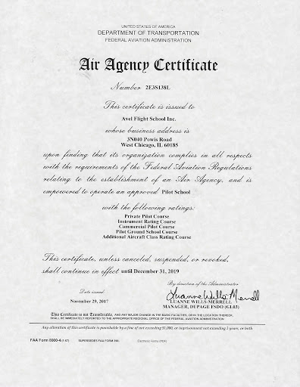
The AAC – Air Agency Certificate
What is an Air Agency Certificate?
An AAC is issued by the FAA when they approve the flight syllabi and TCO submitted by an IHL
Examples of approved courses are:
Private Pilot
Instrument Pilot
Commercial Pilot
Certified Flight Instructor
If an IHL owns their AAC then they are a fully 141 program of education

Slide 6
The LOA – Letter of Authorization
What is a Letter of Authorization?
A LOA can be defined as basically a continuation of the flight schools AAC. For instance, the AAC states that the flight school is approved for the following:
Commercial Pilot
The LOA would then go further and state that the Commercial Pilot course is approved for ASEL and AMEL

Slide 7
FAA Approval Considerations
14 CFR 141.25 (c) - The principal business office may not be shared with, or used by, another pilot school.
14 CFR 141.43 - A briefing area may not be used by the applicant if it is available for use by any other pilot school during the period it is required for use by the applicant.
14 CFR 141.33 – A flight school issued an AAC (regardless of what approved for) must have a Chief Flight Instructor as a permanent employee.
Notes:
the faa regulation is tied to the VA approval criteria when it comes to space and approval of it during the SAA site visit.

Slide 8
Major Points to Remember!
Records are to be maintained at the IHL Facility
NCD facility record-keeping requirements are different than those for an IHL:
NCD Flight Schools are required to only maintain records for 3 years after COMPLETION OF THE FLIGHT CERTIFICATE. This is an FAA requirement through their regulation that the VA abides by because it directly relates to our 3 year policy for record retention and can be found under 14 CFR 61.189 – Flight Instructor Records
IHLs are required to maintain records for 3 years after COMPLETION OF THE DEGREE OR LAST DATE OF REGISTRATION

Slide 9
APPROVAL CRITERIA
Notes:
Instructor Notes:
Pacing:
This section contains 16 slides
should take approximately 15 min (By the end of this section, you will be at 40min of 90min)
It is important to know that no program can be considered for VA educational assistance until the SAA of jurisdiction verifies that the program meets the necessary approval regulations. In this section we’ll discuss the various types of programs that may be approved.]

Slide 10
Requirements for Initial Approval
What is required for initial approval submittal to the SAA by the IHL?
The following information is required for initial approval of a 141-flight program:
Air Agency Certificate 38 CFR 21.4263
All TCO and Syllabi that is FSDO Stamped that matched the AAC 38 CFR 21.4233, 4252
Current college catalog containing:
Exact descriptions of the program and offered courses 38 CFR 21.4253
Cost of each course showing evidence of type of payment (flat rate, bill by hour, bill by percentage) 38 CFR 21.9600, 38 USC 3690 (a)
Proof that each flight course description contains the exact amount of hours needed to complete each course in accordance with PA 223-15-01
Incomplete policy if the school has one or is using one in relation to flight courses not completed within the standard term 38 CFR 21.4253
Evidence that flight labs are conducted on a rigid schedule provided by the institution of higher learning showing completion of the course within the standard term 38 CFR 21.4253
Statements of what will constitute the approval of a re-scheduled flight hour, examples could be weather, maintenance, proof of illness, or instructor availability 38 CFR 21.4253
Notes:
the advisory 223-15-01 states that adequate records must be maintained to show the standards of progress and for flight courses it directly involves the flight hours which leads directly to the ability to show the completion of the program within the standard term in which registered. 4253 d-2 states that within the records a record of last date of attendance (last flight) must be included and may include such records as attendance. For flight, the attendance is the flight hours performed during a rigidly scheduled lab. The regulation is on the side of the VA when asking why a student was unable to complete the program within a specified time and to require the institution to include what is approvable for make-up flight time. There is nothing in the reg that states this requirement cannot be imposed on a program rigidly based on a "time requirement" for successful completion

Slide 11
Equipment Contract
Is a contract used for equipment? 38 CFR 21.4233
If the facility does not own the aircraft ,they may lease/contract the usage from an NCD Flight facility
The NCD facility does not have to be approved by the VA to lease the equipment
The institution conducting training under part 141 is not limited to approving the type of aircraft as an NCD facility
If the NCD facility is approved by the VA, the IHL is not limited to leasing/contracting equipment approved by the VA for usage in their program
The contract for equipment does not have to be as detailed as the contract required for a fully contracted flight program and can be limited to just the aircraft itself
This contract must be submitted to the SAA for approval

Slide 12
Space Contract
Is a contract used for space? 38 CFR 21.4233
If the facility does not own the airfield in which the courses are given, they may lease or contract the space necessary to conduct the training. This also constitutes criteria that must be met in accordance with their accrediting body criteria:
The IHL must lease space in accordance with requirements set aside by their accrediting body
The space must be in good standing with the requirements dictated by the number of students attending the class
The space must have in place all safety requirements mandated for a classroom used within an institute of higher learning
The SAA must verify both criteria above has been proven as part of the contract approval
“YES” the contract must be submitted to the SAA as part of the approval package
Notes:
The FAA regulations set a basis on what is authorized if leasing space at a flight school and this slide directly relates to what the standards are for a normal IHL course that must also be taken into consideration in how it relates to the accrediting body and state standards. they are complimentary.
The site visit is in the standard approval criteria listed within the national approval checklist. it is a part of the initial approval criteria and should be performed.

Slide 13
Faculty or Contracted Instructors
Are flight instructors’ part of the faculty or are they contracted? 38 CFR 21.4233, 4253
Contracts for instructors in a fully 141 program is authorized. However each instructor contracted must meet the following criteria (which may be the same criteria if hired as a member of the faculty):
Must have FAA certifications for each course they are listed to teach
Must have FAA certification to be a Flight Instructor
Must meet the Accrediting Body’s criteria to teach at the accredited IHL
Must meet the State criteria to teach at the IHL
Can substitute certifications for IHL requirements if allowable by state and school regulations and monitored by the assigned faculty member in charge of the program.
Must meet any additional requirements mandated by the institution to teach the course
This includes the institutional policy on the substitution of FAA certifications for possible degree requirements
Notes:
Example – a certified FAA flight instructor that has 8 yr experience is contracted to teach commercial flight and monitored by the CFI who is a member of the faculty.
experience and qualifications directly relate to the accrediting standards and state law. it is all co-mingled one with another. This is why there is a distinction between a faculty member and a contracted instructor.

Slide 14
Faculty or Contracted Instructors (Cont.)
Are flight instructors’ part of the faculty or are they contracted? 38 CFR 21.4233, 4253
Ensure the facility is applying the policy equally among “ALL” degree programs
Watch for “Grow Your Own Instructors” it was found
Some schools are creating different policies in order to hire flight instructors with
No listed flight instructors' hours and/or
A recent graduate of IHLs’ flight program and/or
Has not completed the Flight Instructor course
Notes:
there are qualified instructors teaching at the facility, it is only the Chief Flight Instructor that has left which is why "instruction" can continue. We follow the FAA because of the removal of the 141 after 60 days which directly relates to our regulation as the facility will ge downgraded to operating under part 61 which is then not approvable. It is not that "all" instructors are gone, only the CFI. The school will them be disapproved for the part 141 training but can request a new approval from the SAA under part 61.

Slide 15
KNOWLEDGE CHECK
LOG-IN MENTI.COM WITH THE CODE IN THE INFO POD
Notes:
Does the Chief Flight Instructor that is hired after the resignation of the previous have to have the certifications to match the current AAC and LOA? Yes or No
Answer: Yes. If the CFI doesn’t then the facility is given 60 days for the CFI to obtain the missing certifications or else the AAC will be adjusted accordingly.
Under a complete 141 IHL program, is a listing of the aircraft by tail number, horsepower, and type a requirement for approval submittal? Yes or No
Answer: No. By regulation only the NCD flight program must submit the airplane information for approval.
Does a university with a flight program have to submit each course and credit hour assigned to the FAA for inclusion in the LOA? Yes or No
Answer: Yes. For a 141 IHL Flight School to certify a graduation within an aviation degree, all courses, contracted entities, and course credit hours must be submitted.

Slide 16
PLEASE RETURN IN 5-minutes!

Slide 17
Common Requirements in all Approvals
Notice of Approval that contains:
Date of letter 38 CFR 21.4258
Proper name and address of facility 38 CFR 21.4258
Legal authority of approval 38 CFR 21.4258
Effective date of approval 38 CFR 21.4258
The signature of the responsible SAA official 38 CFR 21.4258
Lastly, the new FY 20 and forward requirement of the date in which all documents needed to verify the approval was received by the SAA (SAA Agreement Condition added in FY19)
Other Requirements for Initial Approval
VA Form 22-8794 38 USC 3684
VA Form 22-1919 38 CFR 21.4258
VA Form 20-8206 38 CFR 21.4258
Visit Report 38 CFR 31.4253

Slide 18
Common Requirements in all Approvals (Cont.)
Other Requirements for Initial Approval-Continued
Written application from the facility 38 CFR 31.4253
Academic calendar 38 CFR 31.4253
Catalog true and correct statement 38 CFR 31.4253
Statement of no use of erroneous, deceptive, or misleading practices 38 CFR 21.4252
Program outline 38 CFR 31.4253
Description of space available, facilities, and equipment 38 CFR 31.4253
Instructor evidence or meeting hiring criteria 38 CFR 31.4253
List of approved coop programs 38 CFR 21.4257, 4233
List of approved courses that includes practical training 38 CFR 21.4265
List of approved independent study courses 38 CFR 21.4267
List of approved off campus sites 38 CFR 21.4267
List of remedial courses 38 CFR 21.5230
Additional SAA criteria

Slide 19
Common Requirements in all Approvals (Cont.)
Other Requirements for Initial Approval-Continued-Catalog Requirements
Are programs educational, professional, or vocational 38 CFR 31.4253
Catalog meets approval requirements 38 CFR 21.4258
Practical training requirements met 38 CFR 21.4265
Cooperative training requirements met 38 CFR 31.4253
Independent study training requirements met 38 CFR 31.4267
Evidence of accreditation 38 CFR 31.4253
Attendance standards (if established by school for all programs of study and not left to instructor discretion) 38 CFR 31.4253
Standards of conduct 38 CFR 31.4253
Prior credit policy (insure one for flight as there is an FAA limitation on the transferability of credit for flight as only 50% can be transferred) 38 CFR 31.4253
Standards of progress (for the flight courses this includes the accurate number of hours to complete each flight course) 38 CFR 31.4253

Slide 20
Specific Flight Approval Criteria
Other Requirements for Initial Approval-Continued-Catalog and additional 141 requirements
Do the flight courses meet the requirements of PA 223-15-01 and 02
Do all flight courses listed in the flight program appear on the AAC 38 CFR 21.4263
All mandatory flight fees and costs are listed within the catalog 38 USC 3690 (a)
Is the AAC and LOA current 38 CFR 21.4263
Flight courses listed within the program are present on the FAA approved AAC 38 CFR 21.4253, 4263
Verification that if contracts are used, they are only for equipment, space, and or instructors 38 CFR 21.4233
CFI is listed as a permanent employee with the IHL and is licensed to instruct ALL courses listed on the AAC 38 CFR 21.4253, 4263
Flight Instructors meet all hiring requirements 38 CFR 21.4263
If a contract is used for instructors, it cannot be with an NCD for their instructors. Each instructor contract must be between the IHL and the instructor alone. PA 223-15-01 and 02, 38 CFR 21.4233

Slide 21
Specific Flight Approval Criteria (Cont.)
Other Requirements for Initial Approval-Continued-Catalog and additional 141 requirements
Evidence that all flight courses will begin within 7 calendar days of the beginning of the term 38 CFR 21.4131
A specific incomplete policy is listed for flight courses if necessary 38 CFR 21.4253
Current copy of the 85/15 is provided by program track for flight 38 CFR 21.4201
Bonus Information: Drone Approval
Drone Programs can be approved as a certificate program as the VA has not addressed this issue
Drone Programs can be approved as a degree granting program as the VA has not addressed this issue
Flight courses can be approved as part of a drone pilot degree or certificate program as the VA has not addressed this issue
Notes:
they can if necessary but for those certified within a standard term this will apply to them. Example: Might be helpful to provide an example of what's acceptable for a "class" at the start of a flight course. 30-minute tour of the flight line = not acceptable. 50-minute meeting where students sign documents for flight training, turn in medicals, and tour the flight line = acceptable.
The only difference is the ability to change the sequencial track of the course work. under 61 it is sequential order based on the FAA regulation. Part 141 allows for the combination of commercial and instrument for example and not having them separated in sequences. But all must follow the assigned hours and criteria to be met for FAA certificate attainment. The main difference is Part 61 is not monitored by the FAA whereas Part 141 is rigidly monitored and approved by the FAA.

Slide 22
RE-APPROVAL CRITERIA

Slide 23
Re-Approval Criteria
38 USC 3672 (2) (A) (ii) states that: A flight training course approved by the Federal Aviation Administration that is offered by a certified pilot school that possesses a valid Federal Aviation Administration pilot school certificate is deemed approved.
Notice the language: Refers to the course being deemed approved not the school
An IHL under 141, must submit the following for re-approval of the flight program:
Must submit the current AAC prior to the expiration of the previous AAC to keep the deemed approved standing. Failure to do so could cause the program to be suspended. If the FAA has issued a Letter of Extension, it must be submitted to the SAA immediately. 38 CFR 21.4263, 4253
Catalog must be submitted and verified to maintain compliance with PA 223-15-01 and 02 and must be certified true and correct in content and policy 38 CFR 21.4253
Standard approval letter containing the afore mentioned criteria must be submitted 38 CFR 21.4258
New copies of any contracts for space, equipment, or instructors that supersedes the previous or are renewed due to contract expiration or copies of the contract extensions must be submitted 38 CFR 21.4233, 4253
Notes:
they can if necessary but for those certified within a standard term this will apply to them. Example: Might be helpful to provide an example of what's acceptable for a "class" at the start of a flight course. 30-minute tour of the flight line = not acceptable. 50-minute meeting where students sign documents for flight training, turn in medicals, and tour the flight line = acceptable.
The only difference is the ability to change the sequencial track of the course work. under 61 it is sequential order based on the FAA regulation. Part 141 allows for the combination of commercial and instrument for example and not having them separated in sequences. But all must follow the assigned hours and criteria to be met for FAA certificate attainment. The main difference is Part 61 is not monitored by the FAA whereas Part 141 is rigidly monitored and approved by the FAA.

Slide 24
Re-Approval Criteria (Cont.)
If new copies of contracts are found, then verification of the contents must occur 38 CFR 21.4233
Example: If new contract for space then another SAA visit must occur, if a new contract for flight instructor then qualifications must be submitted.
Current copy of the 85/15 for the tracks listed within the flight program must be submitted
Continued verification that the facility does not use erroneous, deceptive, or misleading practices
If changes in cost, then new tuition and fee schedule must be submitted
Courses listed on the AAC must be verified again against the flight courses contained within the program outline
Note:
If the above 9 items are not address appropriately during the review it could lead to issues with the Part 141program approval
Any issues that arise during the review SAA Verification must be obtained

Slide 25
KNOWLEDGE CHECK
LOG-IN MENTI.COM WITH THE CODE IN THE INFO POD
Notes:
A flight lab should be conducted just as a chemistry lab. True False
Answer – True, a student should be given a firm flight schedule upon registering for the course which shows all flight times and dates needed to complete the course within the term registered.
In relation to standards of progress, what information is required in the course descriptions in the catalog?
Type of aircraft to be flown
Course titles listed as they appear on the AAC
The number of hours needed to complete the course.
Answer – C – without the hours listed within the catalog as the required hours to fly there would be no standard of progress for the flight course itself and could be construed as open ended or fly to proficiency which is not allowed.
Does an IHL need a VIB for approval? Yes No
Answer – No, A VIB is just something created to be used by an NCD flight school to assist with approval criteria.

Slide 26
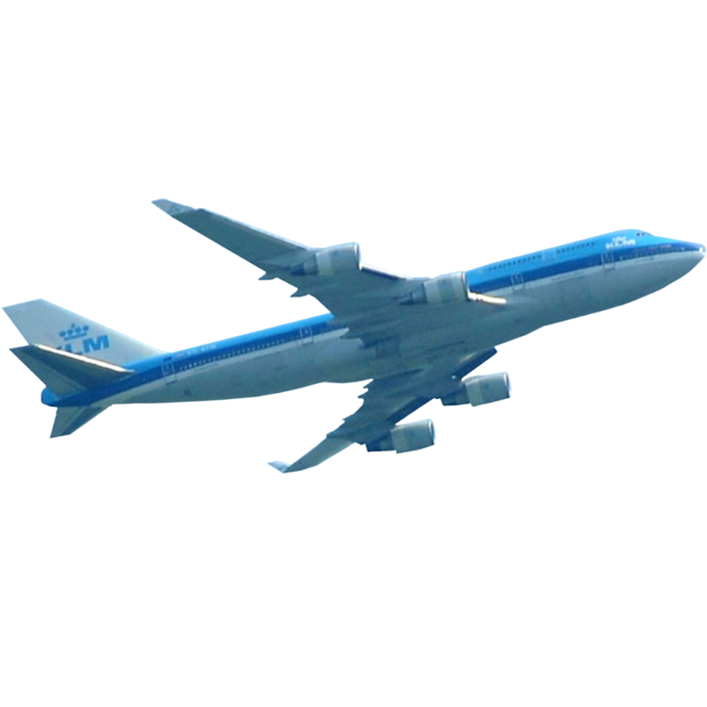
CONGRADULATIONS
141 Flight Approval Training

