Slide 1
Upfront Verification of Federal Tax Information
Pension and Fiduciary Service | February 2024

Slide 2
References
M21-1 XIV.4.A – Federal Tax Information (FTI) Match: General Information
M21-1 XIV.4.B – Federal Tax Information (FTI) Match: Safeguarding
Income Reference Sheet
IRS Publication 1075

Slide 3
Objectives
By the end of this course, trainees will be able to:
Define Federal Tax Information
Indicate the need and use of FTI
Identify where and when FTI is available
Analyze and apply FTI data to pension claims
Distinguish when FTI affects net worth
Explain FTI safeguarding and storage procedures

Slide 4
Federal Tax Information (FTI) Definition

Slide 5
Use of FTI
Why is upfront verification needed?
Allows VA to view earned income from SSA and unearned income from IRS
VA can compare this information to income information provided by an applicant seeking income-based benefits from the VA
Congress mandated upfront verification to prevent pension poaching

Slide 6
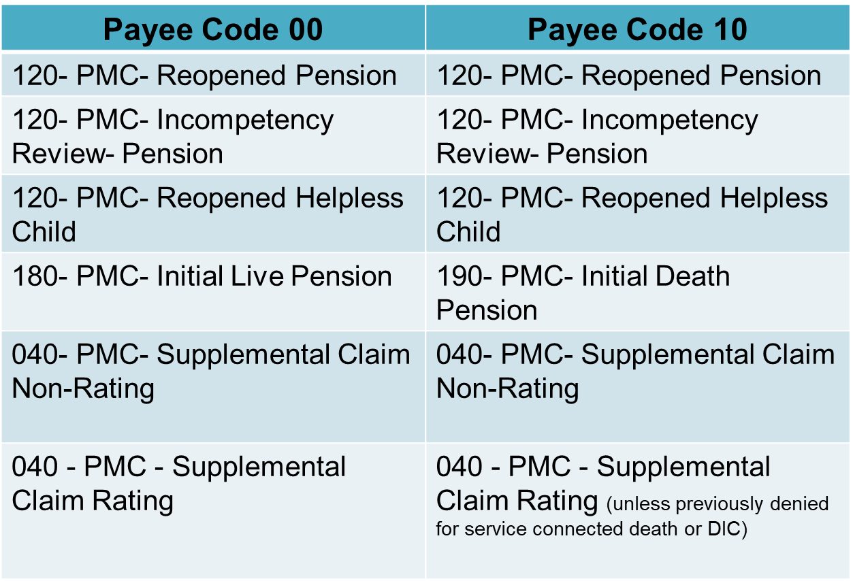
FTI Claim Labels
Claims processors should utilize IRS/SSA return date when processing claims with the claim labels below.

Slide 7
FTI Claim Label Notes
FTI match excludes dependent spouses and children on live awards
Earned income and unearned income is combined under one screen viewed using the VETERAN and S/P tabs
There must be no active, suspended or terminated Veterans Pension, Survivors Pension, death compensation, or Dependency and Indemnity (DIC) award existing for that beneficiary

Slide 8
Availability of FTI
Adjudicators need to allow time for completion of the exchange of information between VA and IRS/SSA.
Once an adjudicator has waited the mandated time based on the claim establishment date, the claims processor may proceed with processing the claim even if FTI data was not returned.
If the IRS or SSA data exchange is experiencing technical difficulties, Pension and Fiduciary Service will notify the field to wait to process affected claims until VA receives the return file from both IRS and SSA.

Slide 9
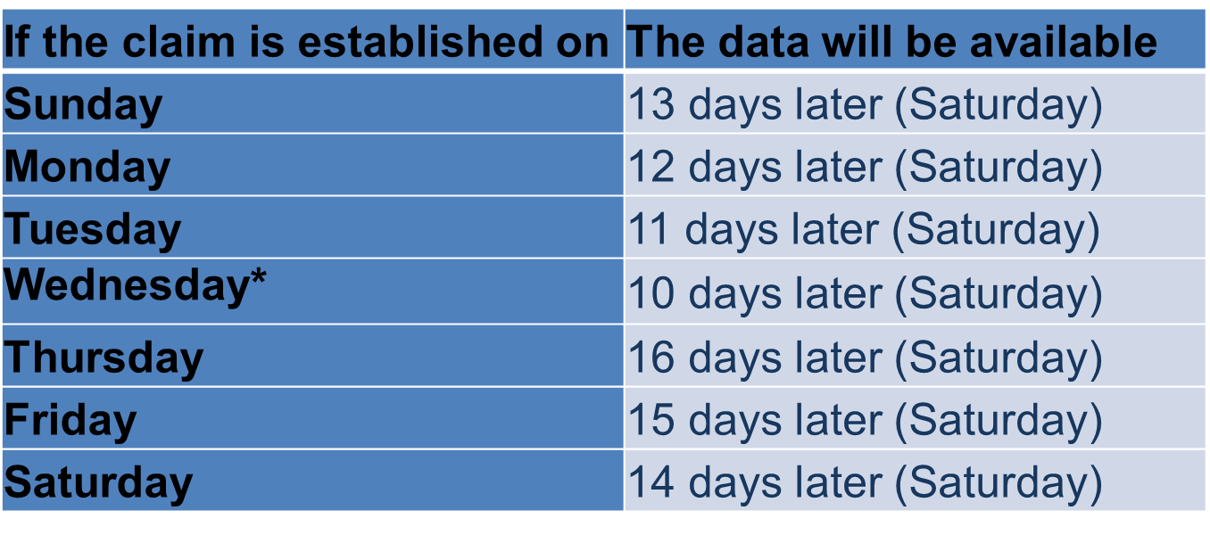
Data Table
The table below explains the date the data will be available based on claims establishment dates.
*If it is after 6:00 p.m. Central time, consider the claim established on Thursday.

Slide 10
When FTI Will Not Populate
FTI will not populate when:
The life cycle status is brokered out, cancelled, closed, authorized, continued at authorization or discontinued
The Social Security Number (SSN) was incorrect or not entered at the time the claim was established, or
The claimant already has a C&P corporate record (i.e., the MOD has already been paid)

Slide 11
FTI Processing Exceptions (1 of 2)
Medicaid rate ($90 rate)
FTI data does not need to be used to verify income if $90 Medicaid rate may be granted; however, this exception does not apply if a net worth discrepancy is identified
Terminally ill, and homeless claims
If FTI data is available when the claim is ready to be adjudicated, use the data to adjudicate the claim. If not, continue to expedite adjudication of these claims.

Slide 12
FTI Processing Exceptions (2 of 2)
Age 90 and older on or after June 15, 2023
Claims from claimants aged 90 and older will be excluded from upfront income verification.
Any claim received before June 15, 2023, should adhere to normal processing guidance.
Notes:
- FTI is not required if the pension can be denied using the income from the application or other eligibility criteria.
- Do not use the IRS/SSA return data for an end product 040 that was previously denied for service-connected death or DIC.

Slide 13
Obtaining FTI Data (1 of 2)
The FTI data obtained from IRS/SSA can be found in the following location:
SHARE>Corporate Record>Claims/Denials Information,
Select the Benefit Claim Line
Select Veteran or S/P as applicable to view the details
This information will be maintained, even after the EP is cleared.

Slide 14
Obtaining FTI Data (2 of 2)
Unless granting back to an earlier date, use the most recent year reported
After waiting the allotted time, a checkmark in the No Record Found box is sufficient if there is also a date in the Date Response Received box

Slide 15
Analyzing Information Provided
Match the income source and IRS income type on the FTI Income Reference Sheet
Determine if the income is countable for VA purposes
Compare information received to the information on the application

Slide 16
Analyzing Information Provided (1 of 2)

Slide 17
Analyzing Information Provided (2 of 2)

Slide 18
FTI Notification Text
What Have We Done? We reviewed your application and determined that you are eligible for VA pension benefits. However, the income from [insert payer name and account] that you reported on your application, [insert amount], is less than the income reported to VA by the Internal Revenue Service (IRS) and Social Security Administration (SSA). We have used the IRS and SSA information in calculating your income and your VA pension. If you believe the IRS or SSA information is incorrect, or if you no longer receive this income, please provide us a written statement regarding the payments made by [name of paying person or entity] and provide other acceptable information that supports your statement. Other acceptable information would include a statement from the person or entity that paid you showing the amount, type, frequency, and date last paid for the payments.

Slide 19
Analyzing the Information

Slide 20
FTI Development Text
What Happens If You Do Not Respond? We will decide your claim for pension based on the [insert year] income of [insert amount] reported by IRS or SSA if we do not receive a response from you within 30 days after the date of this letter. In some cases, this may cause VA to find that your income exceeds the maximum annual pension rate for your circumstances and that you are ineligible for pension.

Slide 21
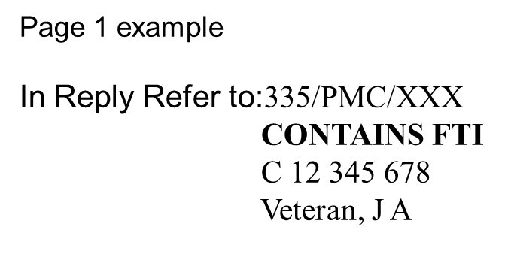
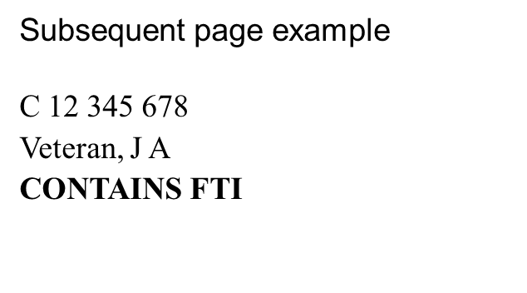
Letters Containing FTI
FTI-related award prints can be stored in VBMS with an annotation See FTI Folder to alert others.
Letters and documents containing FTI should be stored in the restricted FTI File Repository (FFR).
The header on the first page and each subsequent page must include in capital letters and bold font “CONTAINS FTI”

Slide 22
FTI and Net Worth
The income reported by FTI often has an associated net worth value:
beneficiary's share of income, credits, deductions, etc.
distributions from pensions, annuities, retirement or profit-sharing plans, Individual Retirement Arrangements (IRAs), insurance contracts, etc.
shareholder's share of undistributed taxable income, credits, deductions, etc.
statement for recipients of dividends and distributions
develop for net worth of the income source if not reported

Slide 23
Development for Interest (1 of 2)
Initiate development for interest income from net worth if a claimant reports or Federal tax information shows:
assets which may be earning interest, but it is not clear whether they are
FTI is not available and interest-bearing assets are over the threshold provided on the application with no interest income reported
interest or dividend income of over $250, but does not report the source of the dividends or interest as net worth, or
the same amount of interest and net worth, as the claimant most likely confused the two fields

Slide 24
Development for Interest (2 of 2)
When the claimant provided VA Form 21P-0969 Income and Asset Statement in Support of Claim for Pension or Parent’s DIC, because assets are over the threshold provided on the application, additional development is only necessary if:
The interest portion was left blank or,
There is contradictory evidence.
Note: Advise claimants that failure to respond to the request for information will result in a denial of benefits.

Slide 25
Liberalizing Legislation
Use the appropriate year’s FTI information that corresponds to the year at issue under liberalizing law to process the claim
If liberalizing legislation would take effect in 2018, then use the 2018 data from IRS/SSA

Slide 26
Accrued Claims
FTI should be used for accrued claims based on the original EP pending at the time of death.
If development is needed, use MAP-D to request clarification from the established substitute claimant without specifically releasing FTI account numbers using the free-text paragraph listed below:
We have recently received information that (Person’s name) has received income from other sources not listed on his/her original application for benefits. Please submit any information/evidence you may have regarding these other sources of income.
Note: If a substitute claimant has not been established, VA is not allowed to disclose FTI information. This must be completed prior to disclosure of FTI.

Slide 27
Releasing FTI
Generally, FTI can be released to the taxpayer, usually the income payer or income recipient.
VA may disclose tax information to an individual or Veteran’s service organization if the documentation is received within five years from the date the VA Form 21-22 is signed.
VA cannot disclose FTI to a fiduciary for verification of FTI unless the fiduciary is a court-appointed guardian.

Slide 28
Releasing Information Over the Telephone
VA employees may only speak directly to the individual whose FTI data was received.
Telephone development is allowed to:
Discuss a claimant’s need to verify income, in addition to sending a formal letter that requests the same verification of income
Clarify amounts (gross vs. net), or
Discuss what types of documents will satisfy VA’s request for verification of current income
Documentation is required to count a lower amount than reported

Slide 29
Telephone Example
Example: IRS reports dividend income of $2,000 per year; however, the claimant did not report dividend income. The VA employee calls the claimant, and the claimant explains that he did not think to include the dividends as he has the dividend payments set up to automatically roll over into his savings account and that the $2,000 is accurate. Since the claimant has confirmed the FTI, the VA employee can use the call as verification.
Important: VA employees may not accept a statement taken over the phone as verification of a claimant’s income if the amount is less than FTI reported by IRS/SSA

Slide 30
FTI Storage (1 of 2)
VA has obtained approval to process or store FTI in the following systems:
FTI File Repository (FFR), which allows documents to be viewed via the restricted FTI DOCUMENTS tab within VBMS, and
Modern Awards Processing-Development (MAPD)

Slide 31
FTI Storage (2 of 2)
If FTI documents are discovered in VBMS,
Print out all FTI documents and send for imaging and storage in the secure FFR,
Create a service desk ticket, and
APMCM must e-mail the VBMS POC requesting deletion of the document

Slide 32
Safeguarding FTI
As a condition of receiving FTI, the VA must establish and maintain certain safeguards designed to prevent unauthorized uses of the information and to protect the confidentiality of the information.
FTI is subject to the same safeguards while on telework. VA must periodically inspect alternate work sites during the year to ensure proper safeguards are being met and document each inspection.

Slide 33
Unauthorized Disclosure of FTI
The penalty for unauthorized disclosure of FTI by a federal employee (charged with felony) may be:
Fined, not in excess of $5,000,
Imprisoned, not in excess of five years, or
Both
Note: Employee shall also be terminated from employment upon conviction of unlawful disclosure. Employees may also be charged with a misdemeanor and/or found liable of civil penalties

Slide 34
Questions?
Direct any questions about the content of this training to the Field Inquiry Tool (FIT).

Slide 35
TMS Survey
Complete the Upfront Verification of Federal Tax Information course survey for TMS ID # 4655828

