Slide 1
Administrative Error Reminders Quality Call
July 2021
Pension and Fiduciary Service

Slide 2
References
M21-1, Part III, Subpart v, Chapter 1, Section I - Correcting the Erroneous Payment of Benefits to a Beneficiary
M21-1, Part III, Subpart vi, Chapter 5, Section A – Fraud
Administrative Error Paid/Due Calculator Over $25K

Slide 3
Objectives
Review characteristics of administrative errors
Discuss P&F Service review of administrative errors
Understand that not all administrative errors are the fault of the VA
Identify the proper notification elements for due process
Recognize the approval process
Discuss the erroneous payment log

Slide 4
Administrative Error Overview
Occur when VA pays benefits to a beneficiary in an amount that exceeds his/her entitlement due to actions VA took that usually, but not always, stem from misapplication of the law
All administrative errors must be logged and tracked by each Pension Management Center (PMC)
Each case that involves a payment over $25,000 must be approved by Pension and Fiduciary (P&F) Service

Slide 5
P&F Service Review
P&F Service looks for:
Whether the station has made an error
Whether there is any claimant fault to be found
Whether the claimant should have, or did know they were not entitled to benefits

Slide 6
Determining Whether to Attribute the Erroneous Payment of Benefits to Administrative Error (1 of 2)
Consider all the available evidence of record, such as:
correspondence VA sent to the beneficiary, including
cost-of-living adjustment letters
decision notices, and
development letters, and
statements the beneficiary and others made to VA.

Slide 7
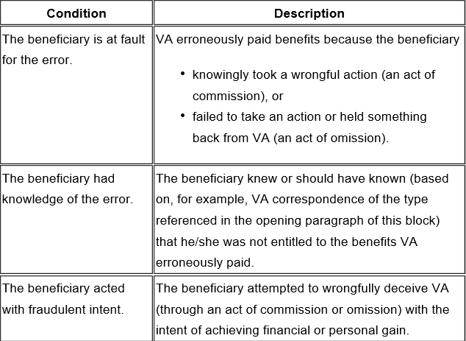
Determining Whether to Attribute the Erroneous Payment of Benefits to Administrative Error (2 of 2)

Slide 8
Issuing Due Process
Propose to retroactively adjust the beneficiary’s award to correct the error
Provide the effective date of the proposed adjustment
Advise the beneficiary that the proposed action, if taken, could create an overpayment that VA might require the beneficiary to repay, and
Inform the beneficiary that he/she has 60 days from the date of the notice to provide evidence showing VA should not take the proposed action
If correction of the administrative error will affect the beneficiary’s current rate of payment, include instructions in the notice of proposed adverse action for minimizing the potential overpayment of benefits
Note: If the administrative error is over $25,000, please send to P&F Service while due process is pending.

Slide 9
Administrative Error Approval Process
If the total amount of benefits VA erroneously paid to the beneficiary is … | Then the decision must be approved by …
less than $2,000 | a coach.
between $2,000 and $24,999 | a Pension Management Center Manager (PMCM), or designee no lower than a coach.
$25,000 or more | Compensation Service’s Program Review Staff or P&F Service’s Quality and Oversight Staff.

Slide 10
Requesting P&F Approval
Extend suspense date 60 days
Notify the P&F Service Quality and Oversight Staff by e-mail (VAVBAWAS/CO/P&F TNG QUAL OVRST) that an administrative decision requiring approval is available in the beneficiary’s eFolder.

Slide 11
Erroneous Payment Log (1 of 2)
The log must contain the following information:
beneficiary’s claim number
Beneficiary Identification and Records Locator Subsystem record number (if applicable)
duplicate payment information, if applicable, including
number of additional payments (outside of the adjusted award) and
total amount of each additional payment (outside of the adjusted award)
the date each EP was established and cleared to control for
correction of the erroneous payment
due process, and
the potential overpayment
trouble ticket number
date the corporate record was corrected, and
amount of any overpayment waived as part of any administrative decision.

Slide 12
Erroneous Payment Log (2 of 2)
PMCMs must e-mail a copy of the log to P&F Service (at VAVBAWAS/CO/P&F TNG QUAL OVRST) on a quarterly basis. (Negative reports are required.) The due date for submission of the log is 14 business days after
March 31
June 30
September 30, and
December 31.

Slide 13
Helpful Tips
Do not inform claimant that we will waive the overpayment in due process letter
Send admin error to P&F Service as due process is sent to claimant
Document the correct dates of overpayment
Provide full review and clear explanations in narrative
Look for claimant knowledge
Notes:
.

Slide 14
Questions
Additional questions should be sent to the Pension Quality and Oversight mailbox: VAVBAWAS/CO/P&F TNG QUAL OVRST

