Slide 1
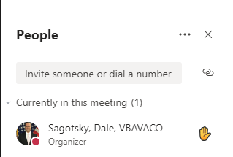
Audio Check
A Training Specialist is speaking now.
If you CANNOT hear, please click the “Raise Your Hand” Icon.
Notes:
Dale: Hello everyone, welcome and thanks for dialing in early to our VR&E Self-Employment Training for Chicago. My name is Lamoyd Figures, VR&E Training Specialist and I would like to take the time to conduct an audio check and to go over some MS Teams functions that we will be using today. Assisting me from training is Dale Sagotsky. First, let’s go over this slide, hopefully most of you all have been hearing me indicating that the audio is working well. If not, hopefully you have been reading the screen and will use the floating menu bar to raise your hand to indicate you may need some assistance and a training team member will be reaching out to you behind the scenes individually. You can use this raise or hand icon or the IM chat to indicate your need for assistance throughout the training. We will go over the IM Chat feature on the next slide.

Slide 2
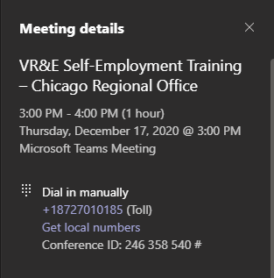
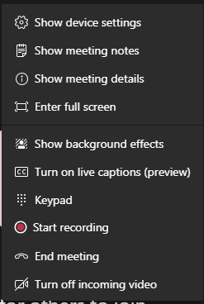
Virtual Overview and Etiquette
1
2
3
4
5
6
3
Turn Camera On
Mute Microphone
Options Menu
Show Conversation (Chat)
Show Participants
Hang up
Notes:
Dale: Since MS Teams is fairly new, I would like to go over some features that will ensure that we have a successful virtual event today. Again I would like to say if you experience any technical issues you can raise your hand, leave a message in the chat box, which I will be going over shortly, or in some cases you may need to leave the call and rejoin.
If you experience any visual problems or audio problems, you may need to log in to the event again, by using the information on the calendar invite or you may use the call in number and conference ID code to join the meeting audio as indicated on the screen.
Or call in (audio only)
+1 872-701-0185,,198457921# United States, Chicago
Phone Conference ID: 198 457 921#
I will leave this slide up while I go over the MS Teams features that we will be using from the floating menu.
Now let's go over some features. Please ensure that your microphones are muted unless you have a speaking part or providing remarks as an award participant and/or on the behalf of an award participant.
#1. Please keep your camera or video turned off for this event.
#2 – Microphone icon - Please ensure that your microphones are muted. If your icon does not have a diagonal line going across the mic icon you are not muted, if it does then you are muted. We will be addressing questions. This will help us reduce the bandwidth that is used for this call
Our 3rd feature is the Options Menu or the Ellipses Icon, which provides multiple options for us to select. I will be reviewing the main ones that you may utilize for this call.
The enter full screen option will increase the size of what is being broadcasted or shown vis MS Team to the full size of your monitor.
To access closed captioning, you can click on the Turn on live captions prompt and the captions will be displayed towards the bottom of your screen. Those are the main features within the ellipses icon that we would like to mention today, but please feel free to play with these and other options at your leisure.
#4 is the show conversation or the IM Chat feature, which will show the chat box and you can converse with all the participants in the event. Again please use this to post any additional questions you may have, we will be addressing all questions at the end of this training. When posting your questions in the chat, please include the slide # so we can reference that during your question. We are addressing questions at the end of this training because we want to ensure that we go over all of the self-employment information today. Also, please keep all questions geared towards the training content that is presented today.
#5 is the Show Participants button, this button will present a list of the event attendees on the right side of the MS Teams window.
And #6 is the Hang Up icon, when you are ready to leave the call, please click this icon.
Now that we have gone over some of the virtual event space logistics, I would like to welcome you to the VR&E Self-Employment Training.
We will be beginning in XXXXX minutes

Slide 3
Self-Employment
Click Here to Play Video
Virtual Training Session
Briefed by:
Policy and Procedures, VR&E Service

Slide 4
Review Question
Which of the following plan of services is the primary purpose for self-employment?
A. Services for claimants whose pursuit of a vocational goal is determined not currently reasonably feasible due to the effects of their disability, and services are needed to improve their independence in daily living
B. Services for claimants who have limited access to traditional employment, need flexible work schedules, or need a more accommodating work environment due to the effects of disability or other life circumstances
C. Services for claimants who express a desire to obtain employment as soon as possible and already have the necessary skills to qualify for competitive employment in a suitable career
D. Services for claimants who need long-term services, such as remedial or refresher courses, specialized training, and/or post-secondary education, to obtain and maintain suitable employment
Notes:
The correct answer is B.

Slide 5
Topic Objectives
Upon completion of this topic, you will be able to:
Define the activities required in the evaluation and planning phase
Identify self employment resources
Explore a suitable vocational goal
Choose appropriate category assignment for self-employment
Understand the process for self-employment track
Develop an effective self-employment plan
Identify the activities required in Job Ready Services
Identify requirements for self-employment under 3117
Notes:
Participants will also have an understanding of how to apply laws, regulations, and the M28C to assist in making appropriate decisions in choosing the Self-Employment track.

Slide 6
Self-Employment Terms/Definitions
Important Terms/Definitions:
Economically Viable
Income
Operational
Profit
Start-up Costs
Sustainable
Notes:
The following terms and definitions can be helpful to ensure that Claimants understand self-employment concepts.
Economically viable – the ability to sustain operations (1 to 3 years of tax returns verifying generated income) 38CFR 21.257 (f)
Income – money earned from work, investments, business
Operational –review tax returns from 1-3 years, or income or earnings statement
Profit – money that is made in a business through investing after all costs and expenses are paid; a financial gain
Start-up Costs – costs needed to start a business (minimum stock of materials, essential equipment, business license fees, etc.) *Marketing fees limited to purchase of business cards. Franchise fees and trademark fees cannot be provided.
Sustainable – business can be maintained or can continue for a long time

Slide 7
Self-Employment Resources
Collaborative Agencies:
Small Business Administration (SBA)
Small Business Development Centers (SBDC)
Service Corps of Retired Executives (SCORE)
Veteran Business Outreach Centers (VBOC)
Veterans Entrepreneurial Portal (VEP)
Center for Veterans Experience (CVE)
Other private services available.
Notes:
As part of the process for the individual to put together a business plan as required by the VA for self employment, the VRC should provide referral information to the agencies mentioned for one-on-one mentoring, consultation and advisory services.
Public or private small business consulting agencies may serve as resources, which include universities, colleges, and business development centers. The following resources are also available to assist in the self-employment process:
1. Small Business Administration
The Small Business Administration ( SBA ) is a federal government agency designed to provide free, community-based counseling, advice, and information on starting a business. SBA has district offices located around the country that provide services through a variety of programs, including:
SBDC partnerships primarily between the government and colleges/universities. SBDCs provide education services to people who are attempting to start a business. SBDC services include financial, marketing, production, organization, engineering, and technical issues and feasibility studies.
SCORE is a non-profit association of volunteer business counselors trained to serve as advisors and mentors to people who are attempting to start a business.
VBOC are designed to provide entrepreneurial development services such as business training, counseling, and mentoring services. VBOCs provide pre-business plan workshops, concept assessments, business plan preparations and comprehensive feasibility study.
2. Office of Small and Disadvantaged Business Utilization (OSDBU)
VA's Office of Small and Disadvantaged Business Utilization's (OSDBU) mission is to enable claimants to gain access to economic opportunity by leveraging the federal procurement system and expanding participation of procurement-ready small businesses.
VEP is designed to save time for claimants by offering direct access to the resources necessary to guide every step of entrepreneurship through Business USA and VA OSDBU
CVE The Center for Verification and Evaluation (CVE), a subdivision of VA OSDBU, runs the Vets First Verification Program to allow access to the Veterans First Contract Program for VA set-asides and sole source contracts for Service-Disabled Veteran-Owned Small Businesses (SDVOSB) and VSOBs, in accordance with 38 CFR 74.1. VA’s OSDBU communicates with SBA regarding small business status. OSDBU provides a variety of services, such as education and training for Veteran-owned and other small businesses on various topics specific to doing business within the federal and commercial marketplaces. Refer to VetBiz for more information. https://www.vetbiz.va.gov/

Slide 8
Self-Employment Track Overview
Self-Employment services are provided to claimants who:
have limited access to traditional employment
need flexible work schedules
or need a more accommodating work environment due to their disabling conditions or other life circumstances
To ensure the likelihood of success, claimants must have a vested interest, financial resources, and aptitude to pursue self-employment.
Notes:
After completion of a comprehensive initial evaluation and selection of the Self-Employment track, services are determined by the severity of the disability and limitations to employability.
The VRC must work closely with the claimant to foster an open line of communication to ensure that this process is successful. The claimant must have a clear understanding of the self-employment process before the pursuit of this track to employment. An informed claimant will be better prepared to anticipate and work within the self-employment process. In accordance with 38 CFR 21.362 and 21.364, the claimant must be notified that he or she must actively participate and cooperate during the self-employment process from the onset of service.
Refer to M28C.V.B.1 and M28C.IV.C.2 for more information on cost approval and concurrence levels. Refer to M28C.IV.C.2 and M28C.V.A.2 for information on case management. Refer to M28C.V.B.3 for information on obtaining the assistance of a VBA Contracting Officer (CO) for procuring items and/or services over the micro-purchase threshold. See Appendix BF, Self-Employment Process Flow Chart, for information on the self-employment process.

Slide 9
Evaluation and Planning Activities
Claimants interested in Self-Employment will be provided the following:
Orientation to the Self-Employment Process
Assessment for Existing Business
Citation – M28C.IV.C.5.01.b and M28C.IV.C.5.02.b
Notes:
If the claimant expresses an interest in self-employment during the initial evaluation, the Vocational Rehabilitation Counselor (VRC) must orient the claimant to the self-employment process.
Self Employment Orientation:
Self-Employment Fact Sheet
A link to video Operation Boots to Business(B2B)- B2B, offered by SBA, is an entrepreneurial education and training program, open to transitioning Servicemembers and their spouses, which provides claimants with an overview of business ownership. For Veterans, SBA offers “Boots to Business: Reboot” program which brings B2B courses off the military installation and into the community.
https://sbavets.force.com/s/
Existing business
Ownership
In existence for one year or more
Operational – shown on the income tax returns
For a claimant interested in self-employment, the VRC must gather information to determine what type of business he or she would like to start and whether the stated goal is consistent with the claimant’s interests, aptitudes, and abilities.
The VRC must determine, during the initial evaluation, if the claimant has an existing business. If the claimant has an existing business that is suitable and no accommodations are needed, the VRC must pursue discontinuance since the claimant is suitably employed.

Slide 10
Existing Business
VRC must assess whether the claimant has an existing business by verifying that both of the following factors apply:
The claimant has been self-employed for one year or more
The business is operational and economically viable as evidenced by tax returns or financial statements that verify generated income.
Notes:
When a claimant expresses an interest in self-employment, the VRC must assess whether the claimant has an existing business by verifying that both of the following factors apply:
The claimant has been self-employed for one year or more (see note below).
The business is operational and economically viable as evidenced by tax returns or financial statements that verify generated income.
Note: In general, the VRC may accept the claimant’s statement whether he or she has been self-employed for a year or more. (This does not apply to evidence validating the business is operational and economically viable.) The only time VA will not accept a claimant’s statement concerning being self-employed for a year or more is when the claimant’s statement raises a question of validity, the statement conflicts with other evidence in the record, or there is a reasonable indication of fraud or misrepresentation. In these instances, VR&E staff should request income data to verify if the claimant owns an existing business.
The VRC must conduct a job analysis on-site at the existing business to determine if the existing business is suitable, if accommodations are needed to enable the claimant to perform essential job functions, and if the claimant has overcome the effects of any identified impairment(s) to employment. Refer to M28C.VI.A.2 for more information on job accommodations.
When a claimant who owns an existing business has been determined entitled to VR&E services, the VRC must determine whether it is currently reasonably feasible for the claimant to maintain the business as suitable employment.
If the existing business is suitable, but the claimant needs accommodations to perform the essential job functions as identified in a job analysis, the services needed to maintain employment must be outlined in a rehabilitation plan. VR&E cannot provide services solely to expand or update an existing suitable business or make it more profitable.
If the existing business is not suitable, the VRC must use the job analysis to identify the factors precluding the existing business from being suitable and what services would be needed to address those factors. The VRC must then determine if the needed services are reasonable. If they are not reasonable, the VRC must determine that it is not possible to make the existing business suitable and assist the claimant in selecting a suitable vocational goal.
All determinations related to the existing business process must be clearly documented using VAF 28-1902b, VAF 28-1902n, VAF 28-1902f, or in electronic case notes, as appropriate.

Slide 11
Business is Suitable or Not Suitable
Business is Suitable
Entitlement Not Determined
Entitlement Determined
Business is Not Suitable
Entitlement Not Determined
Entitlement Determined
Notes:
The following explains the different scenarios for pre-entitlement or post-entitlement determinations needed when the claimant owns an existing business:
1. Business is Suitable
(a) Entitlement Not Determined
(Change Date February 14, 2017)
If an entitlement determination has not yet been finalized, and after the job analysis it is determined that the business is suitable and accommodations are not needed to enable the claimant to perform essential job functions, the VRC must pursue discontinuance since the claimant has overcome the effects of the identified impairment to employment and would not be entitled for services, as outlined in M28C.IV.B.1 .
(b) Entitlement Determined
(Change Date February 14, 2017)
If the VRC determines that the claimant owns or has started an existing business after the claimant has already been found entitled and the claimant is requesting assistance with the business, the VRC must determine if the business is suitable by conducting a job analysis to determine if accommodations are needed to enable the claimant to perform essential job functions.
If the claimant has been determined entitled and the VRC discovers and verifies that the claimant has an existing business that is suitable and accommodations are not needed to enable the claimant to perform essential job functions, the VRC may pursue discontinuance. Refer to M28C.V.A.6 for information on case closures.
If a rehabilitation plan has already been written and approved for the claimant, he or she may continue to receive services outlined in his or her current plan to achieve suitable employment.
2. Business is Not Suitable
(Change Date October 1, 2020)
If the business is not suitable because accommodations are needed to enable the claimant to perform essential job functions, the VRC must determine entitlement and follow the processes for entitlement, feasibility determination, and vocational exploration as outlined in M28C.IV.A.1 , M28C.IV.B.1 , and M28C.IV.B.2 .
After selection of a suitable vocational goal, if it is determined that it is appropriate for the claimant to continue pursuit of the existing business, services may be provided under a combined Individualized Written Rehabilitation Plan (IWRP) / Individualized Employment Assistance Plan (IEAP), as outlined in M28C.IV.C.4, to enable the claimant to perform essential job functions. In accordance with 38 CFR 21.254(a), VR&E may authorize payment for an assistive technology specialist to travel to the claimant’s workplace and assess his or her worksite to ensure it is ergonomically correct and meets his or her needs. The case will not be considered as a self-employment case for the purposes of vocational rehabilitation. Services must only include accommodations needed to overcome disability related barriers (i.e., referral to a VA Medical Center for therapy and other medical treatment options). Neither a business plan nor category assignment are required for these cases. Prior to case closure, the claimant must receive follow-up services for a minimum of 60 calendar days and a final site visit is required. If the business is virtual, the case manager must visit the site online.
If the claimant owns an existing business and the VRC determines that intensive accommodations that could potentially change the business structure are needed to make the business suitable (e.g., hiring employees to perform essential job functions), the VRC must assess the claimant’s rehabilitation needs to determine the next steps.
If self-employment is determined to be appropriate for the claimant after further vocational exploration, the self-employment process outlined in this chapter must be followed. Since intensive accommodations that would change the business structure are needed, a new business plan would be required.
The claimant may pursue alternative rehabilitation options if self-employment is not determined to be appropriate.

Slide 12
Plan Development for Existing Business
A plan to maintain an existing business is not considered a self-employment plan, neither VR&E Officer nor Executive Director of VR&E Service approval is required unless the annual cost of the plan is over $35,000.
Notes:
The combined IWRP/IEAP may be completed after determination of a suitable vocational goal to provide services to a claimant who owns an existing business. The combined IWRP/IEAP guides a claimant who owns an existing business through a program of employment services designed to maintain suitable employment. Since a plan to maintain an existing business is not considered a self-employment plan, neither VR&E Officer nor Executive Director of VR&E Service approval is required unless the annual cost of the plan is over $35,000.

Slide 13
Vocational Exploration
Vocational exploration ensures that the claimant selects a suitable vocational goal that is consistent with his/her interests, aptitudes and abilities, and does not aggravate his/her disability(ies).
Determine if self-employment is appropriate
Notes:
What is the required tool to assist in determining if self-employment is appropriate? Appendix G. Preliminary Evaluation Self-Employment Checklist .
As part of the vocational exploration process, the VRC must utilize the Preliminary Evaluation Self-Employment Checklist, Appendix G, to determine if self-employment is appropriate for the claimant. The Preliminary Evaluation Self-Employment Checklist is a guide to assess the claimant’s needs, potential, suitability and readiness to start a business. The checklist also identifies and addresses all issues or barriers to the successful pursuit of a self-employment plan. Since self-employment is one of the most demanding tracks to employment, at this point in the evaluation the VRC must obtain a clear understanding of the claimant’s motivation, functional abilities, and interests.
Appendix G has 64 questions designed to ensure the Veteran has considered all of the various issues surrounding and challenges anticipated with a self-employment plan.
Appendix G findings will assist the VRC in determining next steps. The VRC must discuss the findings from the checklist with the claimant and determine if self-employment is appropriate. If self-employment is appropriate, the VRC will proceed to the self-employment process below. If self-employment is not appropriate at this time, the VRC will consider alternatives and/or further rehabilitation services to assist the claimant in becoming ready for self-employment. The VRC must document the next steps in the plan development process on the VAF 28-8606, Notes from Counseling and Next Steps. The claimant’s signature on VAF 28-8606 must be obtained, the original copy must be provided to him or her, and a copy filed in the claimant’s VR&E record along with Appendix G.

Slide 14
Claimant Assistance to Start a Business During/After Development of IWRP
Claimant must be given the Self-Employment Fact Sheet and the Appendix G, Preliminary Evaluation Self-Employment Checklist, which must be completed prior to beginning the self-employment process.
VRC will proceed to the self-employment process if appropriate. If not consider alternative rehabilitation services.
Notes:
In some situations, a claimant will complete the objectives of an Individualized Written Rehabilitation Plan leading to a traditional employment goal and subsequently request VR&E assistance with self-employment. If it is determined that the claimant does not own an existing business, the claimant must be given the Self-Employment Fact Sheet and the Appendix G, which must be completed prior to beginning the self-employment process. If self-employment is appropriate, then the VRC will proceed to the self-employment process. If self-employment is not appropriate, then the VRC may consider alternative rehabilitation services, such as employment services or further services to assist the claimant in becoming ready for self-employment.

Slide 15
Category Assignment
Category I
Requires VR&E Central Office Approval
Must Complete an Individualized Extended Evaluation Plan (IEEP)
Category II
Is appropriate for claimants who request assistance to start a business during the rehabilitation process and do not meet Category I criteria.
Notes:
What is the basis for providing self-employment services? Category assignment.
Citations - 38 CFR 21.214; 21.257; M28C.IV.C.5.03.a
The provision of service for self-employment in the IWRP/IEAP is based on category assignment. The VRC must assign the claimant to a category of service when the self-employment track is elected. The category assignment is based on the information obtained from the initial evaluation and the vocational exploration process.
The VRC must inform the claimant that the provision of services is based on category assignment and that VR&E must not be considered the sole source in establishing a business. Establishing a business requires the claimant to rely mainly on his or her own resources if supplies or related assistance needs are beyond the scope of services that may be provided by VR&E under Category I or Category II assignment. The claimant may need to secure alternate funding sources if his or her business requires services greater than what VR&E can authorize. When identifying services and costs during plan development, the VRC must determine whether the services and costs are essential or optional.

Slide 16
Category I
Claimants designated as Category I must meet all of the following conditions:
Serious employment handicap (SEH)
Most-severe service-connected disabilities
Employability limitations are so severe that self-employment is the only option to achieve the vocational goal
All other reasonable vocational goals are unsuitable due to the severity of the claimant’s service-connected disability(ies)
Individualized Extended Evaluation Plan (IEEP) completed
Both the VR&E Officer and Executive Director of VR&E Service concur with the Category I Assignment
Notes:
Claimants designated as Category I must meet the following conditions:
Serious employment handicap (SEH)
Most-severe service-connected disabilities (SCD).
Employability limitations are so severe that self-employment is the only option to achieve the rehabilitation goal.
All other reasonable vocational goals are unsuitable due to the severity of the claimant’s SCDs.
Individualized Extended Evaluation Plan (IEEP) completed.
Both the VR&E Officer and Executive Director of VR&E Service concur with the Category I Assignment.
See M28C.IV.C.2 for information on the Category I approval process.
For a Category I assignment, a realistic start-up budget should only include items that are necessary to start a business.
Given the stringent requirements for a Category I assignment, it is anticipated that only a small number of claimants will qualify for this level of self-employment services. If the claimant does not meet the qualifications for Category I, the VRC will consider Category II assignment.

Slide 17
IEEP Plan Development
An IEEP, under Category I, must include the following:
Functional limitation(s)
Medical Opinion(s)
Training and education evaluation
Self-Employment is the only option
Notes:
If the VRC suspects a Category I assignment may be appropriate, the claimant must first participate in an extended evaluation under an Individualized Extended Evaluation Plan (IEEP) to demonstrate that, due to the severity of SCD(s), even with accommodations, the only way to achieve a suitable vocational goal is through self-employment. All policy and procedural guidance on the development and administration of an IEEP, as provided in M28C.IV.C.2 and M28C.IV.C.3 apply. The IEEP, which may not be a fast track plan, must be completed before category assignment.
The IEEP must address the claimant’s functional limitations and include the following services:
Request a medical opinion related to functional limitations and capabilities from the claimant’s treating physician following guidance specified in M28C.IV.C.4.
A referral to a provider who offers training and education to help determine the claimant’s aptitude for self-employment, which must include completion of required classes on starting one’s own business, such as classes offered at the local SBDC.
3. Objective information indicating self-employment is the only employment option based on the claimant’s functional limitations, which must result in a substantial part from his or her SCDs, is required. This information may be obtained by a concentrated formal job search, including accommodations, if necessary; a referral for a period of work hardening; letters from employers outlining the claimant’s recent failed attempts at employment; or another source. The determination that the claimant lacks the ability to work in a traditional setting cannot be based solely on the claimant’s self-report.

Slide 18
Category II
Claimants designated as Category II must have one of the following:
Employment handicap, or
Serious Employment Handicap, but the service-connected disability(ies) is not considered most severe
Notes:
Category II assignment is appropriate for Claimants who request assistance to start a business during the rehabilitation process and do not meet Category I criteria. Category II assignments do not require CO approval and do not require an IEEP.

Slide 19
Plan Development: Initial IWRP
Objectives of a self-employment IWRP must contain the following objectives:
Training and Certifications
Aptitude for Self-Employment
Feasibility Study
Credit History (to include credit score)
Business Plan Development
Notes:
The Initial Individualized Written Rehabilitation Plan (IWRP) may be developed when the determination of a suitable vocational goal is made. The rehabilitation plan may be developed as a combined IWRP/IEAP.
For Category I cases, this will occur after the IEEP is completed and approval for the Category I assignment is received from the Executive Director of VR&E Service.
For Category II cases, this will occur after the category assignment.
Training and Certifications: The IWRP may include any necessary, relevant training the claimant needs to complete in order to own and operate a business in the selected vocational goal. The claimant may begin any training necessary to achieve the vocational goal, as soon as possible, while concurrently working on the other objectives of the IWRP related to the self-employment process.
Aptitude for Self-Employment: The IWRP must include a referral to a provider who offers training and education to help enhance aptitude for self-employment and must include completion of classes on starting a business, such as classes offered at a local SBDC. When selecting a service provider, the VRC may consider any training facility or provider that offers this type of course. For Category I assignment, this objective may be waived if already completed under an IEEP.
Feasibility Study: The IWRP must include a feasibility study of the business concept to determine if there is a need for the business, how much of a need there is, and the likelihood of success of the business. The feasibility study, along with the required classes to enhance aptitude for self-employment, provides support to help the claimant write a business plan.
A copy of Appendix H, Feasibility Study of the Business Concept Checklist, must be given to the claimant as a guide in the process. The VRC must instruct the claimant to address each of the 12 items listed in Appendix H in the order listed on the form and return to the VRC. In providing the information for the feasibility study, the claimant is laying the groundwork for the business plan and gaining information regarding the challenges and risks that he or she will encounter in the pursuit of self-employment.
The claimant must be referred to a business consultant to assist with the feasibility study and may also need to talk to business owners or complete additional research to complete the feasibility study.
The study must substantially justify the existence of a market for the goods or services that will be produced and/or sold by the small business and support the financial solvency, or ability to pay debts, of the claimant.
Credit History: Important services during pursuit of this objective include a referral to assist the claimant in obtaining and understanding their credit score, asset development, and other tasks needed to ensure that the claimant is financially ready to pursue self-employment. Since most free credit reports provided by credit reporting agencies do not include credit scores, agencies may charge a fee for providing this information, which may be reimbursed, as outlined in M28C.V.A.3 .
Business Plan Development: The IWRP must include business plan development services; this must only be conducted after the feasibility study of the business concept is approved by the VRC. The claimant is responsible for developing the written business plan for VR&E’s consideration. The claimant may opt to begin the development of the business plan prior or subsequent to completion of training as long as the feasibility study of the business concept has been approved. The VRC will provide the claimant with Appendix L, Business Plan Guide; this form contains an outline of the sections and pertinent information that should be included in the claimant’s business plan. In accordance with 38 CFR 21.257, underlined items on the form are items that are required for the feasibility study of the business plan conducted by the VRC. The VRC must inform the claimant that the business plan must clearly document all underlined items even if the outline suggested in Appendix L is not used as a guide in developing the business plan.
Note: This IWRP is likely to be amended following completion of the feasibility study and review by the self-employment plan as outlined below in this chapter.

Slide 20
Feasibility Study
Requirements for the Feasibility Study of the Business Concept
Requirements for the Feasibility Study of the Business Plan
Summation of Business Plan Feasibility Study
Notes:
1. Requirements for the Feasibility Study of the Business Concept
(Change Date February 14, 2017)
The VRC must use Appendix H, once submitted by the claimant, to assess the feasibility of the business concept. The VRC will review the form to ensure the feasibility study sufficiently addresses all items and contact the business consultant who assisted the claimant with the development of the feasibility concept if any questions arise. The VRC will also review the rehabilitation aspects of the feasibility study using to assess whether the feasibility study shows the occupation selected for self-employment is consistent with the claimant’s interests, aptitudes, and abilities.
The feasibility study must be approved before the claimant can proceed with the development of the Business Plan. The VRC must document recommendations, questions, and concerns in the comments section of Appendix H, place a copy in the claimant’s VR&E record, and provide a copy to the claimant. If the feasibility study requires corrections, clarifications, or additions, the claimant must address the VRC’s comments in Appendix H and, upon completion, resubmit to the VRC for further review.
2. Requirements for the Feasibility Study of the Business Plan
(Change Date February 14, 2017)
The VRC will ensure that the claimant is referred to a professional business consultant, either on a voluntary or contractual basis, as a guide in this process. The VRC must instruct the claimant that his or her business plan should outline and organize all necessary elements required to start a business since it is the tool presented to lenders to convince them to take a risk on the business to provide financing.
All proposed and formal business plans must address the areas outlined in Appendix L and 38 CFR 21.257 for the VRC to conduct a thorough analysis of the plan. The business plan must be extremely thorough, thought-provoking, and customized for the proposed business. The completed business plan must “tell the story” of the business to a potential lender; it should serve as a stand-alone document in that all business issues are addressed.
Note: Most of the funding for small businesses comes from either investors or lenders who will closely scrutinize the financial section of the business plan.
Once the claimant submits a business plan, the VRC must conduct an analysis to ensure that the business plan clearly addresses the feasibility of the business and identifies the rehabilitation services needed. To assist with the analysis of the business plan, a VRC must consult with a variety of organizations and entities, including, but not limited to, the business consultant who assisted the claimant with the development of the business plan. Organizations and entities to consult with vary based on the type of business the claimant seeks to pursue; the case manager must use professional judgment in selecting who to consult. For approved Category I cases, the VRC must also ensure that the scope of the business plan is consistent with the results of the claimant’s IEEP, as well as his or her functional abilities and limitations.
3. Summation of Business Plan Feasibility Study
(Change Date February 14, 2017)
The VRC, in conjunction with the business consultant if necessary, must complete a summation of the business plan feasibility study. This summation must address all required areas listed in Appendix H, as well as any additional supporting documentation relevant to the self-employment process. The summation should clearly identify the feasibility of the business plan and rehabilitation services needed. The VRC must:
Summarize information from the business plan analysis in an electronic case note in the claimant’s VR&E record.
If applicable, obtain a written report from the contractor or vendor who assisted in completing the evaluation of feasibility for a proposed business plan. A copy of this report must be included in the claimant’s VR&E record.
4. Business Plan is Not Feasible
(Change Date February 14, 2017)
If the business plan is not feasible upon submission, the VRC must give the claimant the option to redevelop the business plan. The VRC may also consider alternative rehabilitation options, such as traditional employment, if revision will not result in approval. Once the final vocational goal is determined, then the VRC and the claimant will develop and sign a revised IWRP or combination IWRP/IEAP.
If the claimant has been designated as Category I, then a comprehensive Independent Living (IL) assessment must be conducted. See M28C.IV.C.6 for information on IL assessment.
5. Business Plan is Feasible
(Change Date February 14, 2017)
If the VRC determines the business plan is feasible, the VRC must refer the business plan to the Self-Employment Panel (SEP) for review. The VRC will refer to and consult with the SEP, prior to development of an IWRP/IEAP authorizing self-employment services.

Slide 21
Self-Employment Panel
A consultative body, at the regional office (RO) level for claimants who are pursuing a self-employment plan.
Upon receipt of the written report of recommendations from the SEP, the referring VRC must address any action items in the report
Notes:
The SEP serves as a consultative body, at the regional office (RO) level for claimants who are pursuing a self-employment plan. See M28C.II.A.4 for details on SEP membership and roles. The members of the SEP include, but are not limited to:
A VRC or EC, appointed by the VR&E Officer, serves as the Chairperson
The referring VRC for expert knowledge of the specific case
A business consultant from the SBA or SBDC
A representative from the local Chamber of Commerce
Other business professionals from the community
Upon receipt of the written report of recommendations from the SEP, the referring VRC must address any action items in the report. If further action is needed from the claimant, the VRC must contact him or her to discuss next steps. Next steps should be documented on VAF 28-8606, Notes from Counseling and Next Steps, and filed in the claimant’s VR&E record; a copy must be given to the claimant.
The case does not need to return to the SEP once the VRC approves any updates made to the business plan based on recommendations from the SEP.

Slide 22
Amend the IWRP
The VRC must ensure that the objectives of the IWRP specifically address the following:
Allocation of resources.
Purchasing of equipment, inventory, and supplies.
Required licenses and permits.
Funding needs.
Notes:
1. IWRP/IEAP Redevelopment
(Change Date February 14, 2017)
The VRC and claimant will discuss the findings of the business plan review and analysis in an effort to amend the current IWRP to a combined IWRP/IEAP self-employment plan. The rehabilitation plan must clearly outline the claimant’s goals and objectives, as well as criteria for measuring the success of those goals and objectives. The self-employment plan may not be solely for employment assistance. The VRC must ensure that the objectives of the IWRP/IEAP specifically address all identified needs to prepare for, obtain, and maintain self-employment as outlined in 38 CFR 21.84, 38 CFR 21.88, and M28C.IV.C.2 including:
Allocation of resources.
Purchasing of equipment, inventory, and supplies.
Required licenses and permits.
Funding needs.
For self-employment, the supplies and assistance pertaining to special programs which may or may not be provided are outlined in 38 CFR 21.214 and 38 CFR 21.212. See M28C.III.A.1 for information on case status during plan development and redevelopment. Follow M28C.IV.C.2 to provide the claimant with an orientation and document the orientation.

Slide 23
Special Services & Assistance for Category I
VR&E may provide the following level of special services and assistance to claimants assigned to Category I:
Comprehensive training
Minimum stocks of materials
Expendable items required for day-to-day operations
Essential equipment
Incidental services
Job development and placement services.
Notes:
In accordance with 38 CFR 21.214, 21.252, and 21.257, VR&E may provide the following level of special services and assistance to claimants assigned to Category I:
Comprehensive training in the vocational goal and in the operation of a small business.
Minimum stocks of materials such as an inventory of salable merchandise or goods.
Expendable items required for day-to-day operations and items which are consumed on the premises.
Essential equipment, including machinery, occupational fixtures, accessories, and appliances.
Incidental services, such as business license fees, Workers’ Compensation Insurance, and disability insurance.
Job development and placement services.

Slide 24
Special Services & Assistance for Category II
VR&E may provide the following level of special services and assistance to claimants assigned to Category II:
Comprehensive training
Incidental training
License or other fees required for employment
Necessary tools and supplies that are required of all individuals to begin employment in the approved occupational field.
Job development and placement services
Notes:
In accordance with 38 CFR 21.252 and 21.257, VR&E may provide the following level of special services and assistance to claimants assigned to Category II:
Comprehensive training in the vocational goal.
Incidental training in the management of a small business.
License or other fees required for employment (e.g., required business insurance such as workers’ compensation insurance and disability insurance).
Necessary tools and supplies that are required of all individuals to begin employment in the approved occupational field.
Job development and placement services.

Slide 25
Retroactive Induction and Retroactive Reimbursement
Retroactive induction may be considered if the claimant incurred costs for training or other rehabilitation services related to training.
Retroactive reimbursement may be considered if the claimant utilized Chapter 33 to gain the skills necessary to operate a business.
Notes:
Retroactive induction may be considered if the claimant incurred costs for training or other rehabilitation services related to training (i.e., required program costs).
Retroactive reimbursement may be considered if the claimant utilized the Chapter 33, Post 9/11 GI Bill for training or other rehabilitation services related to training (i.e. required program costs) to gain the skills necessary to operate a business. However, if training or related services were to start a business, the VRC must follow the existing business process outlined in this chapter.
See M28C.IV.C.2 for information on retroactive induction and retroactive reimbursement.

Slide 26
Limitations
VA will not authorize any of the following items, under any circumstances:
Full or partial payment to purchase land or buildings
Lease or rental payments
Purchase or rentals of cars, trucks, or other means of transportation.
Stocking either a farm for animal husbandry operations or a fishery
Franchise fees
Support for non-profit business concepts
Notes:
Certain discrete services may not be provided to claimants participating in the self-employment track. In accordance with 38 CFR 21.214, claimants must be informed that VA will not authorize any of the following items, under any circumstances, even if considered essential to the startup of the business for Category I assignments:
Full or partial payment to purchase land or buildings
Lease or rental payments
Purchase or rentals of cars, trucks, or other means of transportation.
Stocking either a farm for animal husbandry operations or a fishery
Franchise fees
Support for non-profit business concepts

Slide 27
Corporate WINRS Activity
When the VRC and the claimant agree upon the services to be provided during the self-employment plan, the VRC must amend the initial IWRP.
Notes:
When the VRC and the claimant agree upon the services to be provided during the IWRP/IEAP self-employment plan, the VRC must amend the initial IWRP by completing the rehabilitation plan data fields under the Rehab tab of CWINRS, as outlined in M28C.IV.C.2 .

Slide 28
Self-Employment Plan Concurrence
Prior to execution of the business plan, the following self-employment cases must be submitted to VR&E Service for approval:
Category I, regardless of program cost
Note: VR&E Service must approve a Category I designation prior to the business plan development.
(b) Category II, if the program cost is over $25,000.
The VREO or designee must submit the approval request documentation with the VR&E record to the attention of the Executive Director of VR&E Service. The case will be reviewed for appropriateness of the entitlement and feasibility determination, as well as the category assignment.

Slide 29
Case Management
VRC must discuss any concerns with the claimant that may arise and take appropriate action(s) to address those concerns, ensuring that the claimant has every opportunity to succeed.
If the claimant is not progressing with the plan as expected, or it becomes clear that the goal of the plan needs to be reassessed, the VRC must amend the rehabilitation plan.
*Case management levels:
IWRP- Level 2
IEAP- Level 3
Notes:
Implementation and provision of services may begin after all approvals and signatures are obtained for the self-employment plan. During this time, the VRC provides case management services to ensure that the objectives and goals of the rehabilitation plan are being addressed and met based on case management level, as outlined M28C.IV.C.2 and M28C.V.A.2 . Additionally, the VRC must discuss any concerns with the claimant that may arise and take appropriate action(s) to address those concerns, ensuring that the claimant has every opportunity to succeed.
If the claimant is not progressing with the plan as expected, or it becomes clear that the goal of the plan needs to be reassessed, the VRC must amend the rehabilitation plan as outlined in M28C.IV.C.2 . VR-58 and VAF 20-0998 must be provided to inform the claimant of the plan redevelopment unless the claimant requested the redevelopment. See M28C.III.A.1 for information on case status during plan modification or amendment.
If the claimant does not follow through with services or elects to discontinue participation, the VRC must follow the processes outlined in M28C.V.A.5 and M28C.V.A.6 .

Slide 30
Job Ready Determination
The VRC must make a determination of the claimant’s job-readiness after all necessary services have been provided to successfully establish the business and there are no impediments to operating the business.
Notes:
The VRC must make a determination of the claimant’s job-readiness after all necessary services have been provided to successfully establish the business and there are no impediments to operating the business. Once the claimant is declared job-ready and the justification for the decision is documented in the claimant’s VR&E record, the VRC must change the case status to Job Ready (JR). Refer to M28C.III.A.1 for more information on case status procedures.

Slide 31
Follow-up Activities
The VRC must perform the follow-up activities during JR status listed below:
Determine the claimant’s eligibility for Employment Adjustment Allowance (EAA)
Conduct follow-up contacts
Conduct a final site visit
Notes:
The VRC must perform the follow-up activities during JR status listed below:
In accordance with 38 CFR 21.268, the VRC must determine the claimant’s eligibility for Employment Adjustment Allowance (EAA) and process the payment as appropriate, as outlined in M28C.V.B.9 .
Conduct follow-up contacts after the successful start of a business to ensure that the claimant’s business is operational, and all needs are addressed and met. A minimum of 12 months of extended follow-up must be provided while the case is in JR status for self-employment cases. The VRC must ensure that all provided services are sustainable without continued support from VR&E. Follow-up should include a review of financial statements, such as an income statement, profit and loss statement, or tax returns by the VRC or by someone (e.g., a business consultant or a member of the SEP) that can interpret and make judgment on the business progress. These records should be reviewed at least quarterly until case closure.
Prior to case closure, a final site visit is required. If the business is virtual, the VRC must visit the business site online during the follow-up period.

Slide 32
Possible Outcomes
Rehabilitated:
The claimant has maintained suitable and successful self-employment for one year and the business is operational
The claimant is successfully adjusted to the vocational goal
All services have been provided
Maximum Rehabilitation Gain
Services contributed to a claimant obtaining or maintaining employment that does not meet the criteria for rehabilitation
Discontinued
Notes:
It is the case manager’s responsibility to ensure that procedures related to case closures outlined in M28C.V.A.6 are followed.
Examples:
Rehabilitation - Claimant goes to work in sponsored self employment, 12 months of documented case management and employment services, services provided as outlined in plan, business is operating and sustainable. It should be mentioned that the business doesn’t need to turn a profit, but it must generate sufficient income to cover business expenses.
MRG – Does not meet criteria for Rehabilitation, however services from VR&E assisted the claimant in employment. Claimant may choose to pursue self employment that is not sponsored by VR&E or operate an existing business that VR&E cannot support, however VR&E did provide services in their rehabilitation that have assisted the claimant with an employment outcome, albeit not one that VR&E supports.
Discontinued – claimant does not pursue services.

Slide 33
Limited and Specifically Defined Self-Employment Assistance 3117
Previous Chapter 31 claimants may receive the following:
Employment services that are limited to the facilitation of services required to secure an SBA-backed loan to buy equipment necessary to establish a business
Assistance to ensure receipt of the special consideration provided for in the Small Business Act
State Vocational Rehabilitation Program
Previous participants may receive supplementary equipment and initial stocks and supplies that the VRC determines are necessary to establish a business.
Notes:
Limited and specifically defined self-employment assistance offered under 38 U.S.C. 3117 is provided for Veterans rated at 10 percent or more who have previously participated in a vocational rehabilitation program either under Chapter 31 or in a State vocational rehabilitation program who do not meet entitlement criteria for Chapter 31 benefits and services.
a. Chapter 31
(Change Date February 14, 2017)
Previous Chapter 31 claimants may receive the following:
Employment services that are limited to the facilitation of services required to secure an SBA-backed loan to buy equipment necessary to establish a business, and
Assistance to ensure receipt of the special consideration (preference for small business, veteran-owned business, etc.) provided for in the Small Business Act (15 U.S.C. 633(b)(1)).
To provide this assistance, the VRC must conduct an initial evaluation to determine that the Veteran is employable in an occupation consistent with his or her interests, aptitudes, and abilities. Development of an IEAP is required. Determinations of EH, SEH, and current reasonable feasibility are not applicable, unless the evaluation indicates that the Veteran is not employable. If the Veteran is not employable, entitlement to other Chapter 31 services and assistance must be determined.
b. State Vocational Rehabilitation Program
(Change Date February 14, 2017)
Previous participants of a State vocational rehabilitation program may receive supplementary equipment and initial stocks and supplies that the VRC determines are necessary to establish a business, if such supplementary equipment and initial stocks and supplies, or assistance in acquiring them, are not available through the State vocational rehabilitation program or other sources.

Slide 34
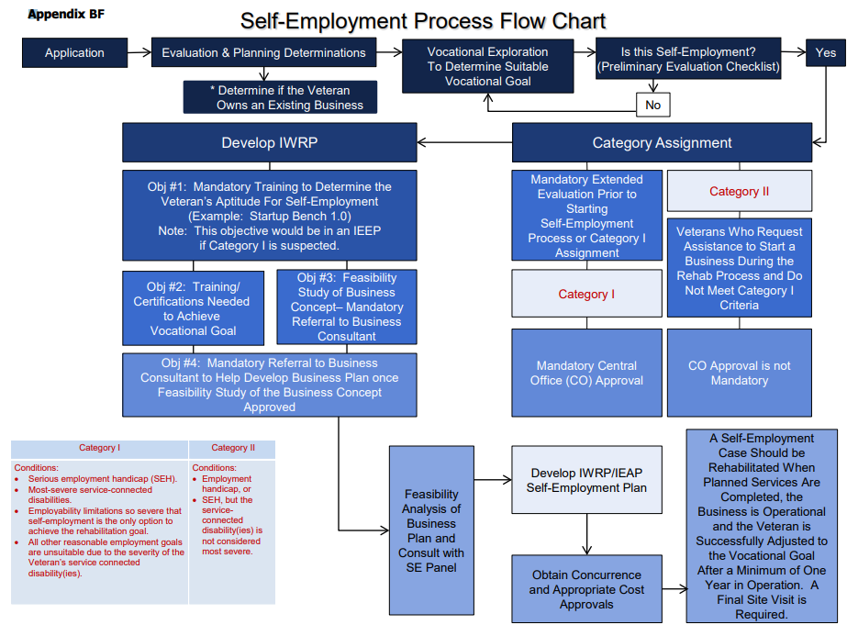
Notes:
There is a lot going on here. Don’t let this flow chart alarm and overwhelm you.
Flow chart re-caps each step previously discussed. (This is Appendix BF.)

Slide 35
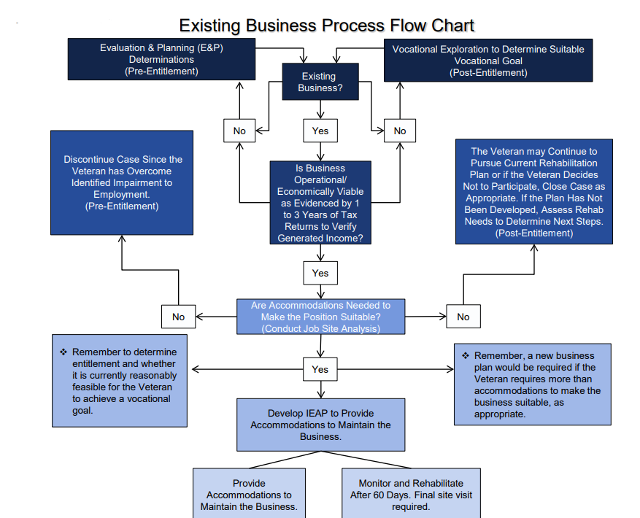
Notes:
This is Appendix BH.

Slide 36
Questions

