Slide 1
Centralized Benefits Communication Management (CBCM) Phase One – Centralized Printing
Compensation Service
August 2020

Slide 2
Motivation
Centralized Benefits Communication Management (CBCM) allows claims processors the ability to submit letters electronically to one central location for printing and distribution, allowing claims processors more time to focus on assessing Veterans compensation claims. And reduces the risk of Personal Identifiable Information (PII) violations.
The lesson also reviews the August 2018 update to VBMS-Awards (VBMS-A)
Notes:
This lesson provides an overview of Centralized Benefits Communication Management (CBCM). CBCM is VA’s initiative deployed Nationally in March 2018. The program is designed to improve productivity and streamline correspondence on Veterans compensation benefits.

Slide 3
Lesson Objectives
Explain the new CBCM update in the Veterans Business Management System-Awards (VBMS-A) program.
Demonstrate how to create packages in VBMS-Core and VBMS-A
Recognize Package status in VBMS-Core.
Identify the actions required of each status: Draft, In Progress, Success, and Failure.
Notes:
Through the lesson the audience will learn and demonstrate how to create packages in VBMS-Core and VBMS-A, identify CBCM’s updated functionality in VBMS-A and identify package status and actions required to move the package forward.

Slide 4
References
M21-1 1.1.B – Duty to Notify Under 38 U.S.C. 5102 and 5103
M21-1 1.3.B – A Representative’s Right to Notification and Review Records.
M21-1 III.ii.1.B – Mail Management
M21-1 III.ii.1.B – Evidence Requested from the Claimant
M21-1 III.v.2.B – Decision Notices
VBMS-Awards User Guide
VBMS-Core User Guide
Notes:
Additional references are included in the Lesson Plan (LP) and Hand Out (HO). Instruct the audience to take time to review the Job Aids included with the trainee HO

Slide 5
Topic 1
Purpose and Benefits of Centralized Benefits Communication Management (CBCM) Phase One – Centralized Printing

Slide 6
Purpose and Benefits of Centralized Benefits Communications Management (CBCM) Phase One – Centralized Printing
Centralized Benefits Communications Management (CBCM) is a Veterans Benefits Administration (VBA) initiative designed to provide greater choice for claimants and beneficiaries in how they receive correspondence from VBA.
Through CBCM-Centralized Printing, letters are electronically submitted to one central location for printing and distribution.
Streamlining the delivery of outbound communications across all VBA business lines.
  Providing an automated and efficient means of generating and delivering compensation benefit letters to claimants.
  Reducing the risk of Personally Identifiable Information (PII) violations and,
  Allows more time for VSR’s to focus on claims processing.
Notes:
VBMS is the primary connection to CBCM, through CBCM-Centralized Printing letters are electronically submitted to one central location for printing and distribution. This functionality already active in VBMS-Core.

Slide 7
Purpose and Benefits of Centralized Benefits Communications Management (CBCM) Phase One – Centralized Printing (cont.)
In August 2018 VBMS-Awards updated, VBMS-Awards interface now mirrors VBMS-Cores Package Manager interface for Veteran Service Officers at co-located Regional Offices (RO).
Claims processors will continue to follow manual guidance for private attorney representatives, addressing correspondence to the attorney’s address listed on VA Form 21-22a Appointment of Individual As Claimant’s Representative and/or referencing the address list in the Office of General Counsel (OGC) database.
Notes:
When in VBMS-Awards, when creating a package the VSO’s address will automatically populate if the VSO is co-located at a Regional Office (RO).
M21-1 I.3.B.1.c. – Providing Notice of Correspondence to VSOs (use smart look up option-to access this reference)
Office of General Counsel (OGC) database
M21-1 I.3.B.1.d – i

Slide 8
Commonly Used Terminology
Centralized Printing – Describes the functionality implemented with phase 1 of CBCM. This term may also refer to VBA’s print vendor, who completes the printing and mailing of the documents.
Package Manager – Functionality in VBMS which allows the user the ability to create a package, add documents to a package, and indicates the recipient(s) of the documents. The interface is integrated with VBMS-A application. Packages created in the Letter Interview functionality are provided to the CBCM Vendor.
Package – a group of documents in a particular order (i.e. 5103 Letter, VA Form 21-4142/4142a, and incomplete form.
Notes:
The audience is aware of terminology associated with centralized printing and package manager; this is a review of terms related to CBCM-Package Manager. Tell the audience a comprehensive glossary is attached to the lesson, titled: Centralized Printing Glossary Quick Reference.

Slide 9
Federal Tax Information (FTI)
VBMS is not an approved system for storing Federal Tax Information (FTI). Therefore, you must not add any documents to the VBMS eFolder that contain FTI, or create a package for Centralized Printing using a document containing FTI.
If you discover FTI in VBMS follow the guidance in: X.4.B.2.d. Removing an FTI Document Within VBMS and Securely Storing Within LCM.
Notes:
As a reminder, if FTI is discovered in VBMS the employee should follow the guidance in X.4.B.2.d. Removing an FTI Document Within VBMS and Securely Storing Within LCM.
When creating a package to send through CBCM for the Veteran, the Veteran’s beneficiaries or the Veteran’s POA ensure that no FTI is attached to the package.

Slide 10
Topic 1 Knowledge Check
1. What does CBCM stand for?
A: Centralized Benefit Communication Management (CBCM)
2. The functionality of sending correspondences through CBCM- Centralized Printing is through which two VBA systems?
A: VBMS-Core and VBMS-Awards (VBMS-A)

Slide 11
Topic 2
Creating a Package in VBMS-Core
Notes:
This section will demonstrate how a finalized letter in VBMS-Core will automatically create a draft package in Package Manager.

Slide 12
Creating a Package in VBMS-Core
A Package is created in VBMS-Core in two ways:
Automatically, when a letter is finalized.
Manually, in Package Manager under the “Veteran” tab.
Notes:
Inform the audience that the following slides will provide instruction on navigating to package manager from the Veteran’s Letter Finalization screen and the Veteran’s eFolder in VBMS-Core. Additional information is available in VBMS-Core’s User Guide https://vbaw.vba.va.gov/VBMS/docs/VBMS_Core_User_Guide_Release_19_0_4.pdf. Package Manager instruction starts on page 190 of the user guide.

Slide 13
Creating a Package via Letter Finalization
Notes:
The next two slide will demonstrate what happens when a letter is finalized in VBMS and how to navigate to Package Manager from letters in VBMS-Core.

Slide 14
Creating a Package via Letter Finalization
VBMS-Core will automatically create a package when a letter is finalized.
From the Letter Chevron in VBMS-Core a letter is generated and finalized. Upon successful creation of the letter a green success bar will appear. Users will be directed to Package Manager by clicking on “here” within the success bar
Through claims establishment, generation of the Request for Application letter and Standard 5103 Notice will also prompt the creation of a package.
Notes:
Finalized letters are automatically saved to a draft package. Inform the audience that once they click on “here” they are automatically directed to Package Manager. Additionally, when the Request for Application letter and/or the Standard 5103 Notice letter generated through clam's establishment these letters will also prompt the system to create a package.

Slide 15
Creating a Package via Letter Finalization (cont.)
From Package Manager, select the name of the package just created.
Choose the correct package from the Distributions tab. The package, automatically generated from the letter finalization will display a “Draft” Status, indicated by a yellow dot
Notes:
When the document package is finalized the package is communicated through CBCM to the centralized printing vendor. The vendor prints and mails the letter, documents and enclosures to the designated recipient. Inform the audience the process for finalizing the package in Package Manager will be taught later in the presentation.

Slide 16
Creating a Package in Package Manager
Notes:
The next several slides will exhibit how to create a package in Package Manager, adding documents, and deleting a package. This process is not applicable to packages automatically created at letter finalization. If a letter is finalized in VBMS-Core, a “draft” package is automatically created in Package Manager.

Slide 17
Creating a Package in Package Manager (cont.)
Packages can be manually created from Package Manager.
Select the Veteran tab and then choose Package Manager.

Slide 18
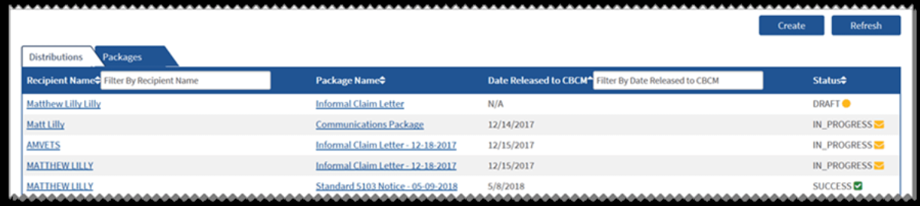
Creating a Package in Package Manager (cont.)
The main page opens to the Distributions tab by default.
A new package can be created by clicking on the “Create” tab in the upper right hand of the screen.

Slide 19
Creating a Package in Package Manager (cont.)
The Create dialog box will appear. When creating a new package, select “New Package” and then “Create”.
Notes:
Chose New Package to Create the package.

Slide 20
Creating a Package in Package Manager (cont.)
When the package information opens the package name defaults to “New Package”
Create a name for the package, using the Veteran’s name or the document/letter related to the package.
Notes:
The package will default to “New Package” as the packages name. See highlighted Package Name in lower image. Note to the audience that it is hard to see but that there is a red (*) asterisk in front of Package Name, as with most forms in VA, if there is a red (*) this means the item needs to be completed to move forward.

Slide 21
Creating a Package in Package Manager (cont.)
Add any additional documents by clicking on the “Add Document(s)” button.
Notes:
Complete all (*) asterisks, name the package using the Veterans name or the document name. Once the package has been named click on “Add Documents”

Slide 22
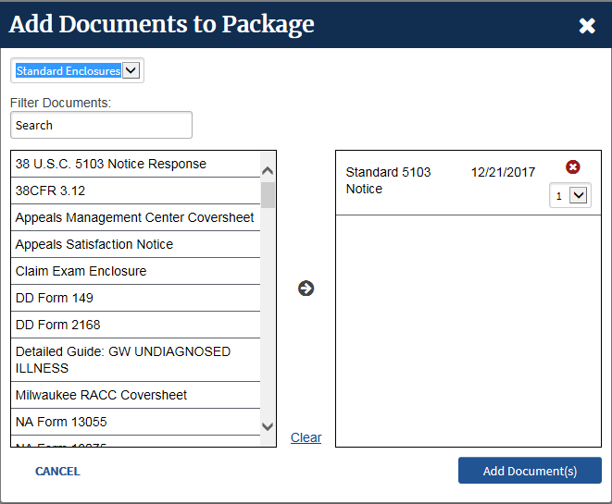
Creating a Package in Package Manager (cont.)
Select Standard Enclosures or eFolder Documents. Chose the document to add to this package. Use the arrows in the middle column to move the document from the left column to the right. Click on “Add Document(s)” once all documents have been moved to the right column.
Notes:
Selecting Standard enclosures will populate all Standard Forms. Choosing the eFolder will allow the user to select the documents in the Veteran’s eFolder to attach to the package. Choose the document on the left column and using the arrow keys in the middle move the documents from the left column to the right.

Slide 23
Creating a Package in Package Manager (cont.)
After documents have been added user will choose the “Recipients” tab to add recipients
User will choose either Individual or Organization. Choosing “Veteran is Recipient” will populate the Veteran’s information to the screen.
Notes:
After all documents have been added to the package, user will designate the recipients by going to the “Recipients” tab. Choosing Individual or Organization. If the user selects Veteran is Recipient, the Veteran’s information will populate the screen.

Slide 24
Creating a Package in Package Manager (cont.)
If “Organization” is chosen, the user can select the Co-located Organization box, and then choose the appropriate POA from the drop-down menu.
Choose Co-located Organization will prompt the system for POA designation. Complete the (**) National/State/Regional Organization
Notes:
Choosing the co-located organization and identifying a POA will automatically populate the address of the co-located RO.
Once the recipient choice has been made, the Save tab needs to be clicked to move the request forward.

Slide 25
Creating a Package in Package Manager (cont.)
Once all sections are complete and the Save tab selected, the package status will show as “Draft” indicated as a yellow dot.
If all the information is correct click on “Send Package”.
Notes:
The package status will display as “Draft” on the left side of the screen, to send the package click on “Send Package” tab. Verify the package has been sent when the yellow dot changes to a yellow envelope and the status changes to FINALIZED. Recipients cannot be edited once the package is finalized. Once the package is finalized the document package is communicated through CBCM to the centralized vendor.

Slide 26
Topic 2 Knowledge Check
Name two areas in VBMS-Core where you can navigate to Package Manager.
A: 1. Letter finalization screen, under letter tab
2. from the “Veteran” tab
When creating a package, which box do you check to automatically populate the Veteran’s name and address?
A: “Veteran is Recipient” box

Slide 27
Topic 3
Identifying the Status of a Package

Slide 28
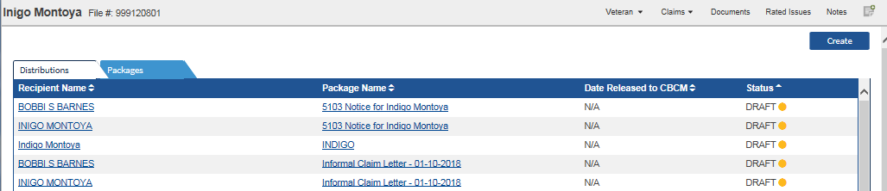
Identifying the Status of a Package
“Distributions Tab” status messages:
  Draft, circle; The package is not finalized. This status means the user must finalize the package to be sent.
  In Progress, envelope; The package is finalized and sent to Centralized Printing. No action is needed.
  Success, checkmark; Centralized Printing received and accepted the package. No action is needed.
  Fail, exclamation point; Centralized Printing received the package, but unable to print it. User should contact VAVBAWAS/CO/VCIP
Notes:
Under the “Distributions” tab, users can see the status of the package. The user will see one of the following four (4) statuses:
Draft with a circle indicates the package has not been finalized and sent. This status means the user must finalize the package to be sent.
In Progress with an envelope indicates the package has been finalized and is being processed by Centralized Printing. This status means the user does not need to take any further action.
Success with a checkmark indicates Centralized Printing has received and accepted the package. This status means that no user action is needed.
Fail with an exclamation point indicates Centralized Printing has received the package, but is unable to print it. In this rare instance, the User should contact VAVBAWAS/CO/VCIP.

Slide 29
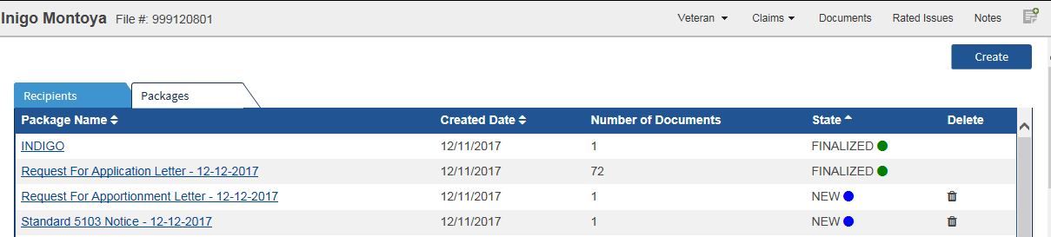
Identifying Package Status’s in Package Tab and Deleting Packages (cont.)
“Packages” status messages:
  New, blue circle; The package has not been finalized and sent. User needs to finalize and send package.
  Finalized, green circle; The package has been sent to Centralized Printing. No further action is needed.
Notes:
Under the “Packages” tab, users can see the status of the package. The user will see one of the following two (2) status messages:
New with a blue circle indicates the package has not been finalized and sent. This means the User needs to finalize and send package.
Finalized with a green circle indicates the package has been sent to Centralized Printing. This means no further action is needed.

Slide 30
Identifying Package Status’s in Package Tab and Deleting Packages
Delete a package in “New” status by selecting Delete (trash can icon).
Package needs to be in “New” status in order to delete.
Notes:
If there is a package you no longer need, you can delete it under the “Packages” tab. In order to do so, select the trash can icon on the same line as the package name to delete the package. Packages which are “Finalized” cannot be deleted.

Slide 31
Topic 3 Knowledge Check
1) Under the “Distributions” tab what are the 4 status’s a user may see?
A: Draft, In Progress, Success and Fail
Under the “Packages” tab what would a user click to delete a new package?
A: The trash icon

Slide 32
Topic 4
Creating a Package in VBMS-A
Notes:
Advise audience that the following slides are an overview of creating a packet in VBMS-A. CBCM recently updated the VBMS-A interface which mirrors the VBMS-Core Package Manager interface for Veteran Service Offices at co-located Regional offices. With this update the co-located VSO’s addresses will automatically populate the address fields when creating a packet in Package Manager. They should review the VBMS-A User Guide for more additional information.

Slide 33
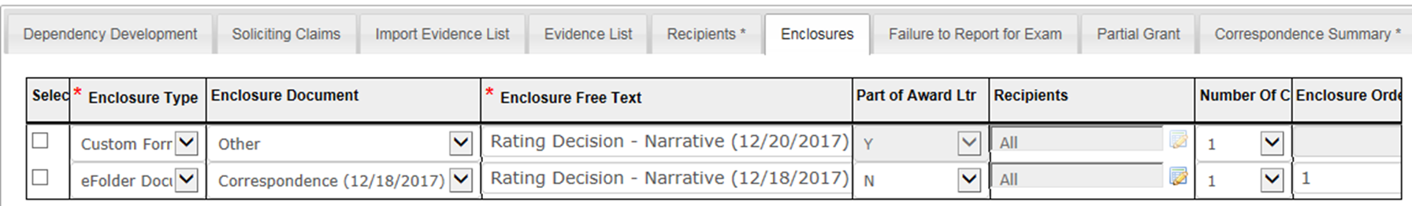

Creating a Package in VBMS-Awards
After generating an award in VBMS-A, navigate to “Award Letter Interview” and select “Gen Letter.”
Click “Enclosures”
Note: Package Manager sends the documents you indicate. Only add documents that are not already in the Letter Preview.
Notes:
Just as there is a way to create a package through VBMS-Core, a user can also create a package through VBMS A.
After generating an award, the user must navigate to the “Award Letter Interview” by selecting Gen Letter button.
Once in the “Award Letter Interview, ” the user will select the “Enclosures” tab.
Please note that the Package Manger sends the documents you indicate. Thus, the user should only add documents that are not already in the Letter Preview.

Slide 34
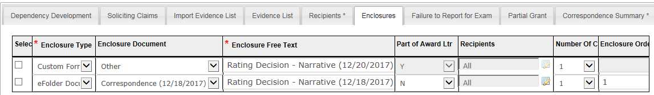
Creating a Package in VBMS-Awards (cont.)
To send additional enclosures, specify the recipients, using the “Enclosures” tab:
  Select “N” under “Part of Award Ltr,” if it is not a part of the normal award package.
  Select the recipient(s) using the pencil scratchpad icon.
  Enter the “Enclosure Order.” For example, if this enclosure goes first, then place a 1 in the space.
Notes:
If specific additional enclosures are needed for certain recipients, such as the Rating Code sheet to a POA but NOT a Veteran, you can do this in the “Enclosures” tab. To do so, select “N” under “Part of Award Ltr” and then select the appropriate recipient(s) using the pencil scratchpad icon.
Users must enter a unique number into the “Enclosure Order” when adding documents this way.

Slide 35
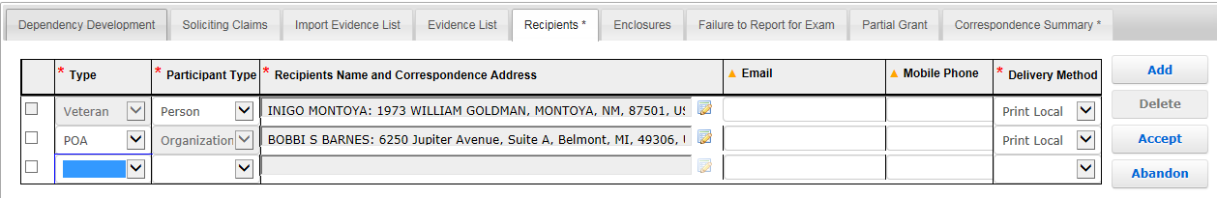
Creating a Package in VBMS-Awards (cont.)
After building the package, navigate to “Recipients” tab and ensure recipients’ addresses are correct.
Additional recipients can be added by selecting the “Add” button.
With the CBCM VSO co-location updated functionality, if the claimant has a Veteran Service Organization (VSO) associated to their profile, the VSO information will automatically populate with the “Local Station of Jurisdiction” (SOJ).
Notes:
After building the package, the user must navigate to the “Recipients” tab. Here, the user must ensure the recipients’ addresses are correct.
Under the “Recipients” tab, the user can also add any additional recipients by selecting the “Add” button. Important: If the “Local SOJ” is not populated, or the claimant has a private attorney, an address will still be required to be entered. The “Station of Jurisdiction” is the closest regional office based on the Veteran’s zip code. This is automatically selected and is not editable.

Slide 36
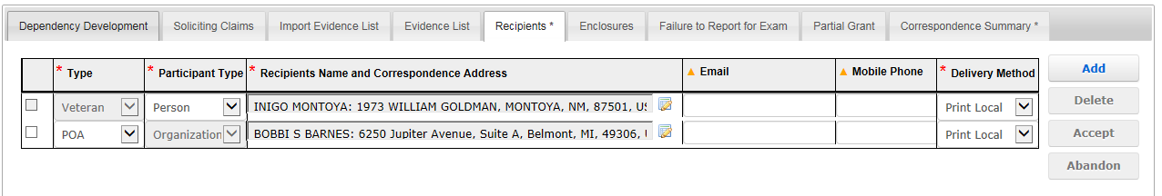

Creating a Package in VBMS-Awards (cont.)
Once all recipients have been identified, click on the arrow under “Delivery Method.”
Print Local: the correspondence package will be sent to a local printer
Print Central: the correspondence package will be sent to the CBCM facility for distribution
*Note: If the Award requires concurrence, the delivery method and recipient information will continue from the Authorizer’s changes.
Notes:
After all recipients have been identified, click on the arrow under “Delivery Method.”
Please note that if an award requires concurrence, the delivery method and recipient information will persist from the Authorizer’s changes.

Slide 37
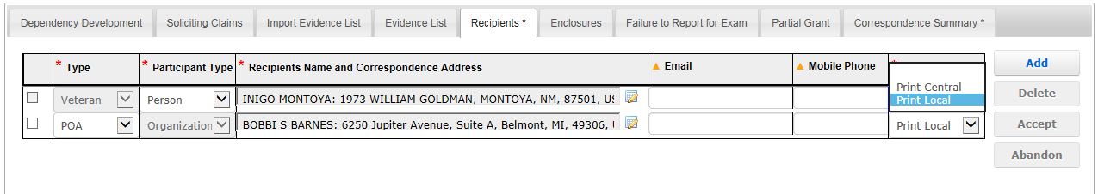
Creating a Package in VBMS-Awards (cont.)
The promulgating VSR will select “Print Central.”
Once all the recipients are added and the delivery method of “Print Central” is complete, select “Accept”
Notes:
Upon clicking the drop-down menu, the new “Print Central” delivery option will reveal. Selecting this option will send the letter distribution for that recipient to the Package Manager upon finalization. Once all the recipient's rows are complete, the user must select the “Accept” button.

Slide 38
Creating a Package in VBMS-Awards (cont.)
From the Awards Correspondence Screen, users can verify the status of the package from the Distribution Status column.
Notes:
Users are able to check on the status of a packet from the Correspondence screen in VBMS-A.

Slide 39
Creating a Package in VBMS-Awards (cont.)
Status Indication | Explanation of Status | Action Required, if any
Submitted | Correspondence package has been submitted to the Package Manager | No user action is needed
Submission Failed | Correspondence Package submission failed to Package Manager | User creates a package via the VBMS –Core Package Manager
Distribution Acknowledged | Correspondence package submitted to Centralized Printing, and acknowledgement has been received | No user action is needed
Distribution Completed | Centralized Printing has received the package, and has printed the documents | No user action is needed
Distribution Failed | Centralized Printing was either unable to create the distribution or unable to hand over the distribution for printing. | User should contact VBVBWAS/CO/VCIP
Notes:
Status explanations and action needed. See Job Aid- Centralized Printing Job Status Quick Reference

Slide 40
Creating Packages in VBMS-A
Authorization Review

Slide 41
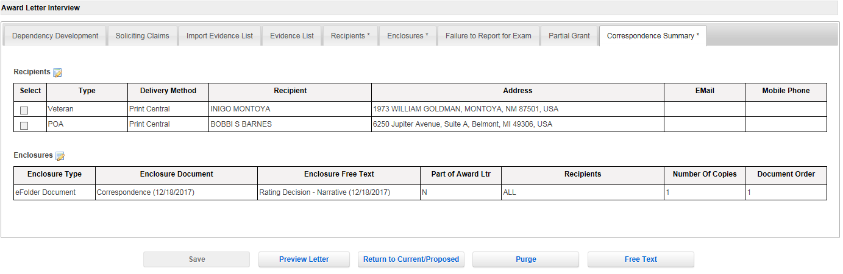
Creating Packages in VBMS-A
Authorization Review
Navigate to the Correspondence Summary to review a snapshot of both “Recipients” and “Enclosures” tabs.
Authorizer can make edits to either recipients or enclosures in their respective tabs
Notes:
From the Award Letter Interview screen, the user completes the necessary information under the “Recipients” and “Enclosures” tabs, the user can navigate to the “Correspondence Summary” tab to review both Recipients and Enclosures for the correspondence.
The authorizer can make edits to either recipients or enclosures in their respective tabs.

Slide 42
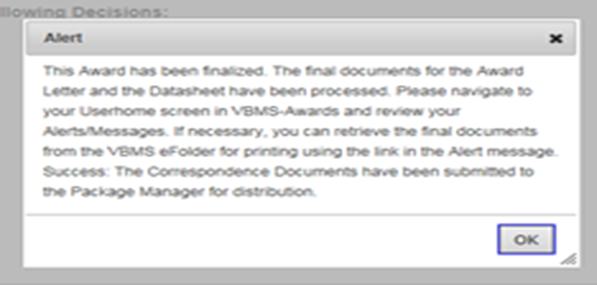
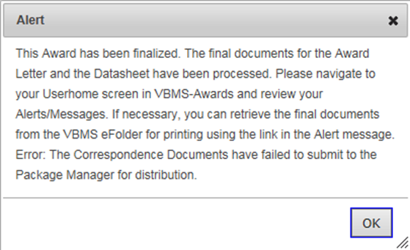
Creating Packages in VBMS-Awards
Authorization Review
Authorizers will receive the following message when a “Print Central” letter is authorized and successfully sent to Package Manager.
If the package failed to submit, the message will refer the user to the Package Manager.
Notes:
Once an award is finalized, users will receive one of 2 messages. If the package is successfully sent to package manager, then the message will indicate success. However, if the package failed to submit, the message will refer the user to the Package Manager.

Slide 43
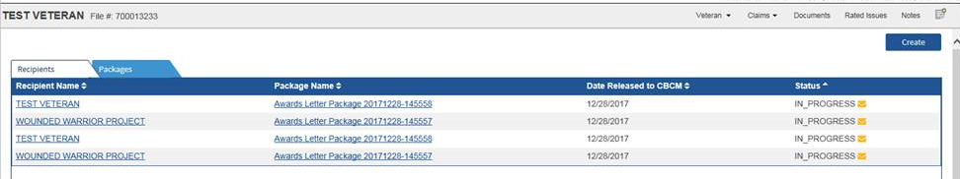
Creating Packages in VBMS-Awards
Authorization Review (cont.)
Verify that packages have been sent from VBMS Awards were received by Package Manager and sent to Centralized Printing by navigating to the Package Manager for that Veteran in VBMS Core.
The “Recipient tab” status displays “In Progress” for successful submission
Notes:
Users can verify that packages sent from VBMS Awards were received by Package Manager and sent to Centralized Printing by navigating to the Package Manager for that Veteran in VBMS Core. The “Recipients” tab status displays “in progress” for successful submission. See Job Aid-Sending Packages in VBMS-Awards.

Slide 44
Lesson Review
Explain the CBCM update in VBMS-A
Demonstrate how to navigate to package manager through VBMS-Core and VBMS-A.
Recognize the status of a package.
Identify the actions required of each package status, draft, in progress, success and failure.

Slide 45
Review
Questions?
Notes:
Questions?

