Slide 1
Notes:
Gain Attention – Giving the class the “WIIFM” (What’s in it for me) with using QMS.

Slide 2
Objectives
Access to QMS
Understanding QMS Terminology
Know the basic functions of the “Review Landing Page” tab
How to use the field, Benefit Claim ID (BCID)
Performing an Initial Review
QMS Error message and other Issues
Notes:
Instructional Hint: While providing objectives, explain how each will be addressed and presented.

Slide 3
References
QMS User Guide
M21-4, CH 6
Notes:
Validate audience has access to each and the benefit they provide.

Slide 4
QMS Terminology
Review Types – VSRPREMQRL and VSRPOSTMentor
Review Status – In-process, On-hold
Review Levels – Initial (INIT)
Individual QMS Tabs – Home, Chatter, Reviews Landing Page and Error Correction
Other QMS Terms – QMS Checklist, Benefit Claim ID (BCID)
Notes:
Explain and point out we will provide definitions while we are navigating through the screens during a mock Perform a review. Inform students they can open the QMS User Guide (located in QRT SharePoint site
Other QMS Term ex: Contact screen, BCID, Error Response, Payment adjustment required
Inform students: The examples above are only some of the QMS Terms

Slide 5
How to Access QMS (Access to Salesforce App)
Single sign-on method in Salesforce site
via Start – All Apps – VBAPPS – Salesforce
https://va.my.salesforce.com/
First time in Salesforce
Notes:
Important: Must be in Salesforce Classic view to perform quality reviews.
Inform the class, by walking them through creating a shortcut to QMS

Slide 6
How to Access QMS (Lightning to Salesforce Classic)
Now you will need to switch from Lightning view to Salesforce Classic
Notes:
Important: Must be in Salesforce Classic view to perform quality reviews.
While in WATRS, direct the attention of the class to the person icon to drop down the menu for switching to Salesforce Classic.

Slide 7
How to Access QMS (cont.)
Notes:
Direct the attention of the class to the drop menu next to “Help & Training” for switching to QMS site.

Slide 8
“Home” Tab
Notes:
Important: Tabs can be customized to the user’s preference. Suggested initial QRS Tabs = Home-Review Landing Page-Error Corrections and the “+” sign for “All Tabs”.
Explain the Home screen (Chatter) is a media function in QMS for personnel to communicate with other QRSs. Similar to “Pulse”
Suggestion: Explain to the class the benefits of creating a shortcut to QMS, using “Favorite Bar” ( Step by step instructions may be needed to walk some through the process)

Slide 9
“Reviews Landing Page” (My Reviews)
This screen provides all pending reviews individually selected by using the “Request a New Review” button. The button provides the QRS a review based on their preset availability in “QMS Information” located in the Contact Detail page.
Note: The Contact Detail page will not be addressed.
Notes:
Make sure to go over the benefits and function with each option and heading. Note to self: This will satisfy QMS Terminology objective.
Explain the individual headings and how the “Request a New Review” button works.
As a reviewer this is the only list of reviews that will be accessible.
Remind class all reviews showing a review status of “In process” must be completed or placed “On hold”, before requesting an additional review using the “Request a New Review” button and/or processing any other pending reviews on list.
IMPORTANT: Inform students if VBMS does not react to BCID search or gives an error message no claim found, could be due to improper/low Security Level.

Slide 10
How to use the field, Benefit Claim ID (BCID)

Slide 11
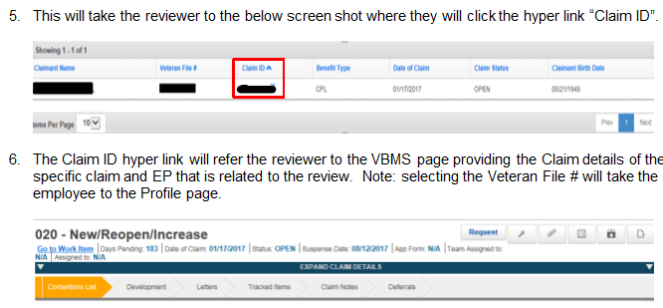
How to use the field, Benefit Claim ID (BCID)

Slide 12
“Reviews Landing Page” (Review Details)
Notes:
Use a live claim for visual presentation training QMS Review ID: or BCID: EP
IMPORTANT: If recording, stop the recording when accessing live claims.
Use the definitions from the QMS User Guide.
IMPORTANT: Inform class “Change Reviewer” and “Deselect Approve/Reject” commands are accessible only to the QRT Coach Team.
Do not take a lot of time on these headings. Experience will be the best training tool.
Provide a thorough, but brief explanation of each option and its benefit and relation to review.

Slide 13
“Reviews Landing Page” (Review Details)
Notes:
Use the definitions from QMS User Guide.
Hint: Inform students the above data will contain zeros for all initial reviews.
Do not take a lot of time on these headings. Experience will be the best training tool
Provide a thorough, but brief explanation of each option and its benefit and relation to review.

Slide 14
“Reviews Landing Page” (Review Details)
Notes:
Use the definitions from the QMS User Guide.
Note: All data above is received from VBMS sites, unless manually added.
Go over when comments will be included with an IQR in QMS. Remind class all Comments are stored in a historical record. Never deleted.
Do not take a lot of time on these headings. Experience will be the best training tool.
Provide a thorough, but brief explanation of each option and its benefit and relation to review.

Slide 15
“Reviews Landing Page” (Review Details)
Notes:
Use the definitions from QMS User Guide.
Inform class Contentions, Transactions, Issues are from VBMS
Do not take a lot of time on these headings. Experience will be the best training tool.
Provide a thorough, but brief explanation of each option and its benefit and relation to review.

Slide 16
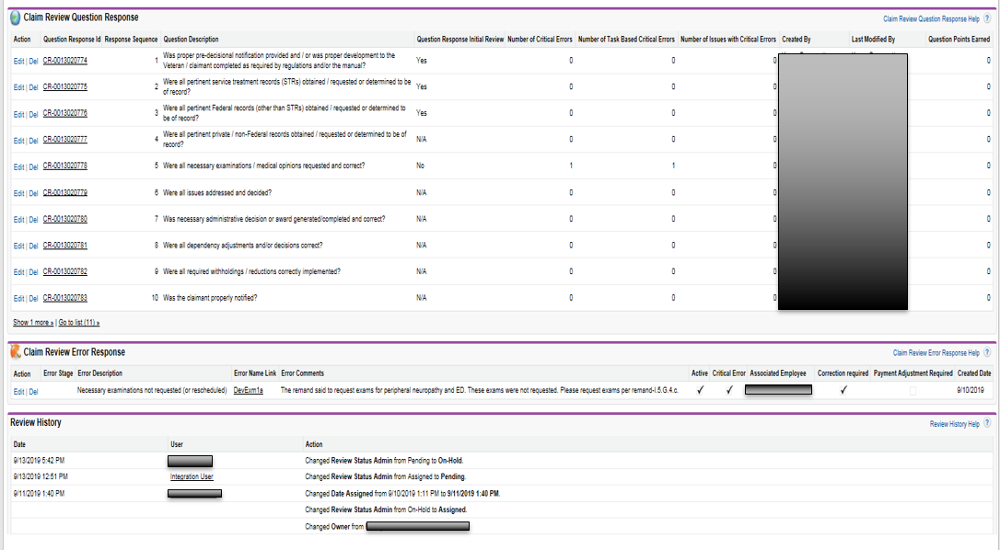
“Reviews Landing Page” (Review Details)
Notes:
Use the definitions from QMS User Guide.
Go over the difference with Question Response and Error Response. Question response total should be accurate with the total number of
questions per Review Type checklist. Ex. VSRIQRPre or Post = 11 questions VSR and for RVSRIQR = 13 RVSR
Briefly, go over the primary use of the Historical record. To understand who opened the review and edited the data. Note: Any change made to the review data is recorded under Review History and includes the users name.
Do not take a lot of time on these headings. Experience will be the best training tool.
Provide a thorough, but brief explanation of each option and its benefit and relation to review.

Slide 17
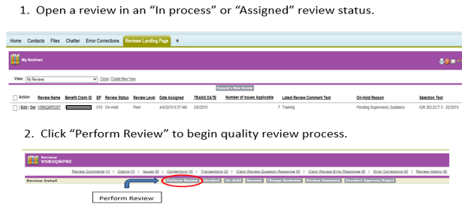
Performing a Review (Initial Action)
Notes:
Reinforce the need to complete a review of the claim transactions that were taken and the ones that were not, prior to performing the review in QMS.
Retention: Include the different methods of selecting a review: Request a New Review button, Pending review in an “In process” or “Assigned” review status
Reminder: When QMS is open and leaving to take a break, go to training or a meeting, make sure to Save and Close the Error Citation or Error Checklist browser before leaving or locking computer.
NEVER select “Perform Review” when you currently have Perform a review open!

Slide 18
Performing a Review (Review Checklist)
Notes:
Inform class: Each review checklist will consist of questions related to that specific review. The review will have two separate checklist formats for answering questions. A. Clicking the circle next to “Yes, No or N/A”. B. Click the answer from available list.
Reminder: When QMS is open and leaving to take a break, go to training or a meeting, make sure to Save and Close the Error Citation or Error Checklist browser before leaving or locking computer.
NEVER select “Perform Review” when you currently have Perform a review open!

Slide 19
Performing a Review (List of Errors)
Notes:
Inform class the blocks in List of Errors are not activated.
Different methods of opening errors and activating error citation
Go over function of each action button on the bottom of page

Slide 20
Performing a Review (Error Citation)
Notes:
Explain how the error description list is displayed and once an error description is checked, the error citation screen is opened. Go over requirements for error narrative and error message. Reminder – Use Narrative Error training to write Error comments.
Contains: Error Description – Brief explanation why an error and a Reference to support the call
Important: If QMS Error message is received do not “Duplicate Tab” or select “Perform Review” if the error citation screens are open.
Reminder: When QMS is open and leaving to take a break, go to training or a meeting, make sure to Save and Close the Error Citation or Error Checklist browser before leaving or locking computer.
NEVER select “Perform Review” when you currently have Perform a review open!

Slide 21
Performing a Review (Error Citation)
Notes:
Explain Critical Error and Non Critical Error Example of a non-critical error: A transaction taken within a 30 day window for manual change, IAW: M21-4, CH 6.
Include the function, when and why to check Correction Required, Training Recommended and Payment Adjustment Required
Reminder: When QMS is open and leaving to take a break, go to training or a meeting, make sure to Save and Close the Error Citation or Error Checklist browser before leaving or locking computer.
NEVER select “Perform Review” when you currently have perform a review open!

Slide 22
Performing a Review (Complete Checklist)
Notes:
Validate comprehension of bottom 3 action buttons.
Inform class all checklist questions must be answered prior to going to Review Summary.
Reminder: When QMS is open and leaving to take a break, go to training or a meeting, make sure to close the Error Citation or Error Checklist browser before leaving or locking computer.
NEVER select “Perform Review” when you currently have Perform a review open!

Slide 23
Performing a Review (Review Summary)
Notes:
Inform class an error message will be received if “Payment Adjustment Required” block was checked and no input in Payment Adjustment Amount.
Go over the data in Review Metrics.
NEVER select “Perform Review” when you currently have Perform a review open!
Reminder: When QMS is open and the User leaves to take a break, go to training or a meeting, make sure to Save and Close the Error Citation or Error Checklist browser before leaving or locking computer.

Slide 24
Performing a Review (Confirm all Responses)
Notes:
Inform class the primary purpose of the Summary Review page. A quick review of the error citation to include error narrative and confirm.
NEVER select “Perform Review” when you currently have Perform a review open!

Slide 25
Performing a Review (Submit Review)
Notes:
Important: At the end of the checklist questions the user will have the option to include additional comments. These comments will not be recorded on the Review Details page.
Inform class once the review is submitted, it is final and the reviewer will be taken to the Review Details page.
Reminder: When QMS is open and leaving to take a break, go to training or a meeting, make sure to Save and Close the Error Citation or Error Checklist browser before leaving or locking computer.
NEVER select “Perform Review” when you currently have Perform a review open!

Slide 26
QMS Error message or Issues
Notes:
Stress the understanding, the QRT Coach makes the decision to resolve any QMS issues.

Slide 27
Recap
Access to QMS
Understanding QMS Terminology
Know the basic functions of the “Review Landing Page” tab
How to use the field, Benefit Claim ID (BCID)
Performing an Initial Review
QMS Error message and other Issues
Notes:
The instructor should allow the class to answer questions related to each objective to evaluate understanding and
to build retention. Refer class to their notes and the QMS User Guide.

Slide 28
Things to Remember
For quicker access to QMS, create a shortcut in “Favorites” or “Favorites Bar” .
The “Request a New Review” button will not give you a review if Review Status shows “In process”.
Any action or editing taken on a review, a comment is always required.
The Benefit Claim ID# can be used to open the claim in VBMS.
If VBMS does not react to a BCID search or gives an error message no claim found, it could be due to an improper/low Security Level.
Non critical errors will be resolved and any communication to employee will be outside of QMS. i.e. E-mail, Skype (IM), Phone
All error messages or issues with QMS will be referred to your QRT Coach Team, first.
NEVER select “Perform Review” when you currently have Perform a review open!
Notes:
This is an opportunity to check and evaluate understanding of QMS and improving retention. While reading the bullet of information, have class explain how they understood QMS functions related to access, perform reviews, review flow and issues with QMS functioning properly.
For retention, the instructor will read the beginning of each bulleted statement and have the class read out-loud the bold font.

Slide 29
Discussion and Questions
Notes:
IMPORTANT: Reinforce: Do not send a request or inquiry to the QRT mailbox, it will be returned with instructions to refer to Coach
and/or Station Management to resend their request or inquiry.

