Slide 1
Accuracy of Disability Benefit Evaluations for Veterans' Service-Connected Heart Diseases
Compensation Service
October 2020
Notes:
Welcome to the Introduction to Medical Electronic Performance Support System (E P S S) course. To advance each slide, click anywhere on the screen.

Slide 2
Course Agenda
Topic discussions
Knowledge checks after each Topic to ensure understanding/clarity
Practical Exercise
Lesson Review/Wrap-up
End of course assessment
  In TMS must achieve 80% > pass
  Unlimited attempts to achieve a passing score
  Open book (all resources can be utilized)

Slide 3
Introduction to “Accuracy of Disability Benefit Evaluations for Veterans' Service-Connected Heart Diseases”
Notes:
Lesson Objectives
Upon completion of this lesson, you will be able to:
Identify how to access Medical EPSS
Identify how to access the Help Menu
Determine how to access the menu tabs at the top of the Medical EPSS
Determine how to utilize the Search function box on the main menu
Identify other reference tools
Locate elements within the Medical EPSS in a practical activity

Slide 4
Purpose
This lesson is intended to introduce and reinforce knowledge of the claims procedures for evaluating claims for heart disease. This lesson will contain discussions and exercises that will allow you to gain a better understanding properly processing these types of claims. This lesson will focus of the findings of OIG VA OIG 19-08095-198 which include:
  VBA decision makers inappropriately evaluated heart disease using insufficient disability benefits questionnaires.
  VBA decision makers inaccurately assigned disability evaluations for service-connected heart disease.

Slide 5
Motivation
The OIG review team found RVSRs had not consistently requested clarification necessary for making disability evaluations.
Example:
A medical provider may have indicated one measurement was used to evaluate the heart disease but then provided an additional statement that another measurement was better. Per VBA guidance, decision makers should request clarification from the medical provider if the disability benefits questionnaire is insufficient.
According to VBA, about 382,000 veterans had service connected disabilities involving heart disease as of September 30, 2019. In addition, VA estimated that up to 560,000 additional veterans may be eligible to receive compensation for illnesses related to herbicide exposure, one of which is heart disease, beginning in January 2020.

Slide 6
Lesson Objectives
Determine the sufficiency of the disability benefits questionnaires (DBQ) when evaluating claims for heart disease.
Determine the appropriate disability evaluation when deciding claims for heart disease.

Slide 7
References
All M21-1 references are found in the Live Manual Website.
38 CFR 3.102, Reasonable doubt
38 CFR 4.7, Choosing between two levels of evaluation
38 CFR 4.104, Schedule of ratings-cardiovascular system
38 CFR 3.309(e), Disease associated with exposure to certain herbicide agents
M21-1 Part IV, Subpart ii.2.C, Service Connection (SC) for disabilities resulting from exposure to environmental hazards or service in the Republic of Vietnam (RVN)
Compensation Service Novel Coronavirus (COVID-19) Operational Information Page

Slide 8
Topic 1: Cardiovascular Disability Benefits Questionnaire (DBQ) Sufficiency

Slide 9
Determining Sufficiency of Cardio DBQ
A disability benefits questionnaire is determined to be insufficient if it does not contain enough findings to render a decision on the claim. This could include missed fields on the disability benefits questionnaire or conflicting or unclear statements by the medical provider.
The RVSR must request clarification when necessary when making disability evaluations. If a medical provider indicates one measurement was used to evaluate the heart disease but then provided an additional statement that another measurement was better. The RVSR should request clarification from the medical provider if the disability benefits questionnaire is insufficient.

Slide 10
Cardiovascular Disability Benefits Questionnaire (DBQ) Sufficiency
A disability benefits questionnaire is determined to be insufficient if it does not contain enough findings to render a decision on the claim. For example, this could include missed fields on the disability benefits questionnaire or conflicting or unclear statements by the medical provider.
The OIG review team found RVSRs had not consistently requested clarification necessary for making disability evaluations. For example, a medical provider may have indicated one measurement was used to evaluate the heart disease but then provided an additional statement that another measurement was better. Per VBA guidance, the RVSR should request clarification from the medical provider if the disability benefits questionnaire is insufficient.

Slide 11
Cardiovascular Disability Benefits Questionnaire (DBQ) Sufficiency
If… | Then…
A medical provider may have indicated one measurement was used to evaluate the heart disease but then provided an additional statement that another measurement was better | decision makers should request clarification from the medical provider if the DBQ is insufficient.
the evidence is ambiguous or incomplete, such as in the case of insufficient or conflicting information on a DBQ | decision makers to seek medical clarification before completing a disability evaluation.
the DBQ requires clarification | the decision maker should not inappropriately apply reasonable doubt or “higher of two evaluations”, the examination should be returned for clarification.

Slide 12
Reasonable Doubt
Reasonable doubt allows claims processors to resolve conflicting evidence in favor of the Veterans if evidence is equal and not due to insuffiency or lack of clarity, however:
Reasonable doubt does not apply if the evidence is unclear or incomplete, such as in the case of insufficient, missing, or conflicting information on a disability benefits questionnaire. In these instances, RVSRs should seek medical clarification before completing a disability evaluation.
Note: RVSRs evaluate the credibility and probative value of all data and determine the approximate balance of positive and negative evidence for or against a finding. In those cases for which there is an approximate balance of positive and negative evidence, the reasonable doubt rule would apply, and such doubt should be resolved in the veteran’s favor. 38 CFR 3.102

Slide 13
Higher of Two Evaluations
Higher of two evaluations allows for a higher percentage to be assigned during the evaluation in the Veteran’s favor if warranted by available evidence if there is doubt between which two percentage evaluations to assign.
However, the evidence must equally (or approximately equally) support two levels of evaluation in order for the higher evaluation to be awarded. RVSRs should not grant the higher of two evaluations. In these instances, VBA guidance RVSRs should seek medical clarification before completing a disability evaluation
Note: Where there is a question as to which of two evaluations shall be applied, the higher evaluation will be assigned if the disability picture more nearly approximates the criteria required for that rating. Otherwise, the lower rating will be assigned. 38 CFR 4.7

Slide 14
Knowledge Check

Slide 15
Topic 2: Cardiovascular Disability Evaluation

Slide 16
Proper Cardiovascular Evaluation
When evaluating heart conditions, METs testing is required, with some exceptions.
When METs testing cannot be conducted for health reasons, the medical provider may provide an estimate of the METs by interviewing the Veteran to determine the lowest activity level at which the veteran reports symptoms of heart disease.
In some situations, however, Veterans may have both service-connected disabilities and disabilities not related to service. Disabilities that are not related to service may also have an impact on METs results. The medical provider must state in the examination that the estimated METs are due solely to the Veteran’s claimed service-connected heart disability.

Slide 17
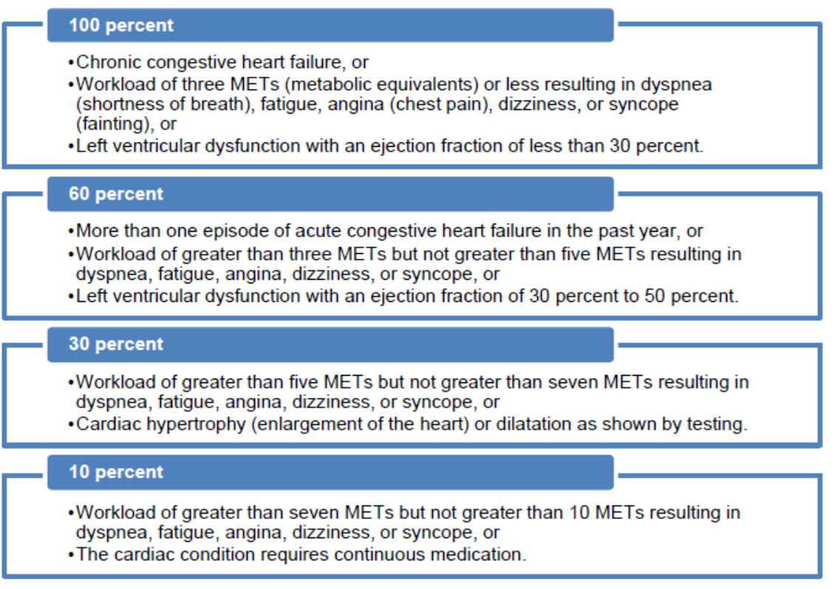
Cardiovascular Evaluation

Slide 18
OIG Note
In addition to this refresher training the OIG recommended that the Under Secretary for Benefits implement a plan to:
Incorporate the system-generated instructions for medical providers directly into the heart disability benefits questionnaire (instead of separately on the examination re quest) and determine whether additional revisions are necessary to ensure medical providers’ findings are sufficient for evaluation purposes.
Ensure medical providers who complete heart disability benefits questionnaires are made aware of common problem areas related to the questionnaire format and system-generated instructions and are provided guidance on how to avoid giving conflicting or insufficient information.

Slide 19
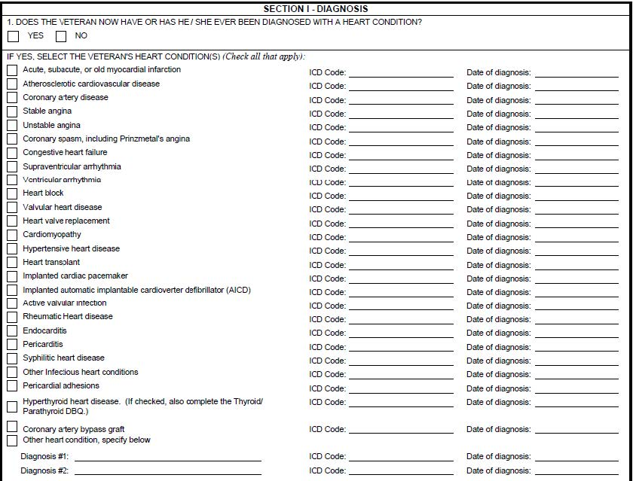
Interpreting Cardiovascular DBQ
The diagnosis section, shown below, contains a list of several heart related diagnoses that a medical provider can select that may not be relevant to the decision.

Slide 20
Interpreting Cardiovascular DBQ
Medical providers can select several diagnoses listed on the DBQ.
However, providing a new diagnosis of a heart condition not claimed by the Veteran or that is not service connected could be problematic. New diagnoses require VBA to obtain clarification to determine whether these conditions affect the MET level or whether any of the conditions should be considered for service connection.
The unrelated diagnoses sometimes conflict with responses to a later question on the DBQ regarding METs due solely to the heart condition as shown below.

Slide 21
Interpreting Cardiovascular DBQ
Example:

Slide 22
Knowledge Check

Slide 23
Conclusion
VBA decision makers inappropriately evaluated service-connected heart disease based on insufficient disability benefits questionnaires.
The formatting of the disability benefits questionnaire used to evaluate the Veteran’s heart disease and the system-generated instructions on examination requests contributed to the identified errors.
In addition, the OIG found VBA decision makers inappropriately applied VBA guidance rather than returning conflicting or unclear disability benefits questionnaire findings for clarification. Errors resulted in both overpayments and underpayments to Veterans.

Slide 24
Review
Questions
Notes:
Questions?

