Slide 1
VBMS-R TipMaster Prompts for Addressing Chap 35 and SMC HB Entitlement
Compensation Service
September 2020

Slide 2
Agenda
Topic discussion
Purpose of Tip Master Within VBMS-R
Tip Master Prompts For 38 USC Chap 35
Tip Master Prompt For SMC HB
Knowledge checks
Practical Exercise
Lesson Review/Wrap-up
End of course assessment
In TMS…must achieve 80% > pass
Unlimited attempts allowed to meet requirement
Open book (all resources can be utilized)

Slide 3
Introduction to VBMS-R TipMaster Prompts for Addressing Chap 35 and SMC HB Entitlement

Slide 4
Purpose of the Lesson
This lesson is intended to remind the RVSR of the functionality of the TipMaster in VBMS-R with regards to Chapter 35 and Special Monthly Compensation entitlements and the appropriate action required in order to address these ancillary issues.

Slide 5
Motivation
Additional entitlements such as 38 USC Chap 35 and Special Monthly Compensation (SMC) are to be granted to a Veteran when the criteria is met. As a RVSR reducing Benefit Entitlement errors nationwide will be achieved by complying with the rules and regulations set in place for addressing these issues. It remains important that we ensure the Veteran receives all ancillary entitlements due them.

Slide 6
Lesson Objectives
Explain the purpose of the VBMS-R TipMaster prompts.
Identify the action required when the VBMS-R TipMaster prompts entitlements for consideration.
Identify when to address 38 USC Chapter 35 entitlement.
Identify when to address SMC HB.

Slide 7
References
38 CFR 3.350
38 CFR 3.807
M21-1 Part IV, Subpart ii, 2.H: Special Monthly Compensation
M21-1 Part III, Subpart iii.6.c: Department of Veterans Affairs Educational Benefits under 38 U.S.C. Chapter 35
M21-1 Part III, Subpart iv.6.D-Codesheet Section
M21-1 Part III, Subpart iv.5.A Principals of Reviewing Evidence and Decision Making
VBMS User Guide

Slide 8
Topic 1: Purpose of Tip Master Within VBMS-R
Overview of the Topic:
This topic will provide a brief overview of the VBMS-R Tip-Master prompt and how it can ensure ancillary entitlements are addressed in a rating decision.
Learning Objective for this topic:
Explain the purpose of the VBMS-R TipMaster prompts
Identify the action required when the VBMS-R TipMaster prompts entitlements for consideration.
Students expected level of understanding:
Identify what action to take when VBMS-R Tip-Master prompt is generated in the rating decision.

Slide 9
Purpose of Tip Master Prompt
The Tip-Master is an embedded “help-aid” that provides prompts for the RVSR to consider during the rating process. In this training we will discuss the prompts as how they relate to entitlements SMC, and Chap 35 benefits.
The Tip-Master will open based on the decision being managed and the entries made on the Issue Management tab.
Reminder: It remains the RVSRs responsibility to review the prompts and determine if the suggested ancillary entitlements are warranted.

Slide 10
Purpose of Tip Master Prompt (cont.)
VBMS-R is designed to provide “TIP” prompts the RVSR is to consider at different stages of the rating process.
These “TIPS” are to prompt the RVSR to consider whether additional entitlements are to be granted for the Veteran.
Citations and pertinent law are also provided.
Reminder: See M21-1 Part III, Subpart iv.5.A.1.e- Attitude When Evaluating Evidence

Slide 11
Using Tip Master
Issues are listed in Tip-Master indicate that an issue (s) should be addressed as suggested within the prompt box.
Select the issue you want to review. You can highlight any issue in the list, but the first issue will be automatically highlighted.
The tip text that applies to the highlighted issue is shown in the Tip for box on the right.
Citations are listed in the Citations box.
Select the citation you want to review. You can highlight any citation in the list, but the first citation will be automatically highlighted.
The law that applies to this citation is shown in the Pertinent Law for box on the right.
Select OK to return to the Issue Summary screen.

Slide 12
Using Tip Master (cont.)

Slide 13
Knowledge Check
The instructor will ask questions based on the topics covered to this point to foster understanding and provide clarity to the information provided.

Slide 14
Topic 2: Tip Master Prompts for 38 USC Chapter 35
Overview of the Topic:
This topic will provide an overview of the VBMS-R Tip-Master prompt and its purpose in making sure Chap 35 is addressed in a rating decision.
Learning Objective for this topic:
Recognize when to address Chap 35 entitlement.
Students expected level of understanding:
Identify what action to take when VBMS-R Tip-Master prompt is generated in the rating decision.

Slide 15
Scenario 1: Establishing DEA/Chapter 35
Veteran is service-connected at 100 percent disabling for posttraumatic stress disorder (PTSD), September 11, 2018.
Medical evidence of Record supports no future examination is warranted, as the total disability will continue for the remainder of the Veteran’s life.
Reminder: Ancillary Benefits are secondary benefits that are to be considered when evaluating claims for compensation, pension or Dependency and Indemnity Compensation (DIC)
The following slides will demonstrate steps the RVSR must take in addressing the ancillary benefit 38 U.S.C. Chap 35.

Slide 16
VBMS-R will automatically create an “Other-Ancillary Decisions” issue when it believes entitlement to an ancillary benefit is grantable and within the scope of the claim. The RVSR is to determine if an ancillary benefit is warranted.

Slide 17
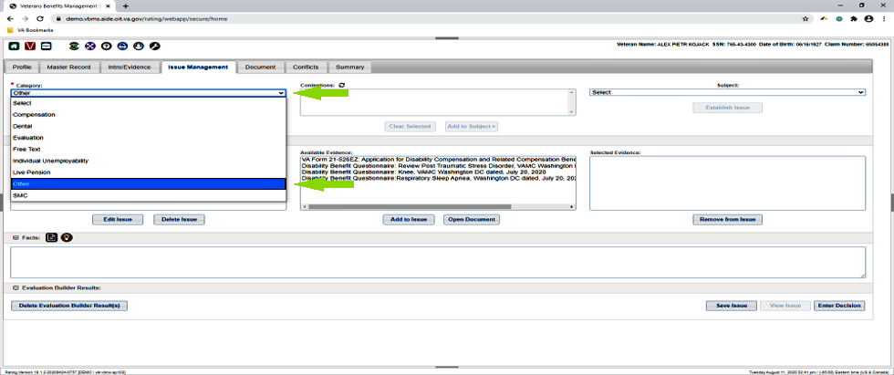
Under the “Category” section of issue management screen click the downward arrow and highlight “other”.

Slide 18
Under the “Subject” section click the downward arrow and select “Ancillary Decisions” then click “enter decision” in lower right-hand corner

Slide 19
Under the “Decision” section click the downward arrow and select Basic Eligibility under 38 USC Ch 35.

Slide 20
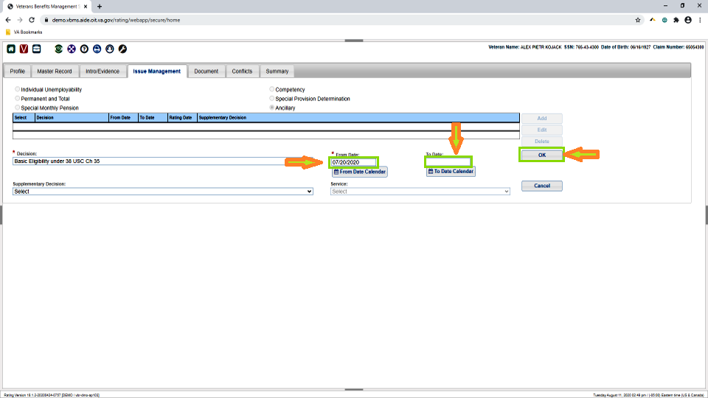
Enter a “From Date”. Enter a “To Date” if applicable. Then select “OK”

Slide 21
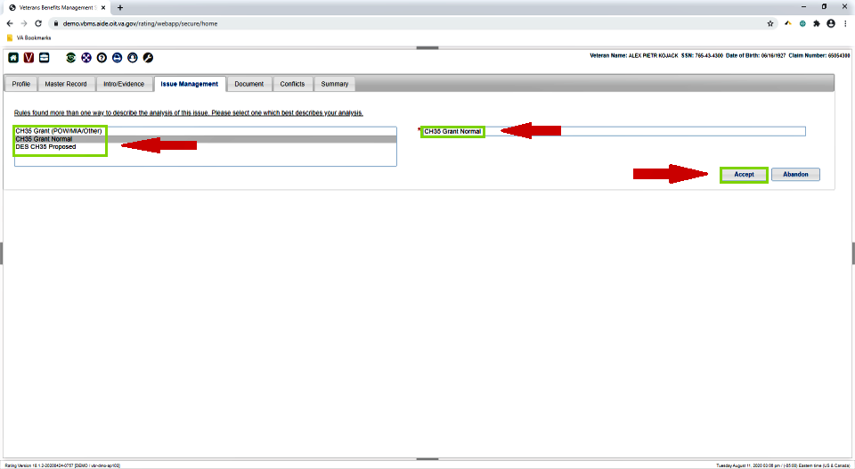
Select the appropriate descriptive reason for CH35 grant and then select “Accept”

Slide 22
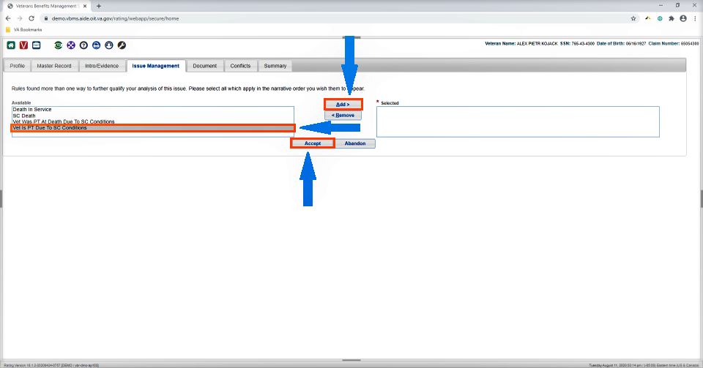
To further qualify your analysis select and add the available reason provided as you want them to appear in your narrative and select “Add”. Then click on “Accept”

Slide 23
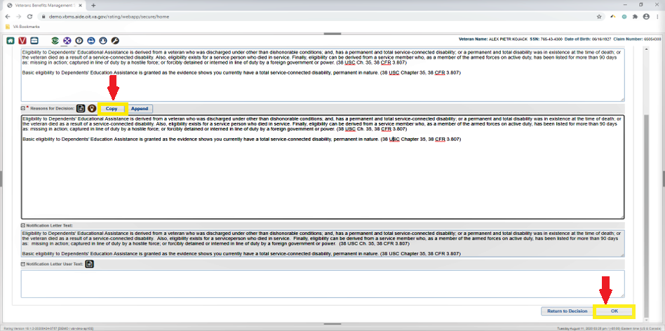
The required text to be included into the Veteran’s rating decision will appear. It remains the RVSR’s responsibility to review the “Reasons for Decision” for completeness and accuracy. Copy accepted narrative language to the Reasons for Decision section. Then click on “OK” located in bottom right-hand corner.

Slide 24
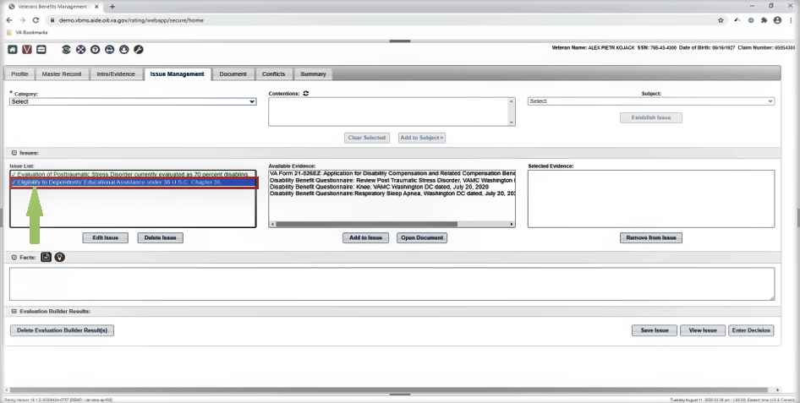
Your ancillary issue “Eligibility to Dependents Educational Assistance under 38 U.S.C. Chapter 35” has been created.

Slide 25
Knowledge Check
The instructor will ask questions based on the topics covered to this point to foster understanding and provide clarity to the information provided.

Slide 26
Topic 3: Tip Master Prompt for Special Monthly Compensation (SMC) Housebound (HB)
Overview of the Topic:
This topic will provide an overview of the Tip-Master prompt in VBMS-R and how it can ensure SMC HB is addressed in a rating decision.
Learning Objective for this topic:
Identify when to address SMC HB.
Identify when/when not to address other SMC entitlements.
Students expected level of understanding:
Identify what actions to take in a rating decision when Tip-Master prompts are generated.

Slide 27
Prompts for SMC Housebound (HB) Scenario 2
In the case where the RVSR has granted a Veteran a single issue at 100% and other service-connected issues add up to 60%, VBMS-R will prompt the RVSR after clicking on the “document tab” to review the rating decision for additional entitlements, specifically SMC HB entitlement. The following screen shots demonstrate the steps the RVSR is to take.

Slide 28
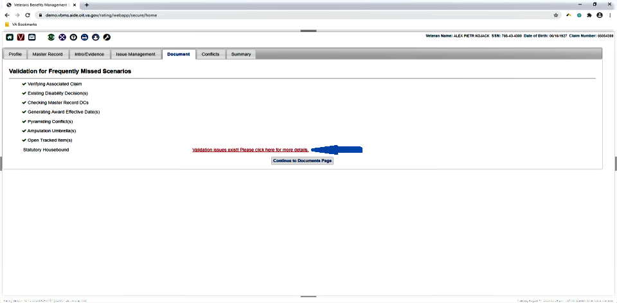
During the “Document” review phase, Tip-Master will prompt the RVSR to review the rating decision to address “statutory housebound”. The RVSR MUST click on the “red sentence” to further investigate whether a grant is warranted.

Slide 29
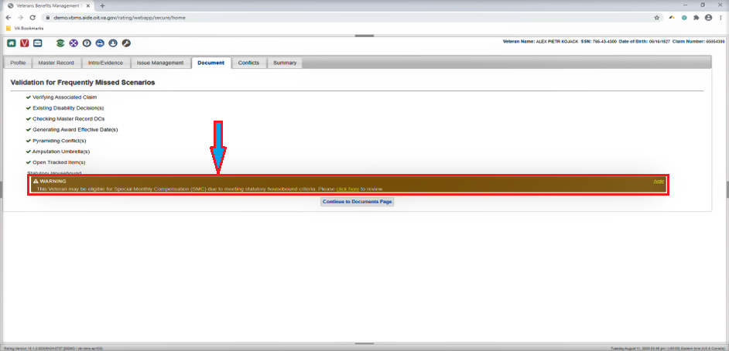
Follow the tip-master prompt by clicking the “Yellow hyperlink” (see arrow) failing to do this could result in a critical error for missing an issue the Veteran is entitled to.

Slide 30
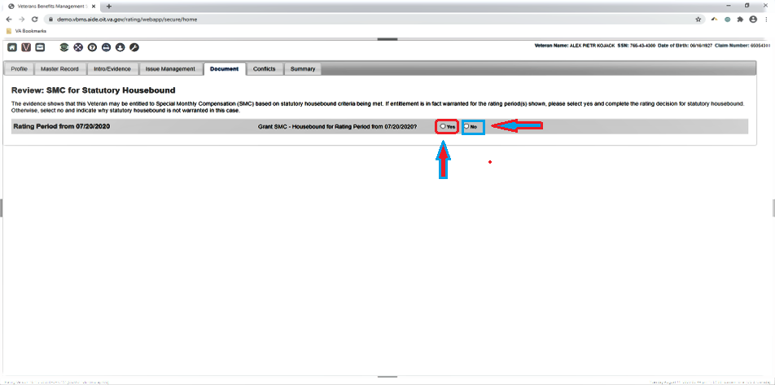
Next the RVSR must determine if the Tip-Master prompt is correct in indicating SMC Housebound criteria is met. If this entitlement is met click “YES” if not click “NO”.

Slide 31
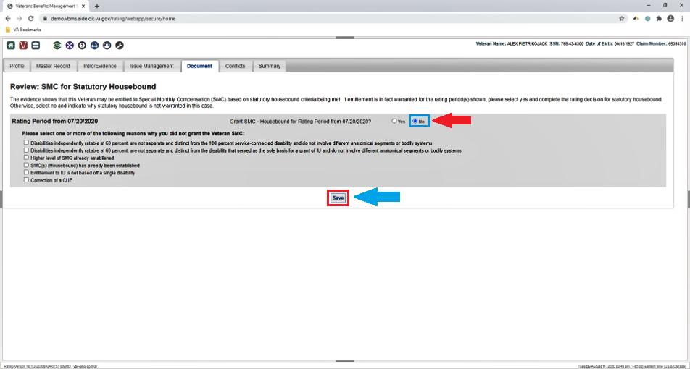
If you select “NO” you will be prompted to select one or more reasons as to why you did not grant SMC. You then will select “Save”

Slide 32
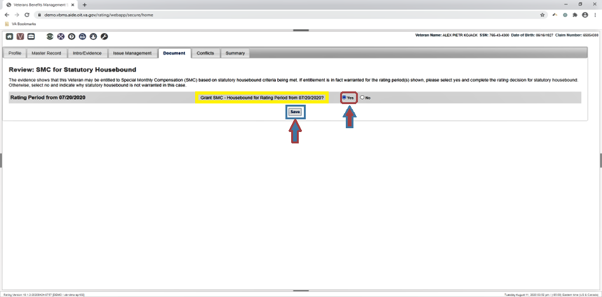
Selecting “YES” will prompt a statement asking if the RVSR wants to grant SMC Housebound for the rating period from XX/XX/XXXX (effective date). RVSR must select save. [See arrow]

Slide 33
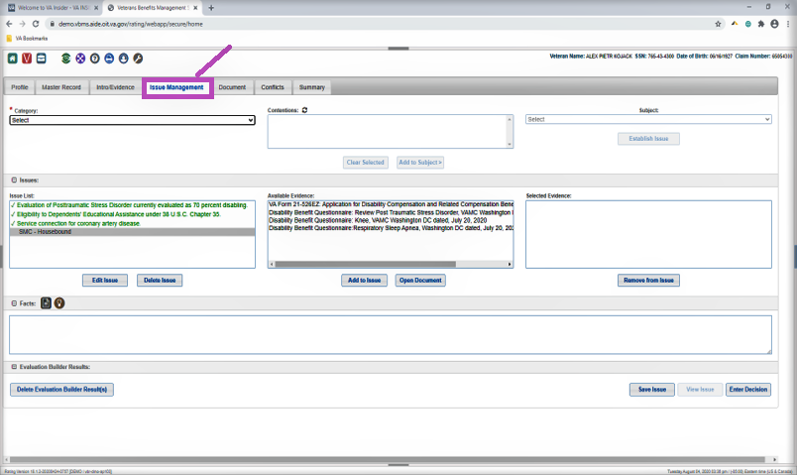
Once the Rater chooses “YES” and save you will be taken to VBMS “Issue Management” screen and the RVSR can now address SMC HB issue.

Slide 34
Knowledge Check
The instructor will ask questions based on the topics covered to this point to foster understanding and provide clarity to the information provided.

Slide 35
Review
Questions
Notes:
Questions?

