Slide 1
Rater Disability Evaluations and Pyramiding (Overview)
Compensation Service
September 2020

Slide 2
Agenda
Topic discussions
Knowledge checks
In-class discussion
Lesson Review/Wrap-up
End of course assessment
In TMS must achieve 80% to pass
Unlimited attempts to achieve a passing score
Open book (all resources can be utilized)

Slide 3
Introduction to Rater Disability Evaluations and Pyramiding

Slide 4
Purpose of Lesson
This lesson is intended to provide students with a general overview in the avoidance of pyramiding within a rating decision. This lesson will contain discussions and exercises that will allow you to gain a better understanding of:
How pyramiding is defined.
General pyramiding principles applicable to body systems.
Purpose of the VBMS-R Conflicts tab.

Slide 5
Motivation
Have you ever considered the prohibition against pyramiding; or, had difficulty understanding the regulations while evaluating various disabilities? Properly understanding 38 CFR 4.14, Avoidance of Pyramiding is imperative to ensure you provide accurate and consistent rating decisions while avoiding instances of pyramiding.

Slide 6
Lesson Objectives
In order to accomplish the purpose of this lesson, the RVSR, DRO, or RQRS will be required to accomplish the following lesson objectives.
The VSR, RVSR, or DRO will be able to:
Define pyramiding.
Identify the prohibition against pyramiding.
Recognize specific pyramiding principles and how they are applicable to each of the body systems.
Discuss how the Conflicts tab in VBMS R assists with preventing pyramiding.

Slide 7
References
38 CFR§4.14 - Avoidance of Pyramiding
38 CFR§4.55 - Principles of Combined Ratings for Muscle Injuries
38 CFR 4.56, Evaluation of Muscle Disabilities
38 CFR 3.73, Schedule of Ratings-Muscle Injuries
38 CFR§4.96 - Special Provisions Regarding Evaluation of Respiratory Conditions
38 CFR 4.97 - Respiratory System
38 CFR§4.113 - Coexisting Abdominal Conditions
38 CFR 4.114, Schedule of Ratings-Digestive System

Slide 8
References (cont.)
38 CFR 4.115, Nephritis
38 CFR 3.310(d), Traumatic Brain Injury
38 CFR 4.126, Evaluation of Disability from Mental Disorders
38 CFR 4.150, Dental and Oral Conditions
M21-1 Part III, Subpart iv, 4.A, Musculoskeletal Conditions
M21-1 Part III, Subpart iv, 4.C, Considering Impairments of Both Visual Acuity and Visual Field
M21-1 Part III, Subpart iv, 4.F, Respiratory Conditions
M21-1 Part III, Subpart iv, 4.L, Skin Conditions
M21-1 Part III, Subpart iv, 4.N, Neurological Conditions and Convulsive Disorders
M21-1 Part III, Subpart iv, 6.D, Sample Draft Codesheet, Amputation Rule

Slide 9
References (cont.)
M21-1, Part III, Subpart iv 6.C - Completing the Rating Decision Narrative
Decision Assessment Document (DAD), Esteban v. Brown, No. 92-693 - Pyramiding

Slide 10
Topic 1: Definition of Pyramiding (38 CFR 4.14)
This topic will allow the trainee to understand the prohibition against pyramiding.
Topic objectives:
Define pyramiding
Identify the prohibition against pyramiding
Recognize specific pyramiding principles and how they are applicable to each of the body systems

Slide 11
Pyramiding: Avoidance of Pyramiding (38 CFR 4.14)
Pyramiding is rating the same manifestations of a disability under two separate Diagnostic Codes (DCs).
Disability from injuries to the muscles, nerves, and joints of an extremity may overlap to a great extent, so that special rules are included in the appropriate bodily system for their evaluation.

Slide 12
Pyramiding: Avoidance of Pyramiding (cont.)
Reminder:
Disabilities may overlap to a great extent
Special rules included in the specific bodily system for their evaluation.
Don’t use manifestations not resulting from service-connected disease or injury in establishing the service-connected evaluation, and
The evaluation of the same manifestation under different diagnoses.

Slide 13
Pyramiding: Musculoskeletal Conditions
Degenerative Arthritis: Separate evaluations under diagnostic code 5003 with any other joint evaluation based on limitation of motion or painful motion, due to degenerative arthritis, is prohibited.
Forearm: Do not assign a compensable evaluation for both limitation of pronation and limitation of supination of the forearm in the same extremity.
Fibromyalgia: The criteria for the evaluation of fibromyalgia does not exclude assignment of separate evaluations when secondary disabilities are diagnosed. The same signs and symptoms; however, cannot be used to assign separate evaluations under different DCs.

Slide 14
Pyramiding: Musculoskeletal Conditions
IVDS: If the evaluation of IVDS is based on incapacitating episodes, a separate evaluation may not be assigned for limitation of motion, radiculopathy, or any other associated objective neurological abnormality.
Arthroplasty: Once joint replacement occurs, separate evaluations for range of motion and/or instability in the joint is prohibited.
Meniscus (semilunar cartilage): Do not assign separate evaluations for a meniscus disability (DC 5258/DC 5259) with limitation of motion in the same knee OR with subluxation/lateral instability.

Slide 15
Pyramiding: Musculoskeletal Conditions
Shin Splints: If the evaluation of shin splints is based on impairment of the knee and/or ankle joint, do not assign separate evaluations for shin splints and the applicable joint(s).
Ankle Instability: Separate evaluations for limitation of motion and instability of the ankle are prohibited.
Pes Planus/Plantar Fasciitis: When SC is established for both pes planus and plantar fasciitis, the symptoms of both symptoms are evaluated together under DC 5276 and cannot be separately evaluated.

Slide 16
Pyramiding: Musculoskeletal Conditions
Muscles: A separate evaluation cannot be assigned for each muscle within a single muscle group.
Muscles/Joints: 38 CFR 4.55, Principles of Combined Ratings for Muscle Injuries.
Muscles/Peripheral Nerves: A muscle injury and a peripheral nerve paralysis of the same body part, whether associated with the muscle injury OR originating from other etiologies, may not be rated separately unless entirely different functions are affected.

Slide 17
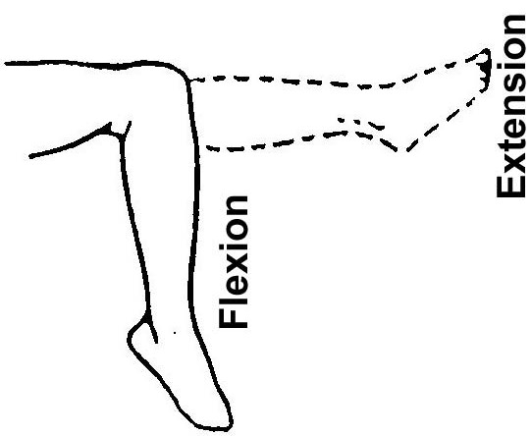
Points to Consider
Do those manifestations result in distinct functional impairments?

Slide 18
Knowledge Check

Slide 19
Pyramiding: Skin and Scars
Scars Associated with Muscle Injury: If there is scarring that results in functional loss under DC 7805 that is compensable, do not assign a separate evaluation if the body part affected and the functional impairment resulting from the scar are the same as the part and function affected by the muscle injury.
Alternative Rating Criteria: When evaluating skin conditions where the DC offers variable methods to evaluate the disability, assign only a single evaluation using the criteria that results in the higher rating. Do not assign separate evaluations.

Slide 20
Pyramiding: Multiple Skin Conditions
Percentage of Exposed Skin/Entire Body Affected: Multiple skin conditions may receive separate evaluations based on the percentage of exposed areas affected by each skin condition. If an examiner cannot provide separate percentages solely due to each skin condition, separate evaluations cannot be assigned using that criteria alone.
Medication Criteria: If the same medication is used to treat each skin condition, separate evaluations may not be assigned unless the separately evaluated condition uses alternative criteria to establish a disability evaluation.

Slide 21
Esteban v. Brown
Esteban claimed separate evaluations for painful scars, disfiguring scars and facial muscle damage with mastication difficulties.
Initially denied multiple evaluations.
The Court determined separate disability ratings are appropriate when a single injury results in distinct functional impairments.
Separate ratings for a single disability, when allowed by the rating schedule, are authorized unless there is overlapping symptomology.

Slide 22
Knowledge Check

Slide 23
Pyramiding: Organs of Special Sense
Vision: Separate evaluations cannot be assigned for impairments of both visual acuity and visual field defect. The evaluations must be evaluated together as a single disability.
Meniere’s Syndrome: Do not provide separate evaluations for hearing impairment, tinnitus, or vertigo with an evaluation of Meniere’s disease under DC 6205.

Slide 24
Pyramiding: Respiratory Conditions
Co-existing Respiratory Conditions: 38 CFR 4.96(a)
Ratings under DCs 6600-6817 and 6822-6847 cannot be separately evaluated.
Where there is lung or pleural involvement, ratings under DCs 6819 and 6820 cannot be separately evaluated from each other or the DCs noted above.
Single ratings are assigned under the diagnostic code which reflects the predominant disability with elevation to the next higher evaluation when the severity of the overall disability warrant such elevation.

Slide 25
Pyramiding: Respiratory Conditions (cont.)
GSW and Respiratory: Separate evaluations for restrictive lung disease due to gunshot wound and muscle group XXI cannot be assigned.
M21-1 III.iv.4.F., Evaluating Coexisting Respiratory Disabilities

Slide 26
Knowledge Check

Slide 27
Pyramiding: Cardiovascular
Hypertension: Evaluate hypertension due to aortic insufficiency or hyperthyroidism, as part of the condition causing it rather than by a separate evaluation.
Cardiovascular and Nephritis: 38 CFR 4.115 Separate ratings are not to be assigned for disability from disease of the heart (which includes hypertension) and any form of nephritis unless there is absence of a kidney or regular dialysis is required.
Cold Injury: Separately diagnosed residuals of cold injuries, such as Raynaud’s phenomenon, muscle atrophy, etc., cannot be assigned as separate evaluations if they are used to support an evaluation under DC 7122.

Slide 28
Pyramiding: Digestive
38 CFR 4.114: Evaluations of digestive conditions under certain DCs will not be combined with each other or assigned separate evaluations. Instead, a single evaluation should be assigned under the DC which reflects the predominant disability, with elevation to the next higher evaluation when the severity of the overall disability warrants such elevation.
Separate evaluations are prohibited for digestive conditions under the following 38 CFR 4.114 DCs:
7301 to 7329, inclusive (meaning all the DCs from 7301 to 7329)
7331
7342, and
7345 to 7348, inclusive (meaning all the DCs from 7345 to 7348)

Slide 29
Pyramiding: Endocrine
Diabetic Complications:
Evaluate compensable complications of diabetes mellitus separately unless they are a part of the criteria used to support a 100-percent evaluation under DC 7913.
Non-compensable complications of diabetes mellitus are considered part of the diabetic process under DC 7913.
Hyperthyroidism: Symptoms of hyperthyroidism used to support the evaluation of other DCs; or, granted as separate disabilities, cannot be used to support an evaluation under DC 7900.
M21-1.III.iv.4.M., Evaluating Thyroid Disabilities After the Initial Diagnosis

Slide 30
Pyramiding: Traumatic Brain Injury
Multiple Evaluations: In addition to the evaluation for TBI manifestations under DC 8045, separate evaluations of comorbid mental, neurologic, or other physical disorder can be assigned unless the manifestation was used to assign an evaluation under DC 8045.
TBI and Vertigo: A separate evaluation of vertigo cannot be assigned. Vertigo is a subjective symptom that is already considered in the facets of TBI criteria.

Slide 31
Pyramiding: Traumatic Brain Injury
TBI and Mental Disorder: Sufficiently clear and unequivocal medical opinion evidence must be present to determine whether TBI and a mental disorder are distinct and can be separately evaluated.
38 CFR 3.310(d) established five conditions held to be secondary to TBI dependent on the initial severity of the TBI and the period between the injury and onset of the secondary illness. Avoid pyramiding when considering the initial TBI evaluation and symptoms that are now associated with the five secondary conditions.

Slide 32
Pyramiding: Peripheral Nerves
Upper Extremities: Separate evaluations may not be assigned for disability affecting multiple nerve branches of the same upper extremity.
Lower Extremities: Separate evaluations for disability affecting lower extremity nerves are warranted when symptoms arise from any of the five individual nerve branches.
Note: If symptoms arise from within the same nerve branch of any of the five individual nerve branches in the lower extremity, assigning separate evaluation for those symptoms would constitute pyramiding.

Slide 33
Knowledge Check

Slide 34
Pyramiding: ALS/MS
Amyotrophic Lateral Sclerosis (ALS): If a single 100 percent evaluation is warranted for a complication of ALS, assign a 100 percent for that complication and separately evaluate additional complications. Do not assign a separate evaluation under DC 8017; however, as this would constitute pyramiding.
Multiple Sclerosis (MS): Residuals of MS are evaluated separately when the combined evaluation for the residuals are 30 percent or greater. When residuals are separately evaluated, the minimum evaluation under DC 8018 may not be concurrently assigned.

Slide 35
Pyramiding: Mental
Physical/Mental Disorders: When a single disability has been diagnosed both as a physical condition and as a mental disorder, the rating agency shall evaluate it using a DC which represents the dominant (more disabling) aspect of the condition.
Important: To warrant separate evaluations, the symptoms considered must be distinct and not overlap.

Slide 36
Pyramiding: Dental and Oral Conditions
Inter-Incisal Motion: In assigning an evaluation for TMJ or any other dental disability based on limited motion of temporomandibular articulation under DC 9905, do not assign separate evaluations for limited inter-incisal motion involving each side of the jaw.
If both sides of the jaw are affected, use the limitation of motion on the side that affords the highest evaluation.

Slide 37
Knowledge Check

Slide 38
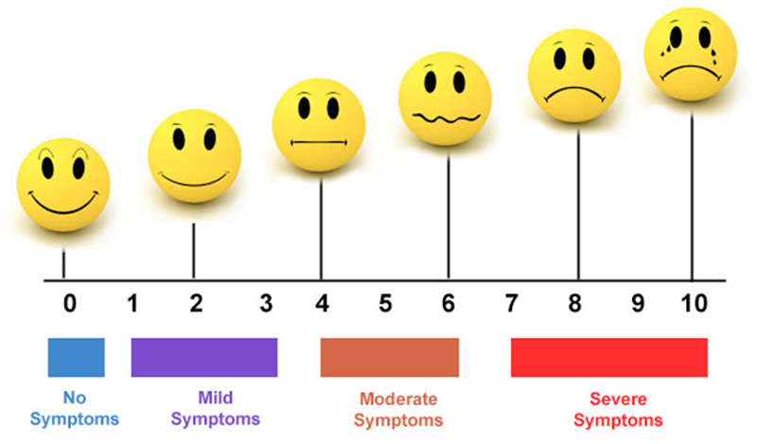
Points to Consider
What are the objective manifestations shown by medical evidence?

Slide 39
Points to Consider
What diagnostic codes in the rating schedule most accurately reflect the objective manifestations?
5260?
5257?
5261?
7331?
7342?
5243?
5242?

Slide 40
Points to Consider
Are the manifestations of the disability covered under one diagnostic code that is duplicative or overlapping of manifestations covered under another diagnostic code?

Slide 41
Remember
Some sections of the code are specifically written to address potential pyramiding.

Slide 42
Topic 2: Review of VBMS R Conflicts Tab
The lesson informs trainees that the Conflicts tab in VBMS R is programmed to assist with identifying and resolving pyramiding issues. When this warning message is flashing it is important for the RVSR to further investigate this issue to ensure a pyramiding situation does not exist.
Topic objectives:
Discuss how the Conflicts tab in VBMS R assists with preventing Pyramiding
The following topic teaching points support the topic objectives:
Review of VBMS R Conflicts tab

Slide 43
Review of VBMS R Conflicts Tab
Some sections of the code are specifically written to address potential pyramiding.

Slide 44
VBMS-R Conflicts Tab

Slide 45
VBMS-R Conflicts Tab

Slide 46
VBMS-R Conflicts Tab

Slide 47
Remember: Pyramiding is:
Pyramiding is rating the same manifestations of a disability under two separate DCs.
Disability from injuries to the muscles, nerves, and joints of an extremity may overlap to a great extent so that special rules are included in the appropriate bodily system for their evaluation.

Slide 48
Knowledge Check Discussion
The following questions are designed to determine if you can recall the topics just discussed:
As you navigate through the VBMS-R Conflicts tab ensure you ask questions of students to determine their understanding of the process. Pose questions and what if scenarios to illicit critical thinking.

Slide 49
Review
Questions

