Slide 1
Exam Liaison Call
Medical Disability Examination Program Office (217)
Briefed by: Medical Disability Examination Program Office Staff
Date: September 10, 2020
Notes:
Ken

Slide 2
Agenda
Regional Chat groups in MS Teams
TMS Number for Exam Liaison Call – August 4557528
Use of the ERRA Tool
VHA Cancellation Comments
VBA In-person Exams
Allowable Mileage
Vendor Cancellation of Appointments
Medical Opinions
Index of DBQ’s/Exams by Disability
Required Info for BDD/IDES ESR’s
Release from Active Duty (RAD) Date
GenMed or SHA
Reminders
Contract Exam Resources
Notes:
Ken

Slide 3
Regional Chat Groups
You will receive an invitation in MS Teams to a Regional EMS Chat Group based on Regional Office (RO) location
Additional Resource for RO Exam Liaisons to discuss or ask questions about topics such as:
Exam Management Systems issues or outages
Vendor portal questions
General scheduling questions
Generalized vendor concerns
Training questions regarding Exam Management System (EMS)
Questions concerning guidance released by the Medical Disability Examination Program Office (MDEPO)
Notes:
Tim

Slide 4
TMS Number for EL Call
TMS number 4557528 has been assigned to the August EL call.
A recording of the call, slide deck and attachments are now available
Questions typed into the chat box will be shown along with the answer that was provided
Going forward we will delete the names from the chat box questions prior to posting
Will be available during the week following the call
This is not considered mandatory training
An Exam Liaison resource site can be found here:
Exam Liaison Resource
Notes:
Tim

Slide 5
ERRA Tool
ERRA reflects VHA facilities that are doing ACE and Tele C&P exams only
100 VHA locations across all VISN’s supporting C&P
VHA has not yet officially resumed in-person C&P examinations at this time
All eligible exams should be sent to VHA unless specifically excluded from ACE/Tele C&P process
If the necessary DBQ is showing as disabled at the closest VAMC send the request to MDE Vendors
VHA will cancel the request if they determine an in-person exam is required, must be re-requested with a vendor
ALL BDD/IDES exams must be request through EMS
ERRA use not applicable to BDD/IDES only
ERRA Tool
Notes:
Tim

Slide 6
VBA In-Person Exams
99% of vendor locations now scheduling in-person exams
Specific requirements must be met prior to in-person exams taking place
Exams requiring the removal of PPE by Veterans/Service members or examiners now permissible in all 50 states, 20 OCONUS locations, and 121 military treatment facilities as of 9/03/20
Notes:
Tim

Slide 7
VBA In-person Exams (cont’d)
https://benefits.va.gov/compensation/claimexam.asp
Notes:
Tim

Slide 8
Allowable Mileage for Contract Examinations
Veterans/Service members can be scheduled to travel up to 50 miles for general examinations and up to 100 miles one way for a specialty examination
Veteran must agree to travel any distances in excess of 50/100
Vendors are again allowed to schedule exams in excess of 50/100, with Veteran consent
Notes:
Linsay

Slide 9
Vendor Cancellation of Appointments
If a Veteran refuses to attend an in-person examination due to COVID19 concerns, or fails to report to an in-person exam, Tele C&P exam, or ACE phone call, the Vendor will:
Cancel the scheduled appointment
Cite “Veteran concerns/risks associated with pandemic”
Hold ESR until Veteran can be scheduled and appointment completed
Vendor will not send a request to cancel the ESR
Notes:
Linsay

Slide 10
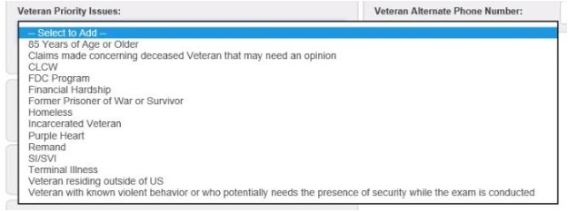
Veteran Priority Issues
You must select the applicable Veteran Priority Issue from the Claim Information tab in EMS when submitting an exam request
The following claim types that require priority processing will be available in VBMS-EMS effective September 14.
Former Prisoner of War or Survivor
85 Years of Age or Older
FDC Program
Terminal Illness
Financial Hardship
SI/VSI
Notes:
Linsay

Slide 11
Medical Opinions
If a medical opinion is required, you must select the correct specialty language needed within the contention
Specialty Language and Medical Opinion DBQ must accompany exam requests that require a Medical Opinion,
If omitted on the original Exam Scheduling Request (ESR), the ESR will have to be cancelled and a new one entered
Notes:
Chris

Slide 12
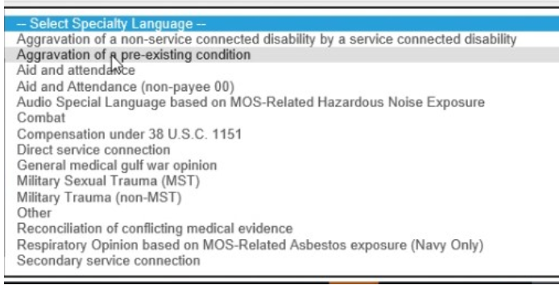
Medical Opinions (cont’d)
Notes:
Chris

Slide 13
Index of DBQ’s/Exams by Disability
Intranet Index of DBQs/Exams by Disability updated August 14, 2020
Consolidated 2041 items to 655 items
Each diagnostic code/disability has a corresponding DBQ
Updated DBQ Names
Removed CAPRI and Legacy tabs
Added Historical DX code column
Added Notes column
Example:
Example:
Intranet link: Index of DBQ/Exams by Disability
Notes:
Christia

Slide 14
Required Info for BDD/IDES ESR’s
Many BDD/IDES ESR’s are being requested without required information.
This results in Clarification Requests that slow the scheduling and completion of exams
The following are required for BDD/IDES ESR’s
Release from Active Duty date (RAD)
Correct DBQ request (General Medical or Separation Health Assessment)
Notes:
Dan

Slide 15
Release from Active Duty (RAD) Date
The vendor can not process the ESR without a RAD date
Ensure there is a RAD date, even if it is a date in the future, for the current period of service prior to inputting an examination request
In order for a claim to be accepted as a BDD claim, the RAD date must be known. (M21-1III.i.2.A.1.d Qualifying for Claim Processing Under the BDD Program)
Claims processors are responsible for ensuring that any unverified period of active duty is entered into VBMS as soon as VA is notified of the (unverified) period of active duty. The service will be marked as verified after VA receives all information required to verify military service
Each RO employee must check to ensure all periods of active service are updated and verified in VBMS when undertaking any claim action. (M21-1 III.ii.3.C.7.a Military Service Verification)
No ESR’s, except IDES, should have a missing RAD date
Notes:
Dan

Slide 16
GenMed or SHA
Ensuring the correct type of “General Medical” examination is selected will reduce delays in the claims processing and Clarification Requests
Veterans within 1 year of discharge should receive a General Medical (GenMed) examination which is the “DBQ General Medical-Compensation” selection
Service Members filing a BDD or IDES claim must undergo a Separation Health Assessment (SHA) which is the “DBQ-Separation Health Assessment” selection
“BDD Excluded” claims require the selection of the “GenMed” DBQ, do not request a SHA
Notes:
Dan

Slide 17
Reminders
All contentions requiring an examination should be requested at the same time and with the same vendor
If additional exams need to be requested after the original ESR is submitted, ensure the new ESR goes to the same vendor
If vendors reach out directly to the RO with requests to change or cancel ESR’s, please contact the MDEPO office
Vendor should only be communicating via Clarification Requests
If a Rework is required but you are unable to create the Rework ESR, please email the MDEPO mailbox
Any communication with the vendors, including Clarification Responses should remain professional
Inappropriate responses will be forwarded to RO leadership
Claims processors must check the “Remand” button in EMS to ensure all AMA Board remands are properly identified and routed
Notes:
Chris

Slide 18
Contract Exam Resources
Your VA Claim Exam
VA claim (C&p) exam
Exam FAQ’s
Mandatory Contract Exam Staff FAQS
COVID-19 Information Page
Novel Coronavirus Disease (COVID-19) Operational Information Page
VBMS EMS
VBMS EMS Information
Decision Tree for Examination Clarification and Correction
Contract Exam Inquiries
Contract Exam Inquiry Protocol Job Aid
Notes:
Ken

Slide 19
Questions
Notes:
Team

