Slide 1
August 19, 2020
BWN Trend Analysis and
Quality Feedback

Slide 2
Objective
Review quality for Blue Water Navy reviews for March, April and May 2020
Review high error categories for Blue Water Navy cases
Review Ship Locator Tool

Slide 3
BWN Issue Based Quality March, April and May 2020 Review
Vanessa Carr
Rating Quality Consultant

Slide 4
BWN Issue-Based Quality Cumulative March, April and May 2020
All-station overall IB quality 83.4%
General rating errors, not specific to the new BWN law
All-station BWN-specific IB quality 95.0%
Errors specific to the new BWN law and procedures

Slide 5
BWN Issue-Based Quality March 2020
All-station overall IB quality 86.6%
General rating errors, not specific to the new BWN law
All-station BWN-specific IB quality 98.1%
Errors specific to the new BWN law and procedures

Slide 6
BWN Issue-Based Quality April 2020
All-station overall IB quality 81.2%
General rating errors, not specific to the new BWN law
All-station BWN-specific IB quality 91.9%
Errors specific to the new BWN law and procedures

Slide 7
BWN Issue-Based Quality May 2020
All-station overall IB quality 82.7%
General rating errors, not specific to the new BWN law
All-station BWN-specific IB quality 95.5%
Errors specific to the new BWN law and procedures

Slide 8
Review of High Error Category Examples
Terri Swann
Rating Quality Consultant

Slide 9
Highest Error Categories
B2 – Development deficiencies
Inadequate verification of qualifying BWN service
Insufficient examinations
D1 – Incorrect effective dates
Misapplication of 38 CFR 3.114
Misapplication of retroactive effective date under PL 116-23

Slide 10
Misapplication of 38 CFR 3.114
The Veteran reported a history of coronary artery disease (CAD) from 1980 with stents placed in 2001. A diagnosis is first shown in the records from 2018, which is after, August 31, 2010, the date CAD was added to the presumptive list based on exposure to herbicides. Therefore, liberalizing legislation under 38 CFR 3.114 does not apply in this case. 38 CFR 3.400(B)(2)
CAD was added as a presumptive condition on August 31, 2010 and if medical records had shown an actual diagnosis (not a history) on or before that date, then 38 CFR 3.114 would apply.

Slide 11
Misapplication of 38 CFR 3.114
A review of the file shows the Veteran submitted medical evidence with his original claim received November 13, 2009 showing he was diagnosed with diabetes mellitus type II (DMII) prior to, May 8, 2001, the date of the liberalizing law. Therefore, an effective date one year prior to November 13, 2009 warranted. 38 CFR 3.114 (a)
DM II was added as a presumptive condition on May 8, 2001 and medical records confirm the diagnosis prior to that date.

Slide 12
Misapplication of 38 CFR 3.114
Reminders
Medical evidence must verify a diagnosis of the condition prior to the date of the law change for 38 CFR 3.114 to apply. A history alone is not sufficient.
It is important to review all medical records, not just the examination, for evidence confirming the date of diagnosis.

Slide 13
Misapplication of PL 116-23
The Veteran submitted his initial claim for prostate cancer on November 18, 2008. However, the rating decision dated August 29, 2009 denied entitlement to service connection because the Veteran failed to provide medical evidence showing his prostate cancer was diagnosed. Since this was the basis for the original denial a retroactive effective date is not warranted. SOP Version 9 Page 33
A retroactive effective date may not be assigned if the claim was denied for a reason other than or in addition to a lack of evidence that the disease was incurred or aggravated by service.

Slide 14
Misapplication of PL 116-23
Reminders
Medical evidence confirming a diagnosis must have been in the file at the time of the previous denial in order to assign a retroactive effective date.
The previously denied claim must be thoroughly reviewed to determine the reason for denial. Simply reading the rating narrative is not sufficient, as this may not be accurate.

Slide 15
Insufficient Examinations
The Veteran submitted a claim for lung cancer. The treatment records from Dr. Ernani notes the Veteran had no recurrence of disease as of May 20, 2019. A subsequent VA examination dated December 20, 2019, which noted review of these records, indicated the cancer is active. However, there is no additional testing or evidence to support this finding. The examination findings conflicted with treatment records reviewed, so the examination should be returned for clarification regarding whether or not the lung cancer remains active. M21-1 III.iv.3.D.3.c.
The examiner’s conclusions must be consistent with other evidence of record. If not, clarification must be obtained.

Slide 16
Insufficient Examinations
Amputation DBQ notes a history of right below the knee amputation and left trans metatarsal amputation. The examiner checked the box indicating the presence of a scar but did not identify the location. The examiner noted he was unable to measure the scar due to the fact it was a telehealth exam. It is unclear if the scar is on the left lower extremity or the right lower extremity, as both extremities have had amputations. The exam should have been returned for the examiner to state the site of the scar. This should be discernible even with a telehealth exam. M21-1 III.iv.3.D.3.a
Incomplete exams should be returned for completion.

Slide 17
Insufficient Examinations
Reminders
Examinations should be reviewed for completeness prior to taking rating action.
Examination findings must be consistent with other medical evidence of record or must be returned for clarification.

Slide 18
Insufficient BWN Service Verification
The documents in the file do not support the finding on the memo. A printout of the ship locator tool shows a ship in the qualifying waters, but this printout does not provide the name of the ship or the date the ship was in the qualifying waters. A printout of deck log availability for the USS Kitty Hawk shows BWN service in November of 1965 and February of 1967. The Veteran entered active duty in December of 1967 and was not on board the USS Kitty Hawk at those times. Additional development is required to verify qualifying BWN service.
BWN Centralized Processing SOP Version 9 “Overview of Exposure Verification Procedures”
Documentation must show the dates the ship was in qualifying waters and that the Veteran was on board the ship during that time.

Slide 19
Ship Locator Tool Overview
Dylan Dubbs
Records Research Team

Slide 20
Objectives
Develop a comprehensive understanding how the Ship Locator Tool (SLT) specialist and/or RRT verifies information inputted into the SLT
Discuss the SLT’s four functions and how they are utilized when making an eligibility determination following the BWN SOP

Slide 21
References
M21-1 Part IV.ii.1.H.1, Developing Claims for Service Connection on Herbicide Exposure
Public Law (PL) 116-23
38 CFR 3.309 (e)
Blue Water Navy Centralized Processing Standard Operating Procedure (SOP) Version 9, June 5, 2020
Records Research Team Standard Operating Procedure (SOP) Version 6, April 20, 2020

Slide 22
SLT Data Input Determinations
Determining the Veterans’ dates of assignments/dates aboard ships during the AO presumptive period from January 9, 1962 to May 7, 1975
Enlisted personnel records
Officer personnel records
Abstract of Service and Medical History
DD Form 214 and other service personnel records considerations

Slide 23
Enlisted Veterans’ Data Considerations
Enlisted Veterans assignments are generally located “Transfers and Receipts” documents found in the Veterans’ service personnel records and typically includes the following information:
Current assignment location
The new location (Ship/Squadron/Military Base) that the servicemember is going to be transferred to
The date of the transfer
The date the servicemember reported to the new location
Temporary assignments
For Future Transfer (FFT) assignments/dates (ie, Naval Station in Subic Bay FFT USS Midway)
Personnel records also contain records of the Veteran’s leave & absence which also needs to be considered
If attached to Squadron, need to research the Dictionary of American Naval Aviation Squadrons Volume 1 and 2
DD Form 214 awards sometimes list specific naval operations (ie Operation Frequent Wind/Operation Eagle Pull)

Slide 24
Commissioned Officer Data Considerations
Commissioned Officer Veterans (sometimes Petty Officers) assignments are generally located on “Report of Fitness of Officers” documents found in the Veterans’ service personnel records and typically includes the following information:
Current assignment location/station
Date the Veteran reported to respective station
Time period of the report
Primary Duties
Name/location of Station/Ship
Performance narrative (sometimes can be very useful as they sometimes include information on TDYs)
Personnel records also contain records of the Veteran’s leave & absence which also needs to be considered
If attached to Squadron, need to research the Dictionary of American Naval Aviation Squadrons Volume 1 and 2
DD Form 214 awards sometimes list specific naval operations

Slide 25
Transfers and Receipts example

Slide 26
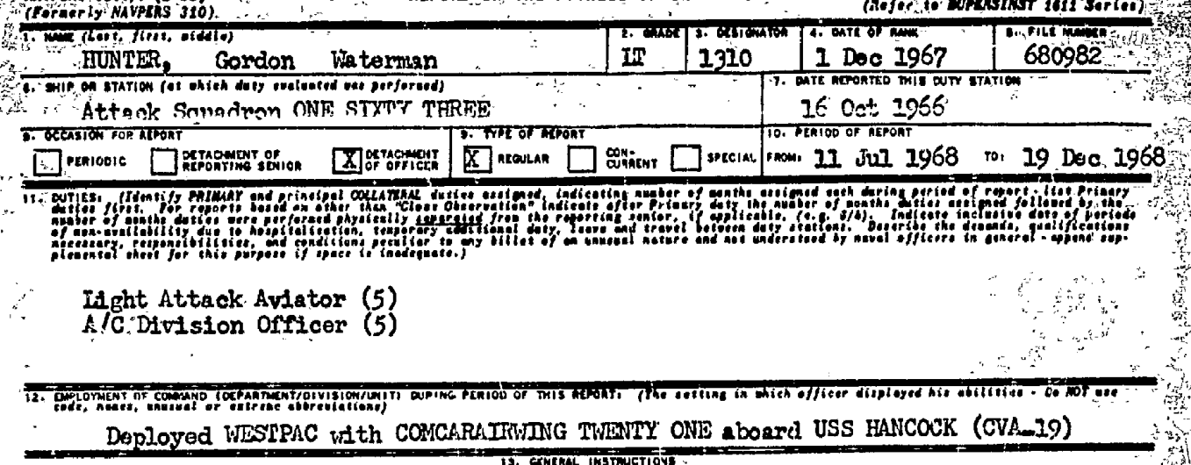
Report on the Fitness of Officers example

Slide 27
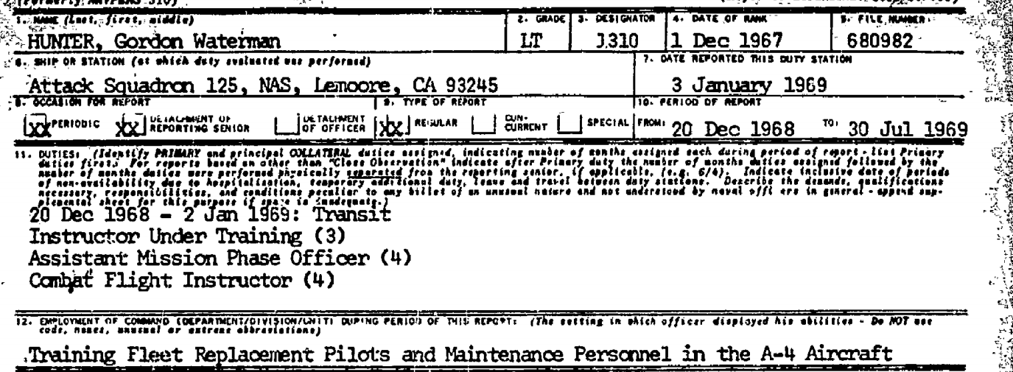
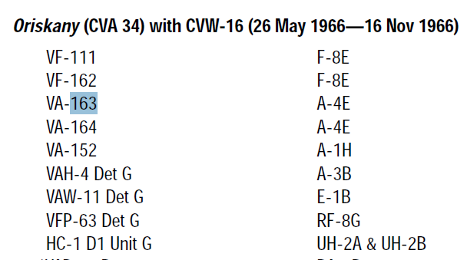
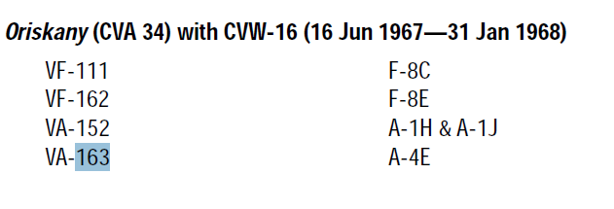
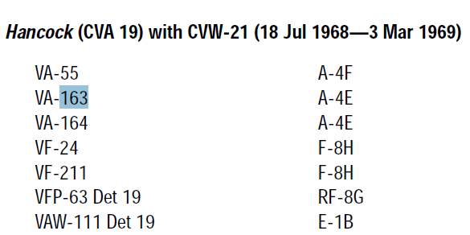
Report on the Fitness of Officers example (continued)

Slide 28
Report on the Fitness of Officers Analysis
Based on the Fitness of Officers example and information contained in the Dictionary of American Naval Aviation Squadrons, the following SLT inputs can be derived from the documents :
While Veteran was attached to Attack Squadron 163 from October 16, 1967 to December 19, 1969, he had the following confirmed nautical service:
USS Oriskany CVA 34: aboard October 16, 1966 to November 16, 1966
USS Oriskany CVA 34: aboard June 16, 1967 to January 31, 1968
USS Hancock CVA 19: aboard July 18, 1968 until December 19, 1968

Slide 29
Required VBMS Uploads
When the SLT places a navy vessel within inland waterways only, or in eligible offshore waters, including bays or harbors, page 14 of the current BWN Centralized Processing SOP requires the use of the SLT to generate the following for upload:
Bulk Print Deck Logs report for the date range used to concede exposure
Deck Log Report Tab results using the same date range as the deck logs uploaded
Screenshot of the Ship Location Map
When the SLT shows navy vessel operated in ineligible offshore waters page 14 of the current BWN Centralized Processing SOP requires the use of the SLT to generate the following for upload:
Deck Log Availability tab results for all vessels and time periods, and
Screenshot of Ship Location Map results for all vessels and time periods

Slide 30
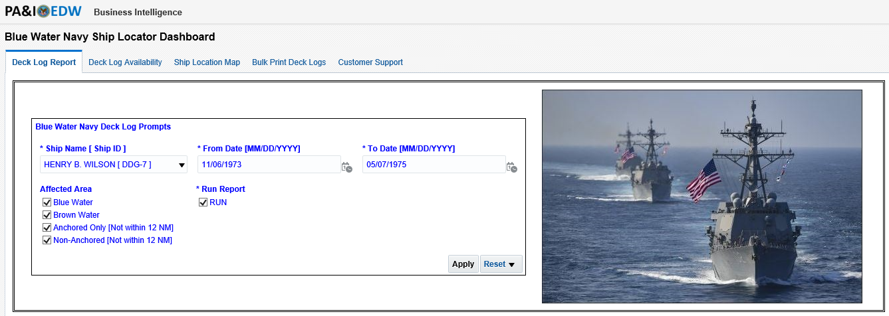
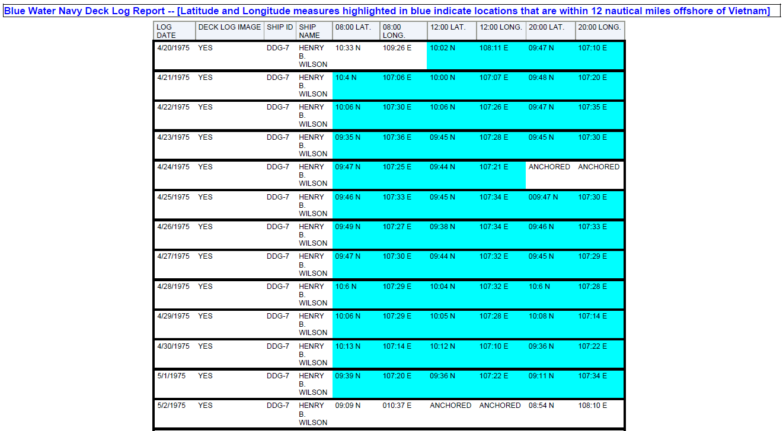
Ship Locator Tool Overview
The Deck Log Report generates a spreadsheet listings the date, ship, and the three daily coordinates

Slide 31
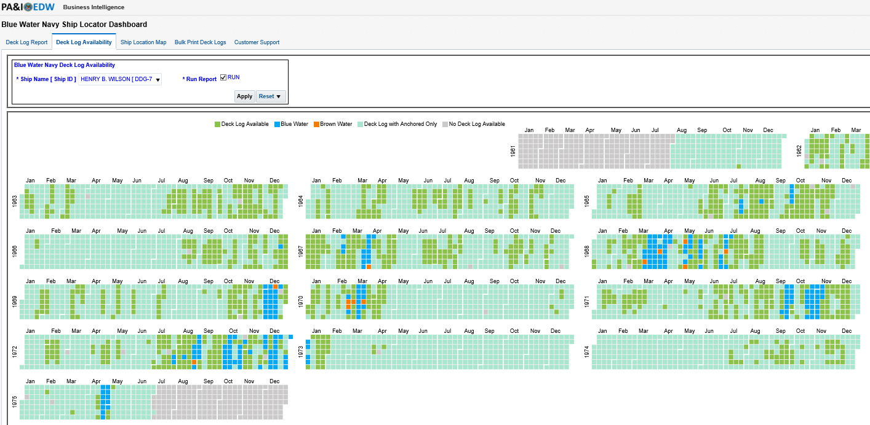
Ship Locator Tool Overview
Deck Log Availability tab results are required to be uploaded when there are no eligible water shown while Veteran was aboard
This is usually the first function that a SLT specialist and RRT refer to within the tool because the color-coded legend (when accurate) gives an overall view/general information regarding the ship’s service

Slide 32
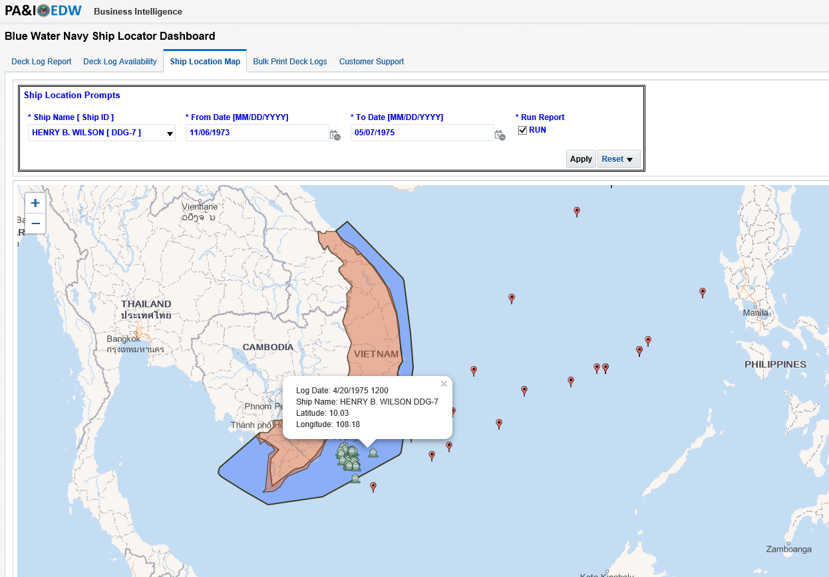
Ship Locator Tool Overview
The Ship Locator Tool’s Ship Location Map is uploaded whenever there is nautical service during the Vietnam war era, currently this map does not show when the ship(s) have service in an approved bay or harbor

Slide 33
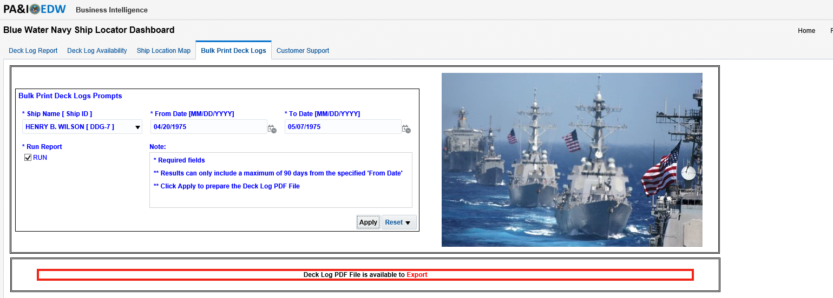
Ship Locator Tool Overview
This function allows SLTs and RRT to print deck logs in bulk up to 90 days depending of size/format of decklogs and when eligible/inland waters are shown, it is required to upload deck logs for the date range used to concede exposure
If not, eligible waters are shown after a negative Records Resource Center (formally JSRRC) the RRT SOP requires:
Upload of all deck logs using this tab for the vessel(s) and date(s) associated with the Veteran’s nautical service

Slide 34
Questions?

