Slide 1
For TMS Training Credit
To obtain training credit in TMS, there is no need to review these slides at this time – immediately close this box by using your mouse to select the “X” in the upper right-hand corner; select “Return to Content Structure” button; and, select the next link (Video) to view the audio recording of the Quality Call along with the Quality Call Bulletin
These slides are included here only in case you want to use them later for training purposes or reference
These are the exact same slides that are shown in the audio recording

Slide 2
Compensation Service Quality Call
August 2020

Slide 3
Welcome to the August 2020 Compensation Service Quality Call
Robert Johnson
Senior Quality Review Specialist
Quality Review Team, Quality Assurance

Slide 4
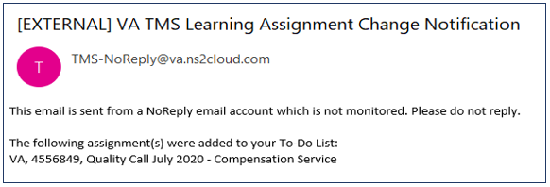
Quality Calls Assigned In TMS
Quality Calls are centrally assigned in TMS to all claims processors
Contain topical & relevant information regarding all aspects of claims processing
For best practice, the TMS Quality Call item should be completed within a week of assignment
Please contact your Local Training Manager if you have not received a ‘VA TMS Learning Assignment Change Notification’ email showing the Quality Call has been added to your To-Do List

Slide 5
Agenda
Update: BVA & Reasonably Raised Claims for Individual Unemployability (IU)
Veterans Appeals Improvement and Modernization Act of 2017 (AMA)
Adding Too Many Laws & Regulations
Missing Law AMA IQR Errors in Confirmed & Continued Evaluations
Prescribed, Schedular Minimum Evaluations
Request for Application (RFA) Site Visit Findings
Separation/Severance Pay Evidence
Acceptable Clinical Evidence (ACE) Examinations
Automated Hospitalization Reports

Slide 6
Update: BVA & Reasonably Raised Claim for IU
Robert Johnson
Senior Quality Review Specialist
Quality Review Team, Quality Assurance

Slide 7
Update: BVA & Reasonably Raised Claim for IU
Previous guidance released via February 2020 Quality Call
That information is no longer valid
Manual recently updated in M21-5
July 31, 2020
If not already of record, develop for VA Form 21-8940 when BVA grants IU
If Veteran fails to respond, implement BVA’s decision using evidence of record
M21-5, 7.G.1.i

Slide 8
Veterans Appeals Improvement and Modernization Act of 2017 (AMA) Laws and Regulations
Robert Johnson
Senior Quality Review Specialist
Quality Review Team, Quality Assurance

Slide 9
Adding Too Many Laws/Regs
Some decision makers are adding too many laws/regs to “protect” themselves from errors on missing relevant AMA laws/regs
Such action is not within the spirit of codified law at 38 CFR 3.103(f)(3)
Improper addition of too many laws/regs:
Important to cite only the laws/regs that are applicable to the decision
Compensation Service is monitoring these types of cases to determine if such action should warrant a critical error

Slide 10
Adding Too Many Laws/Regs (Cont’d)
Reminders
Decision makers should continue to use the Evaluation Builder and canned text in VBMS-R as most generated text within the system already includes the applicable law and/or regulation
To assist with this process, decision makers should refer to the VA Schedule for Rating Disabilities, other available regulations on eCFR.gov, the Applicable Laws and Regulations - Citations (DOC) guide, as well as the AMA training materials

Slide 11
Missing Law AMA IQR Errors in Confirmed & Continued Evaluations
Jennifer Monville
Rating Quality Review Specialist
Quality Review Team, Nashville VA Regional Office

Slide 12
Missing Law AMA IQR Errors in Confirmed & Continued (C&C) Evaluations
38 CFR 3.103(f)(3) requires that the notification (rating) provide the Veteran with “A summary of the laws and regulations applicable to the claim”
VBMS-R and the Evaluation Builder populate numeric laws/regulations for most situations, if used properly
May 2020 Quality Call included a Q-Tip to help avoid these errors
Ongoing missing law AMA errors persist, especially on C&C evaluations
A reason for missing VASRD (rating criteria regulation) has been identified

Slide 13
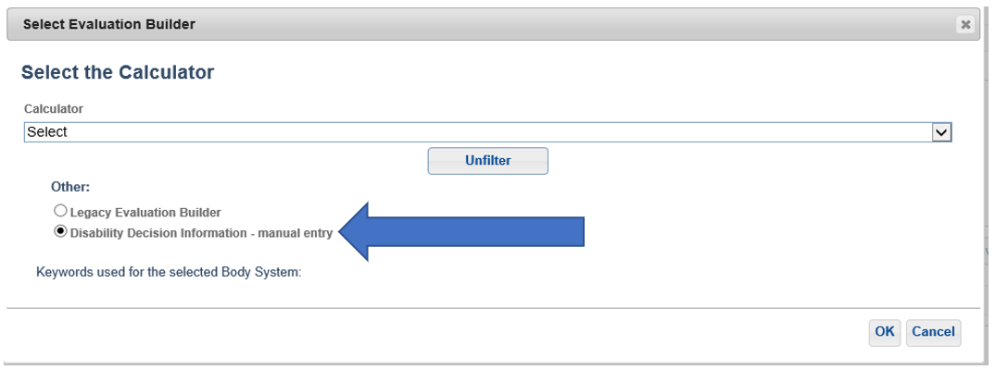
VBMS-R DDI – Manual Entry
If the user chooses ‘Disability Decision Information (DDI)-manual entry’ to bypass the Evaluation Builder, the VASRD may not populate or be incorrect

Slide 14
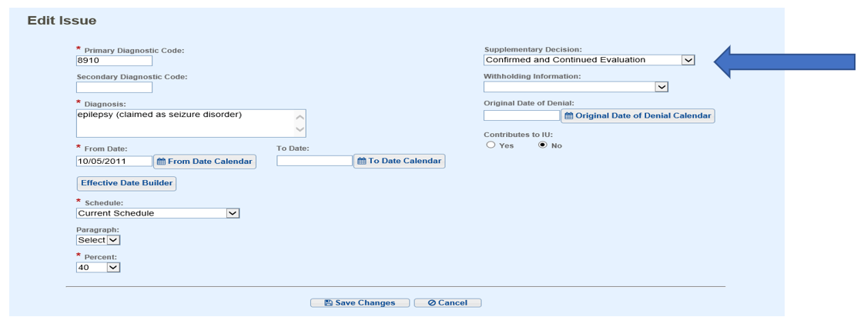
VBMS-R Confirmed and Continued Evaluation
If the user selects ‘Confirmed and Continued Evaluation,’

Slide 15
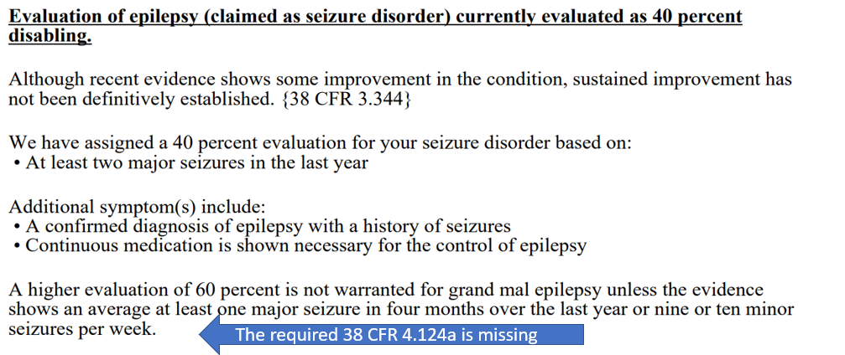
VBMS-R C&C Evaluation (Cont’d)
Then

Slide 16
Tips to Avoid These Types of Errors
Access the Evaluation Builder for C&C evaluations
Use of the Evaluation Builder is mandatory
M21-1, III.iv.6.C.5.c
Properly using VBMS-R selections, glossary fragments and the Evaluation Builder should generally ensure that the proper legal citations populate into the narrative text

Slide 17
Tips to Avoid Errors (Cont’d)
The decision maker is responsible for ensuring that any missing or incorrect legal citations are added/corrected
M21-1, III.iv.6.C.5.e
If the Evaluation Builder (EB) suggested evaluation is less than current evaluation, but reduction is not warranted, enter the prior symptoms used to support the evaluation into the EB to generate the proper C&C evaluation
Use eCFR to ensure that the regulations are correct/complete
https://www.ecfr.gov/cgi-bin/text-idx?SID=667e2d2b1105f47fc93e678b09ba7d6f&mc=true&tpl=/ecfrbrowse/Title38/38cfr4_main_02.tpl

Slide 18
Tips to Avoid Errors (Cont’d)
If a specific legal theory is discussed in a rating narrative, then the numerical citation from which that legal theory derives is also required in the rating
M21-1, III.iv.6.C.5.a
If you add free text or glossaries into the rating narrative, make sure that free text includes any pertinent legal citations
Reasonable doubt (38 CFR 3.102/38 CFR 4.3)
Pyramiding (38 CFR 4.14)
Higher of two evaluations (38 CFR 4.7)
PROOFREAD YOUR RATING!
YOU are your own best defense – ensure a law or regulation is included for each component/legal theory discussed in the rating narrative

Slide 19
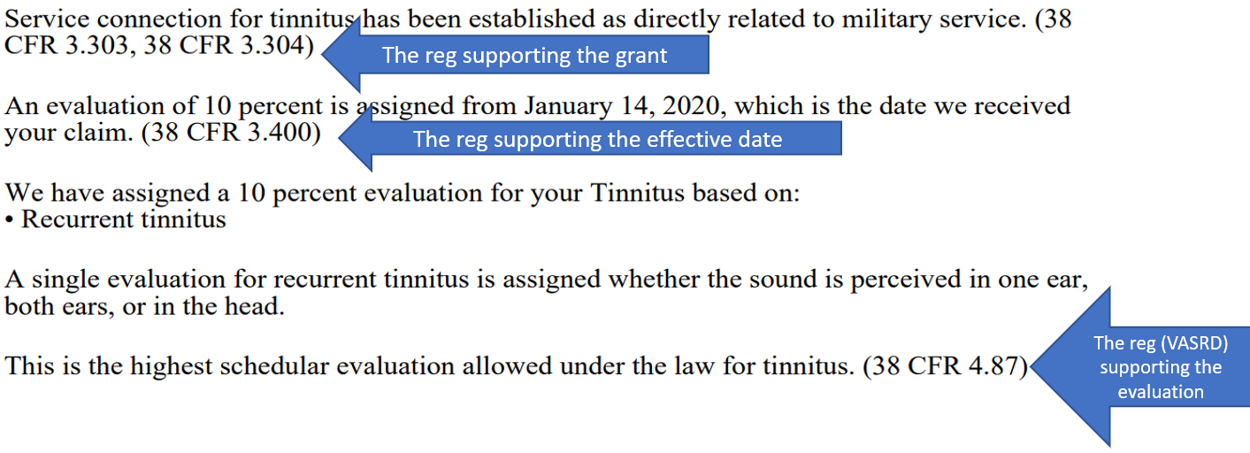
Legally Sufficient Rating Decision

Slide 20
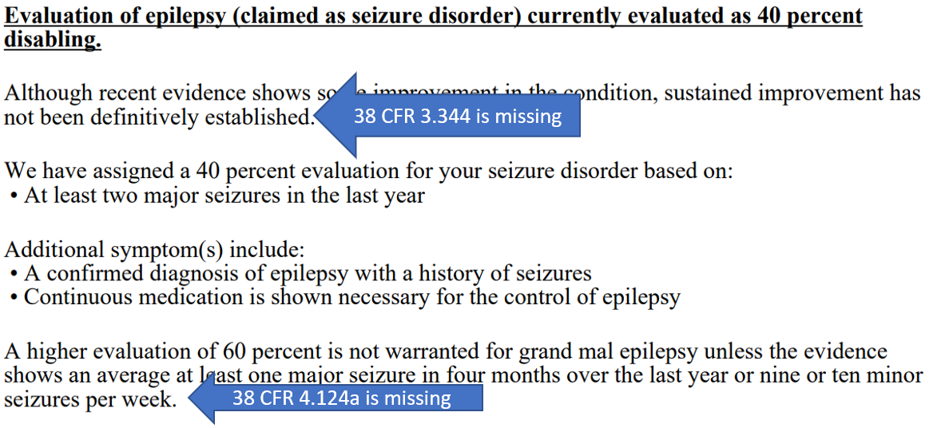
Legally Insufficient Rating Decision

Slide 21
Prescribed, Schedular Minimum Evaluations
Dustin Williams
Lead Program Analyst
Procedures Maintenance Staff, Policy and Procedures

Slide 22
Prescribed, Schedular Minimum Evaluations
Prescribed, schedular minimum evaluations are referenced in M21-1, Part III, Subpart iv, 3.B.2.d, and in 38 CFR 3.327 for the purposes of limiting future reexamination efforts
The phrase does not refer merely to a compensable evaluation the rating schedule provides as the lowest level of disability associated with an individual condition or diagnostic code (DC)

Slide 23
Prescribed, Schedular Minimum Evaluations
Rather, the phrase refers exclusively to instances in which the schedule clearly demands assignment of a certain compensable evaluation once the underlying disability manifests or exists in the manner/state described
Examples:
38 CFR 4.124a, DC 8009 – Minimum 10 percent following brain vessel hemorrhage
38 CFR 4.104, DC 7019 – Minimum 30 percent following cardiac transplantation
38 CFR 4.116, DC 7617 – Minimum 50 percent for hysterectomy with removal of uterus and both ovaries

Slide 24
Request for Application (RFA) Site Visit Findings
Kat Calvitti
Operations Analyst
Program Operations Staff, Quality Assurance

Slide 25
Request for Application (RFA)
In FY20, Compensation Service reviewed 90 Request for Application (RFA) EP 400s in conjunction with Site Visits, and 52 (57.8%) were processed correctly
Error trends identified
Appropriate prescribed form was received and an RFA letter was erroneously sent to the Veteran
RFA letter with the attached VA Form 21-526EZ was erroneously generated in VBMS and sent to the Veteran when the RFA AMA Review Letter was required
No evidence in the eFolder to warrant the RFA EP 400

Slide 26
Request for Application (RFA)
Claims processors are reminded to review the evidence and/or form submitted and VBMS to determine whether an RFA letter is necessary
If the appropriate prescribed form was submitted, place EP under control
RFA is necessary when a request for benefits isn’t submitted on a prescribed form
If the appropriate prescribed form was not submitted, establish EP 400 with a date of claim as the date the evidence was received and generate the applicable RFA letter
M21-1, III.ii.3.B.1.b
M21-1, III.ii.2.B.1.b
M21-1, III.ii.2.C.6.a

Slide 27
Request for Application (RFA)
If any issues were previously decided or denied, and the claim was not submitted on VA Form 20-0995 or 20-0996, send the Veteran the RFA AMA Review letter
The EP 400 RFA must be established in Share to prevent the RFA letter with the attached VA Form 21-526EZ from being auto generated in VBMS
The RFA AMA Review letter must be generated using the Letter Creator, uploaded into VBMS, and sent to the Veteran using Package Manager
Update the subject line in VBMS to indicate it is an AMA RFA letter
The source document that initiated the claim should be labeled in the subject line as an ‘Incorrect AMA application’
Review the Package Manger to ensure the letter was sent!
Compensation Service AMA FAQ

Slide 28
Separation/Severance Pay Evidence
Erin Hawkins
Consultant
Advisory and Special Review Team, Quality Assurance

Slide 29
Duplication of Federal Benefits
38 CFR 3.700 prohibits the Department of Veterans Affairs (VA) from paying compensation to a Veteran who also received certain Separation Benefits from the
Department of Defense (DoD), or
Department of Homeland Security (if the Veteran served in the Coast Guard)
These Separation Benefits include:
Readjustment pay under former 10 U.S.C. 687 and 3814a
Non-disability severance pay under former 10 U.S.C. 359, 360, 859, and 860
Separation pay under 10 U.S.C. 1174
Reservists’ involuntary separation pay (RISP)
Special separation benefit (SSB) under 10 U.S.C. 1174a
Voluntary separation pay (VSP) under 10 U.S.C. 1175a
Disability severance pay under 10 U.S.C. 1212

Slide 30
Improper Payment
If recoupment of Separation or Severance Pay is required and VA fails to do so, then this constitutes an improper payment because the Veteran was not eligible for the payment that he/she received
Impact of Separation/Severance Pay improper payments
Rework
Potential for hardship on the Veteran
VA collects data and reports certain improper payments to stakeholders

Slide 31
Claim Review for Separation Benefits
M21-1 III.v.4.B.1.b – Determining Whether a Veteran Received Separation Benefits provides a list of indicators that the Veteran was paid Separation or Severance Pay
Typical indicators in the claims folder
The notes in this reference refer to Separation Program Designator (SPD) Codes, and the notes provide a link to the list
M21-1 III.v.4.B.2.b – Confirming the Amount of the Separation Benefit outlines steps needed to confirm the amount and type of Separation Benefit

Slide 32
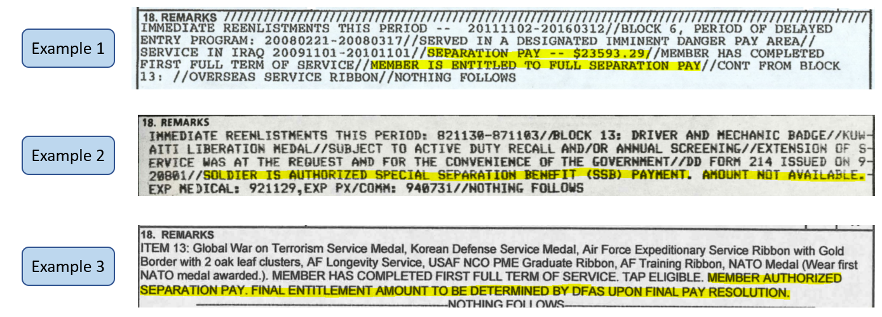
Potential Separation Benefits Examples

Slide 33
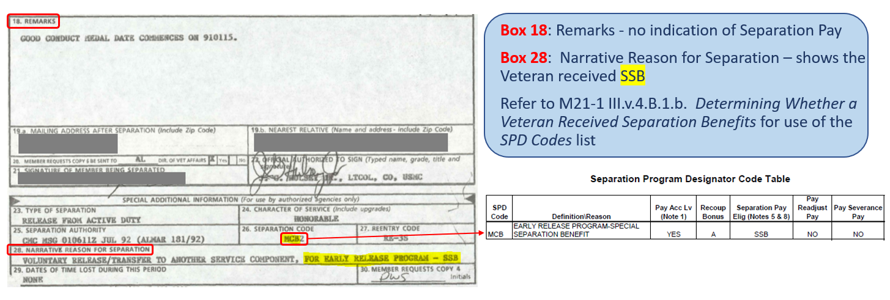
Potential Separation Benefits Examples

Slide 34
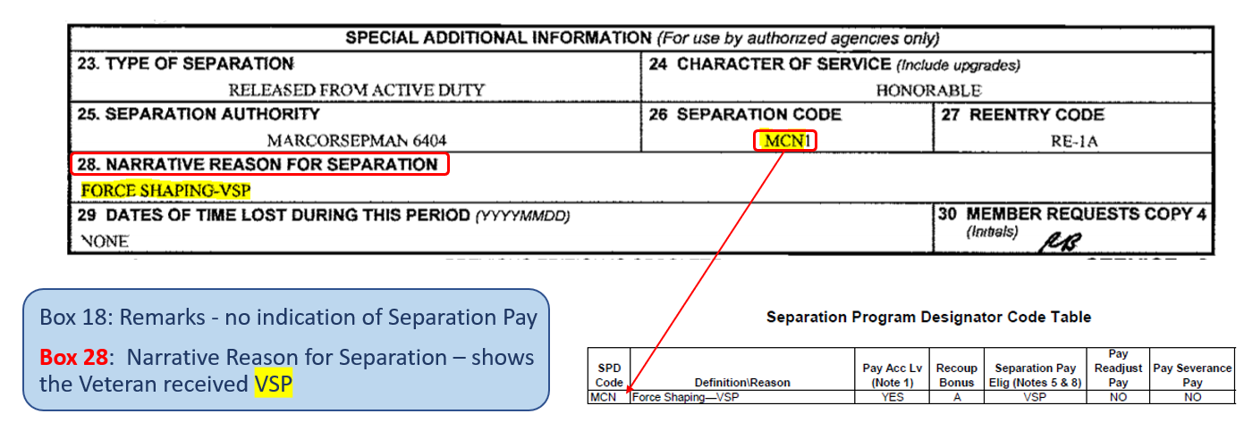
Potential Separation Benefits Examples

Slide 35
Unverified Separation Benefits
If there’s an indication of Separation/Severance pay, but the amount/payment has not been confirmed, do not postpone promulgation of a rating decision while waiting for verification
Promulgate the rating decision using the unverified amount of the separation Benefit, if available
Establish an EP 290 to control for a response to the request submitted through AskDFAS
If no amount is of record (in, for example, Share or on the Veteran’s application for benefits or DD Form 214),
Use $99,999.00 as the amount of the Separation Benefit, and
Establish an EP 290 to control for a response to the request submitted through AskDFAS
M21-1, III.v.4.B.2.b – Step 17

Slide 36
Separation Benefits: Reminders
Review the application for benefits to determine if the Veteran disclosed having received a Separation Benefit
Review the claims folder for DD 214 and DD 215, if service was verified using means that did not include obtaining a copy of the DD214, then a best practice would be to request a copy of the personnel records, or do a VIS check, to review for Separation Benefits
DD214 and 215 are typically located in the personnel records, but the documents may also be found in the Service Treatment Records (STRs) and/or Dental Records

Slide 37
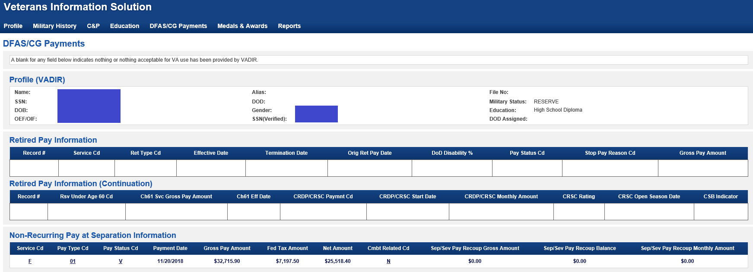
Separation Benefits: Reminders
Check VIS – Review the ‘DFAS/CG Payments’ tab

Slide 38
Acceptable Clinical Evidence (ACE) Examinations
Kelly Kennedy
Senior Quality Review Specialist
Quality Review Team, Quality Assurance

Slide 39
ACE Examinations
ACE Examinations and COVID-19
COVID-19 presents unique challenges to processing Veterans’ claims
Use of ACE has been strongly encouraged as a strategy to continue serving Veterans in need of exams during the pandemic
Reminder: Requirements for a sufficient and complete examination have not changed
The Medical Disability Examinations (MDE) Quality Staff has seen numerous instances in which the ACE process has been improperly utilized

Slide 40
Improperly Completed ACE Exams
Some examples of misuse include
Use of prior DBQ information to populate a new DBQ request
Reporting of information such as METs level without evidence in the claims folder or documented contact with the Veteran
Use of very old or self-reported blood pressure readings
Use of outdated information and lack of communication with the Veteran to complete Prostate Cancer DBQs
The MDE Quality Staff is providing error trend feedback to vendor examiners

Slide 41
Insufficient ACE Examinations
Reminder: It is imperative to return examinations that are insufficient or incomplete for VA rating purposes
As with traditional in-person examinations, ACE examinations must be a thorough, accurate, and complete evaluation of the current level of disability
A claims folder review is always required for ACE examinations
In many instances, a telephone conversation with the Veteran may be necessary to obtain additional information to supplement the evidentiary record
Only new/interval medical evidence should be used to complete DBQs using ACE
If relevant information is missing and/or cannot be obtained, ACE cannot be used to complete the DBQ

Slide 42
References for ACE Exam Quality
All DBQs (traditional in-person or ACE) have the same goal and are held to the same quality criteria
For more information on
Categories of examinations for which the ACE process is prohibited
M21-1, III.iv.3.A.4.b
Requirements for claims folder review for ACE examinations and identifying relevant evidence for examiner review
M21-1, III.iv.3.A.8.b and III.iv.3.A.8.d
Requirements for ACE examination reports
M21-1, III.iv.3.D.2.m
Insufficient examination reports
M21-1, III.iv.3.D.3.a

Slide 43
Automated Hospitalization Reports
Paul Shute
Director of Operational Innovation
Compensation Service Operations

Slide 44
Background
Veterans in receipt of disability compensation and pension benefits who are hospitalized with the VA health care system may be entitled to benefit award adjustments related to their hospitalization
Currently, each regional office (RO) is responsible for navigating multiple business applications to identify applicable hospitalized Veterans
Arduous
Lacks internal controls
Results in improper payments to the Veteran

Slide 45
Solution
As part of the Modern Claims Processing (MCP) program, VBA is utilizing computable medical data to drive business process improvements within our benefit programs
Developed and implemented an automated report based on data from the Veteran Health Administration’s (VHA’s) Corporate Data Warehouse (CDW)
Automated report runs without user intervention and automatically establishes end products that are routed by NWQ to your stations

Slide 46
Overview of Reports
Admission Report for SC Veteran
Discharge Report for SC Veteran
A&A Admission Report
A&A Discharge Report
PMC – Improved Pension Admission Report
PMC – Improved Pension Discharge Report
PMC – Section 306 Pension Admission Report
PMC – Section 306 Pension Discharge Report
A&A Re-Admission Report
A&A Re-Admission Discharge Report
PMC – Improved Pension Re-Admission Report
PMC – Improved Pension Re-Admission Discharge Report
PMC – Section 306 Pension Re-Admission Report
PMC – Section 306 Pension Re-Admission Discharge Report
Admission and Discharge Report for SC Veteran
Special Report for A&A/Pension
Admission Inquiry by Date
Re-Admission Report
CNH Admission and Discharge Report and 90 Day Stays

Slide 47
Hospitalization Attributes
EP: 330
Claim Labels:
330AARADR A&A Readmission Discharge Report
330ARSCV Admission Report for SC Veteran
330DRSCV Discharge Report for SC Veteran
330IPARPMC PMC - Improved Pension Admission Report
330IPDRPMC PMC - Improved Pension Discharge Report
330AAAR A&A Admission Report
330AADR A&A Discharge Report
330AARAR A&A Readmission Report
330SPARPMC PMC - Section 306 Pension Admission Report
330SPDRPMC PMC - Section 306 Pension Discharge Report
330IPRRPMC PMC - Improved Pension Readmission Report
330IPRDPMC PMC - Improved Pension Readmission Discharge
330SPRRPMC PMC - Section 306 Pension Readmission Report
330SPRDPMC PMC - Section 306 Pension Readmission Discharge
Contention: Hospitalization Review
Contention Classification: Administrative Review
VBMS Claim Notes: Name of medical facility where the Veteran was hospitalized (ex: (691) Greater Los Angeles HCS (Los Angeles CA))

Slide 48
Out of Scope of Automation
The following hospitalization reports will continue to require manual generation within CAPRI
Convalescence Report
Contract Nursing Home (CNH) Admission Report
Contract Nursing Home (CNH) Discharge Report
Contract Nursing Home (CNH) 90 Day Stays

Slide 49
References
38 CFR 4.29
38 CFR 4.30
38 CFR 3.551
38 CFR 3.552
M21-1, Adjudication Procedures Manual, specifically
M21-1III.ii.2.B
M21-1III.iii.1.C
M21-1III.v.6.A
M21-1III.v.6.B
M21-1III.v.6.C
M21-1III.v.6.D
M21-1IV.ii.2.J
M21-1V.iv.2
M21-4, Appendix B. End Product Codes and Work-Rate Standards for Quantitative Measurements)

Slide 50
* Present a Topic * Suggestions * Next Quality Call
Robert Johnson
Senior Quality Review Specialist
Quality Review Team, Quality Assurance

Slide 51
Would You Like to Present a Topic?
We are offering opportunities for RO SMEs to present topics during Compensation Service Quality Call recording sessions
Peer-to-Peer communication is optimum
If YOU are interested in presenting a topic in a future Quality Call
Talk to your Coach or other RO management team member
If okay, have management send your name and topic to
VAVBAWAS/CO/InternalQRS

Slide 52
Do You Have Suggestions for Topics?
If you have topic suggestions for a future Quality Call, please email the Quality Call Leads (Robert Johnson & Bonnie Kirby) at VAVBAWAS/CO/InternalQRS
In your email, please include
Cc to your Coach or other RO management
Name of topic
Intended audience (VSR Pre or Post, RVSR, AQRS, RQRS, etc.)
Applicable 38 CFR and/ or M21-1 references
Quality Call Bulletins can be found on the STAR Home Page on the Compensation Service Intranet site, TMS, and VBA Learning Catalog
Audio recordings of the Quality Calls with separate copies of the PowerPoint slides can be found in both TMS and the VBA Learning Catalog

Slide 53
When is the Next Quality Call?
This is the final Quality Call for FY20
Quality Calls will resume in FY21

