Slide 1
MSC Future Endeavors
Briefed by: Karla Leal
Name: MSC Future Endeavors
Date: August 2020

Slide 2
Agenda
Military to Civilian Readiness Pathway (M2CReady) Overview
Separation Health Assessment (SHA) Initiative
Service Treatment Records (STR) Transfer
Combined Assessment
Pandemic Related Focus Group

Slide 3
Military to Civilian Readiness Pathway (M2CReady)
Purpose of Initiative
M2C Ready is an overarching transition framework that establishes the transition period as beginning 365 days pre-separation and extending to 365 days post-separation
The goal is to align all the various components of transition both before and after leaving the military and provide members with an understanding of, and easy access to, all the benefits and resources they are entitled to
Background/Context
Office of Transition & Economic Development (TED) is leading this effort and reports through the Benefits Executive Committee (BEC) to the Joint Executive Committee (JEC)
M2C Ready is a multi-work group effort is structured by 6 steps that are organized based on the transitioning member’s journey beginning 365 days pre-separation and extending to 365 days post-separation

Slide 4
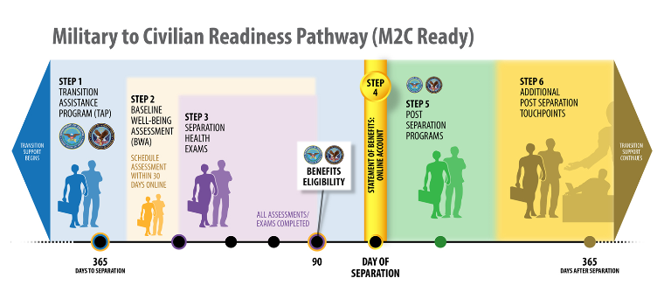
M2C Ready Graphic Overview

Slide 5
M2CReady (cont.)
The VA Solid Start program is one initiative that has been implemented under the Post Separation Programs of M2CReady
VA Solid Start is managed by TED and agents call every newly transitioned service member at three key intervals during their first year of transition
VA Solid Start agents use key factors in successful transition as the basis for open-ended questions that seek to establish the status and disposition of a Transitioning Service Member (TSM)
The program utilizes supporting communications across multiple channels (email, text, social media, etc.) to increase awareness of the program, improve call acceptance rate, and to provide Veterans with important information after each interaction which is tailored to his/her needs
Expectations with the person being called for 1:1 interactions at three key intervals (0-90, 91-180, 181-365 days post transition) during the first year of transition to civilian life

Slide 6
Service Health Assessment (SHA) Initiative STR Transfer
Purpose of Initiative
For Benefits Delivery at Discharge (BDD) population, fully implement electronic availability of AHLTA Web Print (AWP) portion of Service Treatment Records (STR) to VA and completed SHA Disability Benefits Questionnaires (DBQs) to DoD via Health Artifact and Image Management Solution (HAIMS)-Data Access Service (DAS)-Veterans Benefits Management System (VBMS) exchange
DoD will be able to provide the AWP to the VA electronically, permitting an entire paperless claim process for BDD participants
Objectives
Service members will no longer have to submit STRs with their claim
Claim processors will not have to await scanning finalization to proceed with claim processing and intake sites will avoid shipping costs
Provides a secure means of controlling sensitive Protected Health Information (PHI)
The process of transferring the AWP to VA is initiated by establishing a BDD claim
Upon claim establishment, a Notice of Interest (NOI) will be sent to DoD to alert them of the need for the AWP. Accurate claim establishment is essential, as misidentification of a BDD claim could cause DoD to not respond with the NOI

Slide 7
Separation Health Assessment (SHA) Initiative Combined Assessment
Purpose of Initiative
The Separation Health Assessment (SHA) and Separation History and Physical Examination (SHPE) Work Group is a collaboration amongst VA and DoD to ensure all separating services members receive a separation exam. The initiative seeks to add process improvements to the examination process for Service members who apply for benefits delivery at discharge (BDD)
One of the primary goals is to eliminate the duplication of SHA/SHPEs conducted by DoD and VBA and create a “One-SHA” form which both agencies can use to meet their purpose
Objectives
Streamline the transition of health care from DoD to VA
Sub Work Groups have been established to address specialty topics such as Mental Health, Audio, Environmental/Occupational Hazards and Women’s Health
Improve clinical documentation of health status at the time of separation
Enhance the VA claims process for those separating Service members who apply for BDD

Slide 8
Questions
Notes:
====

