Slide 1
Quality Review Checklist/Error Trends Integrated Disability Evaluation System (IDES)
Briefed by: Travis Stockton and Jessica Cabales
Date: August 2020

Slide 2
Objectives
Review errors for FY 20 Quarter 2 and 3
Review top MSC errors cited
Overview of MSC Quality Review Checklist
Identify common IDES MSC Trends
Discuss requests for reconsideration

Slide 3
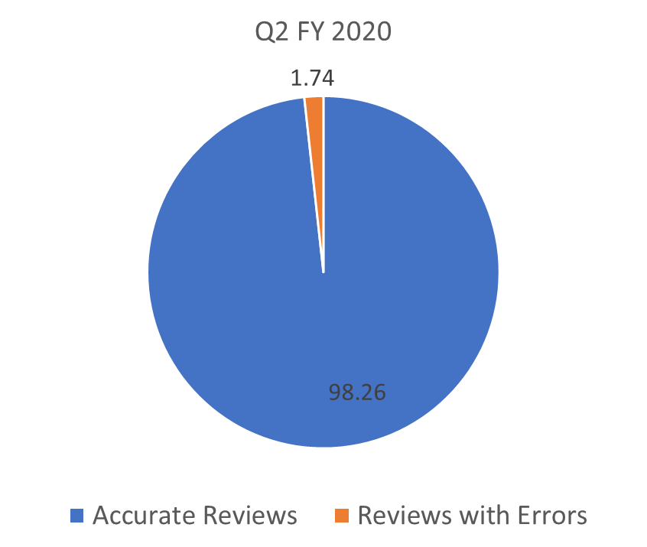
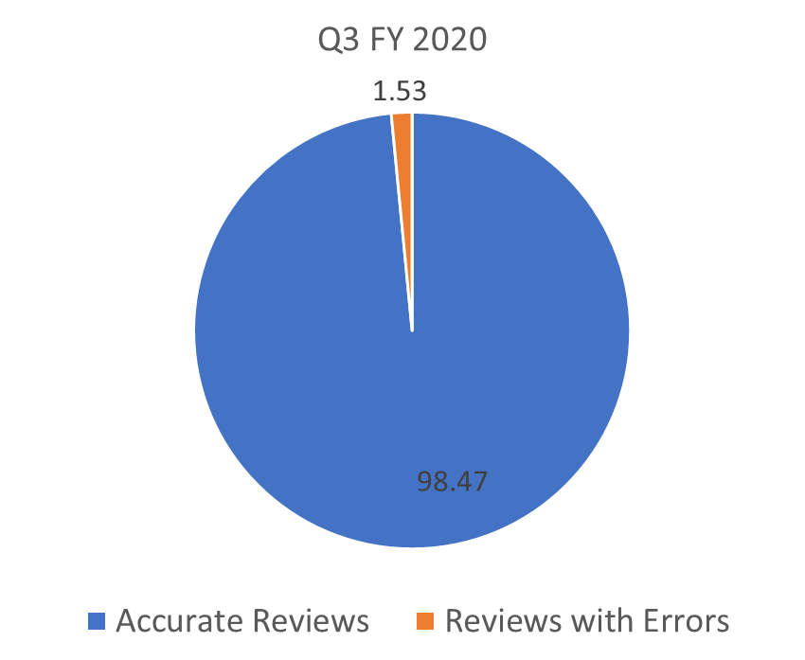
IDES MSC Task Based Quality

Slide 4
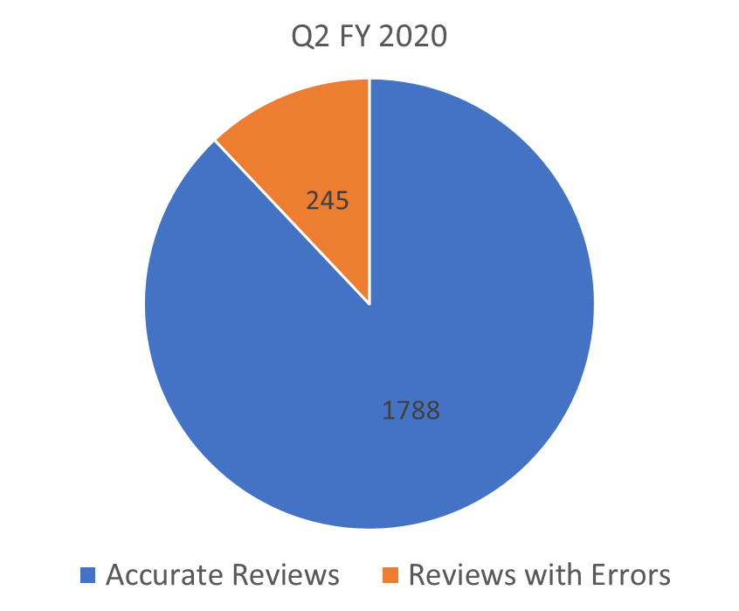
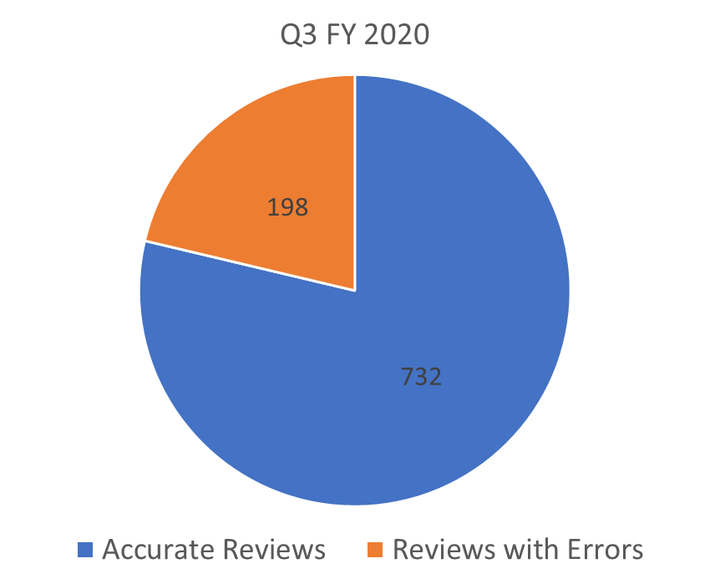
IDES MSC Claim Based Quality

Slide 5
Top IDES MSC Errors Cited

Slide 6
MSC Checklist
Task 1
Task 2
Task 3
Was the claims establishment accurate?
Were all systems accurately updated?
Did the MSC verify appropriate annotations/date stamps on VA Form and do the systems accurately reflect status/evidence?
Task 4
Was proper pre-decisional notice provided?
Task 5
Was proper development completed as required by the regulations and or manual?
Task 6
Were all pertinent service treatment records (STRs) obtained/requested or determined to be of record?

Slide 7
MSC Checklist (cont’d)
Task 7
Task 8
Are all pertinent documents in VBMS and identified in accordance with the manual?
Were all necessary examinations requested?
Were all necessary medical opinions requested?
Task 10
Were all examinations complete?
Task 11
Was prior medical examination information documented in VBMS?
Task 9

Slide 8
Top IDES MSC Errors Cited
Task 2 – Contentions
96 Related Errors cited
Task 2 - Service Verification
73 Related Errors cited
Task 2 - Corporate and Special Issue Flashes
61 Related Errors cited
Task 7 – Application not uploaded into eFolder
52 Related Errors cited
Task 2 - Tracked Items
45 Related Errors cited
Task 1 - Date of Claim
43 Related Errors cited
12 Additional errors cited for CESTing related issues (claim label, inaccurate date stamp, missing date stamps)
Task 9 - Medical Opinions
33 Related Errors cited

Slide 9
Common IDES MSC Trends Found
System Compliance (Task 2) Trends
Missing or incorrect contentions listed in VBMS
Previously denied claimed contentions listed without proper claim document
Dependents not listed as contentions
Service periods left unverified or not entered
Listing ADT periods as active service
Missing special issue indicators (ie: TBI and MST flash)
Incorrect use/updating of tracked items
CESTing Error Trends
Incorrect date of claim used
Claims forms not uploaded to file (ie: 21-0819, 21-526ez, 21-686c)
Exam Error Trends
Missing direct medical opinion for non-active duty claims
Missing aggravation opinion for conditions identified on entrance exam

Slide 10
WATRS QR Pull

Slide 11
Requests For Reconsideration
Request for reconsideration must be submitted within 5 business days of the notification of the error
You may reach out to the AQRS to talk over the error citation. If the MSC still disagrees with the error(s), they may click on the hyperlink that is provided in the error notification email and select “Initiate Recon”. The recon will be routed to the QRT coach for review.
Reconsideration merely because the error was misclassified on the STAR Checklist (e.g. B2 vs. C1) when a legitimate BE error exists will not be overturned
Formal reconsideration requests MUST include:
That you disagree with the error cited
Why you disagree with a brief explanation, and
Supporting statutes, regulations, or other appropriate citations
Please see M21-4 Chapter 6.5.h

Slide 12
Questions
This Photo by Unknown Author is licensed under CC BY-NC

