Slide 1
Quality Review Checklist/Error Trends
Benefits Delivery at Discharge (BDD)
Briefed by: David Modes
Date: August 2020

Slide 2
Objectives
Overview of MSC Checklist
Review errors trends for 1st quarter of 2020 calendar year
Familiarization of systems compliance

Slide 3
References
M21-1 III.i.2
M21-1 IV.ii.1.A.1.a
M21-1 I.3
M21-4 B
Attached checklist with CPKM citations (last updated 08/10/2020)
Subscribe to Calendar
http://vbacoweb03.dva.va.gov/bl/21/Calendar/cal_Subscribe.asp
Monthly Pre-Discharge Calls
https://vbaw.vba.va.gov/vbadod/predischarge.asp
Novel Coronavirus Disease (COVID-19) Operational Information Page
https://vbaw.vba.va.gov/bl/21/corona.htm

Slide 4
MSC Checklist
Task 1
Task 2
Task 3
Was the claims establishment accurate?
Were all systems accurately updated?
Did the MSC verify appropriate annotations/date stamps on VA Form and do the systems accurately reflect status/evidence?
Task 4
Was proper pre-decisional notice provided?
Task 5
Was proper development completed as required by the regulations and or manual?
Task 6
Were all pertinent service treatment records (STRs) obtained/requested or determined to be of record?

Slide 5
MSC Checklist (cont’d)
Task 7
Task 8
Are all pertinent documents in VBMS and identified in accordance with the manual?
Were all necessary examinations requested?
Were all necessary medical opinions requested?
Task 10
Were all examinations complete?
Task 11
Was prior medical examination information documented in VBMS?
Task 9

Slide 6
MSC BDD Error Analysis 01/2020-03/2020
Most common errors:
End-Product and/or claim label incorrect
Contentions for all issues (including dependency) not listed in VBMS
Incorrect date of claim.
Previous periods of active duty that are verifiable by the evidence of record not updated and marked verified in Participant Profile.
Power of Attorney (POA) information/access not correctly updated in all systems
Tracked items for all requested evidence were not entered and updated as necessary (includes disposition and suspense date)
Examination request incomplete –incorrect failure to identify all correct disabilities or identifying incorrect disabilities

Slide 7
Error Analysis cont.

Slide 8
Error Analysis cont.

Slide 9
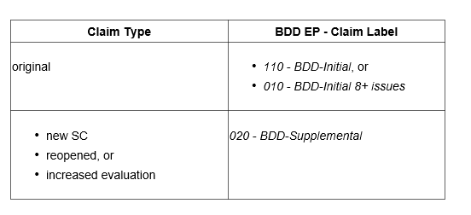
EP Selection
Once development is complete and examinations are ordered, be sure to update the EP
Refer to M21-1 III.i.2.A.2.d chart (Reopen claims fall under AMA regulations)
Other sources of information: M21-4, Appendix B; M21-1, III.ii.2.D; and April 2019 Monthly BDD and IDES Conference Call (discussion of claims formerly known as Reopen).

Slide 10
Contentions
Enter issues as contentions when they are
expressly claimed by the claimant/Veteran/authorized representative, and/or
put at issue and require development.
Important:
This information will be made available via eBenefits/VA.gov and should be easy to understand and in the claimant’s own words, as appropriate.
Each issue, including non-rating issues, must be entered as a separate contention. Example:
Dependency claim for [name of spouse], and
Dependency claim for [name of child]
Refer to M21-1 III.iii.5.A.1.i to determine if EP 130 is required
Non-rating contentions must relate to the specific benefit being sought. Keep in mind certain NR benefits can be processed under EP 290 while SM is in service, i.e. Auto Allowance & Home Loan Guarantee

Slide 11
VSO & Attorney Appointments
VA Form 21-22, VSO Appointment
enough information to identify the Veteran/claimant
the name of the service organization
signature of the Veteran/claimant with a corresponding date of signature, and
signature of the representative acting on behalf of the service organization with a corresponding date of signature.
https://vbaw.vba.va.gov/bl/20/cio/20s5/forms/VBA-21-22-ARE.pdf

Slide 12
VSO & Attorney Appointments
VA Form 21-22a, Individual as Claimant’s Rep
enough information to identify the Veteran/claimant
the name of the individual appointed as the Veteran/claimant’s representative
identification of the type of representation
signature of the Veteran/claimant with a corresponding date of signature, and
signature of the individual providing representation on a one-time basis, representative of an accredited VSO, agent, or attorney with a corresponding date of signature.
https://vbaw.vba.va.gov/bl/20/cio/20s5/forms/VBA-21-22A-ARE.pdf

Slide 13
VSO & Attorney Appointments
The following system updates are required when a claimant appoints a new representative or revokes a current representative:
VBMS, and
Veterans Appeals Control and Locator System (VACOLS) (if there is an active legacy appeal pending at the RO).
Ensure both USC 7332 & Address blocks are reviewed for accuracy in VBMS

Slide 14
Representation System Update

Slide 15
Verification of Service
During routine review of the electronic claims folder (eFolder), all claims processors must conduct eFolder maintenance to ensure information regarding the Veteran’s (service member) service dates and character of discharge in the Veterans Benefits Management System (VBMS) is consistent with the evidence in the eFolder
M21-1 III.iii.2.B provides procedure for obtaining service records. Example chart next slide

Slide 16
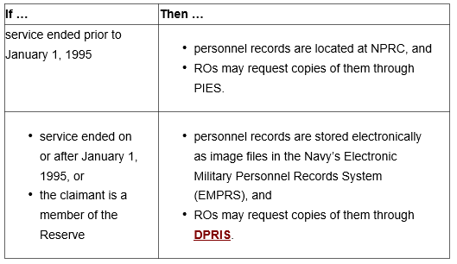
Verification of Service cont.
US Navy:

Slide 17
Verification of Service cont.

Slide 18
Examinations
Exam Request Builder (ERB) and VBMS Contract Exam systems are reliant upon user entered data. If disability is not entered in Contention screen, it is very likely the claimed disability will not be identified as an issue examination request. The examination request should clearly cite the conditions or particular diagnoses requiring attention

Slide 19
Examination Tools & References
ERRA tool (III.iv.3.A.2.b)
Index of DBQ/Exams by Disability tool (III.iv.3.A.2.d)
ERB tool (III.iv.3.A.2.e)
Appropriate Application for Entering Examination (III.iv.3.A.2.f)
TMS courses specific to ERB & VBMS Exam input:
4415934,
4415941,
4415942,
4415947,
4415952,
4202061,
1202934 (Medical Opinions)
*June 2020 Pre Discharge call: ALL SHA examinations are to be routed to QTC.
*Remember- Mental, Dental, Eyes, and Ears (Audio DBQ) and TBI.

Slide 20
5103 Notice
How is 5103 Notice provided?
on a standard VA Form 21-526EZ application form when filing:
a claim through the BDD (including any claim excluded from BDD including those received 1 -89 days before discharge),
a claim through the Fully Developed Claim (FDC) Program, or
a claim through the standard claims process or any other qualifying VA claims program,
through online claims submission via
eBenefits,
VA.gov,
Digits to Digits (D2D) or
the Stakeholder Enterprise Portal (SEP)
Notes:
M21-1, III.i.3.A.2.d. https://vaww.vrm.km.va.gov/system/templates/selfservice/va_kanew/help/agent/locale/en-US/portal/554400000001034/content/554400000014109/M21-1,-Part-III,-Subpart-i,-Chapter-3,-Section-A---General-Information-About-the-Fully-Developed-Claim-(FDC)-Program#2g

Slide 21
5103 Notice cont.
when an automated Section 5103 notice is generated during the establishment of the end product (EP), via the
Veterans Benefits Management System, or
Letter Creator, or
when, on VA Form 20-0995, Decision Review Request: Supplemental Claim, the claimant certifies receipt of notice under Section 5103 via electronic review.
In rare instances, ROs may still need to send claimants the traditional Section 5103 notice letter but only when one of the above methods was not utilized in the filing of the claim. (i.e. non-original claim submitted and signed only by VSO)

Slide 22
Additional Notice Required?
Some issues may require additional notice:
Asbestos
Camp Lejeune contaminated water
Chemical Biological Radiological Nuclear and Explosives (CBRNE) claims
environmental hazards (not covered under 38 CFR 3.317)
fire-related STRs
More special issues claim can be found at M21-1, I.1.B.1.f.

Slide 23
Questions?

