Slide 1

Reviewing Examinations for Completeness
Briefed By: Mary-Rose Juco and Eric Sylvestre
Date: August 2020

Slide 2
Purpose and Objectives
Purpose:
  Review of the requirements for a VA examination
  Discuss requirements for sufficient VA examinations
Objectives:
  Locate and identify exam reports
  Identify the components of an adequate examination

Slide 3
References
38 CFR §3.159(c)(4) - Providing medical examinations or obtaining medical opinions
38 .FR 3.306 - Aggravation of Preservice Disability
38 CFR §3.326 - Examinations
38 CFR §3.327 - Reexaminations
38 CFR §4.125 - Diagnosis of Mental Disorders
M21-1.I. 1. C - Requesting Records
M21-1.I.1.C.3 - Assisting With Medical Opinions or Examination Requests
M21-1.III.iv.3.A - Examination Requests Overview (Topic 7 Medical Opinions)
M21-1.III.iv.3.D - Examination Reports
M21-1.III.i.2.D – Integrated Disability Evaluation System (IDES)

Slide 4
Common Processing Delays
Improper identification of duty status (National Guard, Reserve, Active)
  Identifying duty status prior to ordering exams helps ensure sufficiency; typically, pre-discharge claims only require direct service opinions when complicated duty statuses exist such as National Guard, Reserve, or multiple enlistments
Generic conditions claimed need clarification, such as:
  left vs right vs bilateral extremities
  Individual fingers (index, long, all fingers, etc.) or toes (great toe, little toe, etc.)
Claimed conditions were not listed on an exam request
Routine medical opinions needed (direct or aggravated)
Notes:
Some insufficient exams are easily recognized by the missing pertinent tests or information. The DRAS is responsible for requesting insufficient exams. However, delays can be avoided if the IDES MSC identifies the insufficient exam and notifies the DRAS of the possible insufficient when the exams are sent for review.
The information below is to help IDES MSCs recognize important factors of examination reports.

Slide 5
Common Processing Delays (cont’d)
Missing Entrance Exam
  Entrance exams can be material to exam sufficiency when pre-existing conditions are present, necessitating an aggravation opinion
  Review STR’s for entrance exams, noting whether multiple enlistment periods exist, ensure entrance exams are present for all active duty periods when possible
  Scars, pes planus, and joint injuries most commonly appear on the entrance and require an M.O.
Examiner did not complete all required exams, fill out all necessary sections of the exam, or the exam was not completed by an appropriate specialist
  Occasionally, exams are “missing” from VBMS, but are often still obtainable from the vendor portals (IE. Exam Track)
Notes:
Some insufficient exams are easily recognized by the missing pertinent tests or information. The DRAS is responsible for requesting insufficient exams. However, delays can be avoided if the IDES MSC identifies the insufficient exam and notifies the DRAS of the possible insufficient when the exams are sent for review.
The information below is to help IDES MSCs recognize important factors of examination reports.

Slide 6
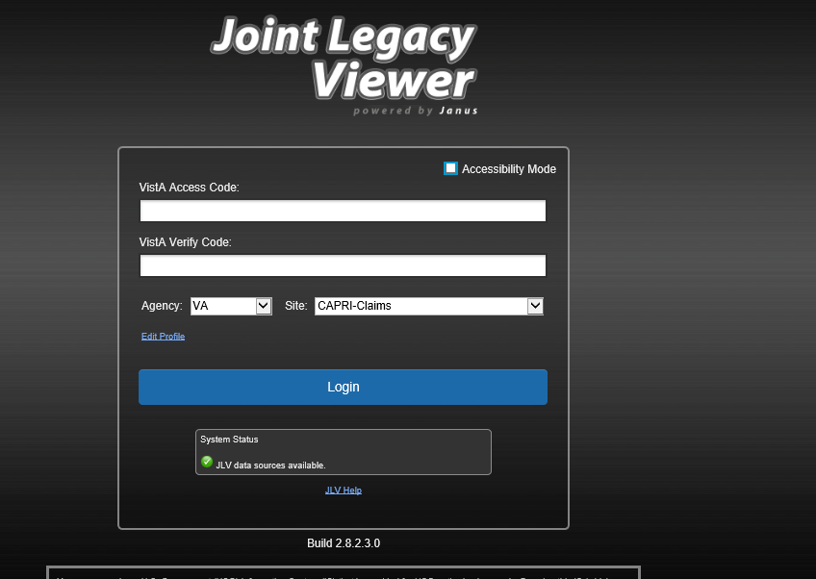
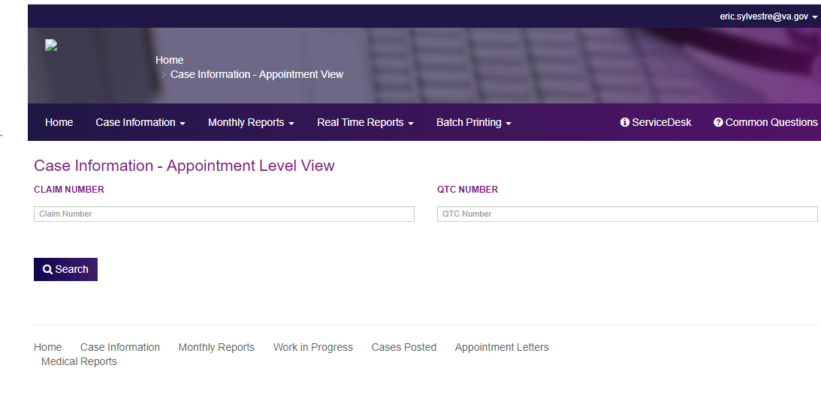
Locate and Identify Exams
Exams should automatically become available in VBMS on completion. If exams are missing, check:
  CAPRI/JLV (VAMC)
  Exam Track (QTC)
QTC is the only contractor servicing IDES/BDD exams within the U.S. VES is the contractor for overseas exams and has different procedures and portals to obtain completed exams.

Slide 7
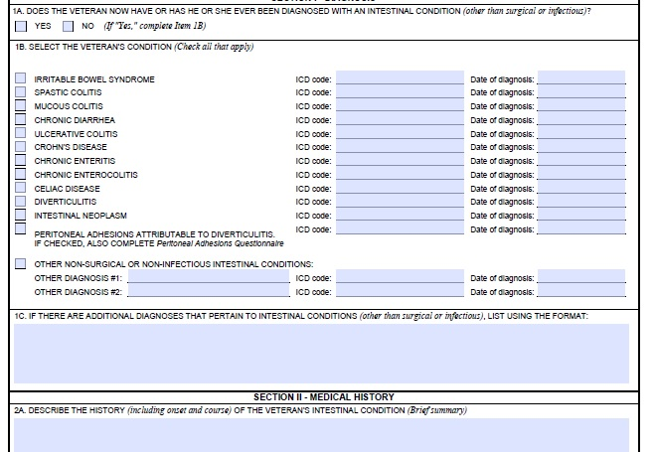
Reviewing DBQs
DBQs provide clear medical language aligned with the rating schedule
Missing or incomplete information therefore directly impacts a rating decision and result in deferrals

Slide 8
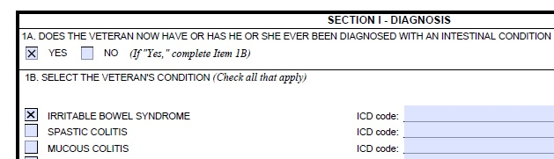
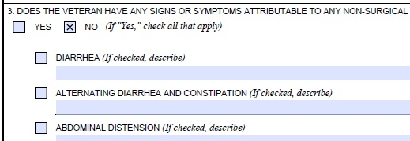
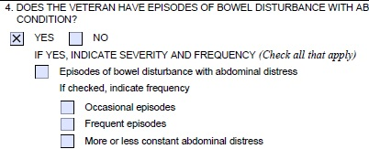
Reviewing DBQs
Is there a diagnosis?
Are all the questions answered?
Did they fill out ranges of motion/symptoms?

Slide 9
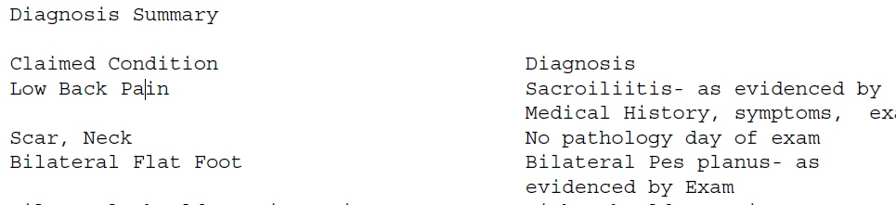
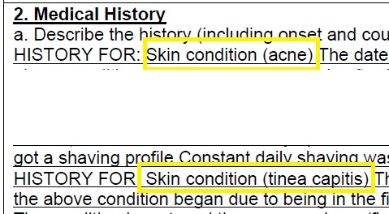
Checking Exams
Are all the issues addressed?
Notes:
Verifying all the referred and claimed conditions were examined.
-Compare the conditions listed on the VA Form 21-0819 to the completed examination reports to find any missing exams.
- Compare the exam request to the completed exam reports.

Slide 10
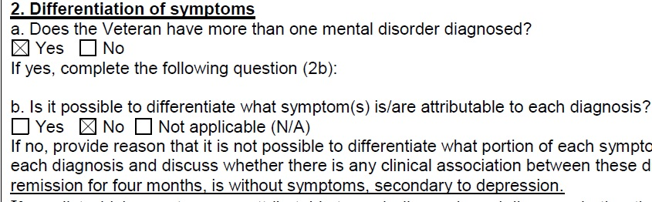
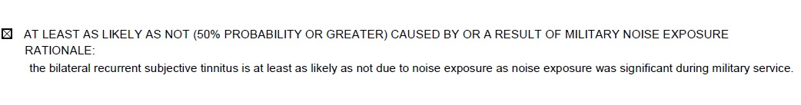
Checking Exams
Are all requested medical opinions completed?
Mental Disorders DBQ
Hearing Loss and Tinnitus DBQ

Slide 11
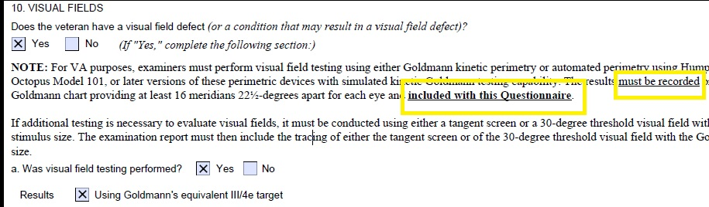
Checking Exams
Did they include all accessory information?
Arthritis DBQ
Eye Conditions DBQ

Slide 12
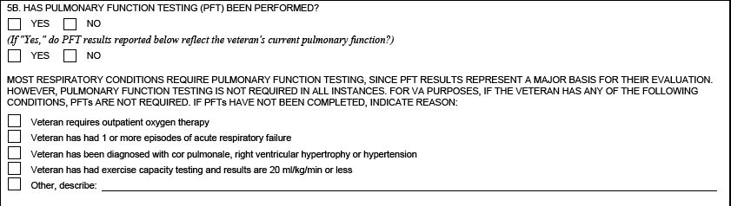
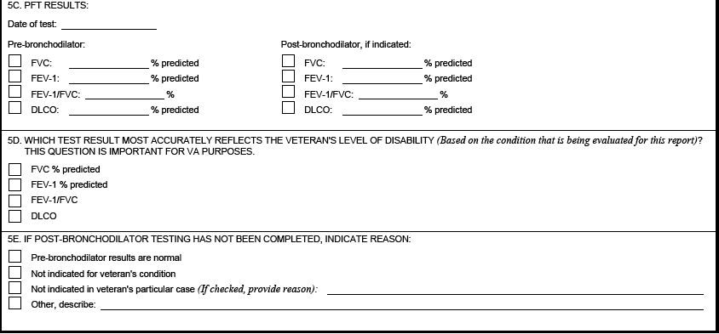
Checking Exams
Commonly Missing Information:
Pulmonary Function Testing (PFT) (Respiratory DBQs)
  Was the test performed? If not, does the examiner provide a valid rationale why?

Slide 13
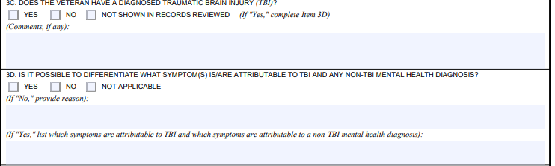
Checking Exams
Commonly Missing Information (cont’d):
Comorbid Delineation (Mental/TBI)
  Either the mental exam or the TBI exam should contain a medical opinion from the examiner (usually the mental exam) as to whether symptoms of the two conditions overlap. When a TBI has been diagnosed, ensure the mental examiner notates and acknowledges this; it’s common for a TBI exam to be completed after the mental, therefore the examiner may answer “not applicable” as they’re unaware of the TBI results

Slide 14
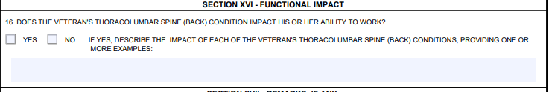
Checking Exams
Commonly Missing Information (cont’d):
ROMs, Deluca, Mitchell, and Functional Impact (All Joint DBQs – Ankle, Knee, etc.)
  Are all Range of Motion findings present?
  Occasionally the examiner will not be able to examine ROMs due to significant injuries requiring re-examination at a later date
  If a diagnosis is strictly pain related, (e.g. “lower back pain”, “dorsalgia”, “cervicalgia”) please ensure the “Functional Impact” section is completed

Slide 15
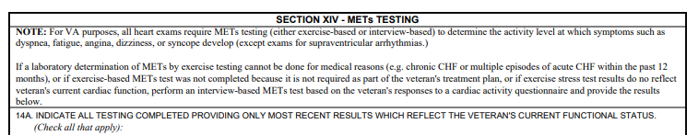
Checking Exams
Commonly Missing Information (cont’d):
  Bruxism – this is not a stand-alone SC disability. The examiner has to provide etiology
  Heart examination – metabolic equivalents of task (METS) is required. If the Veteran has comorbid conditions that prevents the examiner from estimating the METS, then the examiner must indicate why a METS could not be performed

Slide 16
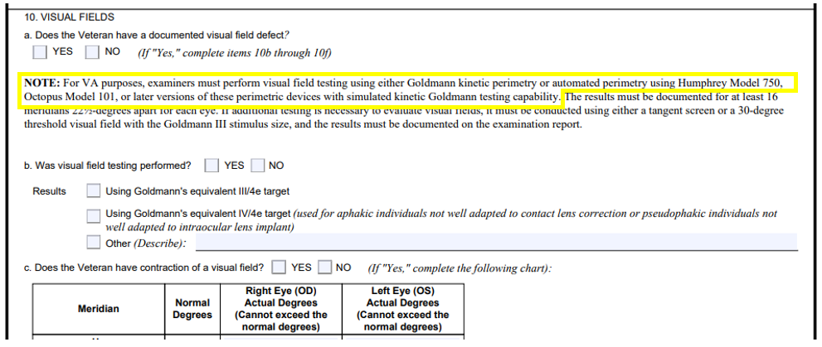
Checking Exams
Commonly Missing Information (cont’d):
  Eye examination - visual field testing using Goldmann Kinetic Perimetry or other perimetric devices. If exam was not performed using the proper testing or not recorded on a standard Goldmann Chart, exam is insufficient

Slide 17
Manual Reminder
Per M21-1III.i.2.D.7.c, MSCs must ensure that all parts of an IDES exam are completed before the Medical Evaluation Stage can be closed
Exam results should be deemed complete only when:
All claimed and referred conditions have been addressed
All DBQs indicated on the exam request have been returned
All DBQs identified as required on the SHA DBQ have been returned, and
All parts of the DBQ (to include required testing) have been returned

Slide 18
House Keeping Reminders
Whenever possible, encourage the Service member to consolidate claimed issues
  Example: back pain, dorsalgia, and lumbago all typically refer to the same thing and might all be listed on a 526EZ. A best practice would be to only list one of these issues on the claim form or list as (lumbago claimed as dorsalgia and backpain)
  Some SM’s are likely to still wish to claim redundant issues; in these instances, reviewing the exam to ensure these issues have been referenced explicitly is important. Even if it seems logical that a claimed issue is related to a diagnosis, the RVSR is more likely to defer because the issue wasn’t explicitly listed on the DBQ

Slide 19
House Keeping Reminders (cont’d)
When downloading/uploading STRs from JLV into VBMS, please ensure that they are contained in as few PDFs as possible (preferably one). This makes identifying favorable findings for denied conditions more streamlined, thus reducing delays in processing a rating decision

Slide 20
Questions?

